Slide 1
Faith in the Dark: God’s Infinite Wisdom
If I Were God for a Day…
God’s Great Knowledge
God’s Plan for Evil

Slide 2
1. If I Were God for a Day

Slide 3
³ If only I knew where to find him;
if only I could go to his dwelling!
⁴ I would state my case before him
and fill my mouth with arguments.
- Job 23:3-4

Slide 4
1. If I Were God for a Day

Slide 5
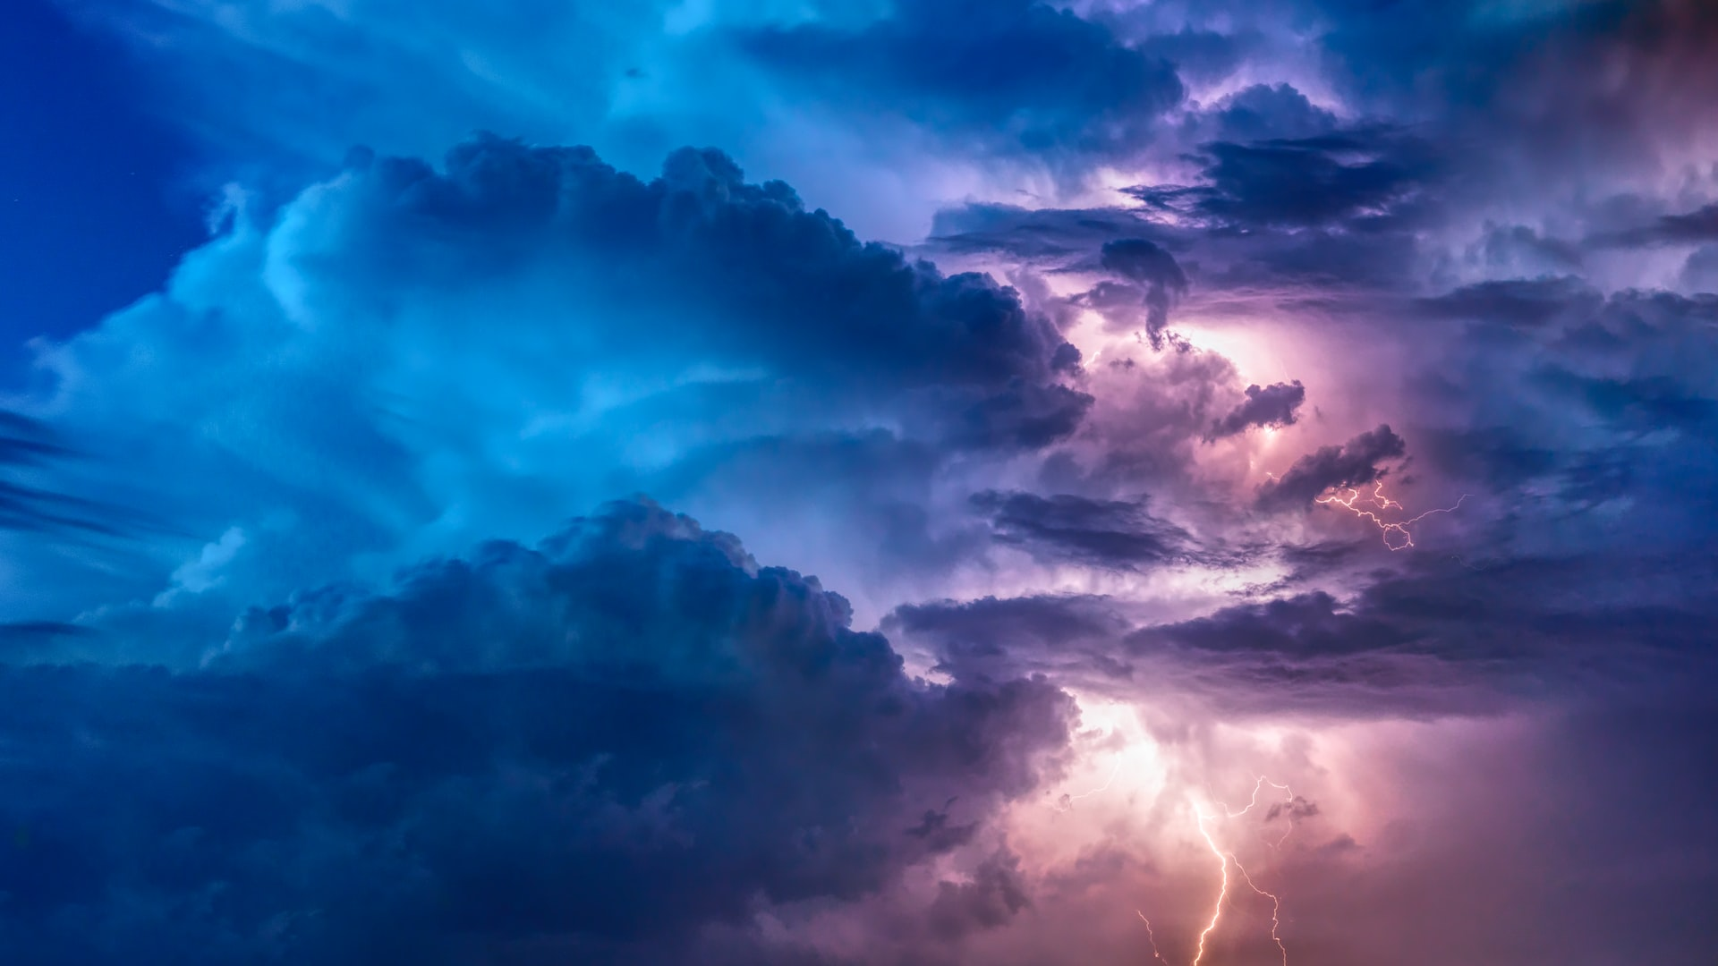

Slide 6
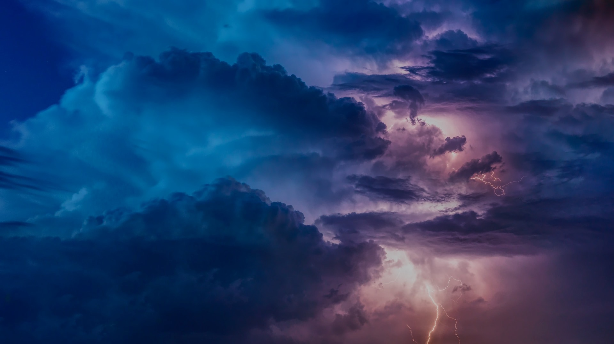
“Who is this that obscures my plans with words without knowledge?
- Job 38:2

Slide 7


Slide 8


Slide 9
2. God’s Great Knowledge (38:4-39:30)

Slide 10
2. God’s Great Knowledge (38:4-39:30)
Creation of the world (38:4-7)
Limits of the sea (v.8-11)
Morning and night (v.12-15)
Depth of the sea and death (v.16-18)
Order of light and darkness (v.19-21)
Weather system and water (v.22-38)

Slide 11
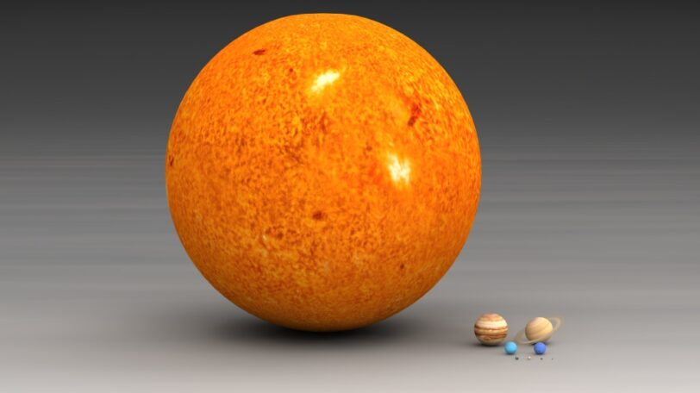

Slide 12
2. God’s Great Knowledge (38:4-39:30)
Creation of the world (38:4-7)
Limits of the sea (v.8-11)
Morning and night (v.12-15)
Depth of the sea and death (v.16-18)
Order of light and darkness (v.19-21)
Weather system and water (v.22-38)
Animals (38:39-41:30)

Slide 13
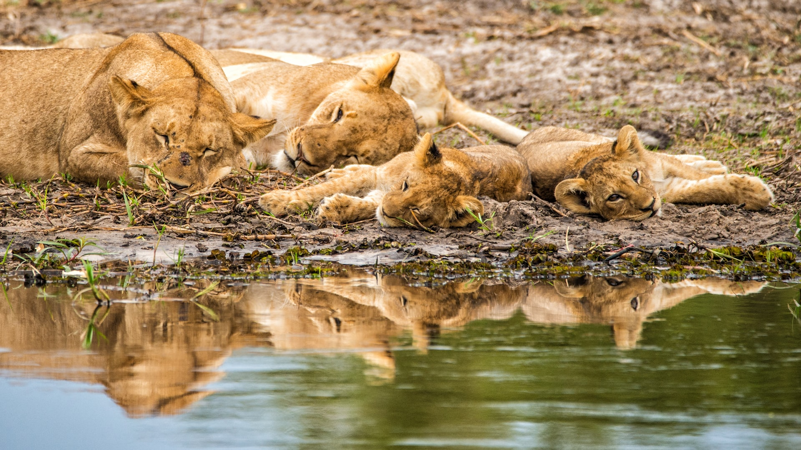

Slide 14
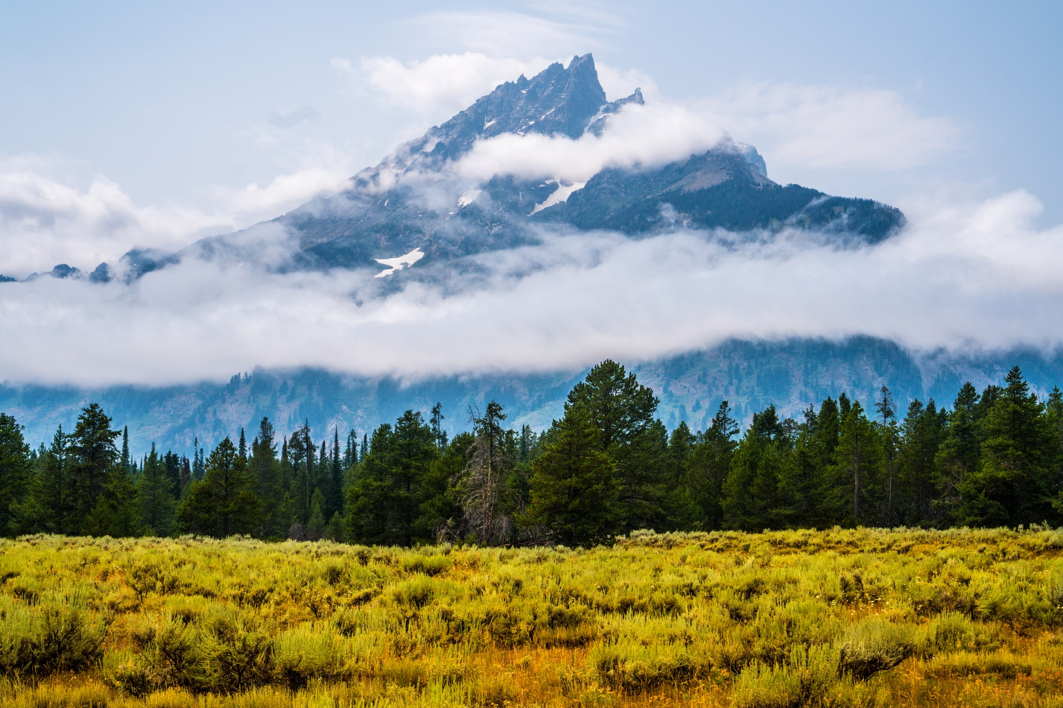

Slide 15
2. God’s Great Knowledge (38:4-39:30)
‘Why’ to ‘Who’?

Slide 16
3. God’s Plan for Evil (38:8-15, 40:1-41:34)

Slide 17


Slide 18


Slide 19
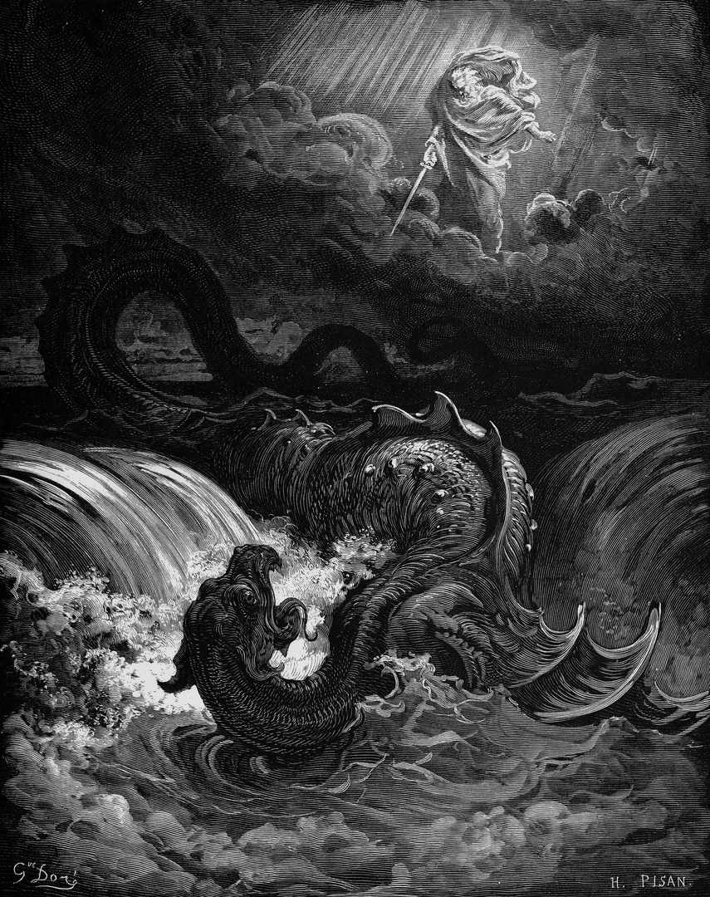

Slide 20
‘Why’ to ‘Who’?

