Slide 1
Miserable comforters
Job 2:11-13, 6:8-10, 9:32-35, 11:1-8

Slide 3
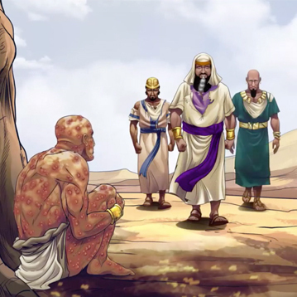
Who are Job’s friends?

Slide 4
Chapter 1-3 Introduction
Chapter 4-5 Eliphaz speaks
Chapter 6-7 Job responds
Chapter 8 Bildad speaks
Chapter 9-10 Job responds
Chapter 11 Zophar speaks
Chapter 12-14 Job responds
Chapter 15-21 Second cycle of debate
Chapter 22-27 Third cycle of debate (without Zophar)
Chapter 28-42 Monologues from Job, Elihu & God

Slide 5
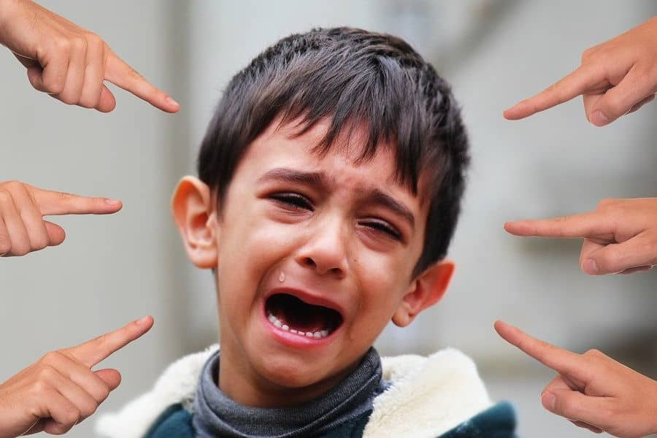
What do Job’s friends say?

Slide 6
What sort of friend does Job really need?

