Slide 2
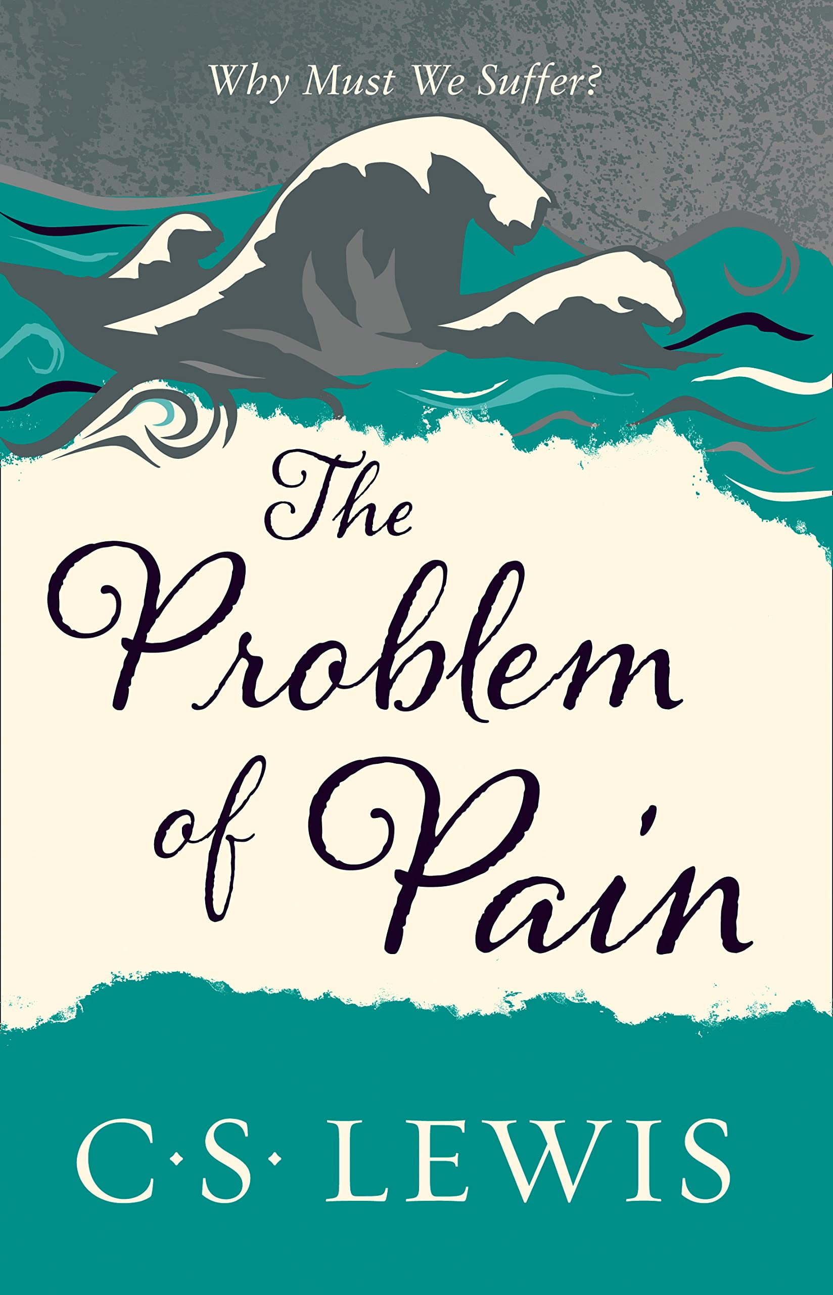

Slide 5
My ears had heard of you but now my eyes have seen you. Therefore I despise myself and repent in dust and ashes.”
- Job 42:5-6

Slide 6
1. Relationship (v.1-6)

Slide 7
2. Restoration (v.7-17)

Slide 8
2. Restoration (v.7-17)
Grace, not reward or reparation

Slide 10
3. Conclusion
What characterizes your relationship with God? Do you trust God?

Slide 11
My ears had heard of you but now my eyes have seen you. Therefore I despise myself and repent in dust and ashes.”
- Job 42:5-6

