Slide 2
Guard the Truth: Content of Our Faith
Hold on to What You’ve Received
Core Is Grace
Faith’s Goal Is Love

Slide 3
Hold on to What You’ve Received

Slide 4
3 As I urged you when I went into Macedonia, stay there in Ephesus so that you may command certain people not to teach false doctrines any longer 4 or to devote themselves to myths and endless genealogies. Such things promote controversial speculations rather than advancing God’s work—which is by faith.

Slide 5
¹⁸ Timothy, my son, I am giving you this command in keeping with the prophecies once made about you, so that by recalling them you may fight the battle well, ¹⁹ holding on to faith and a good conscience, which some have rejected and so have suffered shipwreck with regard to the faith.

Slide 6
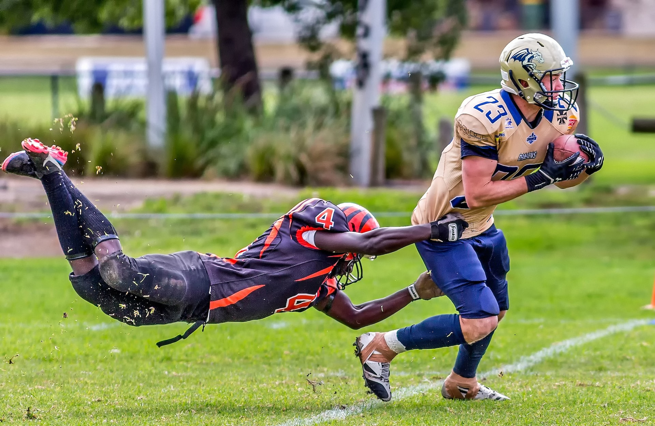

Slide 7
¹⁸ Timothy, my son, I am giving you this command in keeping with the prophecies once made about you, so that by recalling them you may fight the battle well, ¹⁹ holding on to faith and a good conscience, which some have rejected and so have suffered shipwreck with regard to the faith.

Slide 8
“…this book explains how I fancied I was the first to set foot in Brighton, and then found I was the last…. Like them, I tried to be some ten minutes in advance of the truth. And I found that I was eighteen hundred years behind it…. When I fancied that I stood alone, I was really in the ridiculous position of being backed up by all Christendom.”
- GK Chesterton, Orthodoxy

Slide 9
2. Core Is Grace

Slide 10
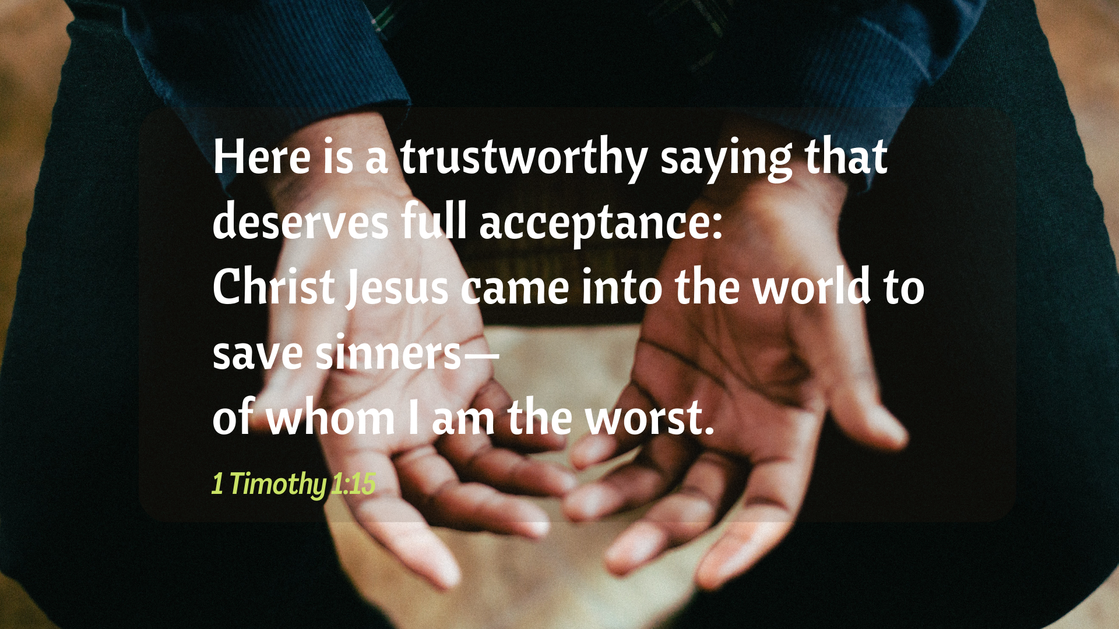

Slide 11
15 Here is a trustworthy saying that deserves full acceptance: Christ Jesus came into the world to save sinners—of whom I am the worst. 16 But for that very reason I was shown mercy so that in me, the worst of sinners, Christ Jesus might display his immense patience as an example for those who would believe in him and receive eternal life. 17 Now to the King eternal, immortal, invisible, the only God, be honor and glory for ever and ever. Amen.

Slide 12
⁸ We know that the law is good if one uses it properly. ⁹ We also know that the law is made not for the righteous but for lawbreakers and rebels, the ungodly and sinful, the unholy and irreligious, for those who kill their fathers or mothers, for murderers, ¹⁰ for the sexually immoral, for those practicing homosexuality, for slave traders and liars and perjurers—and for whatever else is contrary to the sound doctrine

Slide 13
3. Faith’s Goal Is Love
God’s love directs and guides.

Slide 14
3. Faith’s Goal Is Love
God’s love directs and guides.
Love goes beyond the law.

Slide 15
Guard the Truth: Content of Our Faith
Hold on to What You’ve Received
Core Is Grace
Faith’s Goal Is Love

