Slide 2
He Must Become Greater: God in the Dock
We Aren’t the Judge
Jesus Is the Judge
Jesus Is Merciful

Slide 3
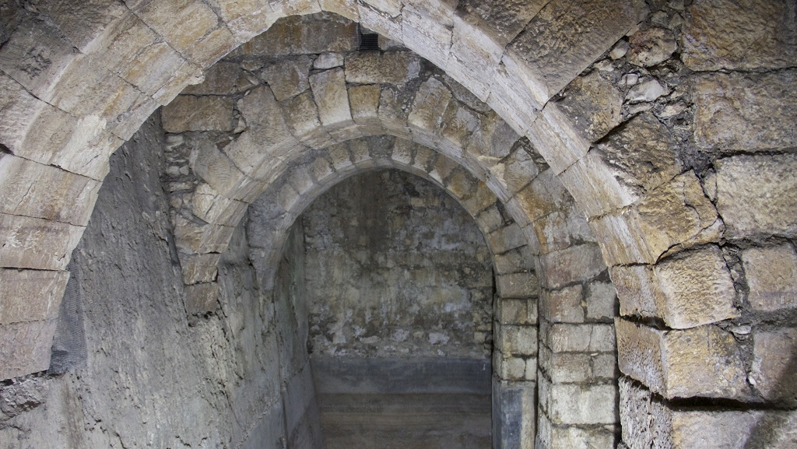
Arches of Pool of Bethesda

Slide 4
¹⁶ So, because Jesus was doing these things on the Sabbath, the Jewish leaders began to persecute him. ¹⁷ In his defense Jesus said to them, “My Father is always at his work to this very day, and I too am working.” ¹⁸ For this reason they tried all the more to kill him; not only was he breaking the Sabbath, but he was even calling God his own Father, making himself equal with God.

Slide 5
1. We aren’t the judge
The man who was healed is guilty

Slide 6
1. We aren’t the judge
The Man who was healed is guilty
Jewish leaders are guilty

Slide 7
3:19 This is the verdict: Light has come into the world, but people loved darkness instead of light because their deeds were evil. 20 Everyone who does evil hates the light, and will not come into the light for fear that their deeds will be exposed.

Slide 8
1. We aren’t the judge
The Man who was healed is guilty
Jewish leaders are guilty

Slide 9
2. Jesus Is the Judge

Slide 10
2. Jesus Is the Judge
Jesus claims equality with God (v.17-18)
Jesus claims to have authority over life and death (v.21, 25-26)
Jesus claims to be the ultimate judge (v.22, 27, 29-30)

Slide 11
³³ “You have sent to John and he has testified to the truth. ³⁴ Not that I accept human testimony; but I mention it that you may be saved. ³⁵ John was a lamp that burned and gave light, and you chose for a time to enjoy his light.

Slide 12
36 “I have testimony weightier than that of John. For the works that the Father has given me to finish—the very works that I am doing—testify that the Father has sent me. 37 And the Father who sent me has himself testified concerning me. You have never heard his voice nor seen his form, 38 nor does his word dwell in you, for you do not believe the one he sent.

Slide 13
39 You study the Scriptures diligently because you think that in them you have eternal life. These are the very Scriptures that testify about me, 40 yet you refuse to come to me to have life.

Slide 14
2. Jesus Is the Judge
Jesus claims equality with God (v.17-18)
Jesus claims to have authority over life and death (v.21, 25-26)
Jesus claims to be the ultimate judge (v.22, 27, 29-30)
Jesus has witnesses (John, miracles, the Bible...etc)

Slide 15
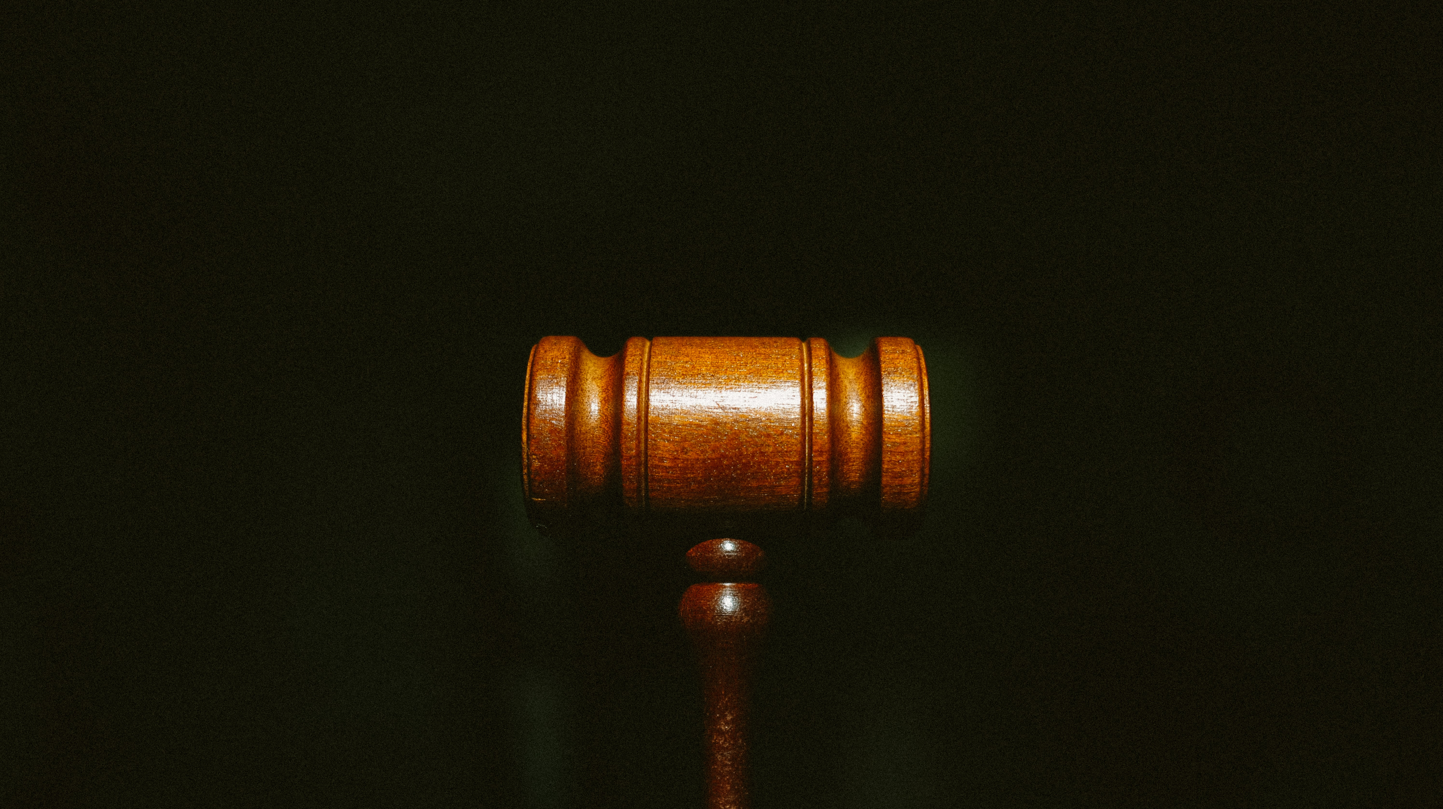

Slide 16
45 “But do not think I will accuse you before the Father. Your accuser is Moses, on whom your hopes are set. 46 If you believed Moses, you would believe me, for he wrote about me. 47 But since you do not believe what he wrote, how are you going to believe what I say?”

Slide 17
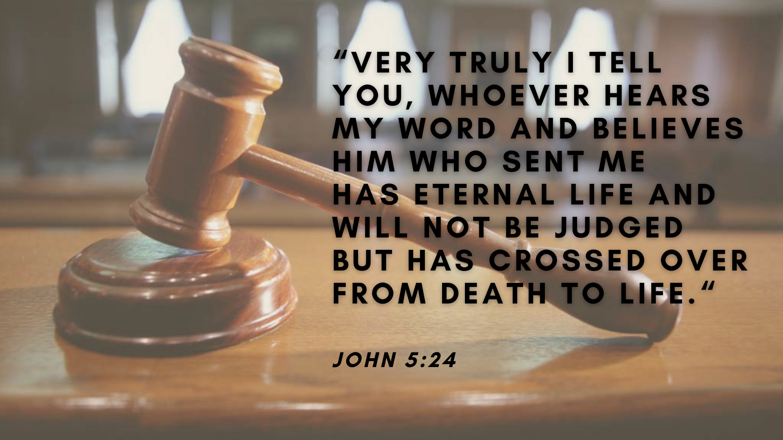

Slide 18
Do you want to be healed?

