Slide 1
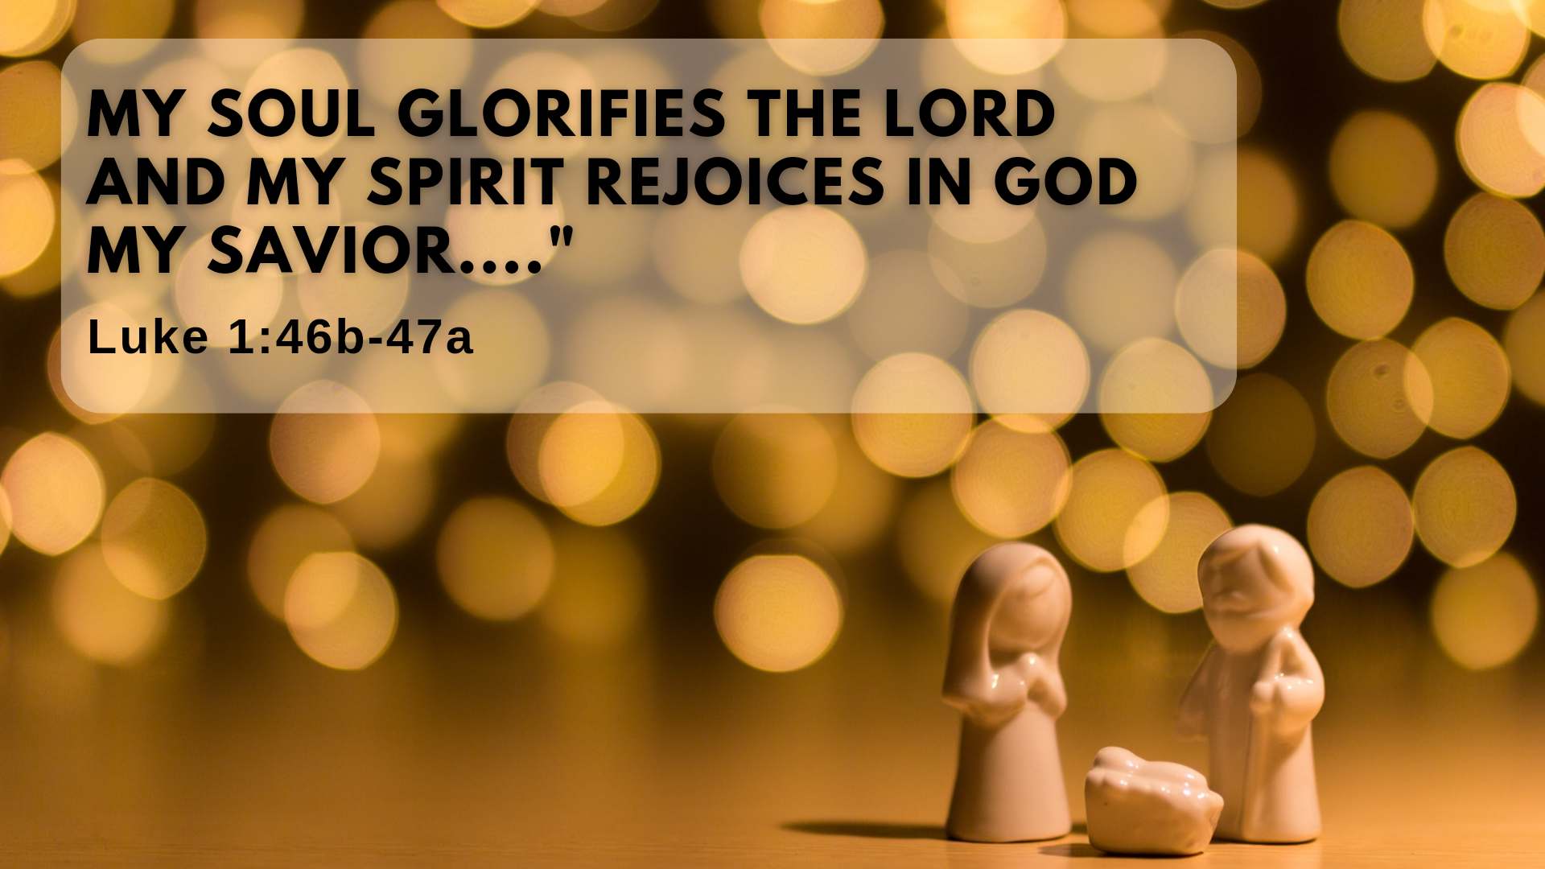

Slide 2
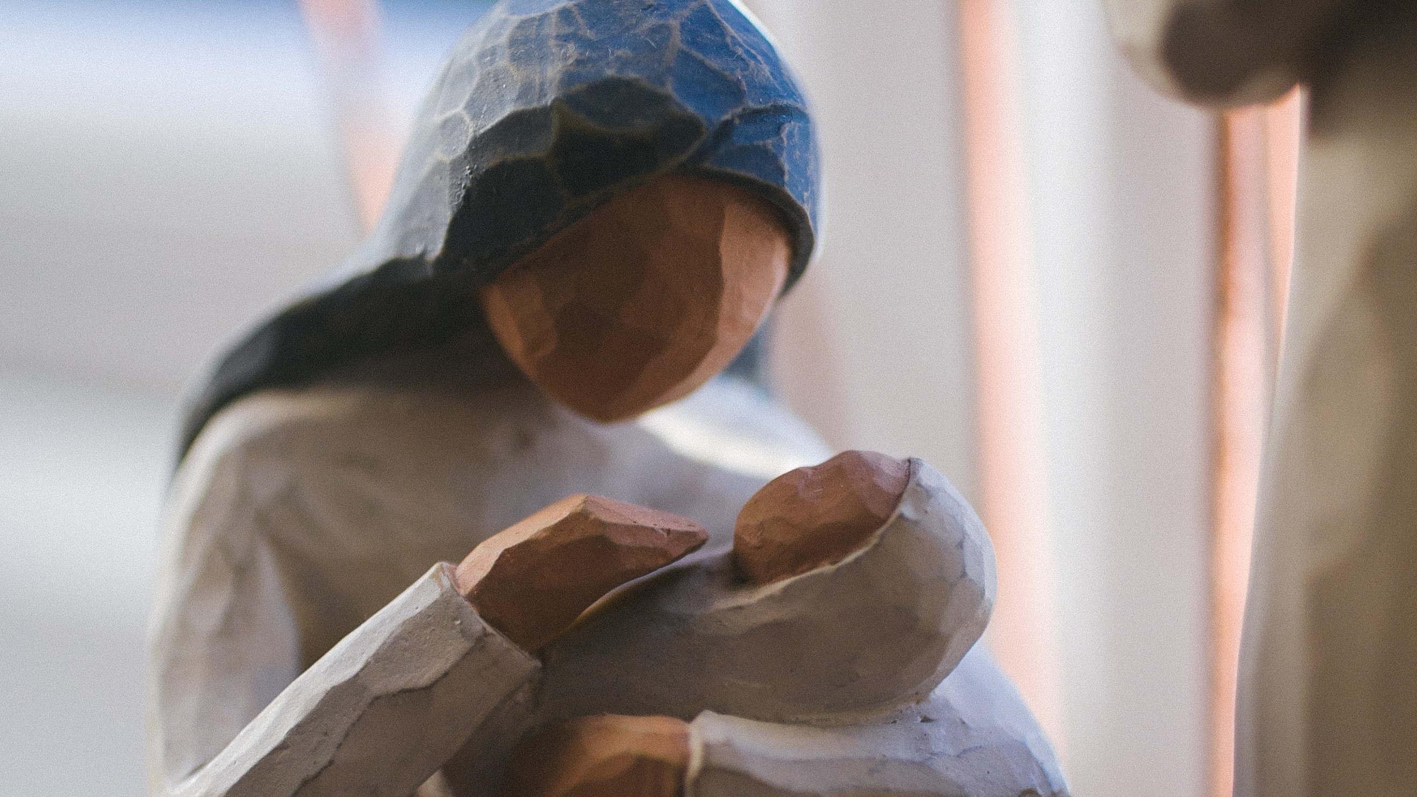
Mary, did you know that your baby boy
Would one day walk on water?
Mary, did you know that your baby boy
Would save our sons and daughters?
Did you know that your baby boy
Has come to make you new?
This child that you delivered, will soon deliver you
Mary, did you know that your baby boy
Will give sight to a blind man?
Mary, did you know that your baby boy
Will calm the storm with his hands?

Slide 3
“30 But the angel said to her, “Do not be afraid, Mary; you have found favor with God. 31 You will conceive and give birth to a son, and you are to call him Jesus. 32 He will be great and will be called the Son of the Most High. The Lord God will give him the throne of his father David, 33 and he will reign over Jacob’s descendants forever; his kingdom will never end.”

Slide 4
⁴⁶ And Mary said:
“My soul glorifies the Lord
⁴⁷ and my spirit rejoices in God my Savior,
⁴⁸ for he has been mindful
of the humble state of his servant.
From now on all generations will call me blessed,
⁴⁹ for the Mighty One has done great things for
me— holy is his name.

Slide 5
⁵⁰ His mercy extends to those who fear him,
from generation to generation.
⁵¹ He has performed mighty deeds with his arm;
he has scattered those who are proud in
their inmost thoughts.

Slide 6
⁵² He has brought down rulers from their thrones
but has lifted up the humble.
⁵³ He has filled the hungry with good things
but has sent the rich away empty.
⁵⁴ He has helped his servant Israel,
remembering to be merciful
⁵⁵ to Abraham and his descendants forever,
just as he promised our ancestors.”

Slide 7


Slide 8
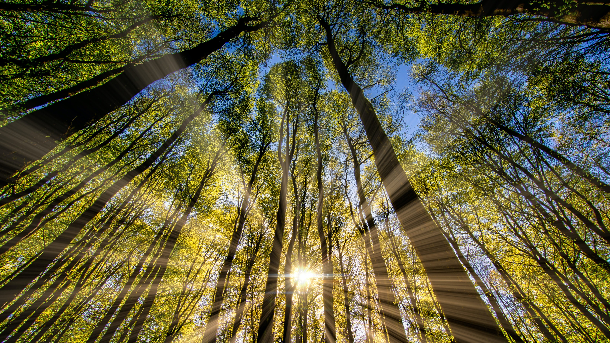
Sun of Righteousness (Mal 4:2)

Slide 9
“Blessed is she who has believed that the Lord would fulfill his promises to her!”
- v.45

Slide 10
Mary, did you know that your baby boy
Is Lord of all creation?
Mary, did you know that your baby boy
Would one day rule the nations?
Did you know that your baby boy
Is heaven's perfect Lamb?
That sleeping child you're holding is the great, I Am

