Slide 1
Notes:
Insert a map of your country.

Slide 2
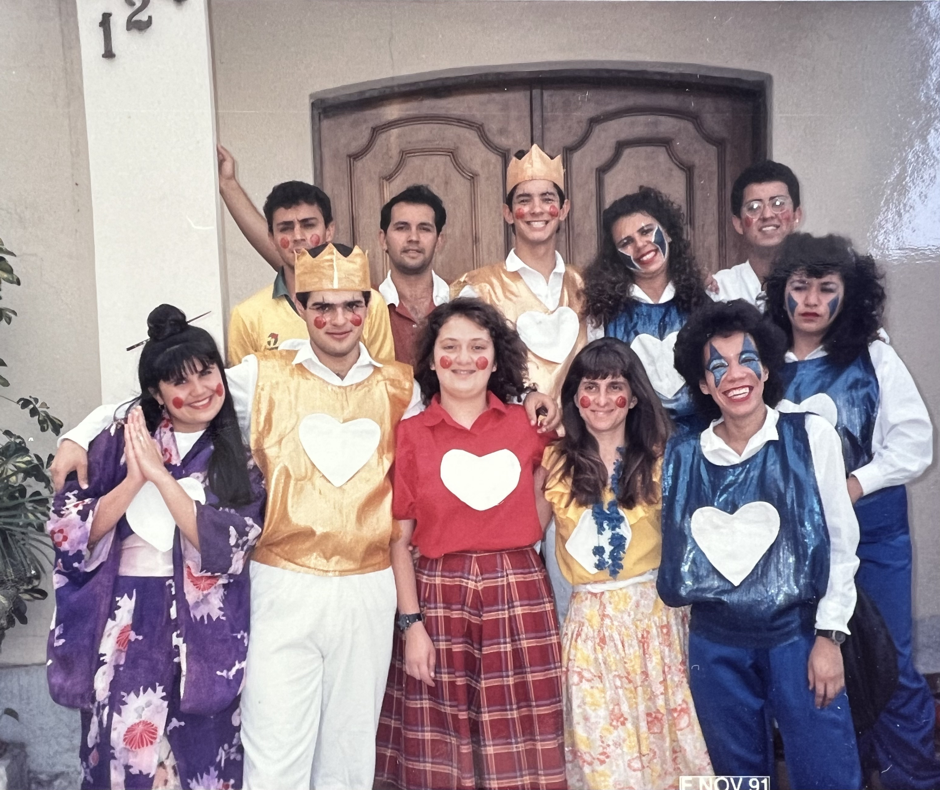

Slide 3
And beginning with Moses and all the Prophets, he [Jesus] explained to them what was said in all the Scriptures concerning himself. They asked each other, “Were not our hearts burning within us while he talked with us on the road and opened the Scriptures to us?” (Luke 24:27, 32)

Slide 4
And beginning with Moses and all the Prophets, he [Jesus] explained to them what was said in all the Scriptures concerning himself. They asked each other, “Were not our hearts burning within us while he talked with us on the road and opened the Scriptures to us?” (Luke 24:27, 32)

Slide 5
1. THE INTRODUCTION
God’s promise to Abram
if he believes and obeys God
(Genesis 12:1–3)
• I will bless you • You will be a blessing

Slide 6
1. THE INTRODUCTION
God’s promise to Abram
if he believes and obeys God
(Genesis 12:1–3)
• I will bless you • You will be a blessing
TOP-LINE BOTTOM-LINE
BLESSINGS RESPONSIBILITIES

Slide 7
2. THE STORY
Reading the Bible with a
Top-Line Blessing / Bottom-line Responsibility
perspective
Daniel and the Lion’s Den – Daniel 6:25-26 (every language in all the earth)
David and Goliath – 1 Samuel 17:46 (the whole world)
Solomon’s wisdom – 2 Chronicles 9:22-23 (all the kings of the earth)
Dedication of the Temple – 1 Kings 8:41-43 (all the peoples of the earth)
Salvation in Christ – Luke 24:46-47 (all nations)

Slide 8
2. THE STORY
Bottom-line Responsibility
our MISSION FIELDS
(Acts 1:8)
Jerusalem
Judea
Samaria
Ends of the Earth
→
→
→
→
Edifying and discipling within our church
Evangelism within our own culture, language, worldview
Evangelism within the same language but different culture and worldview
Evangelism within different language, culture, worldview

Slide 9
3. THE CONCLUSION
With your blood you purchased for God persons from every tribe and language and people and nation. (Revelation 5:9)
After this I looked, and there before me was a great multitude that no one could count, from every nation, tribe, people and language, standing before the throne and before the Lamb. They were wearing white robes and were holding palm branches in their hands. And they cried out in a loud voice: “Salvation belongs to our God, who sits on the throne, and to the Lamb.” (Revelation 7:9–10)

Slide 10
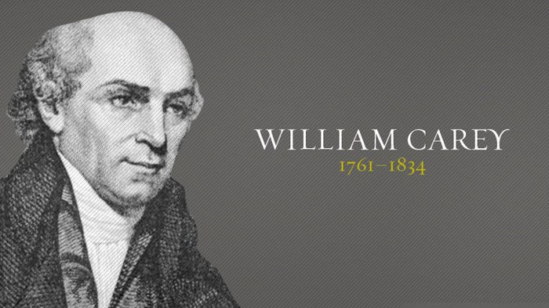
"Young man, sit down! You are an enthusiast. When God pleases to convert the heathen, he'll do it without consulting you or me."
An Enquiry into the Obligations of Christians to Use Means for the Conversion of the Heathens

Slide 11
Notes:
Insert a map of your country.

Slide 12
“Surely it is worthwhile to lay ourselves out with all our might, in promoting the cause, and kingdom of Christ.” (William Carey)

