Slide 1
I Believe: In the Holy Spirit

Slide 3
1.
The Personhood of the Holy Spirit
God the Father, God the Son, God the Holy Spirit- one God three persons

Slide 4
The Holy Spirit is given names
Spirit of God -Rom. 8:9, Gen. 1:2
Spirit of Christ - Rom. 8:9,
Spirit of your Father - Matt. 10:20,
The Spirit of Truth - John 14:17, 15:26.
The Spirit of the Lord - Acts 8:39, Judges 15:14; 1 Sam. 16:12

Slide 5
The Holy Spirit is referred to as a person
Who - Rom. 8:11, John 6:63, 1 John 5:6, 1 Cor. 2:12; 2 Tim. 1:14
He - John 14:26
Himself - Rom. 8:16, Rom. 8:26
This Photo by Unknown Author is licensed under CC BY-SA

Slide 6
Personhood of the Holy Spirit
Grieves
Isaiah 63:10, Eph. 4:30
Loves
Rom. 15:30
Has a Mind
Rom. 8:27
Can be resisted
Acts 7:51
Knows
1 Cor. 2:11
Can be a witness
Acts 5:32
Has an awareness of goodness
Acts 15:28
Makes overseers
Acts 20:28
Can Be Lied to and Tested
Acts 5:1-11 – Ananias and Sapphira
Speaks
2 Sam. 23:2, Acts 8:29, Acts 10:19, Acts 11:12, Acts 13:2, Acts 21:11, Acts 28:25-26, 1 Tim. 4:1, Heb. 3:7-8, Rev. 2:7, 2:11, 17, 29; 3:6, 13, 22. Rev. 14:13, Rev. 22:17,

Slide 7
Activities of the Holy Spirit
Teaches - John 14:26, Luke 12:12
Intercedes - Rom. 8:26
Leads - Matt. 4:1
Gives life - John 6:63
Filled by - Acts 2:4
This Photo by Unknown Author is licensed under CC BY

Slide 8
The Holy Spirit mentioned on an equal level with God
Matt. 28:19
“Go therefore and make disciples of all the nations, baptizing them in the name of the Father and the Son and the Holy Spirit,”
2 Cor. 13:14
“The grace of the Lord Jesus Christ, and the love of God, and the fellowship of the Holy Spirit, be with you all.”
Eph. 4:4-6
“There is one body and one Spirit, just as also you were called in one hope of your calling; one Lord, one faith, one baptism, one God and Father of all who is over all and through all and in all.”

Slide 9
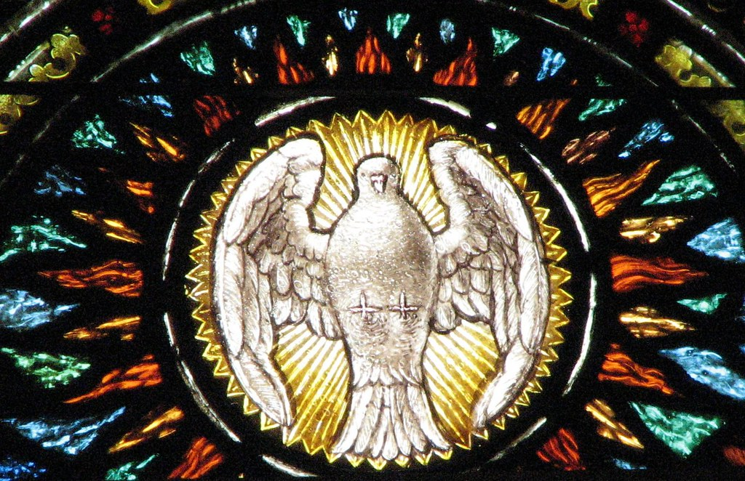
Important?
We have a relationship with a person not a thing
Refocuses our approach to God
This Photo by Unknown Author is licensed under CC BY

Slide 10
If we think of the Holy Spirit merely as a power or influence, our thought will be, "How can I get more of the Holy Spirit?"; but if we think of Him as a divine Person, our thought will be, "How can the Holy Spirit get more of me?" The former conception leads to self-exaltation; the latter conception to self-humiliation, self-emptyings and self-renunciation. - R.A. Torrey

Slide 12
2.
The Work of the Holy Spirit in us
Testifies about Christ, Illuminates Scripture, and Sanctifies

Slide 13
Beginning
The Holy Spirit works in the beginning of our Christian life

Slide 14
The Holy Spirit testifies about Christ
John 15:26-27 “When the Advocate comes, whom I will send to you from the Father—the Spirit of truth who goes out from the Father—he will testify about me. And you also must testify, for you have been with me from the beginning.

Slide 15
The Holy Spirit testifies about Christ
John 16:8-11 When he comes, he will prove the world to be in the wrong about sin and righteousness and judgment: 9 about sin, because people do not believe in me; 10 about righteousness, because I am going to the Father, where you can see me no longer; 11 and about judgment, because the prince of this world now stands condemned.

Slide 16
The Holy Spirit testifies about Christ
Is the spirit testifying to you?
Is there someone God has called you to share the Gospel with?
This Photo by Unknown Author is licensed under CC BY-SA

Slide 17
Continuation
The Holy Spirit continues to work in our Christian life

Slide 18
The Holy Spirit Illuminates Scripture and Teaches us
John 14:15-18 “If you love me, keep my commands. 16 And I will ask the Father, and he will give you another advocate to help you and be with you forever— 17 the Spirit of truth. The world cannot accept him, because it neither sees him nor knows him. But you know him, for he lives with you and will be[c] in you. 18 I will not leave you as orphans; I will come to you.

Slide 19
The Holy Spirit Illuminates Scripture and Teaches us
John 14:25-27 “All this I have spoken while still with you. 26 But the Advocate, the Holy Spirit, whom the Father will send in my name, will teach you all things and will remind you of everything I have said to you. 27 Peace I leave with you; my peace I give you. I do not give to you as the world gives. Do not let your hearts be troubled and do not be afraid.

Slide 21
The Holy Spirit brings sanctification
Romans 8:5-6 Those who live according to the flesh have their minds set on what the flesh desires; but those who live in accordance with the Spirit have their minds set on what the Spirit desires. The mind governed by the flesh is death, but the mind governed by the Spirit is life and peace.

Slide 22
The Holy Spirit brings sanctification
Galatians 5:22-23
But the fruit of the Spirit is love, joy, peace, forbearance, kindness, goodness, faithfulness, gentleness and self-control. Against such things there is no law.

Slide 23
The Holy Spirit in our lives
Ask the Holy Spirit to guide you as you study God’s Word
Have the Holy Spirit continue in sanctifying you
This Photo by Unknown Author is licensed under CC BY-NC-ND

Slide 24
3.
The Work of the Holy Spirit in the church

Slide 25
The Holy Spirit in the church
1 Corinthians 12:1-3
Now about the gifts of the Spirit, brothers and sisters, I do not want you to be uninformed. 2 You know that when you were pagans, somehow or other you were influenced and led astray to mute idols. 3 Therefore I want you to know that no one who is speaking by the Spirit of God says, “Jesus be cursed,” and no one can say, “Jesus is Lord,” except by the Holy Spirit.

Slide 26
The Holy Spirit in the church
1 Corinthians 12:4-7
There are different kinds of gifts, but the same Spirit distributes them. There are different kinds of service, but the same Lord. There are different kinds of working, but in all of them and in everyone it is the same God at work.
Now to each one the manifestation of the Spirit is given for the common good.

Slide 27
The Holy Spirit in the church
Are you using your gifts of the spirit to encourage and strengthen the church?

Slide 28
Student Leaders – Spiritual Gifts
Rhoda
Teaching
Pastor/Shepherd
Exhortation
Naomi
Pastor/Shepherd
Administration
Faith
Zeph
Mercy
Faith
Serving
Isaac
Faith
Mercy
Discernment and Administration
Raphael
Mercy and Pastor/Shepherd
Serving and Faith
Teaching
Daniel
Faith
Mercy
Serving

Slide 29
I Believe: In the Holy Spirit

