Slide 2
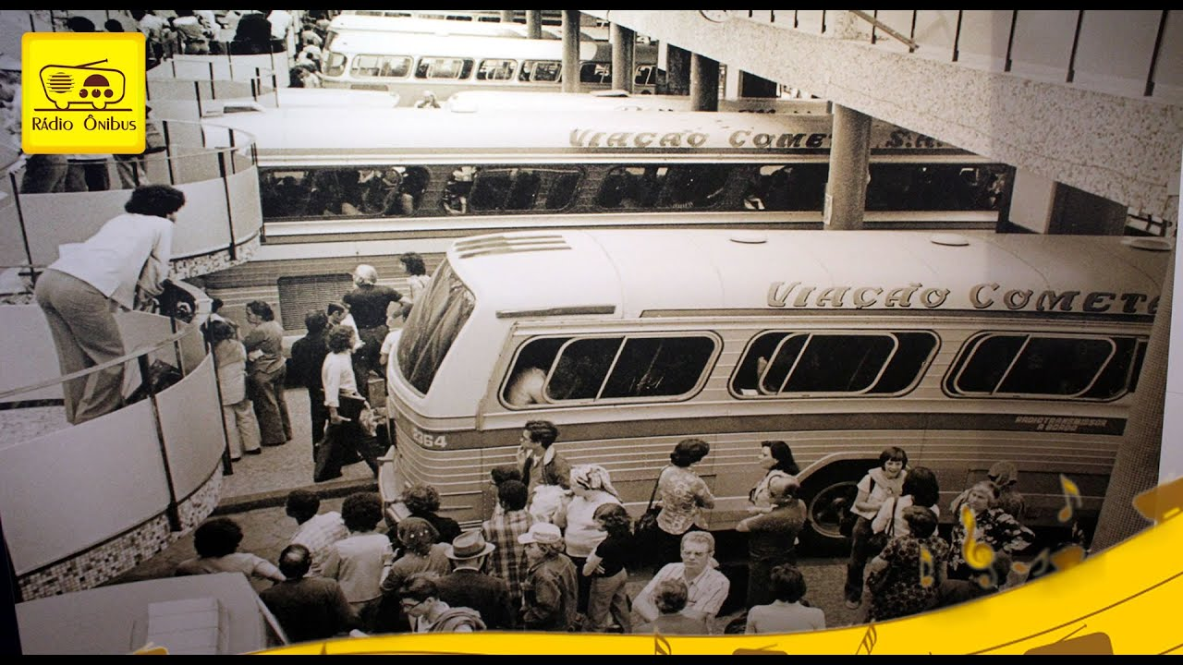

Slide 4
The Past
REMEMBER
God’s faithfulness in the past
(v1) “When the Lord restored the fortunes”
(v5) “Sow with tears”
(v6) “Go out with weeping”
ANTICIPATE
God’s continuous faithfulness in the future
(v4) “Restore our fortunes.”
“Reap with songs of joy”
“Return with songs of joy”
➩
➩
➩

Slide 5
WORSHIP
— constant present reality
Songs of Joy (vs. 2, 5, 6)
(v. 2) Then it was said among the nations, “The Lord has done great things for them.”

Slide 6
WORSHIP
— constant present reality
Songs of Joy (vs. 2, 5, 6)
(v. 2) Then it was said among the nations, “The Lord has done great things for them.”
Question:
Why did the nations attribute their restoration to being the Lord’s work?

Slide 7
WORSHIP
— constant present reality
Songs of Joy (vs. 2, 5, 6)
(v. 2) Then it was said among the nations, “The Lord has done great things for them.”
Question:
Why did the nations attribute their restoration to being the Lord’s work?
Answer:
Because the laughter and songs of joy must have attributed it to the Lord’s work, not to the work of their own hands!

Slide 8
FUTURE
— hope and anticipation
(Psalm 30:5) “Weeping may stay for the night, but rejoicing comes in the morning.”

Slide 9
FUTURE
— hope and anticipation
(Psalm 30:5) “Weeping may stay for the night, but rejoicing comes in the morning.”
(2 Corinthians 4:16–18) “16 Therefore we do not lose heart. Though outwardly we are wasting away, yet inwardly we are being renewed day by day. 17 For our light and momentary troubles are achieving for us an eternal glory that far outweighs them all. 18 So we fix our eyes not on what is seen, but on what is unseen, since what is seen is temporary, but what is unseen is eternal.”

Slide 10
eternity
Measuring with an “eternal yard stick!”
Sow in tears ➔ In this world, you will have trouble. (John 16:33)
Reap with joy ➔ Take heart! I have overcome the world. (John 16:33)

