Slide 2
Good News for All: For This Hope...
Live Out Your Identity (v.12-16)
Groans of this World (v.17-25)
Groans of the Spirit (v.26-27)

Slide 3
1. Live Out Your Identity (v.12-16)

Slide 4
¹² Therefore, brothers and sisters, we have an obligation—but it is not to the flesh, to live according to it. ¹³ For if you live according to the flesh, you will die; but if by the Spirit you put to death the misdeeds of the body, you will live.¹⁴ For those who are led by the Spirit of God are the children of God. ¹⁵ The Spirit you received does not make you slaves, so that you live in fear again; rather, the Spirit you received brought about your adoption to sonship.^{[f]} And by him we cry, “Abba,^{[g]}Father.” ¹⁶ The Spirit himself testifies with our spirit that we are God’s children. ¹⁷ Now if we are children, then we are heirs—heirs of God and co-heirs with Christ, if indeed we share in his sufferings in order that we may also share in his glory.

Slide 5
¹² Therefore, brothers and sisters, we have an obligation—but it is not to the flesh, to live according to it. ¹³ For if you live according to the flesh, you will die; but if by the Spirit you put to death the misdeeds of the body, you will live.¹⁴ For those who are led by the Spirit of God are the children of God. ¹⁵ The Spirit you received does not make you slaves, so that you live in fear again; rather, the Spirit you received brought about your adoption to sonship.^{[f]} And by him we cry, “Abba,^{[g]}Father.” ¹⁶ The Spirit himself testifies with our spirit that we are God’s children. ¹⁷ Now if we are children, then we are heirs—heirs of God and co-heirs with Christ, if indeed we share in his sufferings in order that we may also share in his glory.

Slide 6
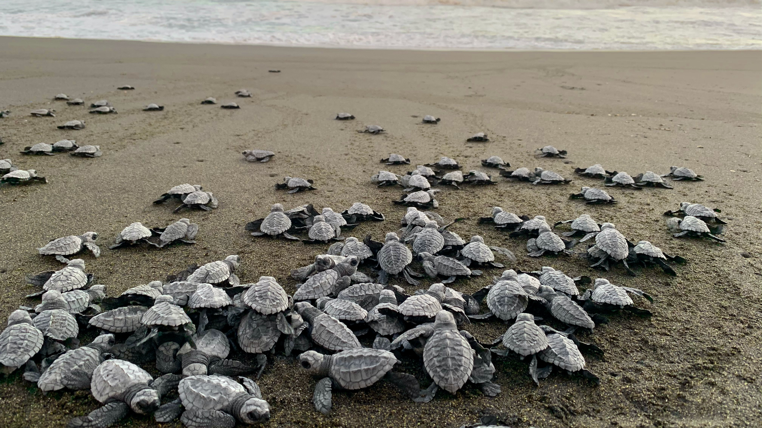

Slide 7
2. Groans of the World (v.17-25)
¹⁷ Now if we are children, then we are heirs—heirs of God and co-heirs with Christ, if indeed we share in his sufferings in order that we may also share in his glory.

Slide 8
2. Groans of the World (v.17-25)
Suffering now
  Pains of sanctification
  Pains of self-sacrifice
  Pains of persecution
  General suffering of the creation

Slide 9
2. Groans of the World (v.17-25)
Suffering now
Glory Later
  Suffering not worth comparing
  Joyful end is guaranteed

Slide 10
2. Groans of the World (v.17-25)
Suffering now
Glory Later
Balance to the Christian life

Slide 11
3. Groans of the Spirit (v.26-27)
26 In the same way, the Spirit helps us in our weakness. We do not know what we ought to pray for, but the Spirit himself intercedes for us through wordless groans. 27 And he who searches our hearts knows the mind of the Spirit, because the Spirit intercedes for God’s people in accordance with the will of God.

Slide 12
