Slide 1
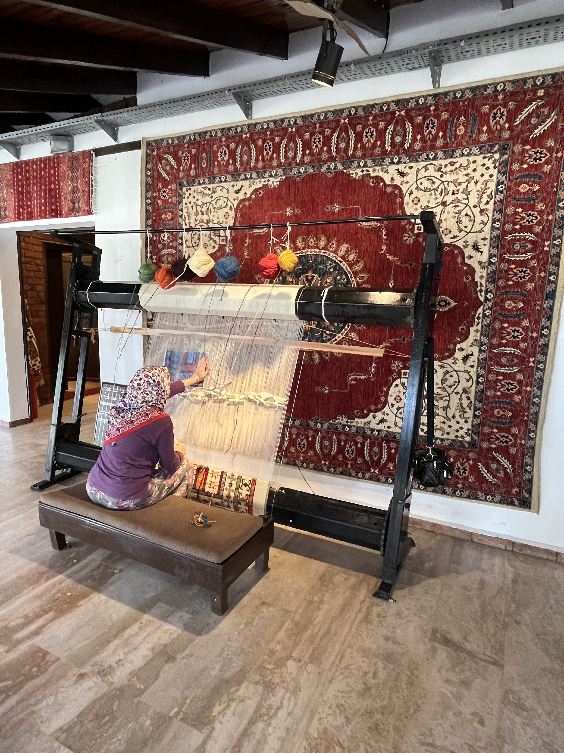

Slide 2
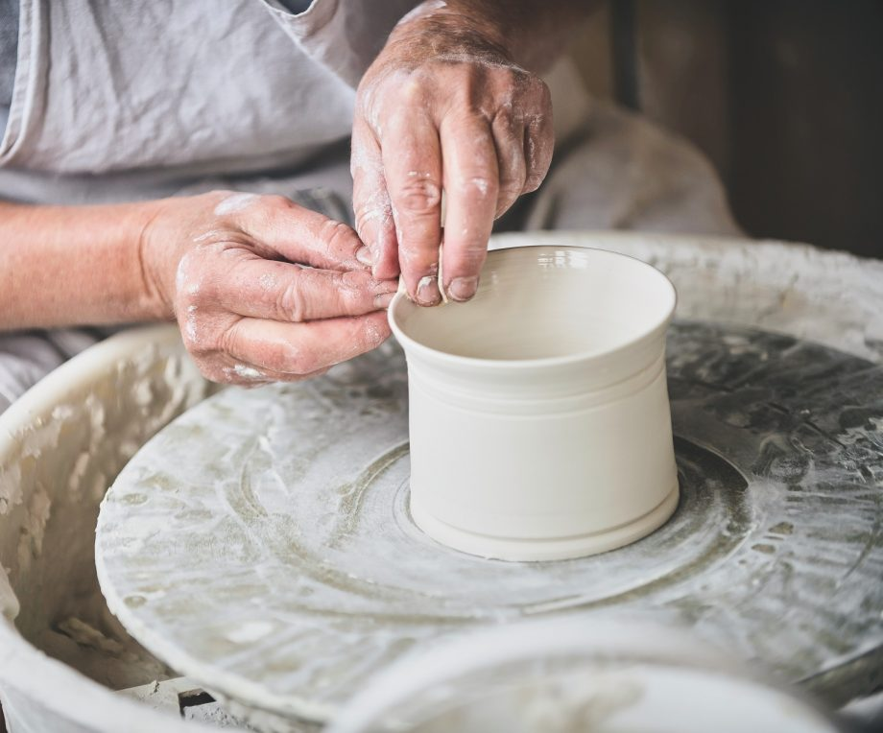

Slide 3
I praise you because I am fearfully and wonderfully made…
PSALM 139:14

Slide 4


Slide 5
1. THE LIMITLESS GOD

Slide 6
1. THE LIMITLESS GOD
¹You have searched me, LORD, and you know me. ²You know when I sit and when I rise; you perceive my thoughts from afar. ³You discern my going out and my lying down; you are familiar with all my ways…⁶Such knowledge is too wonderful for me, too lofty for me to attain..
PSALM 139:1-3, 6

Slide 7
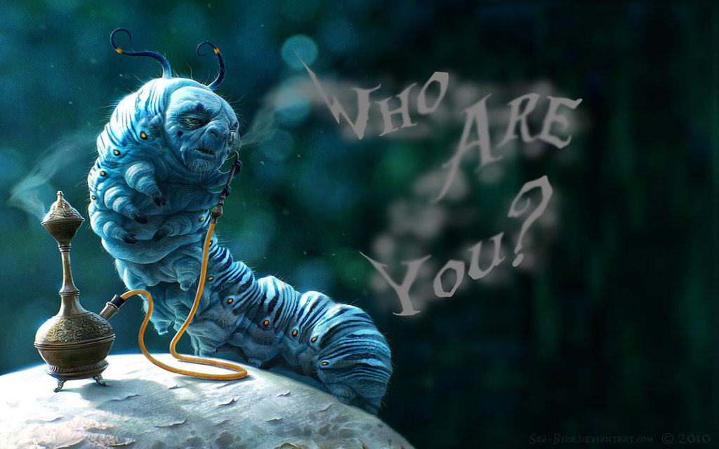

Slide 8
1. THE LIMITLESS GOD
¹You have searched me, LORD, and you know me. ²You know when I sit and when I rise; you perceive my thoughts from afar. ³You discern my going out and my lying down; you are familiar with all my ways…⁶Such knowledge is too wonderful for me, too lofty for me to attain..
PSALM 139:1-3, 6

Slide 9
1. THE LIMITLESS GOD
⁷Where can I go from your Spirit? Where can I flee from your presence? ⁸If I go up to the heavens, you are there; if I make my bed in the depths, you are there. ⁹If I rise on the wings of the dawn, if I settle on the far side of the sea,¹⁰even there your hand will guide me, your right hand will hold me fast..
PSALM 139:7-10

Slide 10
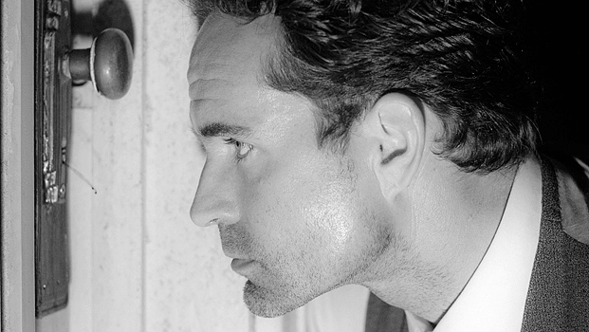

Slide 11
1. THE LIMITLESS GOD
⁷Where can I go from your Spirit? Where can I flee from your presence? ⁸If I go up to the heavens, you are there; if I make my bed in the depths, you are there. ⁹If I rise on the wings of the dawn, if I settle on the far side of the sea,¹⁰even there your hand will guide me, your right hand will hold me fast..
PSALM 139:7-10

Slide 12
1. THE LIMITLESS GOD
¹³For you created my inmost being; you knit me together in my mother’s womb.¹⁴ I praise you because I am fearfully and wonderfully made; your works are wonderful, I know that full well…. ¹⁶Your eyes saw my unformed body….
PSALM 139:13-14, 16

Slide 13
1. THE LIMITLESS GOD
Your eyes saw my unformed body; all the days ordained for me were written in your book before one of them came to be..
PSALM 139:16

Slide 14
2. PEOPLE FEARFULLY AND WONDERFULLY MADE

Slide 15
2. PEOPLE FEARFULLY AND WONDERFULLY MADE
¹³For you created my inmost being; you knit me together in my mother’s womb… ¹⁵My frame was not hidden from you when I was made in the secret place, when I was woven together in the depths of the earth.¹⁶ Your eyes saw my unformed body…
PSALM 139:13, 15-16

Slide 16
2. PEOPLE FEARFULLY AND WONDERFULLY MADE
…all the days ordained for me were written in your book before one of them came to be..
PSALM 139:16

Slide 17
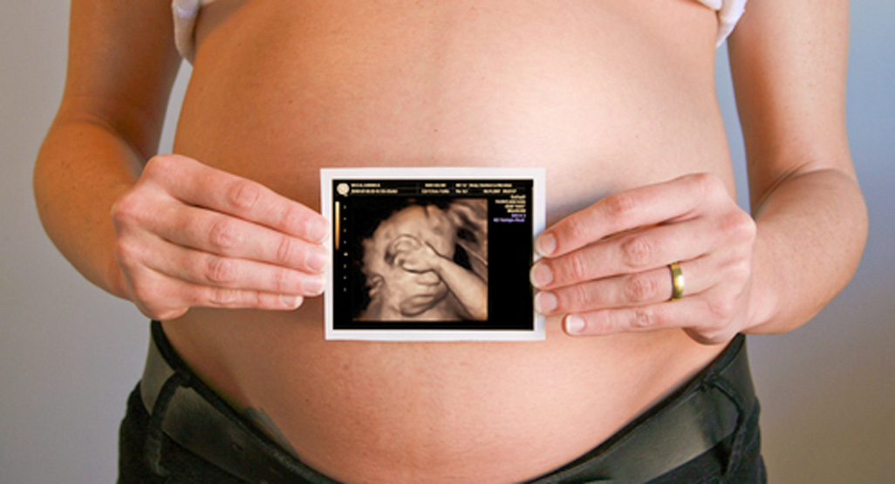

Slide 18
2. PEOPLE FEARFULLY AND WONDERFULLY MADE

Slide 19
2. PEOPLE FEARFULLY AND WONDERFULLY MADE
Moses said to the LORD, “Pardon your servant, LORD. I have never been eloquent, neither in the past nor since you have spoken to your servant. I am slow of speech and tongue.”
EXODUS 4:10

Slide 20
2. PEOPLE FEARFULLY AND WONDERFULLY MADE
The LORD said to him, “Who gave human beings their mouths? Who makes them deaf or mute? Who gives them sight or makes them blind? Is it not I, the LORD?”
EXODUS 4:11

Slide 21
“Does God cause blindness, or does he allow it? Does he plan for a person to be born deaf or does he permit it? In short, does God want disease? The key here is how we use the word ‘want’. God doesn’t want disease to exist in the same way that he enjoys it. He hates disease, just as he hates all the results of sin – death, guilt, sorrow, for example. But God must want disease to exist in the sense that he wills or chooses for it to exist, for if he didn’t, he would wipe it out immediately”
JONI EARECKSON TADA

Slide 22
“Weak spots. It’s scary to think of having your weak spots exposed, isn’t it? Weaknesses have a way of either raising or lowering your value in the eyes of others.”
JONI EARECKSON TADA

Slide 23
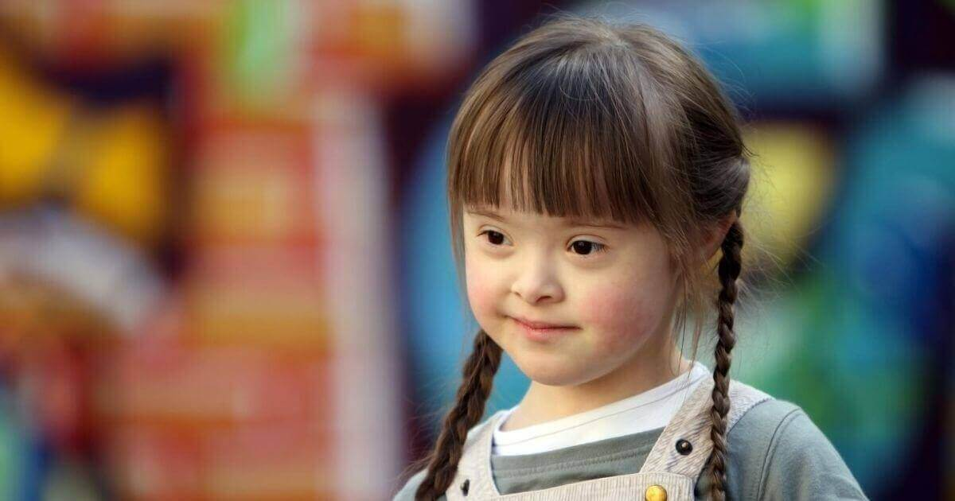

Slide 24


Slide 25
For we do not have a high priest who is unable to empathize with our weaknesses, but we have one who has been tempted in every way, just as we are—yet he did not sin.
HEBREWS 4:15

Slide 26
He had no beauty or majesty to attract us to him,
nothing in his appearance that we should desire him.
³ He was despised and rejected by mankind,
a man of suffering, and familiar with pain.
Like one from whom people hide their faces
he was despised, and we held him in low esteem.
ISAIAH 53:2-3

