Slide 1
Pursuing Sanctification

Slide 2


Slide 3
Pursuing Sanctification
1.
2.
3.
Spiritual Disciplines
Sanctification – God Making Us Holy
Preparing a way for God to sanctify us

Slide 4
Spiritual Disciplines
What is a Spiritual Discipline?

Slide 5
Don Whitney
“The spiritual disciplines are those practices found in Scripture that promote spiritual growth among believers in the gospel of Jesus Christ. They are habits of devotion, habits of experiential Christianity that have been practiced by God’s people since biblical times.”

Slide 6
Characteristics
1. Personal or Interpersonal
2. Activities
3. Found in Scripture
5. Motivation
4. Gospel

Slide 7
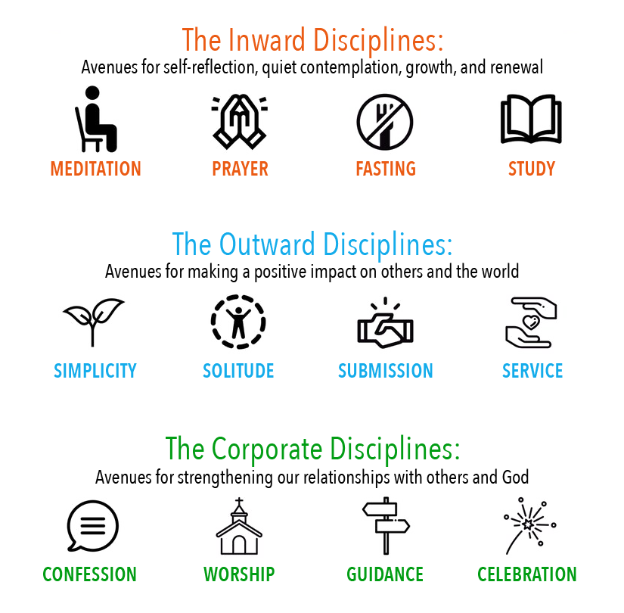

Slide 8


Spiritual Disciplines
Books

Slide 9
Sanctification – God Making Us Holy

Slide 10
Erickson
Sanctification is the continuing work of God in the life of believers, making them actually holy. By “holy” here is meant “bearing an actual likeness to God.” Sanctification is a process by which one’s moral condition is brought into conformity with one’s legal status before God. It is a continuation of what was begun in regeneration, when a newness of life was conferred upon and instilled within the believer.

Slide 11
Hebrews 10:10;14
10 And by that will we have been sanctified through the offering of the body of Jesus Christ once for all.
14 For by a single offering he has perfected for all time those who are being sanctified.

Slide 12
Foster
inner righteousness is a gift from God to be graciously received. The needed change within us is God’s work, not ours. The demand is for an inside job, and only God can work from the inside. We cannot attain or earn this righteousness of the kingdom of God; it is a grace that is given.

Slide 13
John 17:17-19
17 Sanctify them by the truth; your word is truth. 18 As you sent me into the world, I have sent them into the world. 19 For them I sanctify myself, that they too may be truly sanctified.

Slide 14

Allow God to Sanctify You

Slide 15
Preparing a way for God to Sanctify Us

Slide 16
1 Timothy 4:7-8
“Have nothing to do with godless myths and old wives’ tales; rather, train yourself to be godly. For physical training is of some value, but godliness has value for all things, holding promise for both the present life and the life to come.”

Slide 17
1 Timothy 4:11-13
11 Command and teach these things. 12 Let no one despise you for your youth, but set the believers an example in speech, in conduct, in love, in faith, in purity. 13 Until I come, devote yourself to the public reading of Scripture, to exhortation, to teaching.

Slide 18
J.C. Ryle
“There are no spiritual gains without pains. I would soon expect farmer just prosper in business who contended himself with sowing fields and never looking at them till harvest as expect a believer to attain much holiness who is not diligent in his Bible reading, his prayers, and his use of Sundays.”

Slide 19
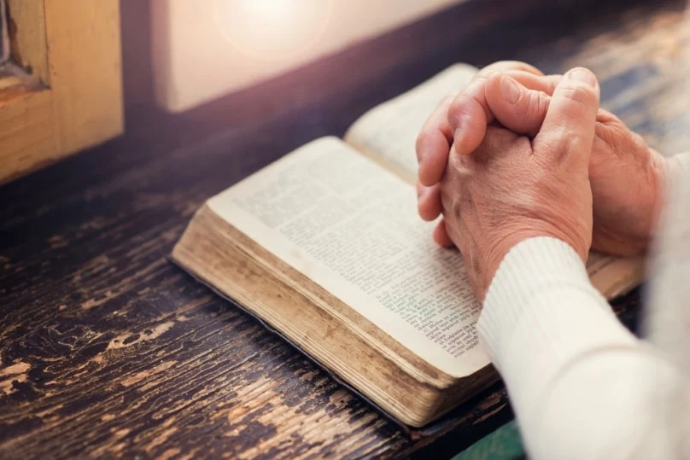
Pursue Doing the Spiritual Disciplines

Slide 20
Spiritual Disciplines
Internal
Reading the Bible, Praying, Fasting, Meditating, and Journaling
External
Evangelizing, Being good Stewards, Solitude, Serving, Simplicity, and Rest
Corporate
Worship, Confession, Celebration, Guidance, and Fellowship

Slide 21


Slide 22
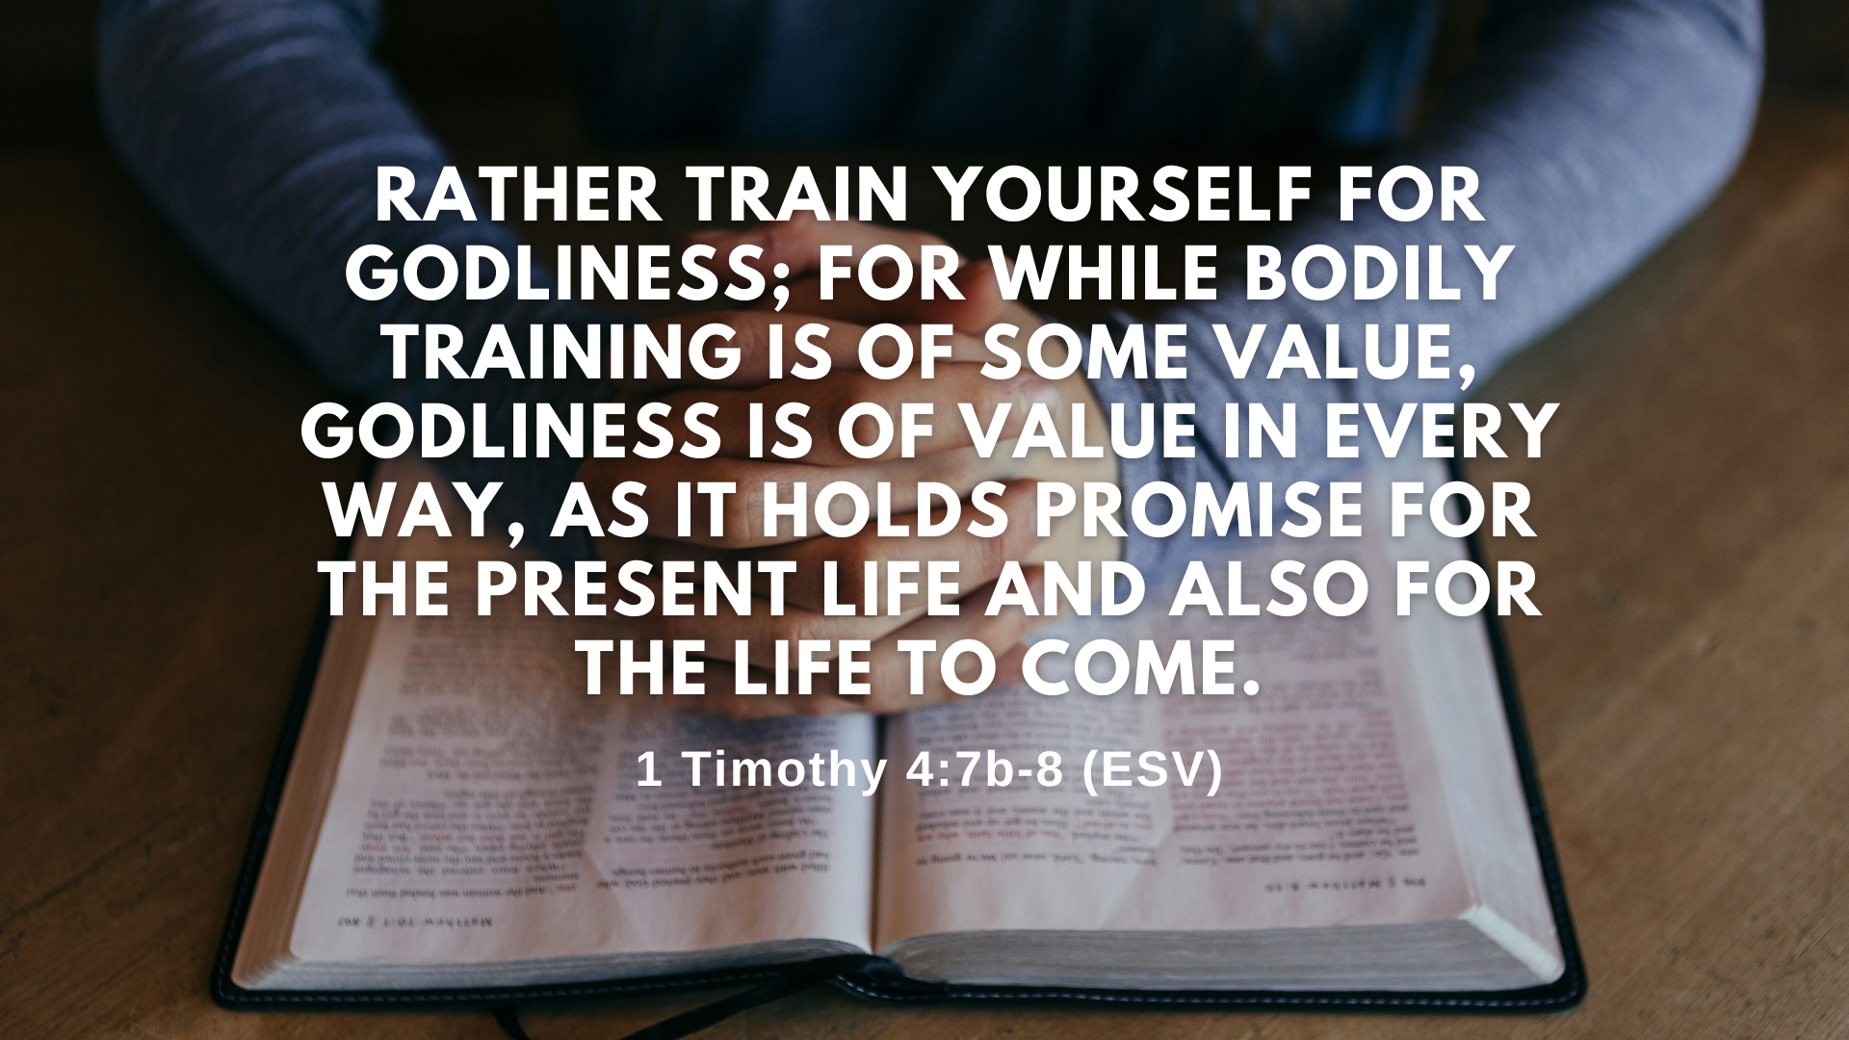

Slide 23
Pursuing Sanctification

