Slide 2
He Is Risen!
Surprise
Predictions
Reactions

Slide 3
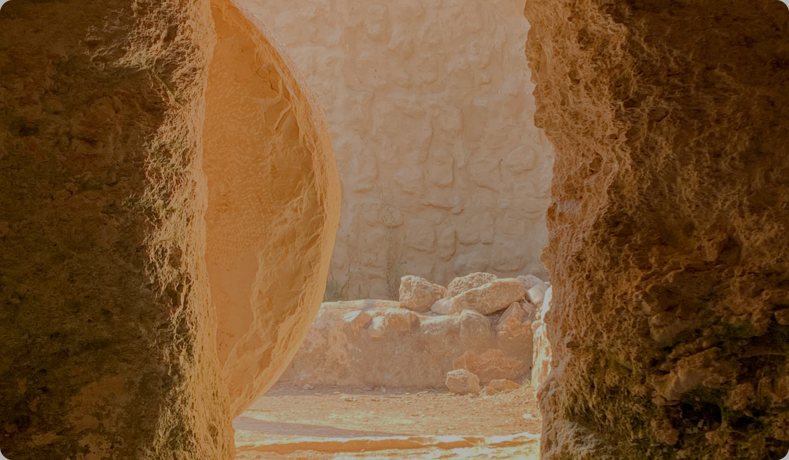
24 But on the first day of the week, at early dawn, they went to the tomb, taking the spices they had prepared. 2 And they found the stone rolled away from the tomb, 3 but when they went in they did not find the body of the Lord Jesus. 4 While they were perplexed about this, behold, two men stood by them in dazzling apparel. 5 And as they were frightened and bowed their faces to the ground, the men said to them, “Why do you seek the living among the dead? 6 He is not here, but has risen. Remember how he told you, while he was still in Galilee, 7 that the Son of Man must be delivered into the hands of sinful men and be crucified and on the third day rise.” 8 And they remembered his words,

Slide 4
1. Surprise
The resurrection means…
What Jesus said is true

Slide 5
1. Surprise
The resurrection means…
What Jesus said is true
Our sins are forgiven
  ...Christ died for our sins in accordance with the Scriptures… (1 Cor 15:3).
  And if Christ has not been raised, your faith is futile and you are still in your sins (1 Cor 15:7).

Slide 6
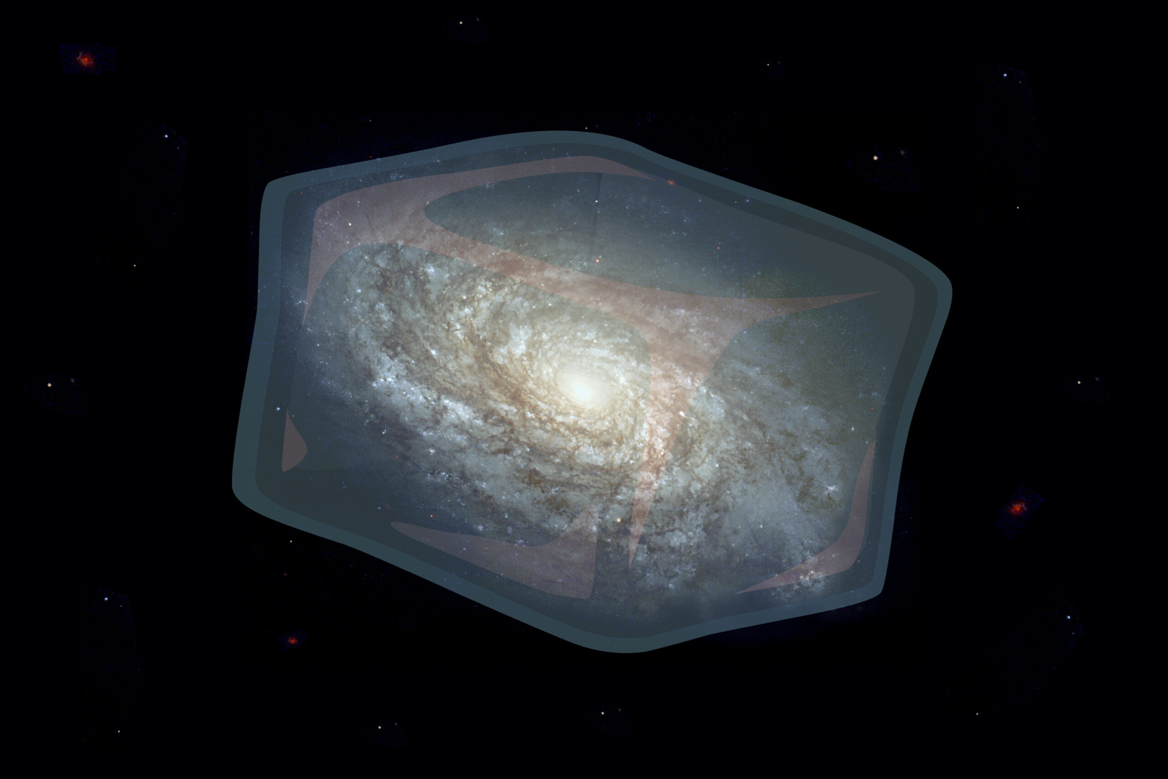

Slide 7
1. Surprise
The resurrection means…
What Jesus said is true
Our sins are forgiven
New creation is coming
  But in fact Christ has been raised from the dead, the firstfruits of those who have fallen asleep (1 Cor 15:20).

Slide 8
2. Predictions (and Foreshadowing)
Old Testament
“because you will not abandon me to the realm of the dead, nor will you let your faithful one see decay” (Psalm 16:10, quoted in Acts 2:31).
“After he has suffered, he will see the light of life and be satisfied” (Isaiah 53:11a).
Story of Jonah

Slide 9
2. Predictions (and Foreshadowing)
Nature / in Us
season, seed, sun…
stories we love (Tolkein’s eucatastrophe)
longing for life after death and happy ending, belief in justice and progress, death being evil…

Slide 10
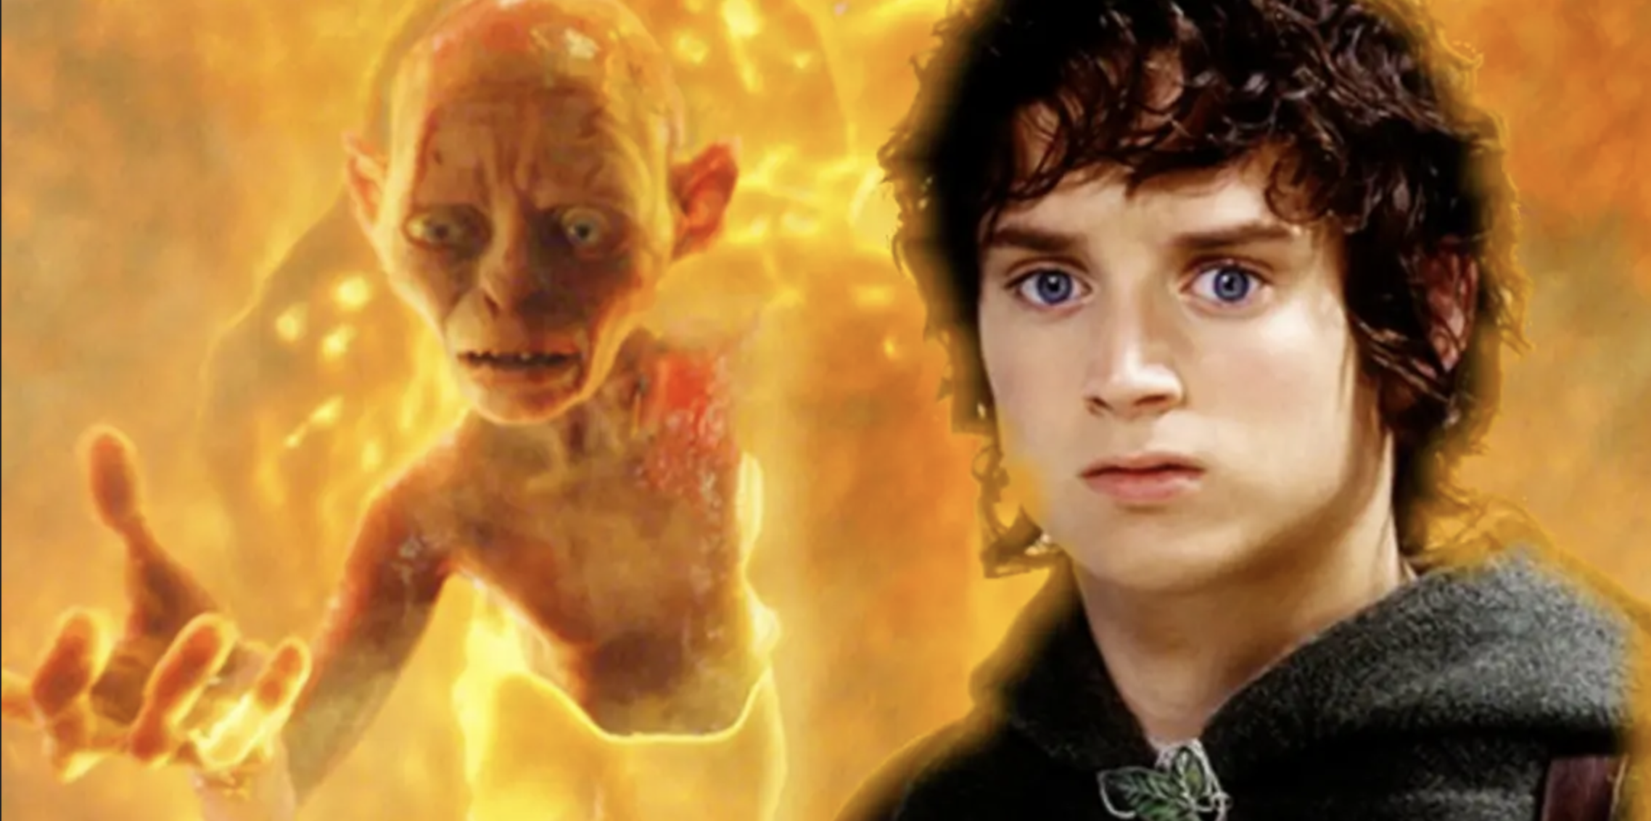

Slide 11
2. Predictions (and Foreshadowing)
Nature / in Us
season, seed, sun…
stories we love (Tolkein’s eucatastrophe)
longing for life after death and happy ending, belief in justice and progress, death being evil…

Slide 12
3. Reactions
10 It was Mary Magdalene, Joanna, Mary the mother of James, and the others with them who told this to the apostles. 11 But they did not believe the women, because their words seemed to them like nonsense. 12 Peter, however, got up and ran to the tomb. Bending over, he saw the strips of linen lying by themselves, and he went away, wondering [marveling (ESV)] to himself what had happened.

Slide 13


Slide 14
