Slide 2
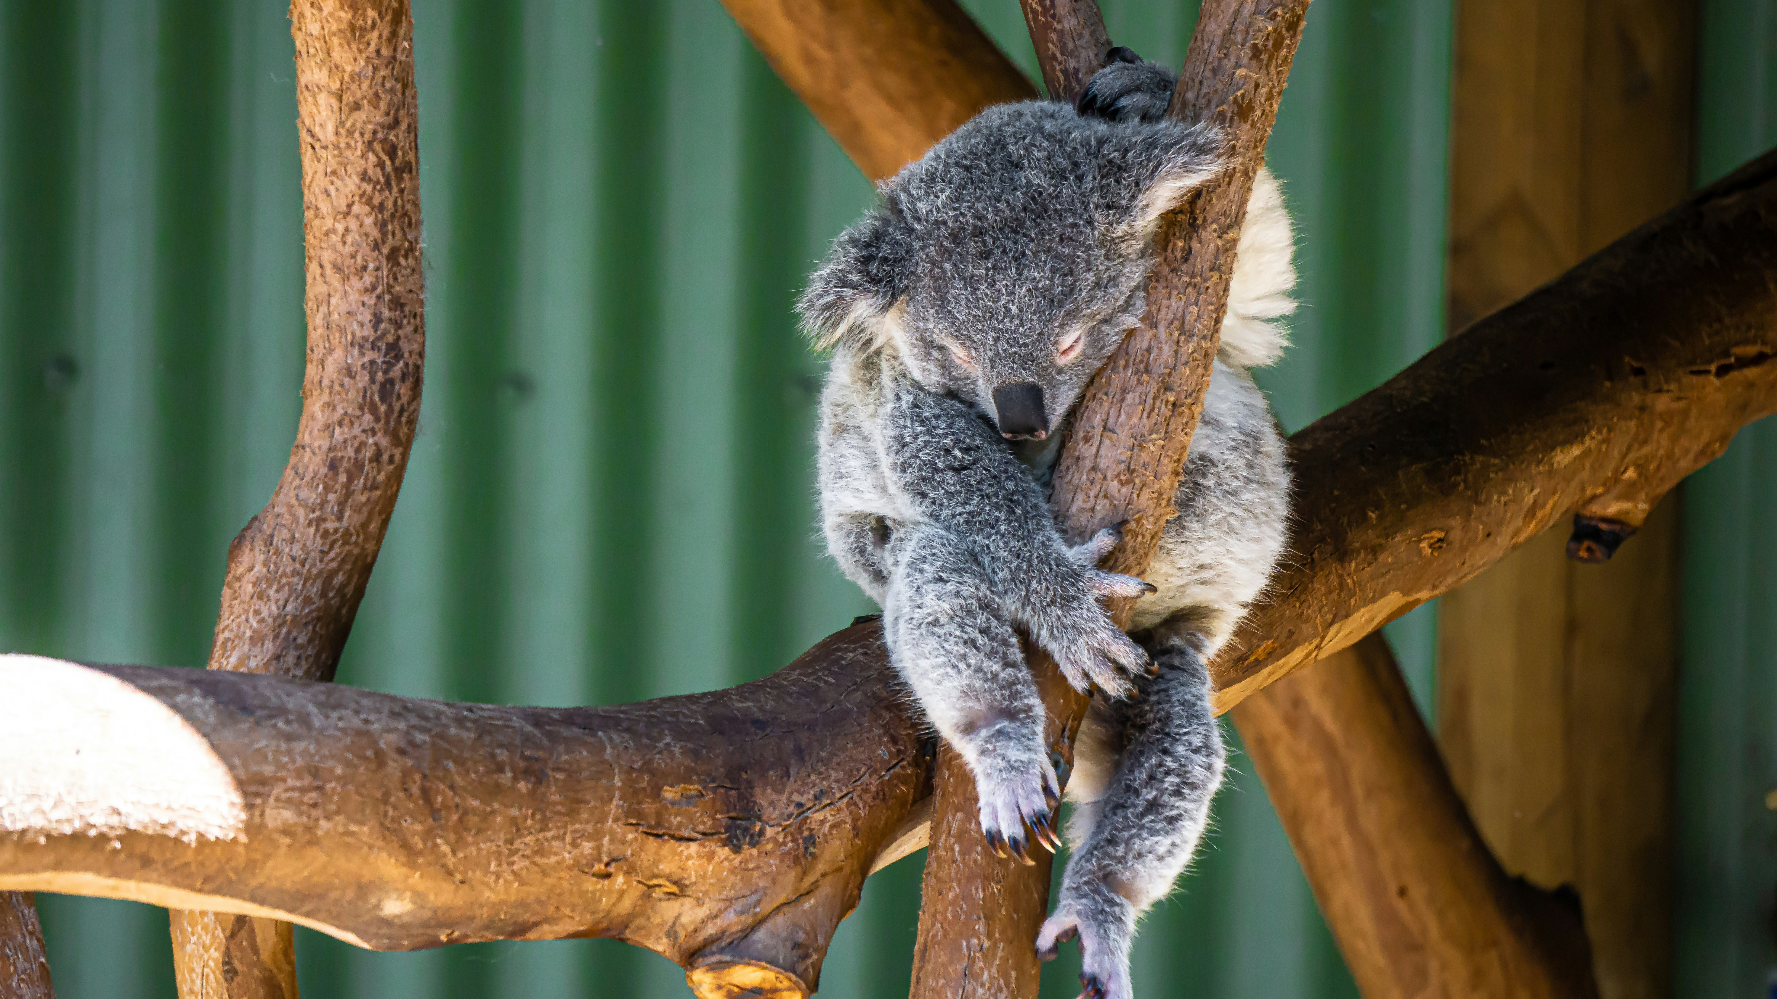

Slide 3
2 Samuel 6: God at the Centre
God at the Centre
God Is Holy
Worship Before God

Slide 4
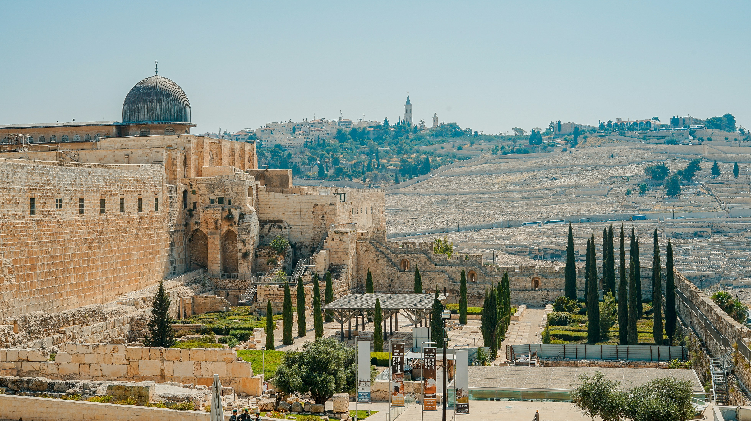

Slide 5
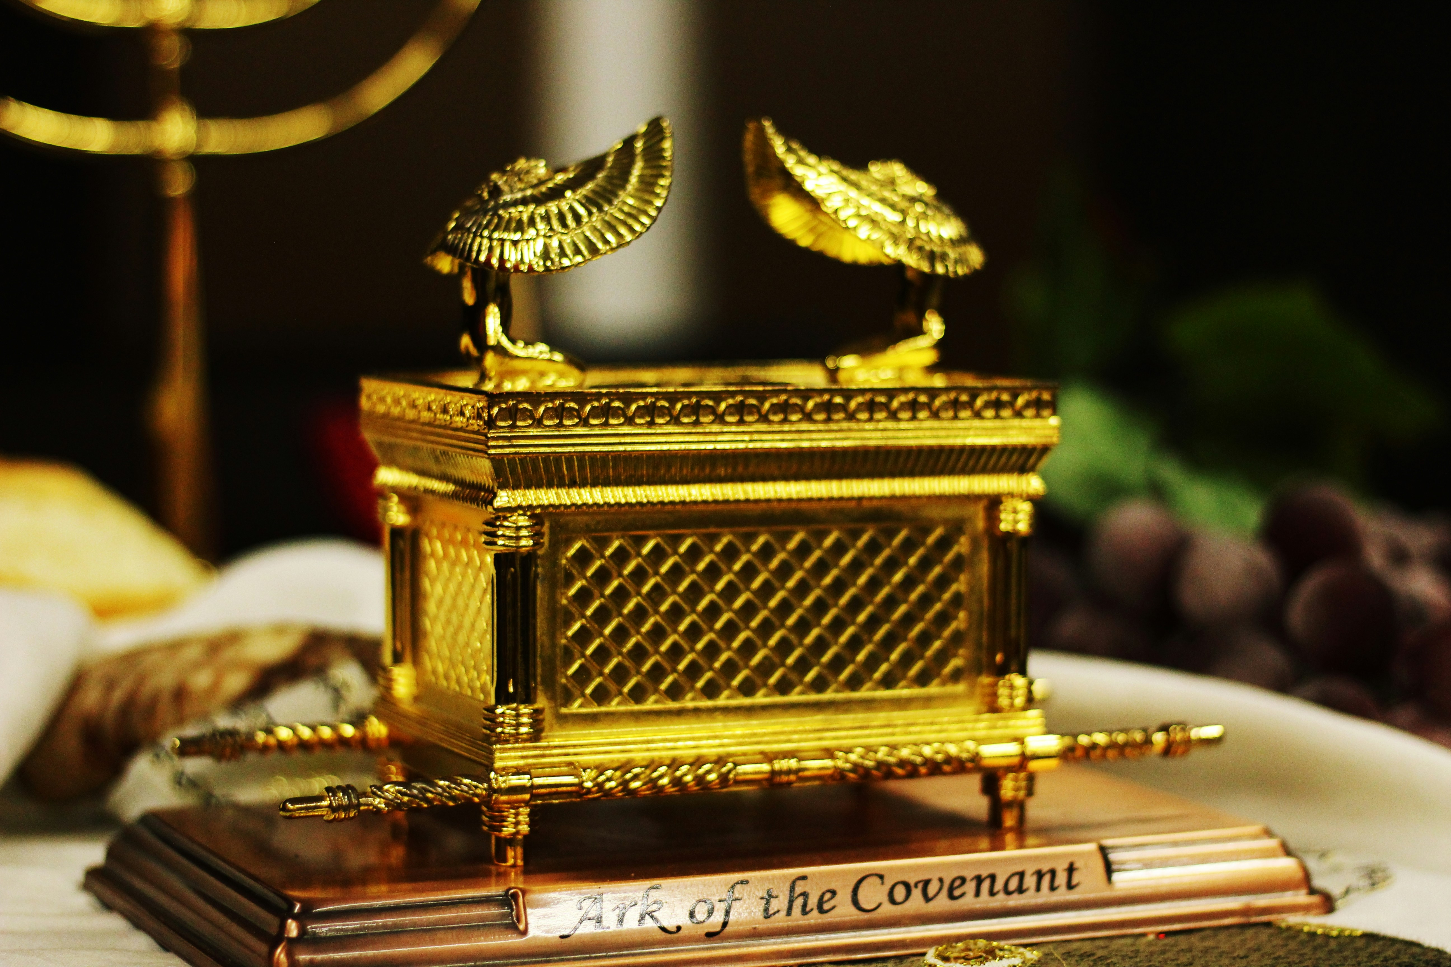

Slide 6
Contents of the Ark:
Ten Commandments (Revelation)
Manna (Provision)
Staff (Salvation)

Slide 7
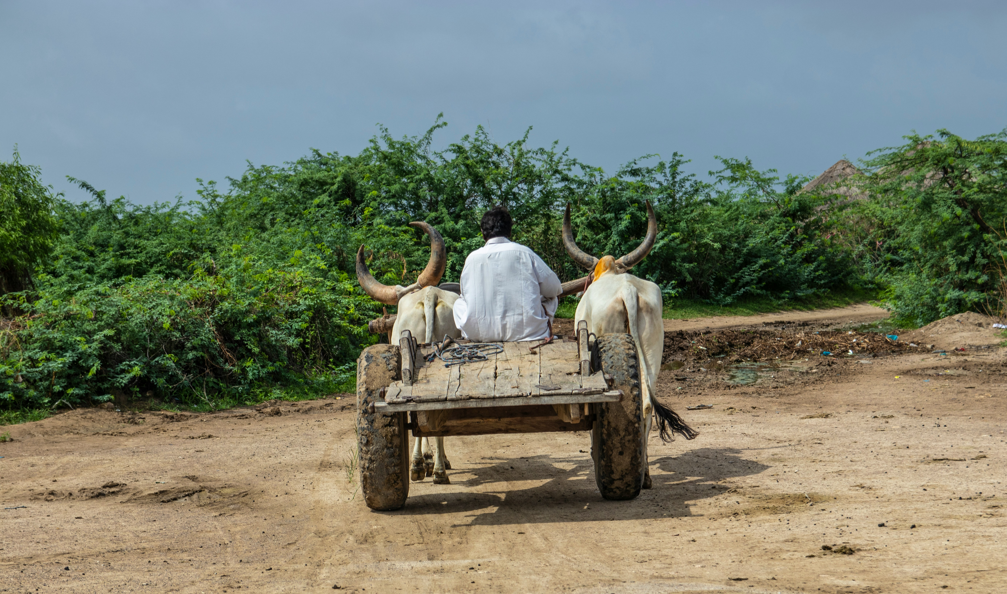

Slide 8
Instructions on how to carry the ark
Numbers 4:4-6, 15, 17-20, and 7:9
  Numbers 4:15 “After Aaron and his sons have finished covering the holy furnishings and all the holy articles, and when the camp is ready to move, only then are the Kohathites to come and do the carrying. But they must not touch the holy things or they will die. The Kohathites are to carry those things that are in the tent of meeting.

Slide 9
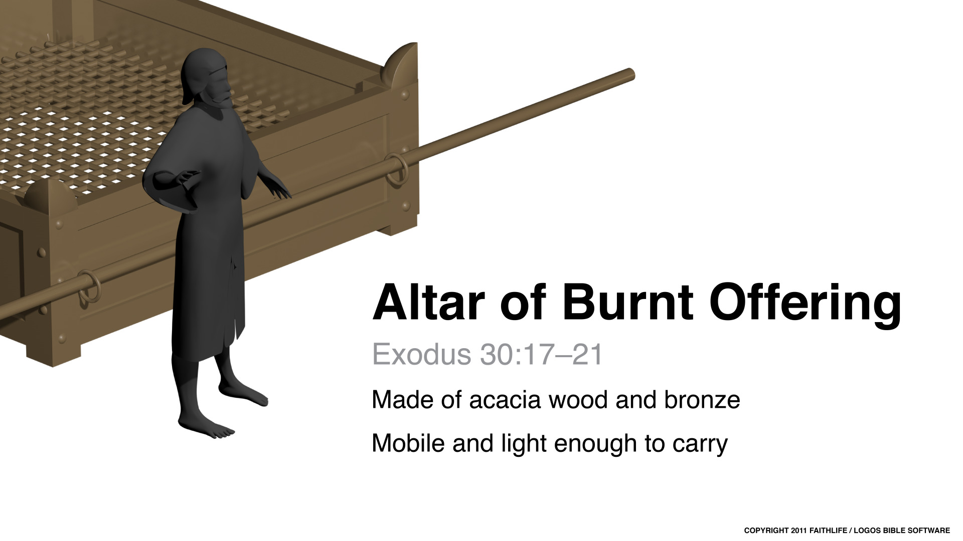

Slide 10
11 Day after day every priest stands and performs his religious duties; again and again he offers the same sacrifices, which can never take away sins. 12 But when this priest had offered for all time one sacrifice for sins, he sat down at the right hand of God, 13 and since that time he waits for his enemies to be made his footstool. 14 For by one sacrifice he has made perfect forever those who are being made holy.
- Hebrews 10:11-14

Slide 11
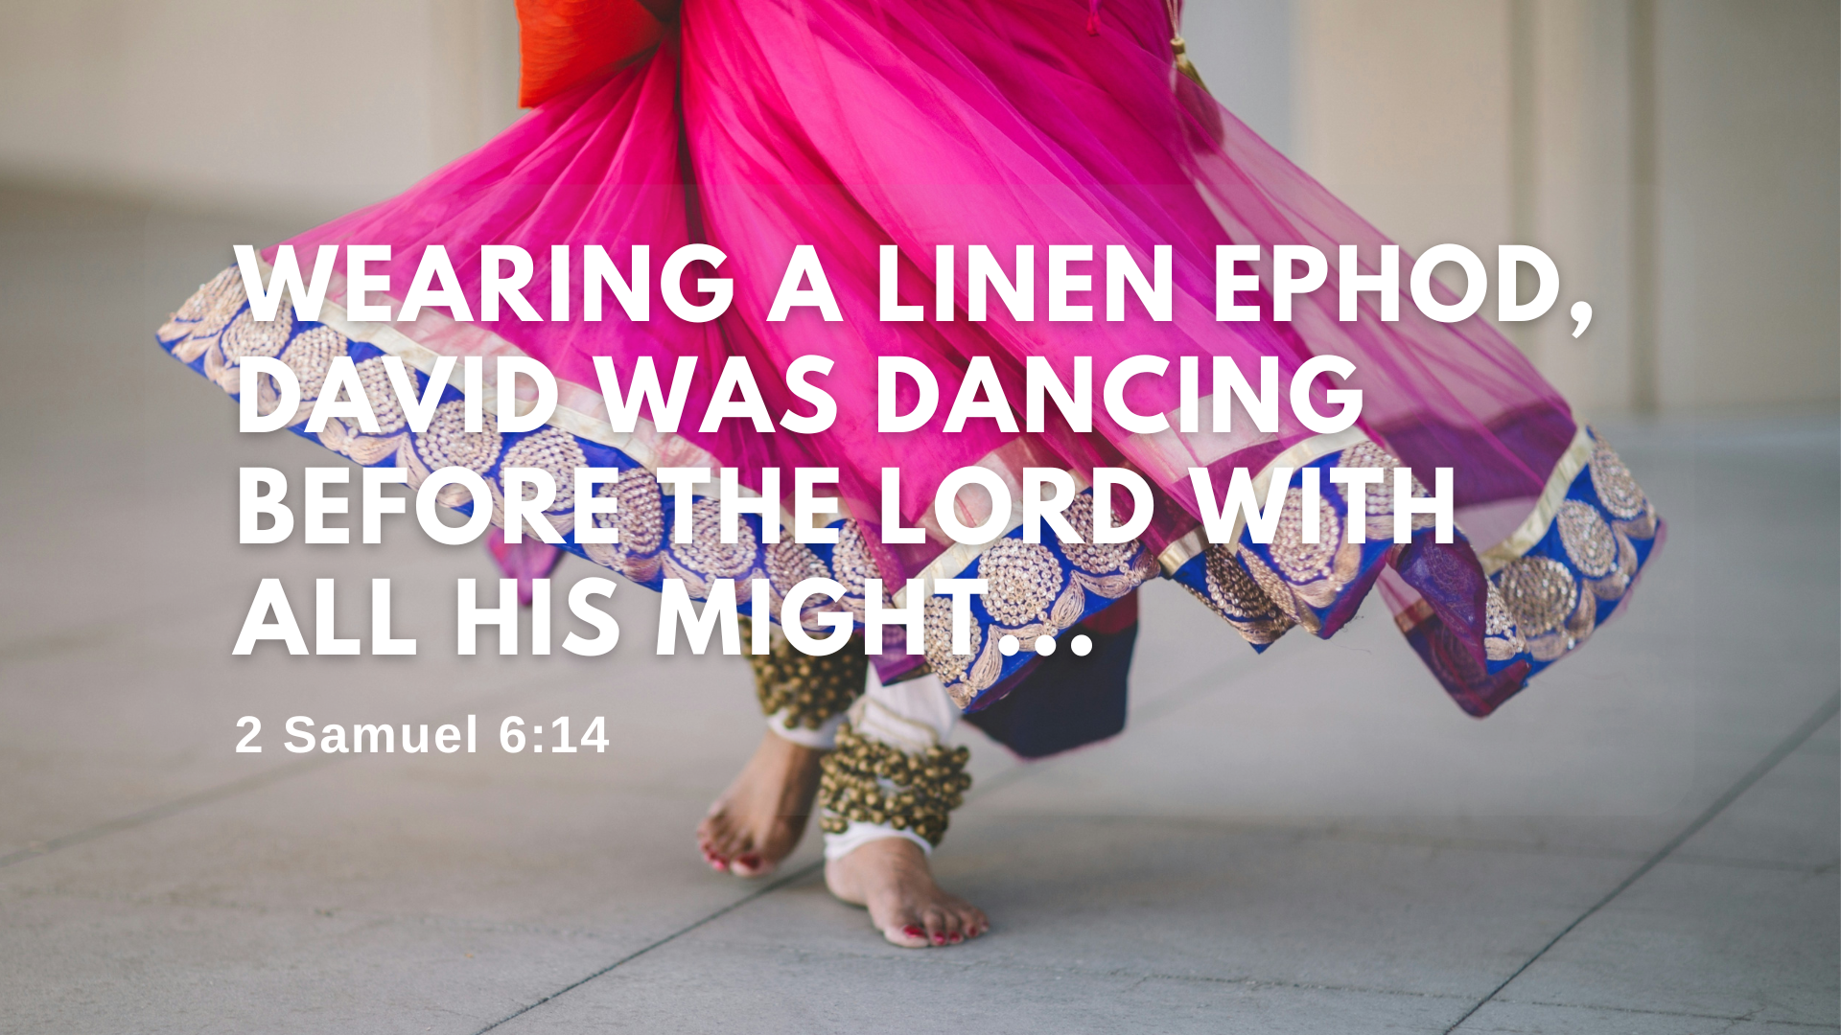

Slide 12
“It was before the LORD, who chose me rather than your father…. I will celebrate before the LORD! I will become even more undignified than this, and I will be humiliated in my own eyes.”
- 2 Sam 6:21-22,

