Slide 2


Slide 3
2 Samuel 9: King of Love
King of Love
Demonstration of Love
Scope of Love

Slide 4
1. King of Love
David asked, “Is there anyone still left of the house of Saul to whom I can show kindness for Jonathan’s sake?” (v.1)

Slide 5
1. King of Love
14 But show me unfailing kindness like the Lord’s kindness as long as I live, so that I may not be killed, 15 and do not ever cut off your kindness from my family—not even when the Lord has cut off every one of David’s enemies from the face of the earth.”16 So Jonathan made a covenant with the house of David, saying, “May the Lord call David’s enemies to account.” 17 And Jonathan had David reaffirm his oath out of love for him, because he loved him as he loved himself.
(1 Samuel 20:14-17)

Slide 6
⁴ (Jonathan son of Saul had a son who was lame in both feet. He was five years old when the news about Saul and Jonathan came from Jezreel. His nurse picked him up and fled, but as she hurried to leave, he fell and became disabled. His name was Mephibosheth.)
(2 Samuel 4:4)

Slide 7
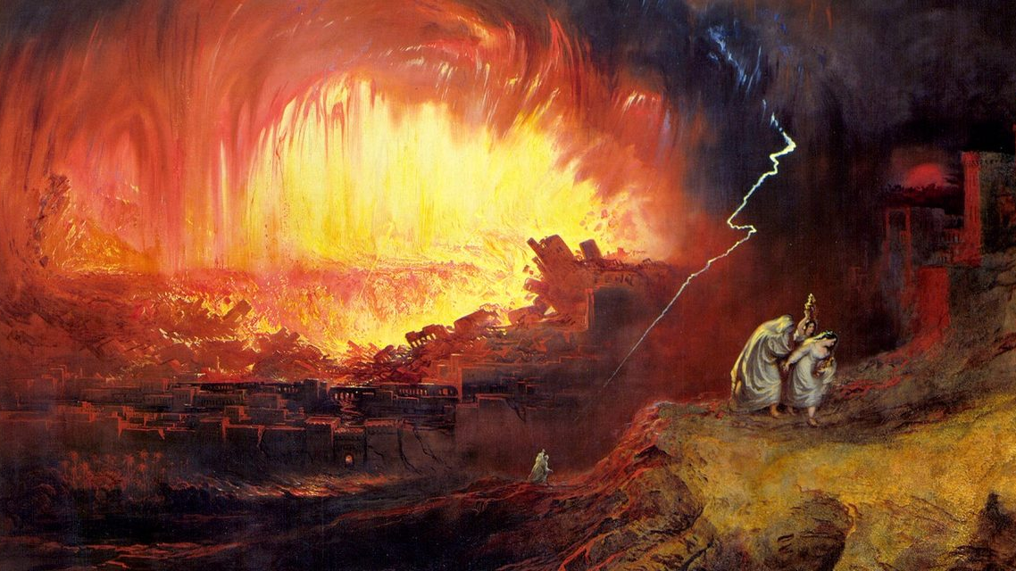

Slide 8
"When it is a question of a sinner He does not merely stand still, open his arms and say, 'Come hither'; no, He stands there and waits, as the father of the lost son waited, rather He does not stand and waits, He goes forth to seek, as the shepherd sought the lost sheep, as the woman sought the lost coin. He goes - yet no, He has gone, but infinitely farther than any shepherd or any woman, He went, in sooth, the infinitely long way from being God to becoming man, and that way He went in search of sinners."
(Soren Kierkegaard)

Slide 9
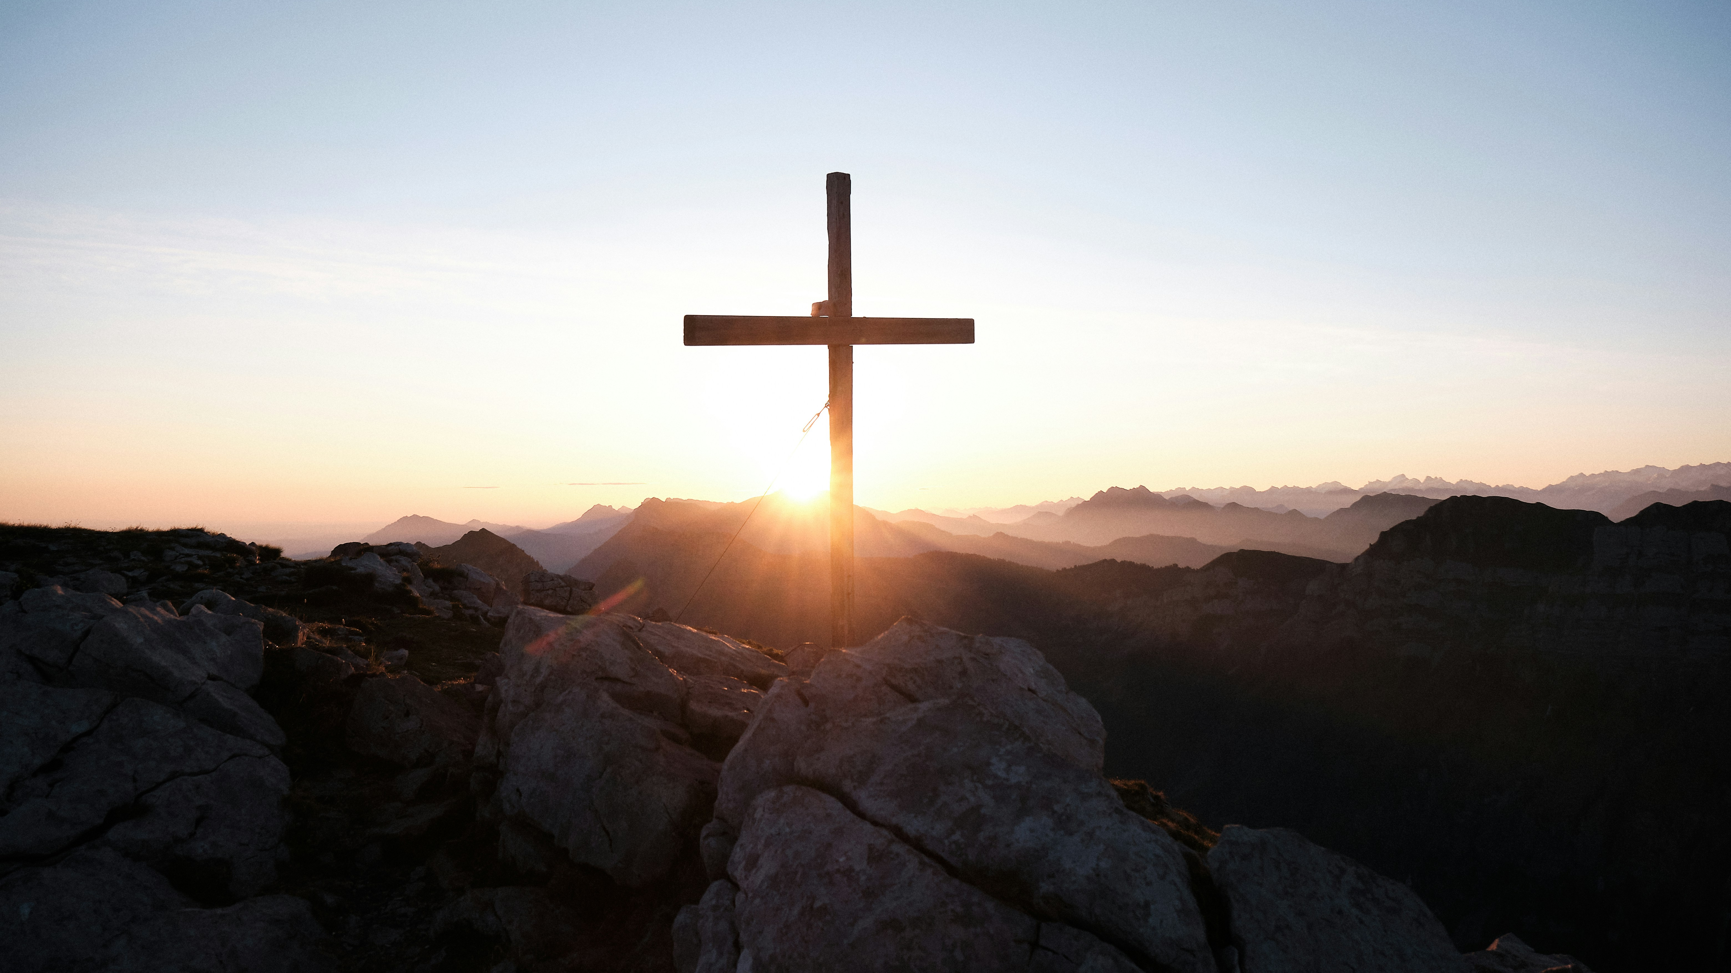

Slide 10
2. Demonstration of Love
7 “Don’t be afraid,” David said to him, “for I will surely show you kindness for the sake of your father Jonathan. I will restore to you all the land that belonged to your grandfather Saul, and you will always eat at my table.”
8 Mephibosheth bowed down and said, “What is your servant, that you should notice a dead dog like me?”
9 Then the king summoned Ziba, Saul’s steward, and said to him, “I have given your master’s grandson everything that belonged to Saul and his family. 10 You and your sons and your servants are to farm the land for him and bring in the crops, so that your master’s grandson may be provided for. And Mephibosheth, grandson of your master, will always eat at my table.” (Now Ziba had fifteen sons and twenty servants.)

Slide 11
2. Demonstration of Love
Adoption
Foster Care
Sponsoring…
Helping those in need, generosity, hospitality
“Let us not love with words or speech but with action and in truth” (1 John 3:18)

Slide 12
3. Scope of Love

Slide 13
3 The king then asked, “Where is your master’s grandson?”Ziba said to him, “He is staying in Jerusalem, because he thinks, ‘Today the Israelites will restore to me my grandfather’s kingdom.’”
4 Then the king said to Ziba, “All that belonged to Mephibosheth is now yours.”
“I humbly bow,” Ziba said. “May I find favor in your eyes, my lord the king.”
(2 Samuel 16:3-4)
26 He said, “My lord the king, since I your servant am lame, I said, ‘I will have my donkey saddled and will ride on it, so I can go with the king.’ But Ziba my servant betrayed me. 27 And he has slandered your servant to my lord the king. My lord the king is like an angel of God; so do whatever you wish. 28 All my grandfather’s descendants deserved nothing but death from my lord the king, but you gave your servant a place among those who eat at your table.So what right do I have to make any more appeals to the king?”
(2 Samuel 19:25-28)

