Slide 2


Slide 3
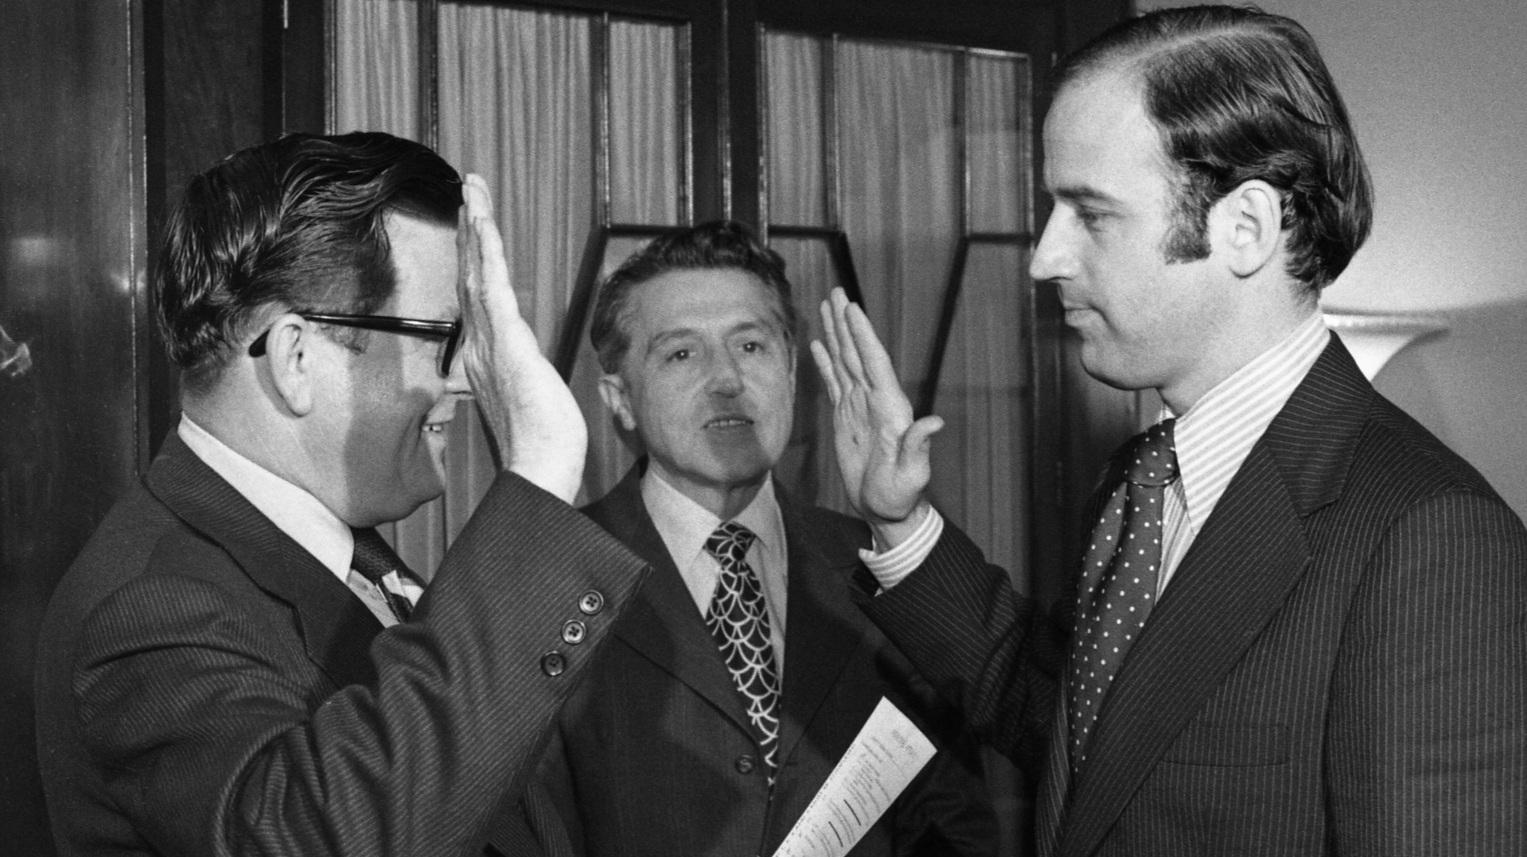

Slide 4

To the one who is victorious and does my will to the end, I will give authority over the nations… I will also give that one the morning star.
- Rev. 2:26-28

Slide 5
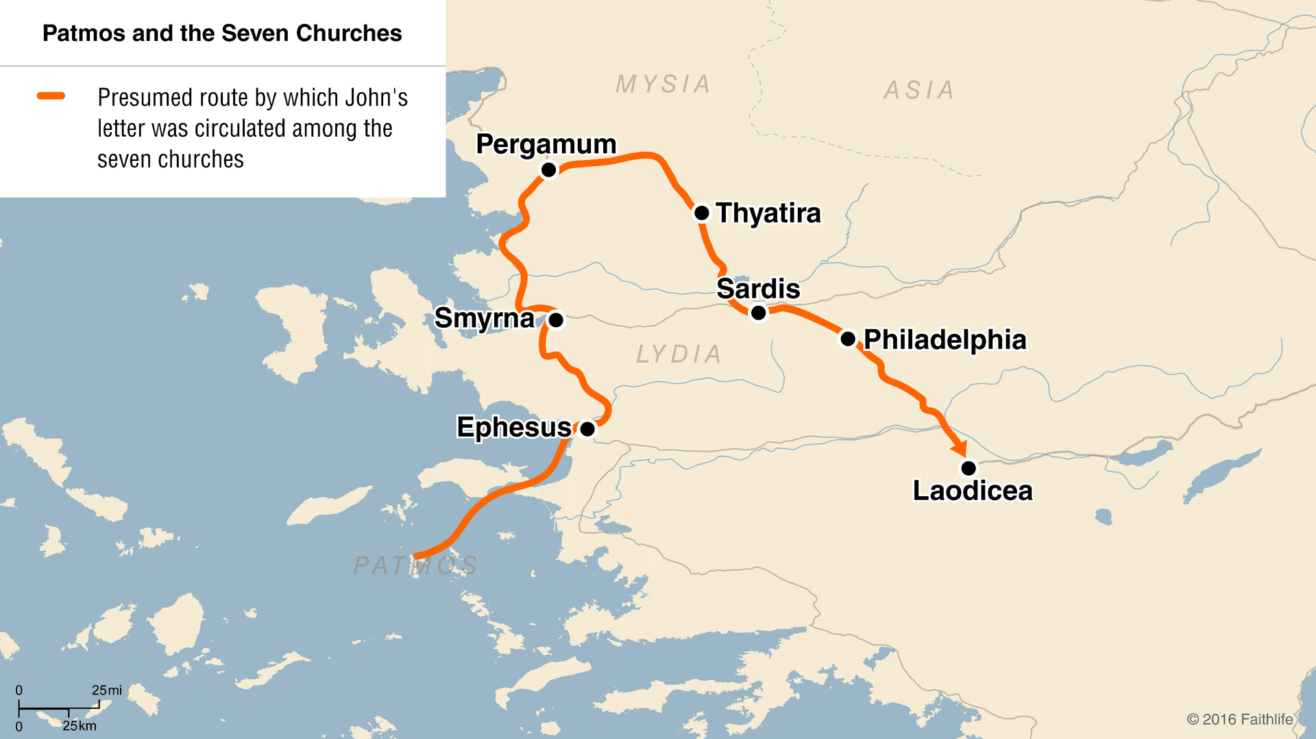

Slide 6
1. Jesus Encourages
V.19 I know your deeds, your love and faith, your service and perseverance, and that you are now doing more than you did at first.
24 Now I say to the rest of you in Thyatira, to you who do not hold to her teaching and have not learned Satan’s so-called deep secrets, ‘I will not impose any other burden on you, 25 except to hold on to what you have until I come.’ 26 To the one who is victorious and does my will to the end,

Slide 7
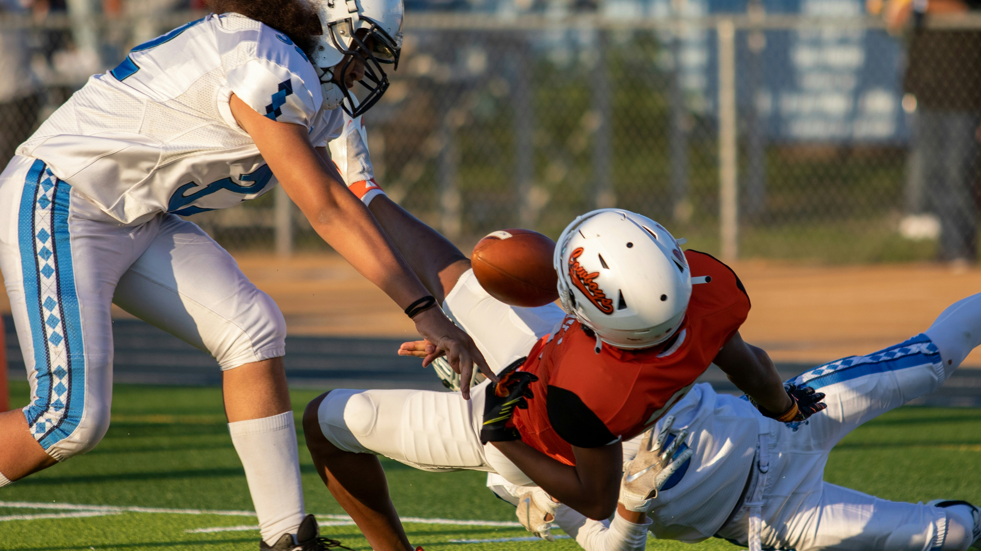

Slide 8
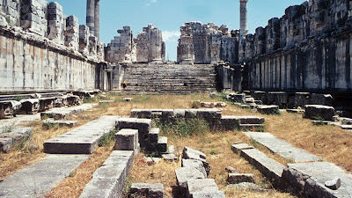
2. Jesus Disciplines

Slide 9
2. Jesus Disciplines
21 I have given her time to repent of her immorality, but she is unwilling. 22 So I will cast her on a bed of suffering, and I will make those who commit adultery with her suffer intensely, unless they repent of her ways. 23 I will strike her children dead. Then all the churches will know that I am he who searches hearts and minds, and I will repay each of you according to your deeds.

Slide 10
2. Jesus Disciplines
Do we expect the Lord’s (and the church’s) discipline?
How do we respond to rebuke and discipline?
What sins do we tolerate in ourselves? In the church?

Slide 11
To the one who is victorious and does my will to the end, I will give authority over the nations… I will also give that one the morning star.
- Rev. 2:26-28

Slide 12
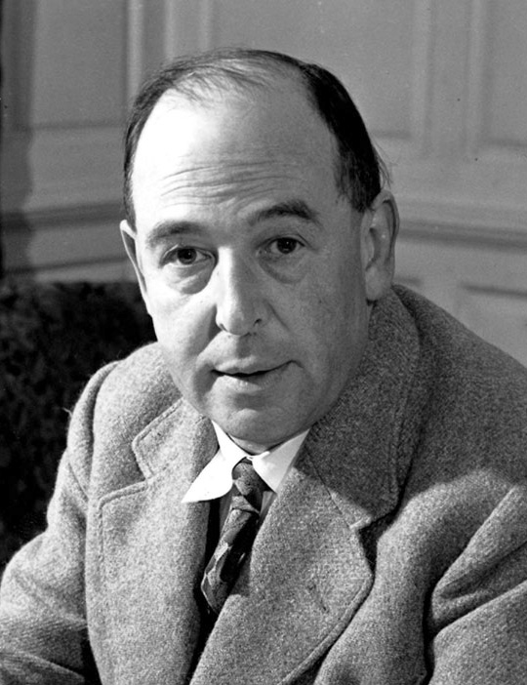
“The book or the music in which we thought the beauty was located will betray us if we trust to them; it was not in them, it only came through them, and what came through and them was longing. These things – the beauty, the memory of our own past – are good images of what we really desire; but if they are mistaken for the thing itself they turn into dumb idols, breaking the hearts of their worshipper. For they are not the thing itself; they are only the scent of a flower we have not found, the echo of a tune not heard, news from a country we have never yet visited.”

Slide 13
To the one who is victorious and does my will to the end, I will give authority over the nations… I will also give that one the morning star.
- Rev. 2:26-28

