Slide 2


Slide 3
Enjoyment Under the Sun
Pleasure Is Not Satisfying (v.1-11)
Everything Is Meaningless (v.12-23)
There Is Enjoyment Under the Sun (v.24-26)

Slide 4
1. Pleasure Is Not Satisfying (v.1-11)
Verse 1, “I said to myself, ‘Come now, I will test you with pleasure to find out what is good.’”
Verse 10, “I denied myself nothing my eyes desired;
I refused my heart no pleasure.
My heart took delight in all my labor,
and this was the reward for all my toil.”

Slide 5
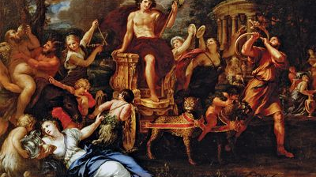

Slide 6


Slide 7


Slide 8
2. The World Is Cursed (v.12-23)

Slide 9


Slide 10


Slide 11
2. The World Is Cursed (v.12-23)
Ecclesiastes as a commentary on Genesis 3?
  Curses of this world
  Inescapable effects of sin and death

Slide 12
3. There Is Enjoyment under the Sun (v.24-26)
“A person can do nothing better than to eat and drink and find satisfaction in their own toil. This too, I see, is from the hand of God, for without him, who can eat or find enjoyment?”

Slide 13
3. There Is Enjoyment under the Sun (v.24-26)
“A person can do nothing better than to eat and drink and find satisfaction in their own toil. This too, I see, is from the hand of God, for without him, who can eat or find enjoyment?” 26 To the person who pleases him, God gives wisdom, knowledge and happiness, but to the sinner he gives the task of gathering and storing up wealth to hand it over to the one who pleases God. This too is meaningless, a chasing after the wind.

Slide 14
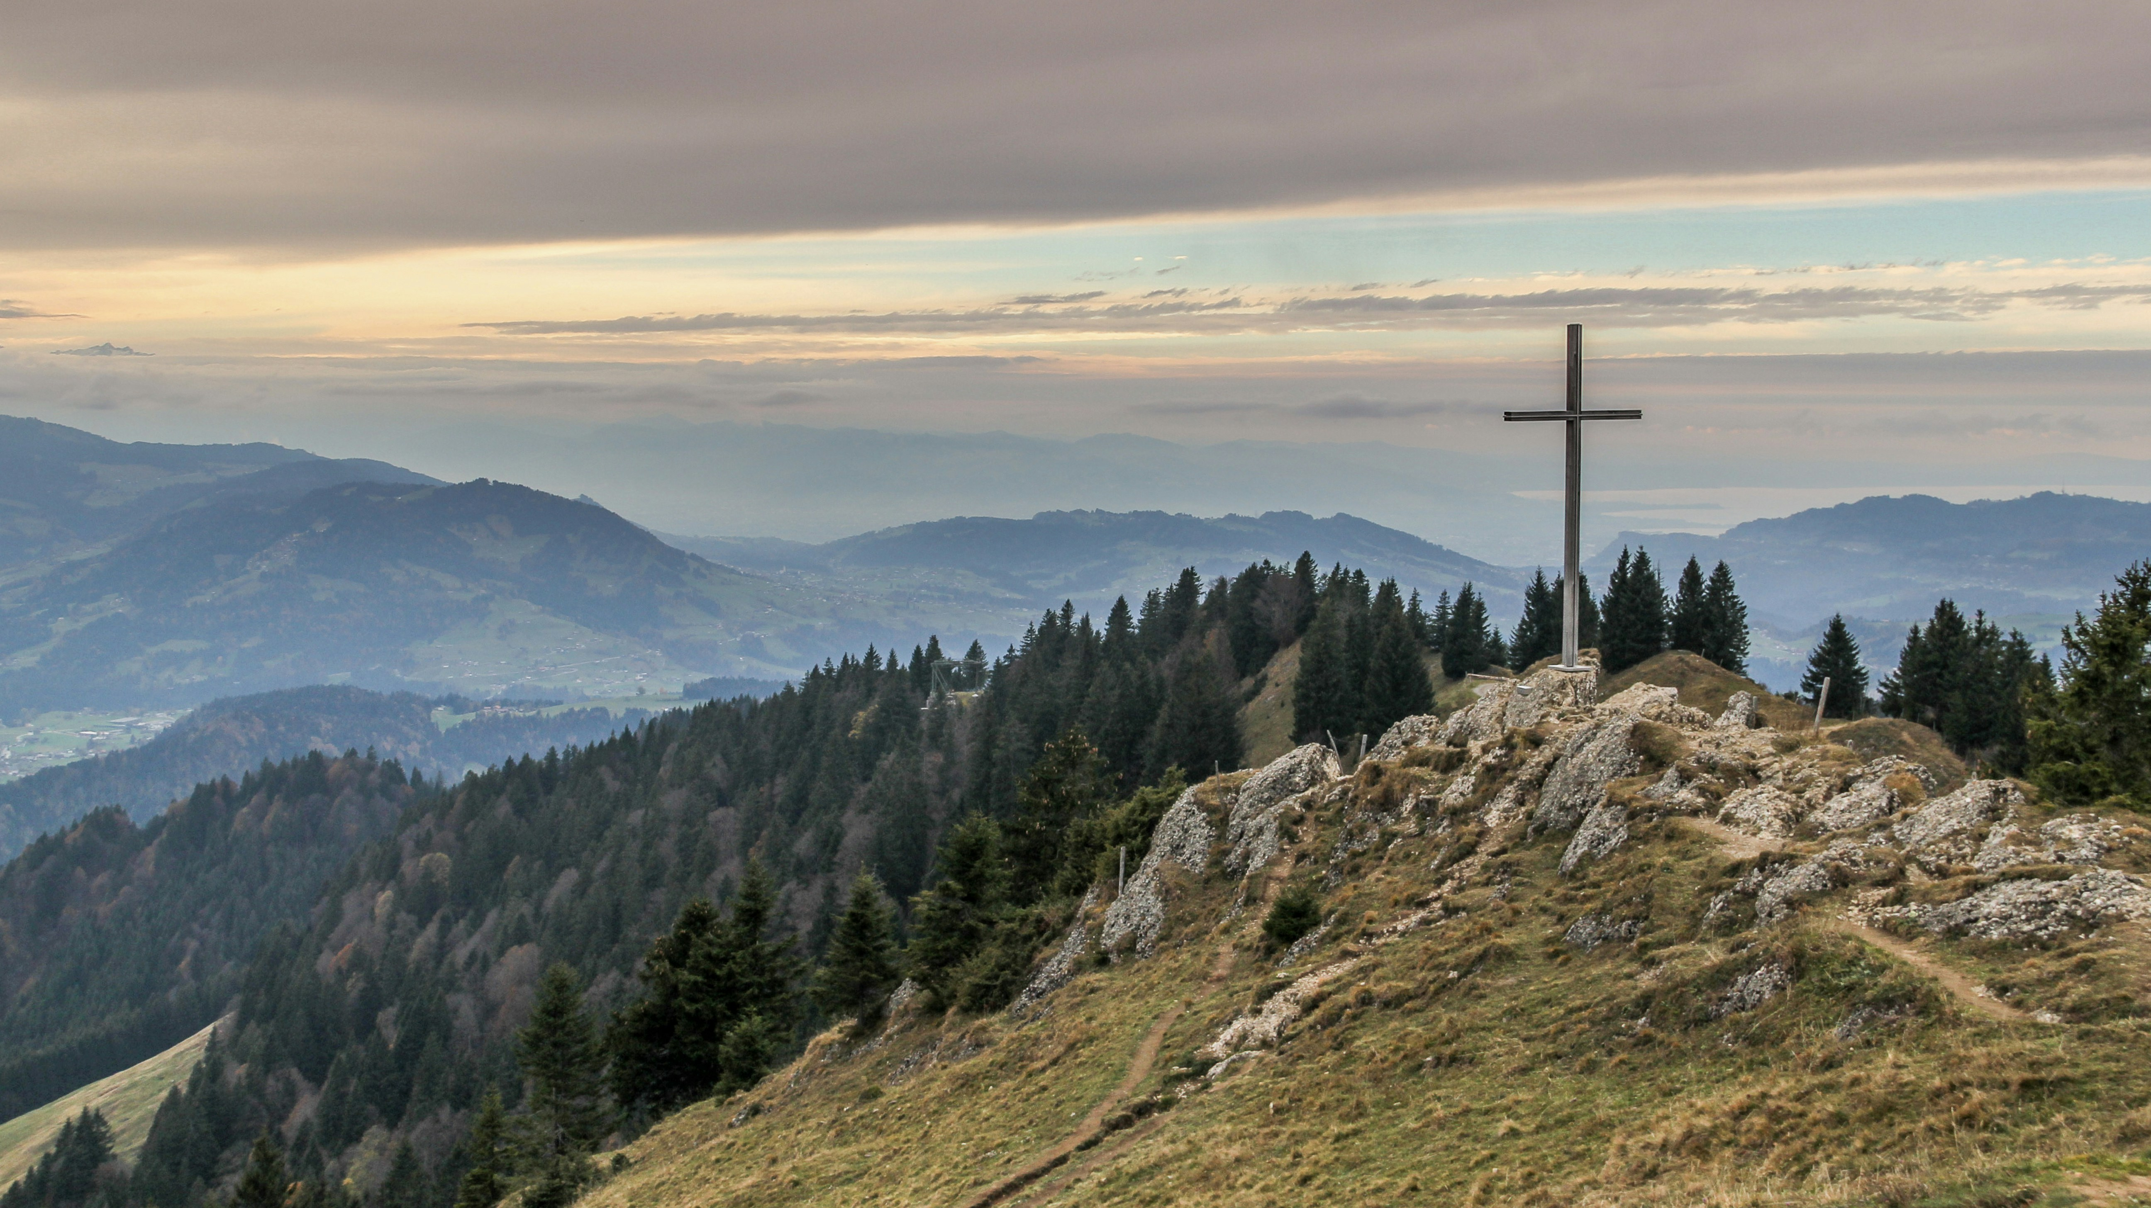

Slide 15
