Slide 2
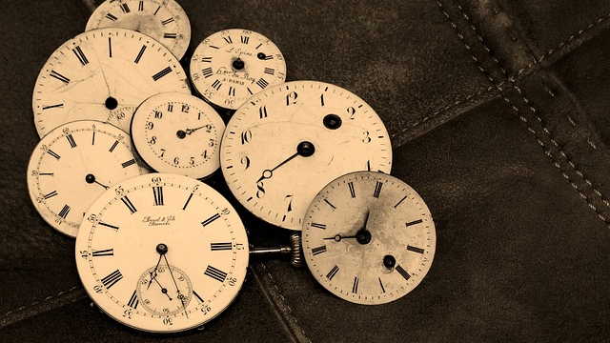

Slide 3
Beautiful in Its Time
Seasons of This Life (v.1-8)
Beautiful in His Time (v.9-15)

Slide 4
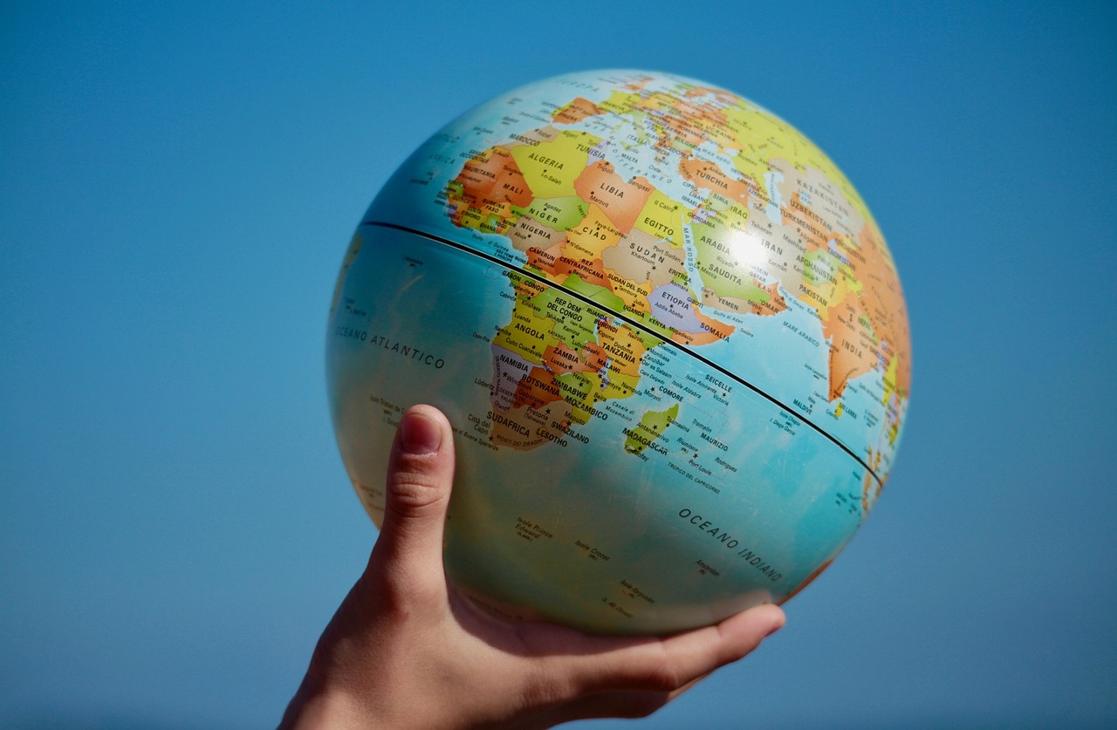

Slide 5
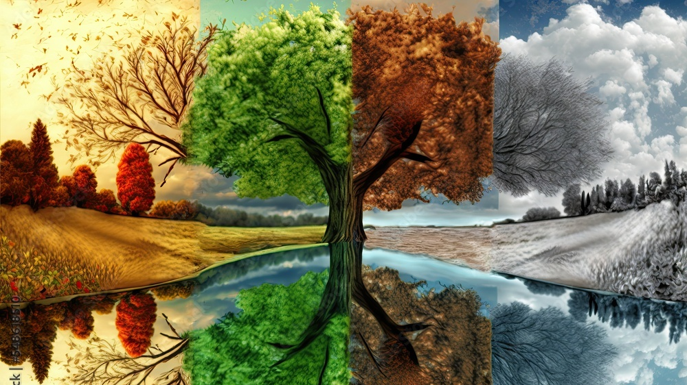

Slide 6
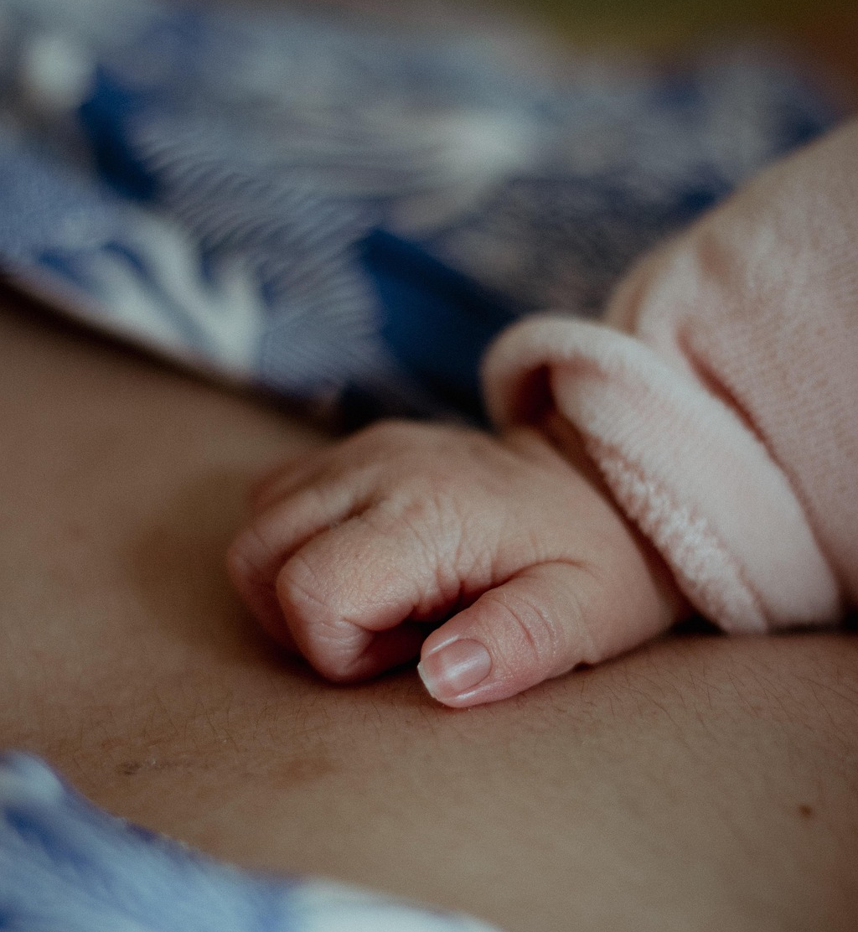
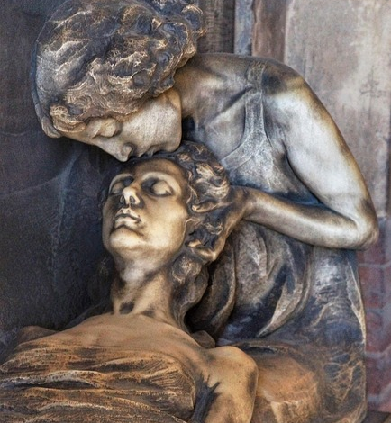

Slide 7
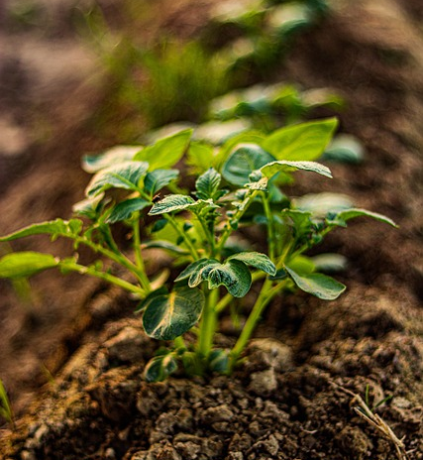
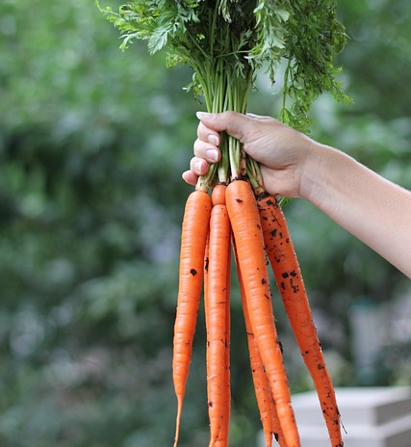

Slide 8
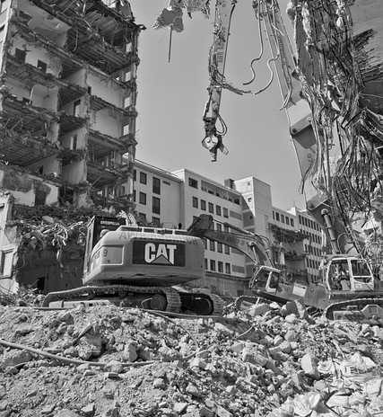
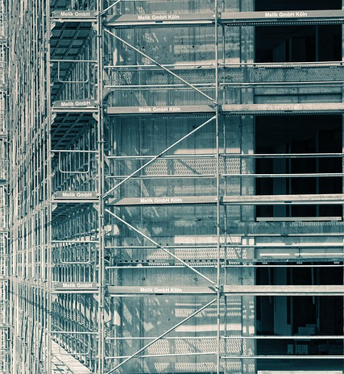

Slide 9
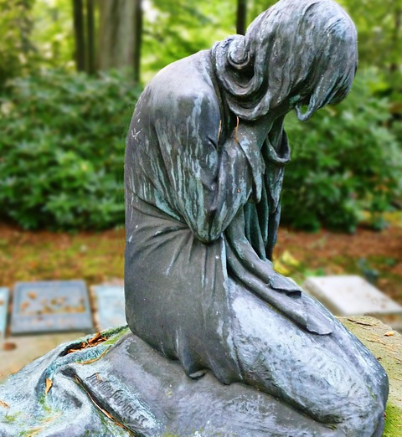

Slide 11
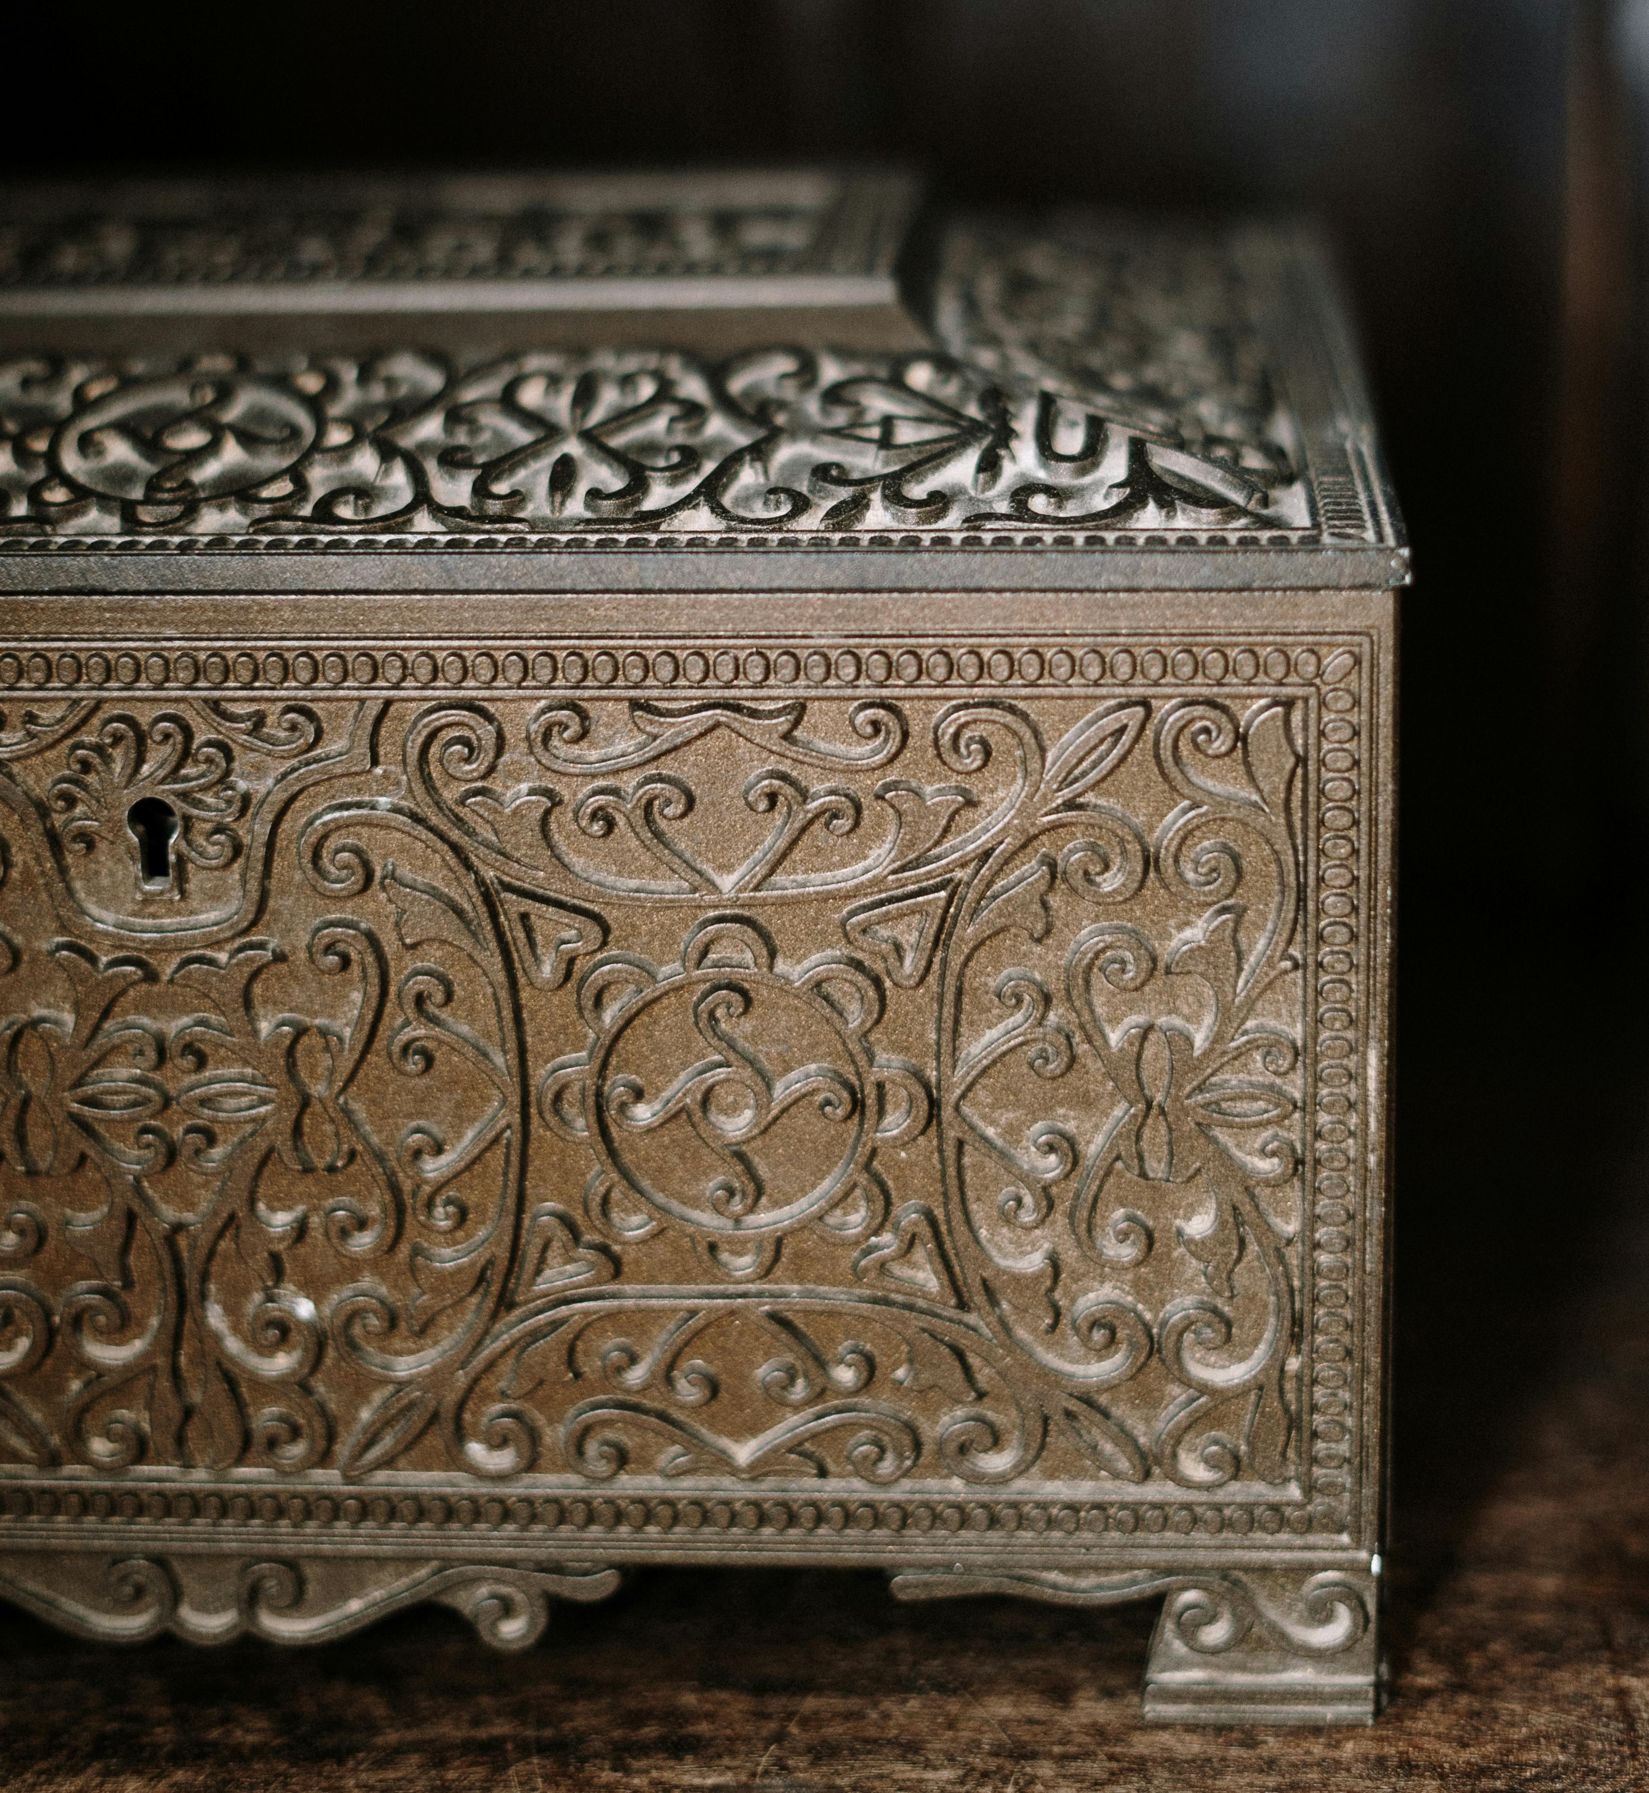
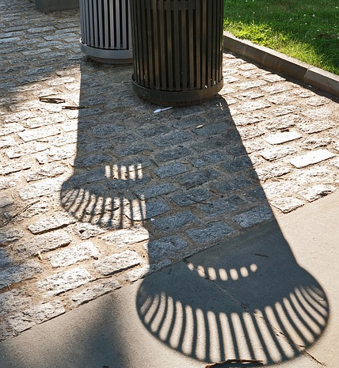

Slide 12
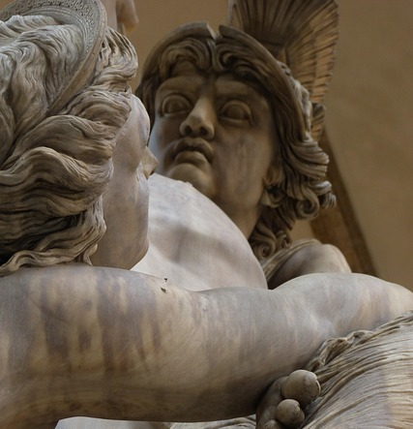

Slide 13
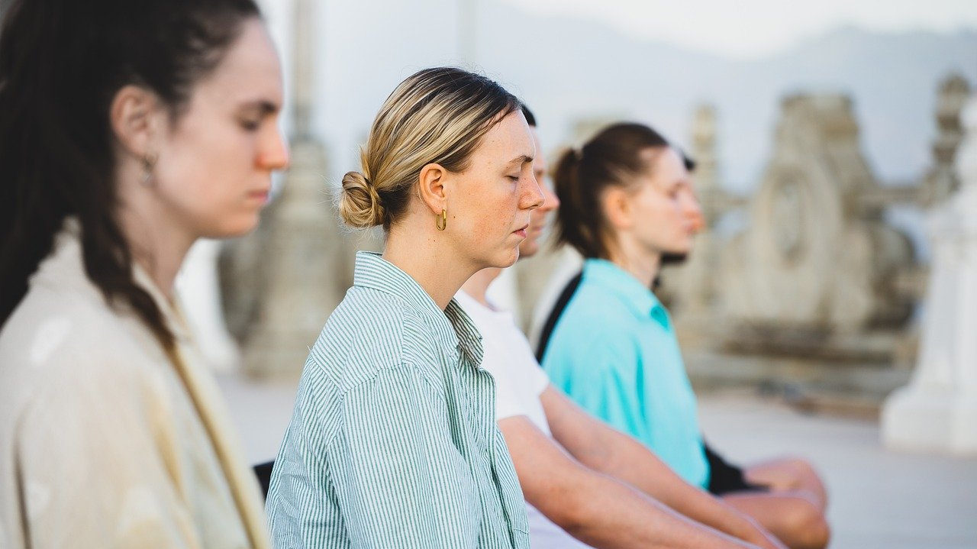

Slide 15
² a time to be born and a time to die, a time to plant and a time to uproot, ³ a time to kill and a time to heal, a time to tear down and a time to build, ⁴ a time to weep and a time to laugh, a time to mourn and a time to dance, ⁵ a time to scatter stones and a time to gather them, a time to embrace and a time to refrain from embracing, ⁶ a time to search and a time to give up, a time to keep and a time to throw away, ⁷ a time to tear and a time to mend, a time to be silent and a time to speak, ⁸ a time to love and a time to hate, a time for war and a time for peace.

Slide 16
2. Beautiful in His Time (v.9-15)

Slide 19
2. Beautiful in His Time (v.9-15)
¹¹ He has made everything beautiful in its time. He has also set eternity in the human heart; yet no one can fathom what God has done from beginning to end.

Slide 21
2. Beautiful in His Time (v.9-15)
¹⁴ I know that everything God does will endure forever; nothing can be added to it and nothing taken from it. God does it so that people will fear him.
Fearing means trusting God that he has made everything beautiful in its time.

Slide 22
2. Beautiful in His Time (v.9-15)
¹² I know that there is nothing better for people than to be happy and to do good while they live. ¹³ That each of them may eat and drink, and find satisfaction in all their toil—this is the gift of God.
Trusting him means being able to enjoy the present

