Slide 3
Fellowship of the Sick
Community of Strivers
Union of Sinners
Fellowship of Sinners

Slide 5
1. Community of Strivers
Exhausting
Divisive
Insecure

Slide 6
“Her words were heartbreaking to hear. In her mind, church was a place she could come only when she felt like her life was together. She didn’t even identify this as a problem…. Church should be the place we sprint to when things are at their worst, not the place we avoid until we’ve got our Instagram-worthy Christianity back in place.”

Slide 7
2. Union of Sinners
‘On hearing this, Jesus said to them, “It is not the healthy who need a doctor, but the sick. I have not come to call the righteous, but sinners”’ (2:17).

Slide 11
2. Union of Sinners
‘On hearing this, Jesus said to them, “It is not the healthy who need a doctor, but the sick. I have not come to call the righteous, but sinners”’ (2:17).

Slide 12
3. Fellowship of Sinners
“Accept one another, then, just as Christ accepted you….”
(Romans 15:7)

Slide 14
3. Fellowship of Sinners
Acceptance
Vulnerability

Slide 15
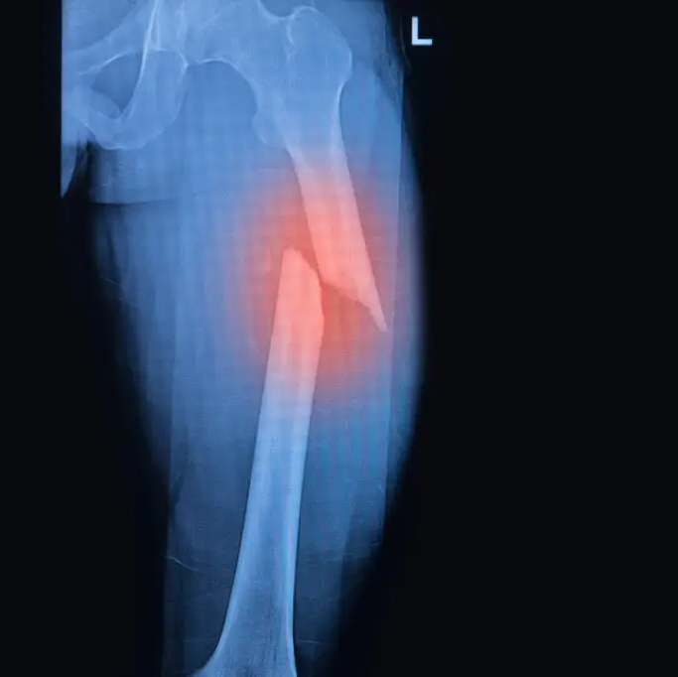
3. Fellowship of Sinners
Acceptance
Vulnerability
Loving

Slide 16
Fellowship of the Sick
Community of Strivers
Union of Sinners
Fellowship of Sinners

