Slide 1


Slide 2
Life in the Haze: Death Comes to All
Know You Will Die (v.1-3)
Enjoy God’s Good Gifts (v.4-10)
Know Death Has Been Defeated

Slide 3


Slide 4
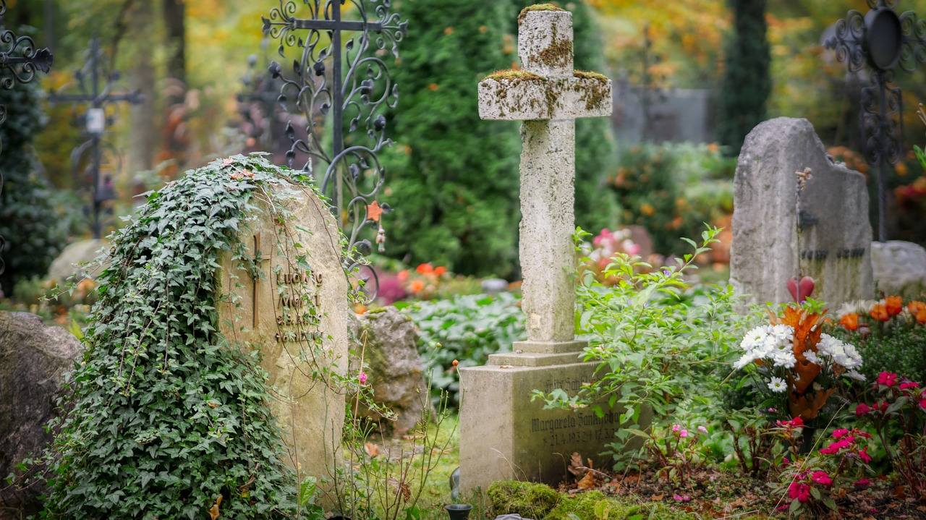

Slide 5
It is better to go to a house of mourning
than to go to a house of feasting,
for death is the destiny of everyone;
the living should take this to heart.
- Eccl 7:2

Slide 6
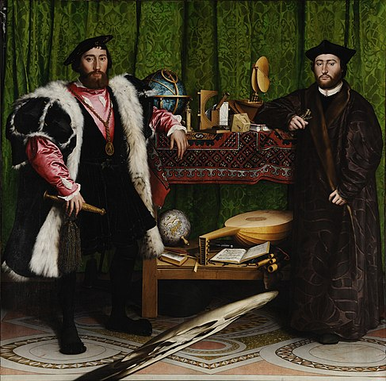

Slide 7


Slide 8
Life in the Haze: Death Comes to All
Know You Will Die (v.1-3)
Enjoy God’s Good Gifts (v.4-10)

Slide 9
⁷ Go, eat your food with gladness, and drink your wine with a joyful heart, for God has already approved what you do. ⁸ Always be clothed in white, and always anoint your head with oil. ⁹ Enjoy life with your wife, whom you love, all the days of this meaningless life that God has given you under the sun—all your meaningless days. For this is your lot in life and in your toilsome labor under the sun. ¹⁰ Whatever your hand finds to do, do it with all your might, for in the realm of the dead, where you are going, there is neither working nor planning nor knowledge nor wisdom.

Slide 10
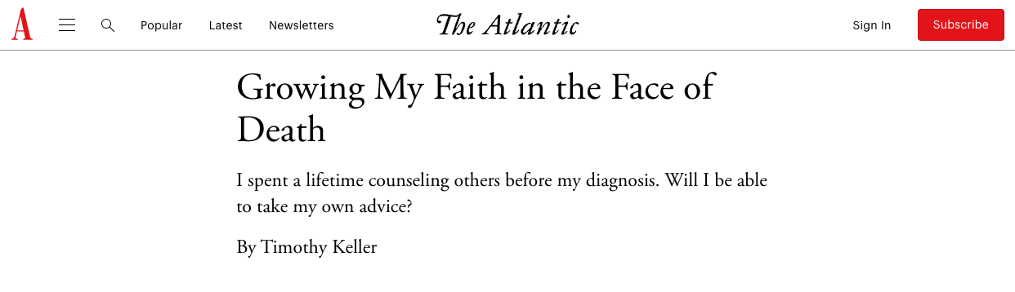
I can sincerely say, without any sentimentality or exaggeration, that I’ve never been happier in my life, that I’ve never had more days filled with comfort….”

Slide 11
3. Know Death Has Been Defeated
³ This is the evil in everything that happens under the sun: The same destiny overtakes all. The hearts of people, moreover, are full of evil and there is madness in their hearts while they live, and afterward they join the dead.

Slide 12
3. Know Death Has Been Defeated
^{3:11} He has made everything beautiful in its time. He has also set eternity in the human heart; yet no one can fathom what God has done from beginning to end.

Slide 13


Slide 14
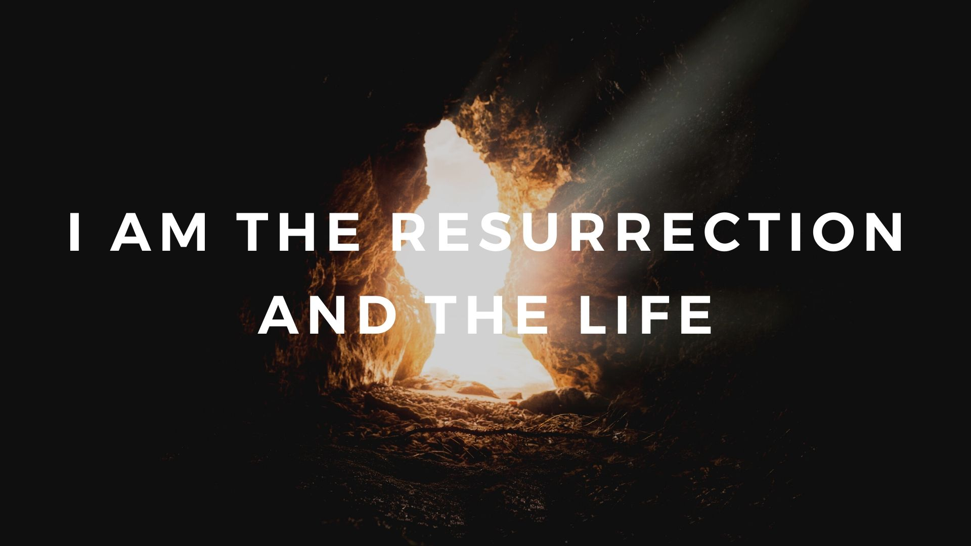

Slide 15
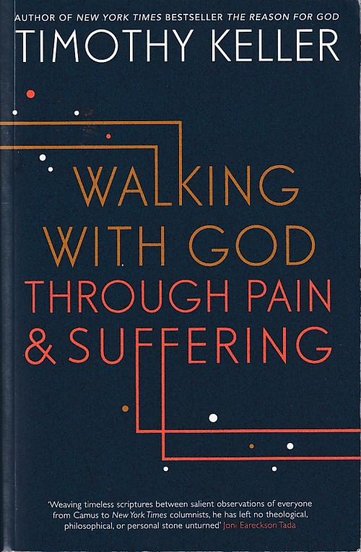
It was just before my cancer surgery my thyroid was about to be removed, and after that, I faced a treatment with radioactive iodine to destroy any residual cancerous thyroid tissue in my body. Of course my whole family and I were shaken by it all, and deeply anxious. On the morning of my surgery, after I said good-byes to my wife and sons, I was wheeled into a room to be prepped. And in the moment before they gave me the anesthetic, I prayed.

Slide 16
To my surprise, I got a sudden, clear new perspective on everything. It seemed to me that the universe was an enormous realm of joy, mirth, and high beauty. Of course it was - didn’t the Triune God make it to be filled with his own boundless joy, wisdom, love, and delight? And within this great globe of glory was only one little speck of darkness – our world – where there was temporarily pain and suffering.

Slide 17
But it was only one speck, and soon that speck would fade away and everything would be light. And I thought, ‘It doesn’t really matter how the surgery goes. Everything will be all right. Me – my wife, my children, my church – will be all right.’ I went to sleep with a bright peace on my heart.”

Slide 18
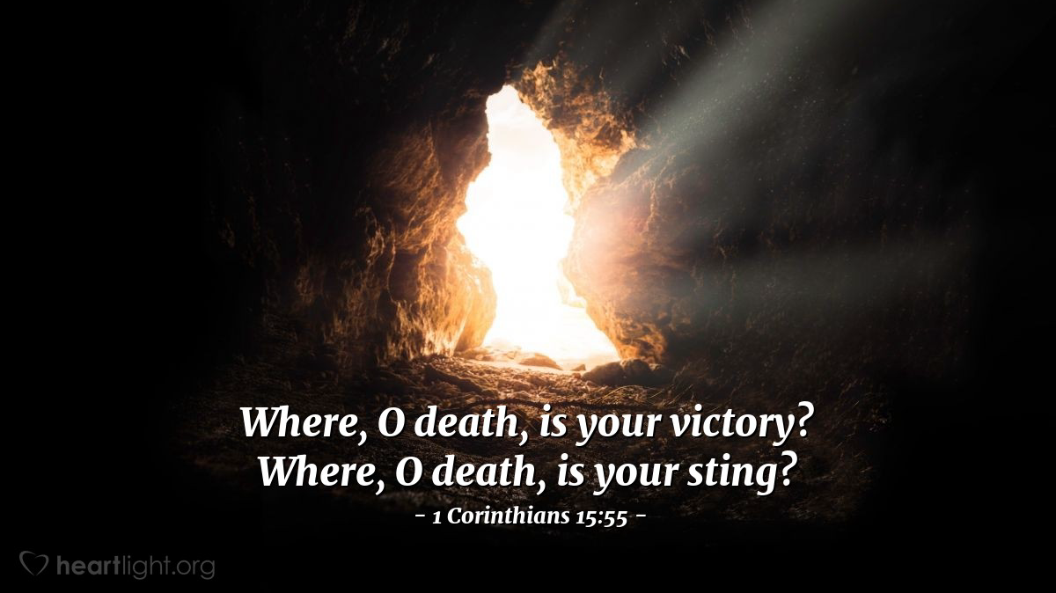

Slide 19
“Whatever your hand finds to do, do it with all your might, for in the realm of the dead, where you are going, there is neither working nor planning nor knowledge nor wisdom” (Eccl 9:10).
“Therefore, my dear brothers and sisters, stand firm. Let nothing move you. Always give yourselves fully to the work of the Lord, because you know that your labor in the Lord is not in vain” (1 Cor 15:58).

