Slide 3
Who Is an Evangelical?
Beliefs of First Importance:
Revelation – God’s Revealed Word
Redemption – Son’s Finished Work of the Cross
Regeneration – Spirit’s Transforming Power

Slide 4
Revelation

Slide 5
Now, brothers and sisters, I want to remind you of the gospel I preached to you, which you received and on which you have taken your stand. ² By this gospel you are saved, if you hold firmly to the word I preached to you. Otherwise, you have believed in vain (1 Cor 15:1-2)

Slide 6
¹⁶ All Scripture is God-breathed and is useful for teaching, rebuking, correcting and training in righteousness, ¹⁷ so that the servant of God^{[a]} may be thoroughly equipped for every good work (2 Tim 3:16-17).

Slide 7
Redemption

Slide 8
³ For what I received I passed on to you as of first importance: that Christ died for our sins according to the Scriptures, ⁴ that he was buried, that he was raised on the third day according to the Scriptures (1 Cor 15:3-4).

Slide 9
Cosmic Child Abuse?

Slide 10
Redemption
For many liberal Christians, Jesus is an example to follow, rather than a savior who died for our sins.
For evangelicals, Jesus is firstly our savior, secondly an example.
But the way Jesus has saved us makes us self-sacrificial and loving.

Slide 11
Redemption
“…go to the front lines, at home or abroad, in the battles against hunger, malaria, prison rape, obstetric fistula, human trafficking or genocide, and some of the bravest people you meet are evangelical Christians (or conservative Catholics, similar in many ways) who truly live their faith."

Slide 12
Regeneration

Slide 13
Regeneration
^{“7} You should not be surprised at my saying, ‘You must be born again.’ ⁸ The wind blows wherever it pleases. You hear its sound, but you cannot tell where it comes from or where it is going. So it is with everyone born of the Spirit” (John 3:7-8).

Slide 15
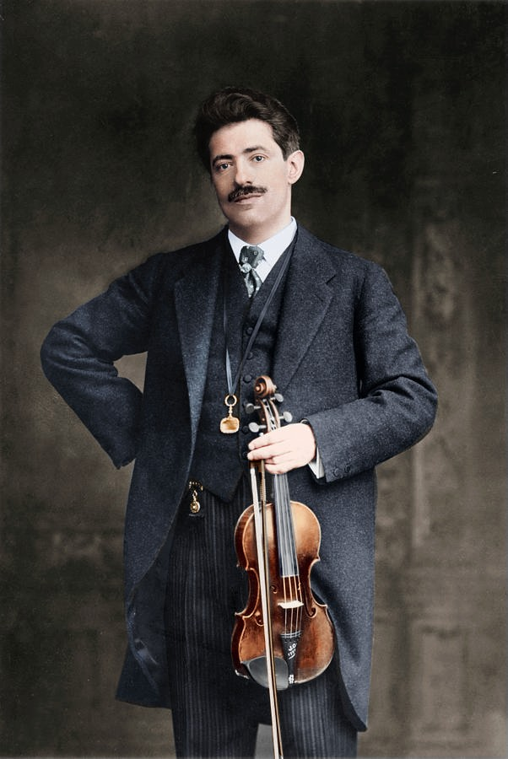

Slide 16
Radical Humility
“To magnify the self-revelation of God is to confess our complete ignorance without it. To magnify the cross of Christ is to confess our utter lostness without it. To magnify the regenerating, indwelling and sanctifying role of the Holy Spirit is to confess our abiding self-centeredness without it.”

