Slide 1
Psalm of Praise
Psalm 33

Slide 4
1. Sing to Him a New Song (v.1-3)
Sing joyfully to the Lord, you righteous; it is fitting for the upright to praise him. ² Praise the Lord with the harp; make music to him on the ten-stringed lyre. ³ Sing to him a new song; play skillfully, and shout for joy.

Slide 6
2. Reasons to Sing (v.4-19)
Character (v.4-5)
Power (v.6-9)
Sovereignty (v.10-15)
Our God (v.16-19)

Slide 8
2. Reasons to Sing (v.4-19)
Character (v.4-5)
Power (v.6-9)
Sovereignty (v.10-15)
He sees everything
Our God (v.16-19)

Slide 9
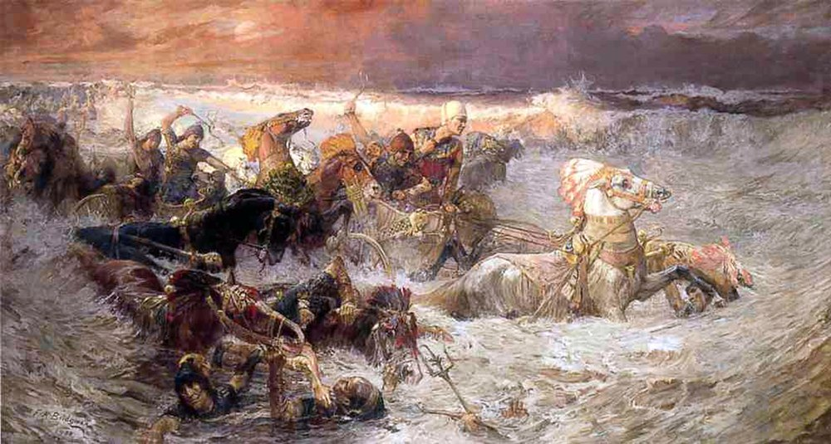

Slide 10
3. We Praise in Hope (v.20-22)
We wait in hope for the Lord; he is our help and our shield. ²¹ In him our hearts rejoice, for we trust in his holy name. ²² May your unfailing love be with us, Lord, even as we put our hope in you.

Slide 11
Sing joyfully to the Lord, you righteous; it is fitting for the upright to praise him. ² Praise the Lord with the harp; make music to him on the ten-stringed lyre. ³ Sing to him a new song; play skillfully, and shout for joy.

