Slide 1
Partners in the Gospel
Romans 16

Slide 2
1. Love the Family
“Greet one another with a holy kiss” (16:16)
Also 1 Cor 16:20, 2 Cor 13:12, 1 Thess 5:26, and 1 Peter 5:14)

Slide 3
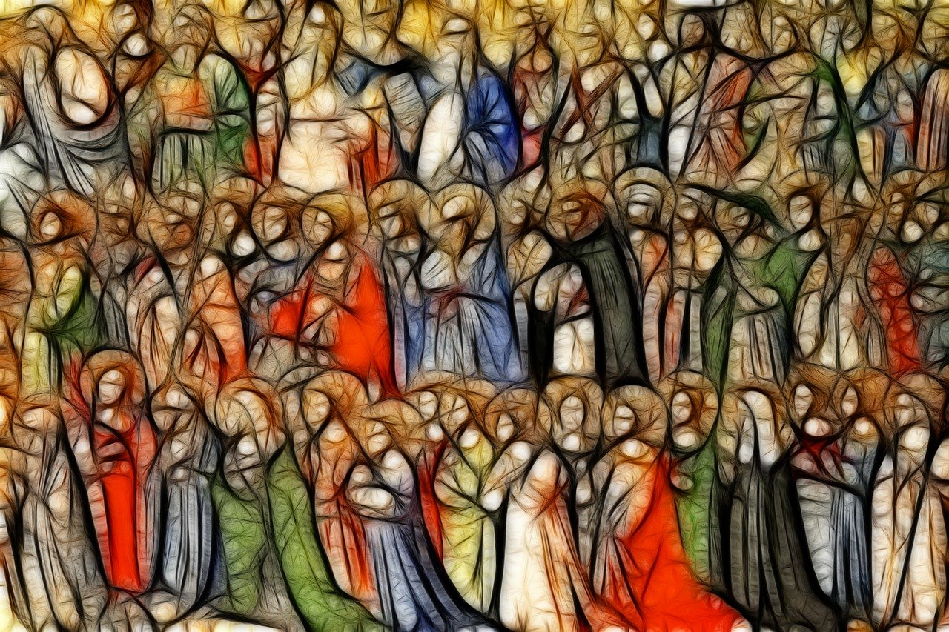
“Here are my mother and my brothers. For whoever does the will of my Father in heaven is my brother and sister and mother” (12:49-50).

Slide 4
1. Love the Family
“Greet one another with a holy kiss” (16:16).
“brothers and sisters” (v.14, 17).
“…who has been a mother to me too” (v.13).
Beloved (agapetos), 5, 8, 9, 12.
26 people named in this list
Imagine keeping track of them without the modern technology!

Slide 5
2. Honor One Another
Phoebe (v.1-2)
Priscilla and Aquilla (v.3-4)
Mary (v.6)
Andronicus and Junia (v.7)
Apelles (v.10)

Slide 6
Love one another with brotherly affection.
Outdo one another in showing honor.
- Romans 12:10

Slide 7
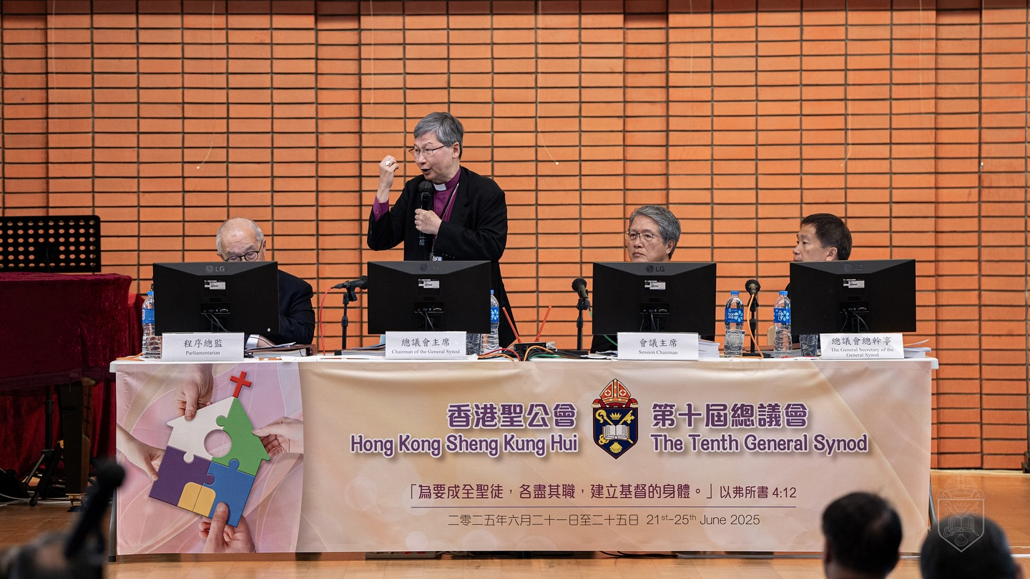

Slide 8
2. Honor One Another
With words
Listening attentively
Serving
Recognizing the work big and small
(Despite our differences!)

Slide 10
3. Live for God’s Glory

Slide 11
3. Live for God’s Glory
V.1, deacon, coworkers
V.3, risked their lives…
V.7, who have been in prison with me; outstanding apostles
V.9, co-workers in Christ
V.10, whose fidelity to Christ has stood the test
V.12, who work hard in the Lord

Slide 12
3. Live for God’s Glory
“Now to him who is able to establish you in accordance with my gospel, the message I proclaim about Jesus Christ, in keeping with the revelation of the mystery hidden for long ages past, but now revealed and made known through the prophetic writings by the command of the eternal God, so that all the Gentiles might come to the obedience that comes from faith— to the only wise God be glory forever through Jesus Christ! Amen.”‭
Romans 16:25-27

Slide 13
Romans
Introduction and Greeting (Romans 1:1-17)
God’s Wrath Against Sin (Romans 1:18-32)
God’s Righteous Judgment (Romans 2)
Universality of Sin and Justification (Romans 3)
Righteousness Through Faith (Romans 4)
Peace and Hope Through Christ (Romans 5)
Life in the Spirit (Romans 6-8)
God’s Sovereign Plan for Israel (Romans 9-11)
Practical Christian Living (Romans 12-15)
Greetings and Final Instructions (Romans 16)

