Slide 1
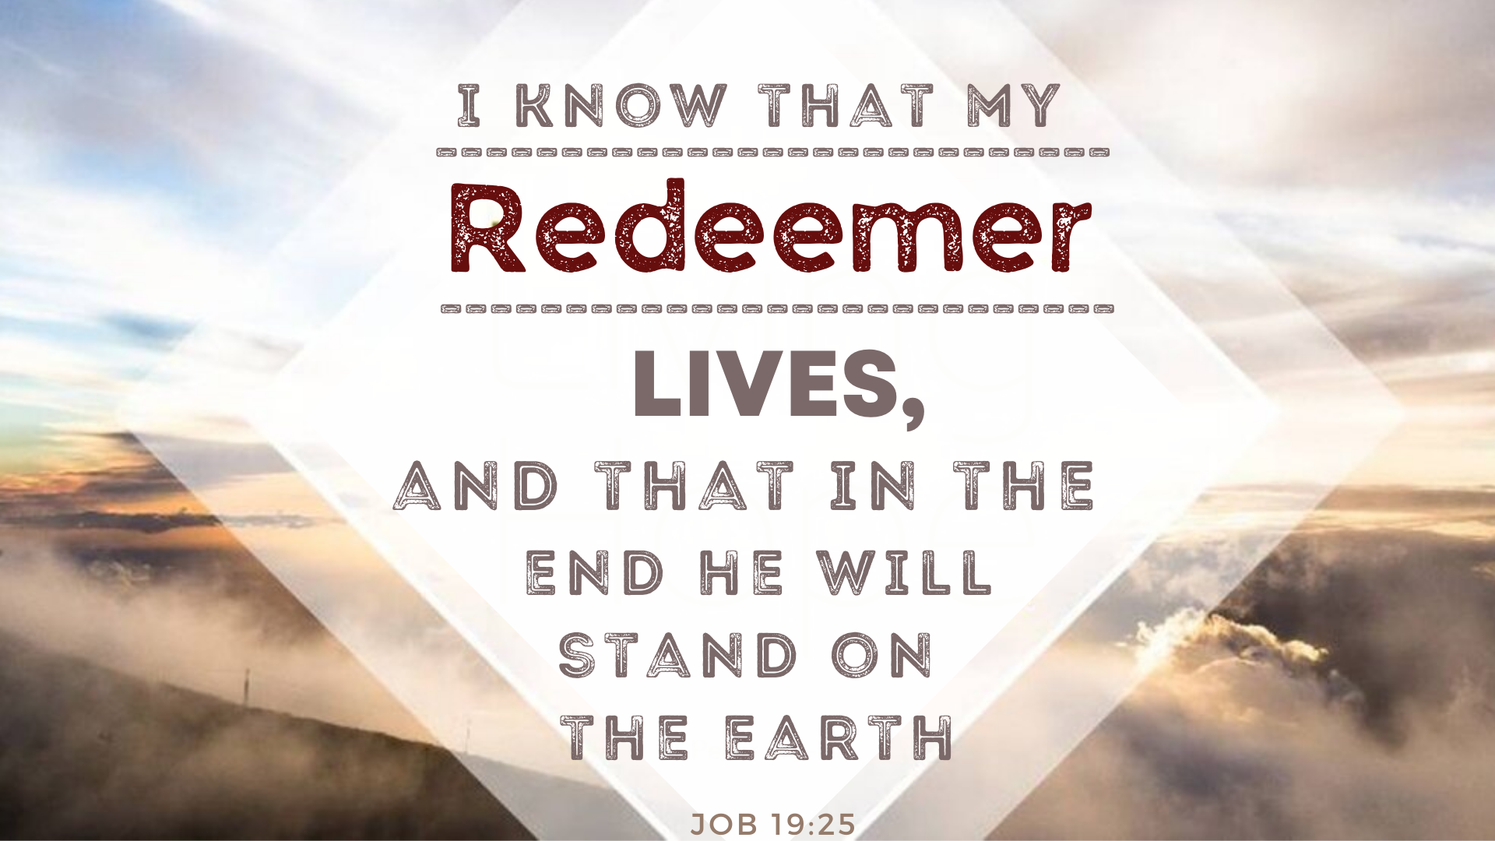

Slide 2
⁷ “Though I cry, ‘Violence!’ I get no response; though I call for help, there is no justice. ⁸ He has blocked my way so I cannot pass; he has shrouded my paths in darkness. ⁹ He has stripped me of my honor and removed the crown from my head. ¹⁰ He tears me down on every side till I am gone; he uproots my hope like a tree. ¹¹ His anger burns against me; he counts me among his enemies. ¹² His troops advance in force; they build a siege ramp against me and encamp around my tent.

Slide 3
¹³ “He has alienated my family from me; my acquaintances are completely estranged from me. ¹⁴ My relatives have gone away; my closest friends have forgotten me. ¹⁵ My guests and my female servants count me a foreigner; they look on me as on a stranger. ¹⁶ I summon my servant, but he does not answer, though I beg him with my own mouth. ¹⁷ My breath is offensive to my wife; I am loathsome to my own family. ¹⁸ Even the little boys scorn me; when I appear, they ridicule me. ¹⁹ All my intimate friends detest me; those I love have turned against me. ²⁰ I am nothing but skin and bones; I have escaped only by the skin of my teeth.^{[a]}

Slide 4
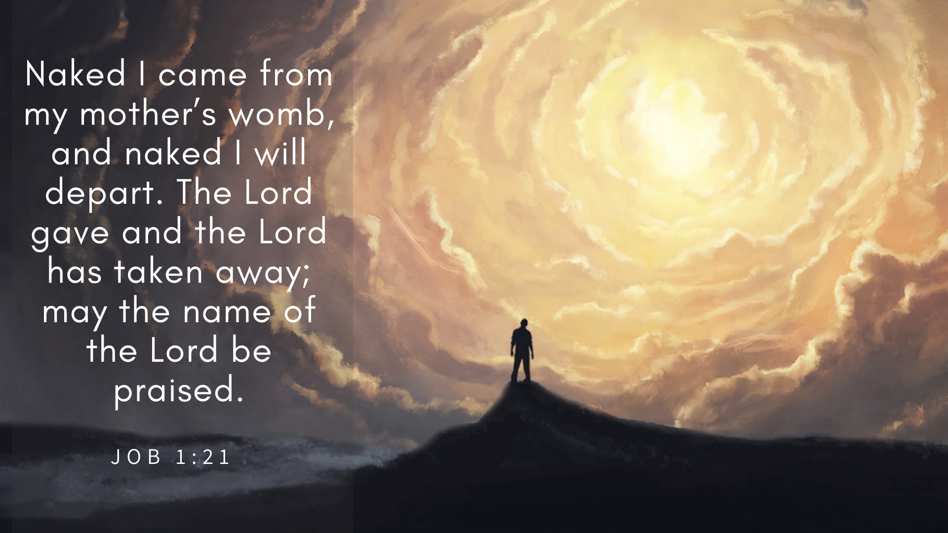

Slide 5
After this, Job opened his mouth and cursed the day of his birth. 2 He said:
3 “May the day of my birth perish, and the night that said, ‘A boy is conceived!’
3:1-3

Slide 6
Oh, how I wish that God would speak, that he would open his lips against you and disclose to you the secrets of wisdom, for true wisdom has two sides. Know this: God has even forgotten some of your sin.
11:5-6

Slide 7
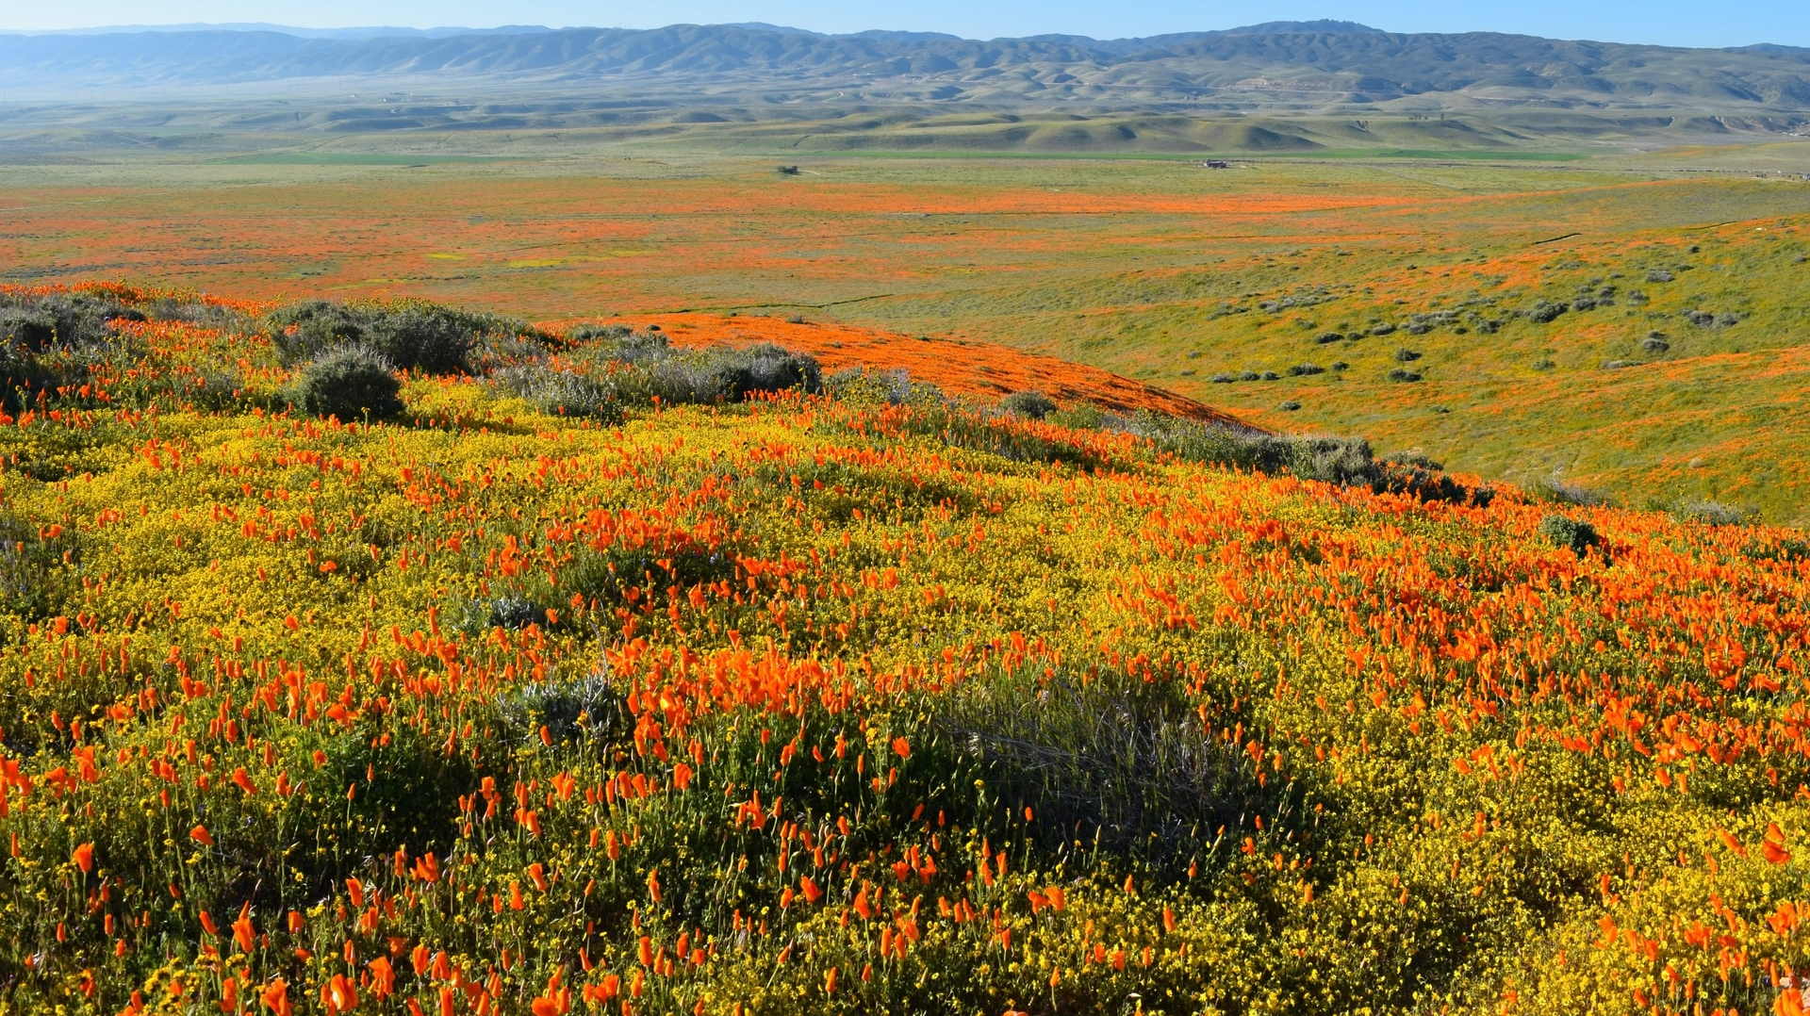

Slide 8
^{14:13} “If only you would hide me in the grave and conceal me till your anger has passed! If only you would set me a time and then remember me! ¹⁴ If someone dies, will they live again? All the days of my hard service I will wait for my renewal^{[b]} to come. ¹⁵ You will call and I will answer you; you will long for the creature your hands have made.

Slide 9
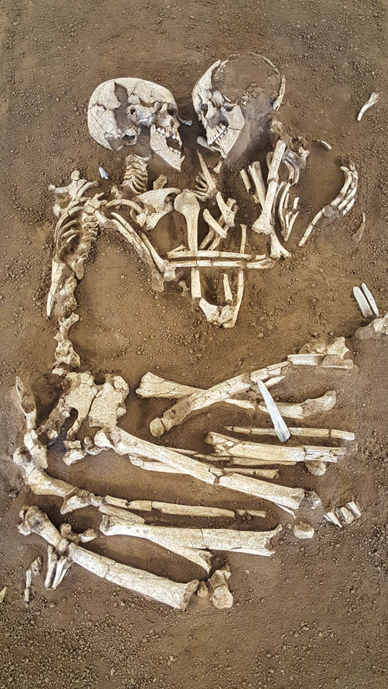

Slide 10
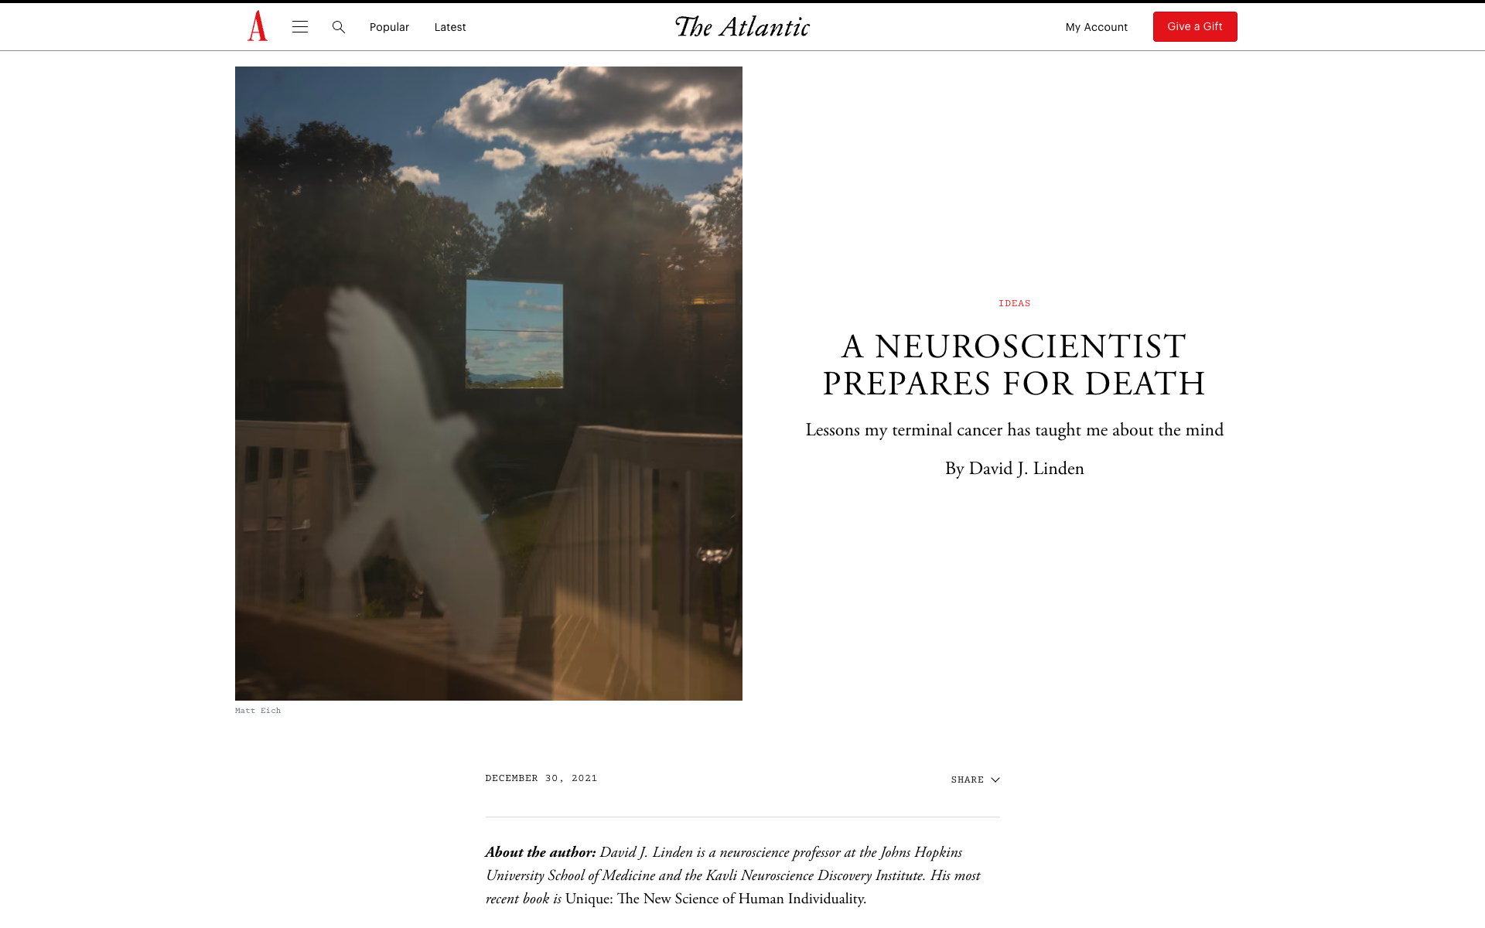
“I’m not sure whether, in the end, faith in afterlife/reincarnation stories is a feature or a bug of human cognition, but if it’s a bug, it’s one for which I have sympathy..... And what a special delight it would be to see Dena and my children again after I’m gone.”

Slide 11


Slide 13


Slide 14
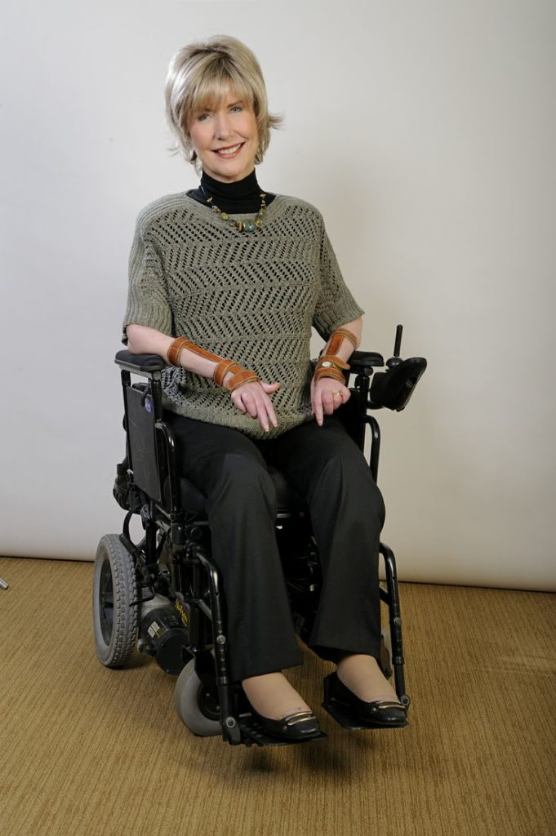

Slide 15
If possible, somewhere, sometime before the party gets going, sometime before the guests are called to the banquet table at the Wedding Feast of the Lamb, the first thing I plan to do on resurrection legs is to drop on grateful, glorified knees. I will quietly kneel at the feet of Jesus.”

