Slide 1


Slide 2
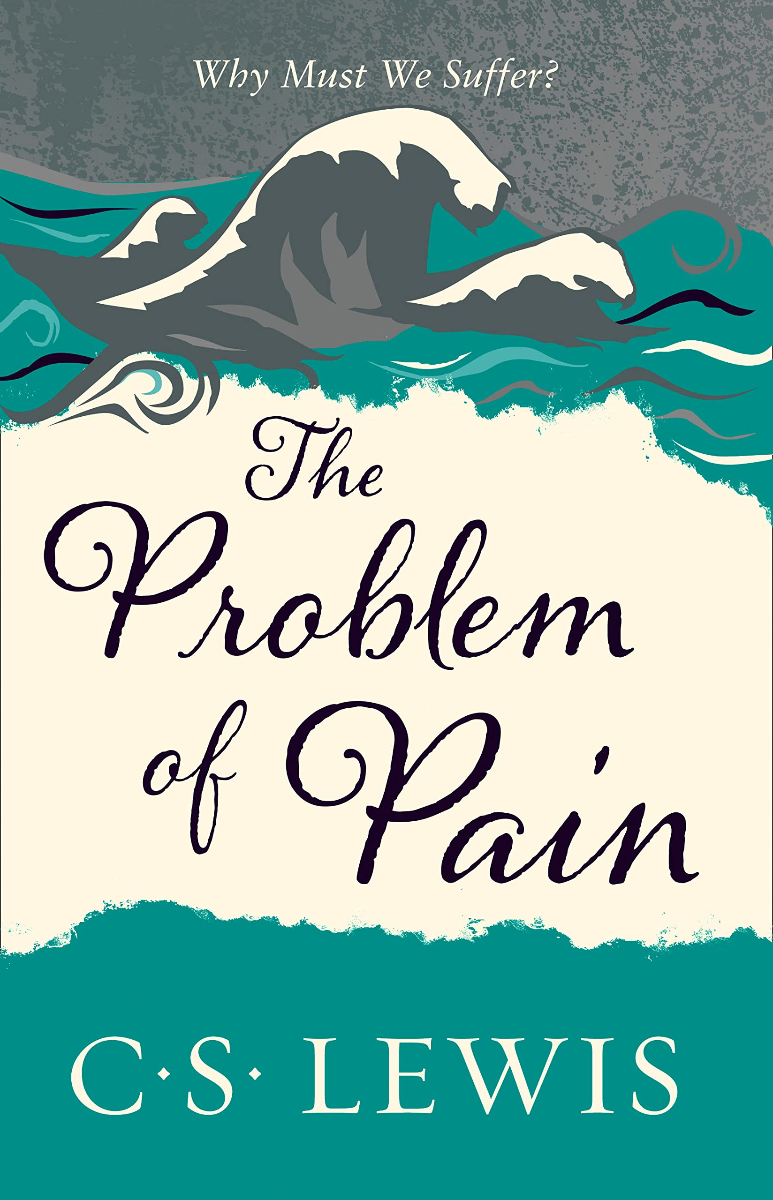

Slide 3


Slide 4


Slide 5

My ears had heard of you
but now my eyes have seen you. Therefore I despise myself
and repent in dust and ashes.”
- Job 42:5-6

Slide 6
1. Relationship (v.1-6)

Slide 7
2. Restoration (v.7-17)

Slide 8
2. Restoration (v.7-17)
Grace, not reward or reparation

Slide 9


Slide 10
3. Conclusion
What characterizes your relationship with God? Do you trust God?

Slide 11
My ears had heard of you
but now my eyes have seen you. Therefore I despise myself
and repent in dust and ashes.”
- Job 42:5-6

Slide 12
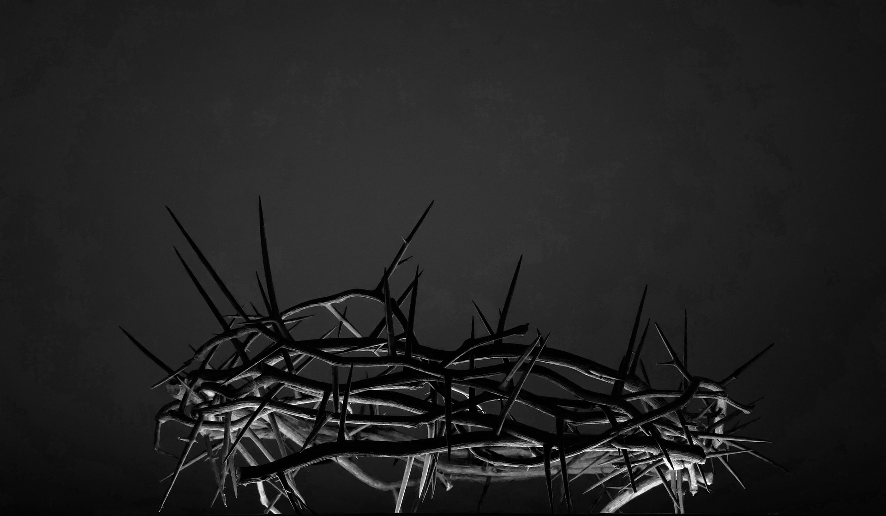

Slide 13


