Slide 2



Slide 3
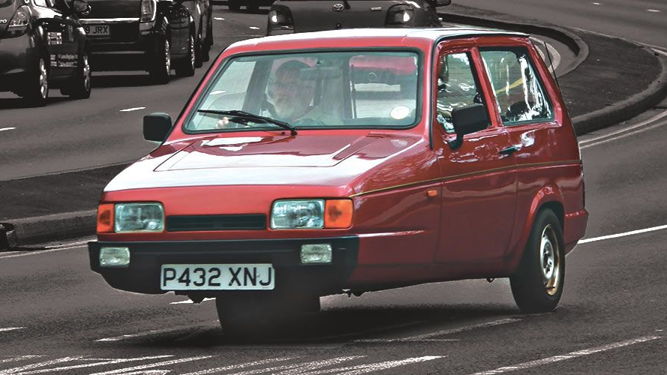


Slide 4
“You shall not misuse the name of the Lord your God, for the Lord will not hold anyone guiltless who misuses his name.
Deut 5:11

Slide 5
1. Misusing God’s Name
God’s name YHWH stands for who he is: “I am who I am.”

Slide 6
1. Misusing God’s Name
God’s name YHWH stands for who he is: “I am who I am.”
Misuse in the OT: sorcery, false prophecy, swearing by God’s name.

Slide 7
“You shall not misuse the name of the Lord your God, for the Lord will not hold anyone guiltless who misuses his name.
Deut 5:11

Slide 8
1. Misusing God’s Name
God’s name YHWH stands for who he is: “I am who I am.”
Misuse in the OT: sorcery, false prophecy, swearing by God’s name.
Mission – draws people away or towards YHWH God.

Slide 9
“You shall not misuse the name of the Lord your God, for the Lord will not hold anyone guiltless who misuses his name.
Deut 5:11

Slide 10
2. Honoring God’s Name
“Therefore go and make disciples of all nations, baptizing them in(to) the name of the Father and of the Son and of the Holy Spirit…” (Matt 28:19)

Slide 11
2. Honoring God’s Name
At the name of Jesus every knee should bow in heaven and on earth and under the earth and every tongue acknowledge that Jesus Christ is Lord, to the glory of God the Father” (Phil 2:10-11).

Slide 12
2. Honoring God’s Name
“And whatever you do, whether in word or deed, do it all in the name of the Lord Jesus, giving thanks to God the Father through him” (Col 3:17).

Slide 13


Slide 14


Slide 15


Slide 16
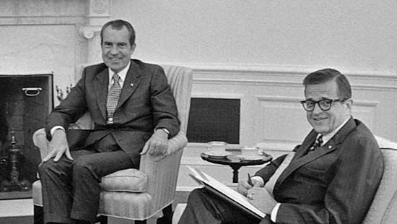

Slide 17
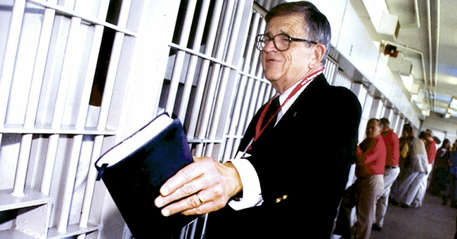

Slide 18
Jesus:
YHWH Saves

