Slide 2
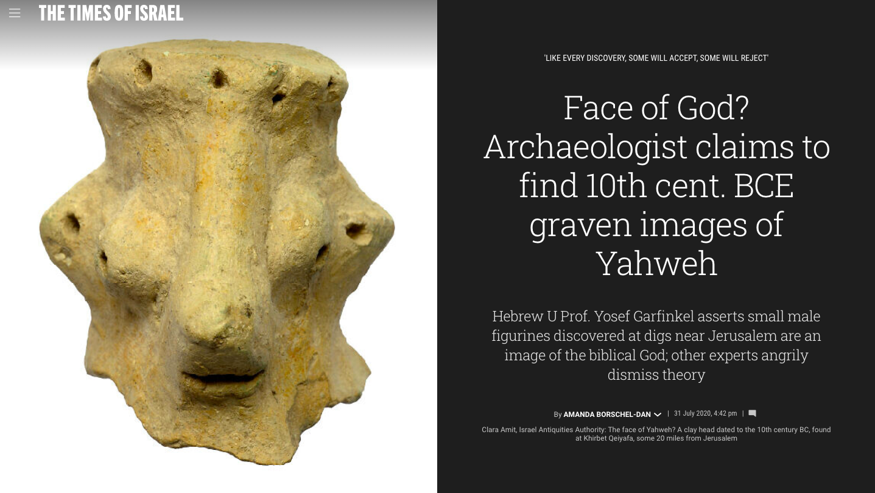

Slide 3
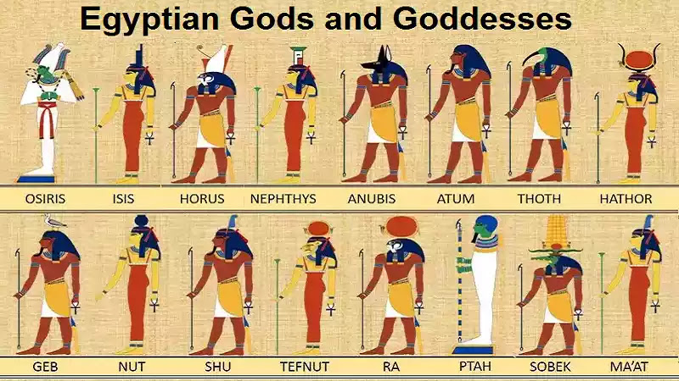

Slide 4
One True God

Slide 5
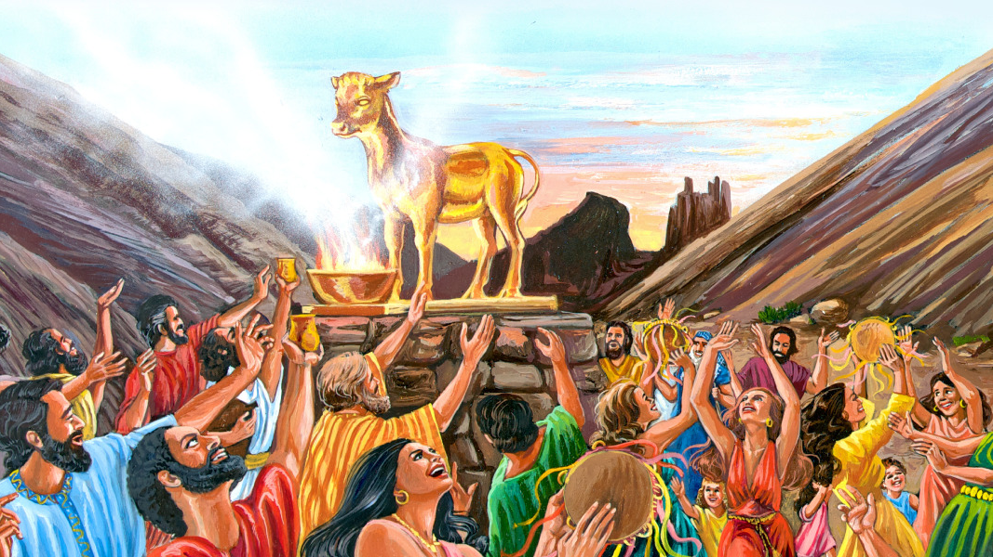

Slide 6
Isaiah 44:6-8 (NIV)
“This is what the Lord says – Israel’s King and Redeemer, the LORD Almighty: I am the first and and I am the last; apart from me there is no God. Who then is like me? Let Him proclaim it. Let him declare and lay out before me what has happened since I established my ancient people, and what is yet to come- yes, let them foretell what will come. Do not tremble, do not be afraid. Did I not proclaim this and foretell it long ago? You are my witnesses. Is there any God besides me? No, there is no other Rock; I know not one”

Slide 7
One True God
Israel’s King and Redeemer (Isaiah 44:6-8)
I am the first and I am the last
There is no other Rock
Apart from me there is no God

Slide 9
False Image of God

Slide 10
In verse 12, the blacksmith takes a tool and works with it in the coals, he shapes an idol with hammers, he forges it with might of his arm…
In verse 13, the carpenter measures with a line and makes an outline with a marker;… He shapes it in human form, human fom in all its glory, that it may dwell in a shrine.
In verse 14, he cut down cedars…he let it grow among the trees
In verse 15, it used for fuel for burning…he kindles a fire and bakes bread. But he also fashions a god and worships it; he makes an idol and bows down to it.
In verse 17, he prays to it and says, “save me! You are my god”

Slide 11
False Image of God
you shall not bow down (Deut. 5:9)
all who make idols are nothing (Isaiah 44:9)
the things they treasure are worthless
those who would speak up for them are blind
they are ignorant, to their own shame

Slide 13
Return to God
Showing love to a thousand generations (Deut.5:10)
I will not forget you
I have swept away your offenses
I have redeemed you

Slide 14
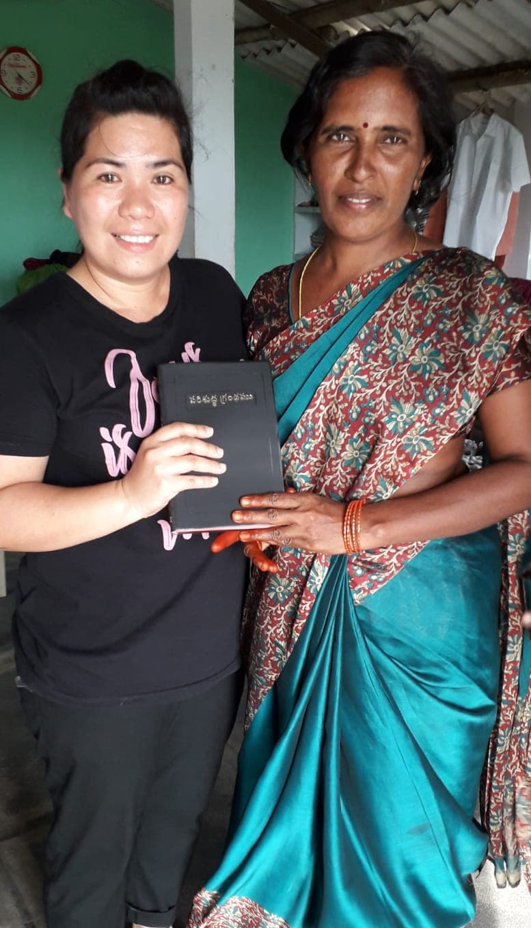

Slide 16
“yet a time is coming and has now come when the true worshippers will worship the Father in the Spirit and in truth, for they are the kind of worshippers the Father seeks.
God is spirit and his worshipers must worship in the Spirit and in truth.”
John 4:23-24 (NIV)

