Slide 2


Slide 3
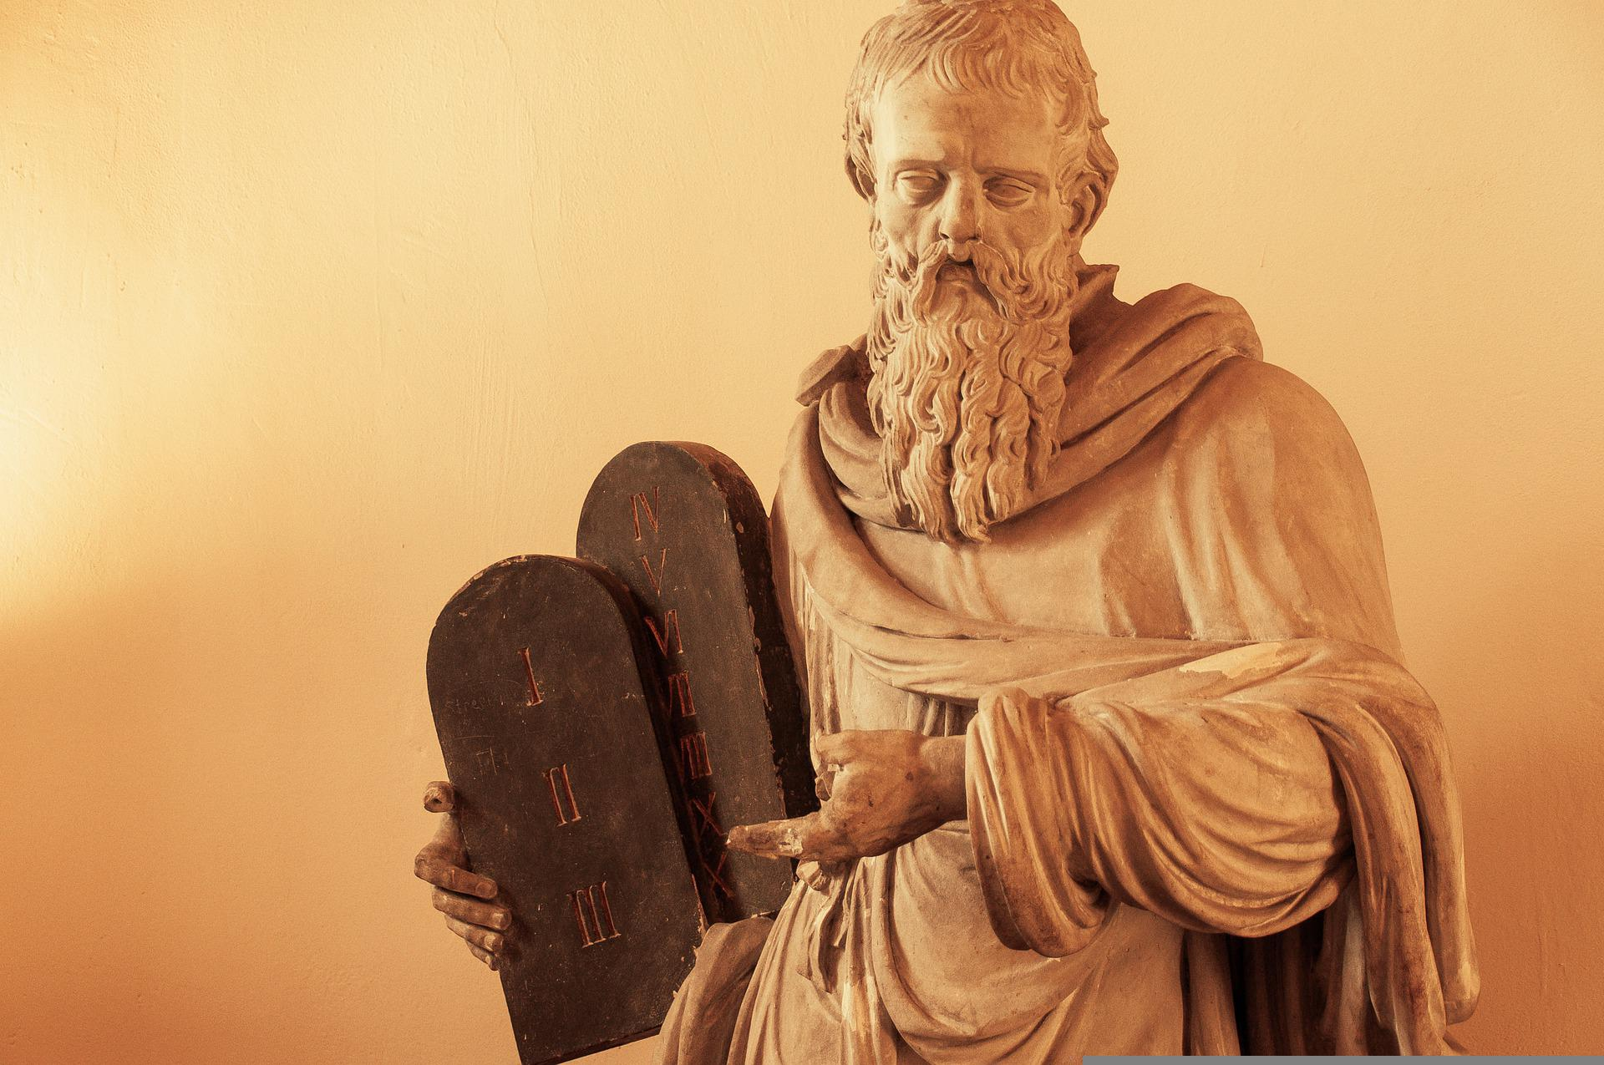

Slide 4
1. The Purpose of the Commands
“Observe them carefully for this will show your wisdom and understanding to the nations, who will hear about all these decrees and say, ‘Surely this great nation is a wise and understanding people’” (4:6)

Slide 5
1. The Purpose of the Commands
“what other nation is so great as to have their gods near them the way the LORD our God is near us whenever we pray to him?” (v.7)

Slide 6
You shall have no gods before me
You shall not make an idol
You shall not misuse the name of the LORD
Keep Sabbath holy
Honor your parents
You shall not murder
You shall not commit adultery
You shall not steal
You shall not give false testimony
You shall not covet

Slide 7
Implied order in the commands
God (1-3),
Society (4),
Family (5),
Life (6)
Sex (7),
Property/money (9-10)

Slide 8
2. Grounds of the Commands

Slide 9


Slide 10


Slide 11
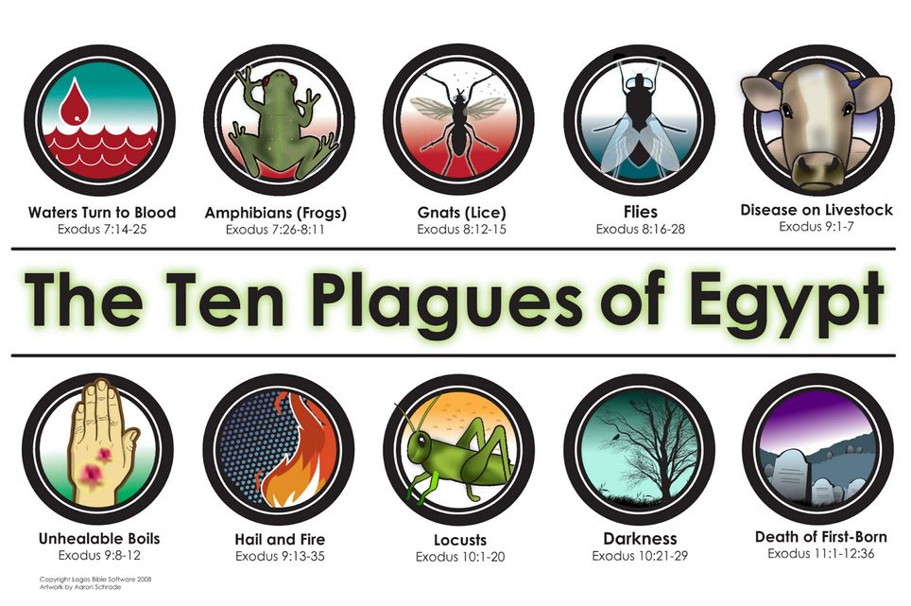

Slide 13
2. Grounds of the Commands
Grace not works

Slide 14
3. Test of Loyalty
“You shall have no other gods before me.”

Slide 15
3. Test of Loyalty
“You shall have no other gods before me.”
Whose voice do you listen to?
What is your God and…?

Slide 16
“No one can serve two masters, for either he will hate the one and love the other, or he will be devoted to the one and despise the other.”
- Matthew 6:24

Slide 17

“We may think dual allegiance is desirable, but Jesus assures us it is not even possible. We are created for single-minded allegiance. We are designed for it. We are made in the image of one God, to bear the image of one God. We cannot conform to both the image of God and the image of an idol” (Jen Wilkin, Ten Words).

Slide 18
You? (second person, singular)

