Slide 1
He Must Become Greater: Living Water
John 4:1-42
Notes:
© Copyright PresentationGO.com – The free PowerPoint template library

Slide 2
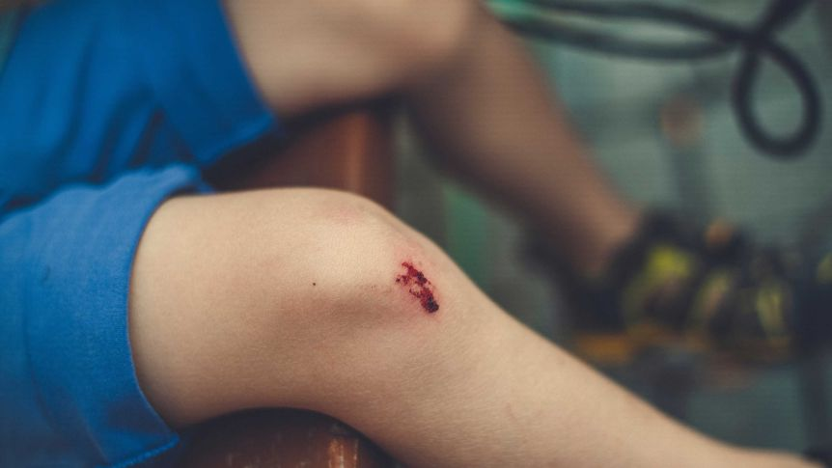

Slide 3
The Living Water Brings Eternal Life
John 4:1-14

Slide 4
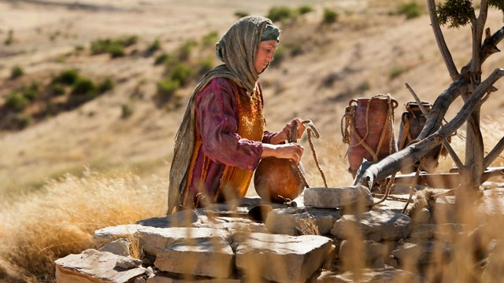

Slide 5
Nicodemus vs The Samaritan Woman
Nicodemus
He was learned, powerful, respected, orthodox, theologically trained
He was a man, a Jew, a ruler
The Samaritan Woman
she was unschooled, without influence, despised, capable only of folk religion.
She was a woman, a Samaritan, a moral outcast

Slide 6
John 4:9
The Samaritan woman said to him, “You are a Jew and I am a Samaritan woman. How can you ask me for a drink?” (For Jews do not associate with Samaritans.)

Slide 7
John 4:10
Jesus answered her, “If you knew the gift of God and who it is that asks you for a drink, you would have asked him and he would have given you living water.”

Slide 8


Slide 9
John 4:13-14
Jesus answered, “Everyone who drinks this water will be thirsty again, 14 but whoever drinks the water I give them will never thirst. Indeed, the water I give them will become in them a spring of water welling up to eternal life.”

Slide 10
Echoes of the Old Testament Promises
Is. 12:3 - ‘will draw water from the wells of salvation’
Is. 49:10 - ‘They will neither hunger nor thirst’
Is. 44:3 - ‘water on the thirsty land, and streams on the dry ground’
Is. 55:1-5 - ‘Come, all you who are thirsty, come to the waters … that your soul may live.’ ‘an everlasting covenant’ with all who come—not only with Israel but with ‘the peoples’

Slide 11
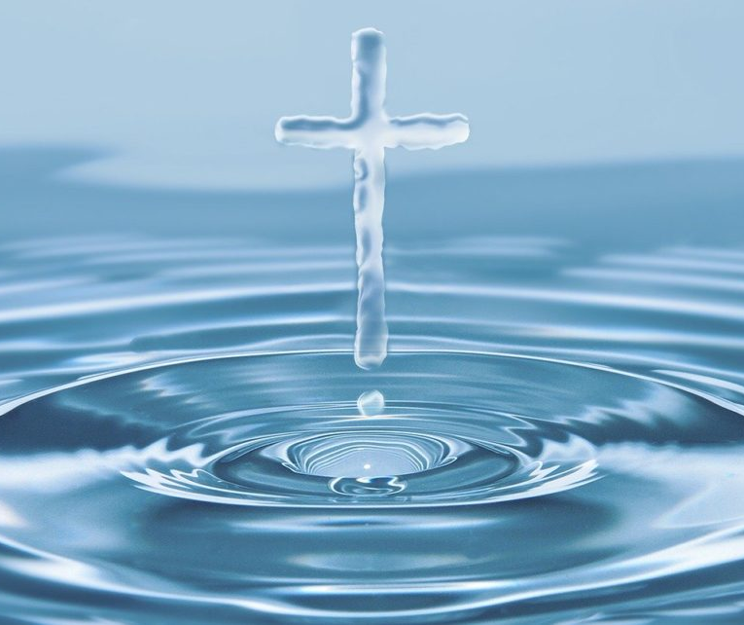
Eternal Life is For Everyone
Have you tasted the Living Water? Have you accepted eternal life?
Do you have prejudices? Is there someone who you think can not be saved?

Slide 12
The Living Water Brings Spiritual Healing
John 4:15-30, 39-42

Slide 13
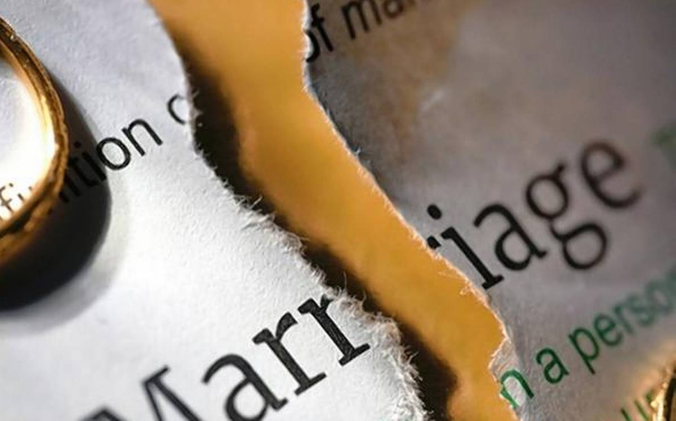

Slide 14


Slide 15
John 4:21-22
“Woman,” Jesus replied, “believe me, a time is coming when you will worship the Father neither on this mountain nor in Jerusalem. 22 You Samaritans worship what you do not know; we worship what we do know, for salvation is from the Jews.

Slide 16
John 4:23-24
Yet a time is coming and has now come when the true worshipers will worship the Father in the Spirit and in truth, for they are the kind of worshipers the Father seeks. 24 God is spirit, and his worshipers must worship in the Spirit and in truth.”

Slide 17


Slide 18
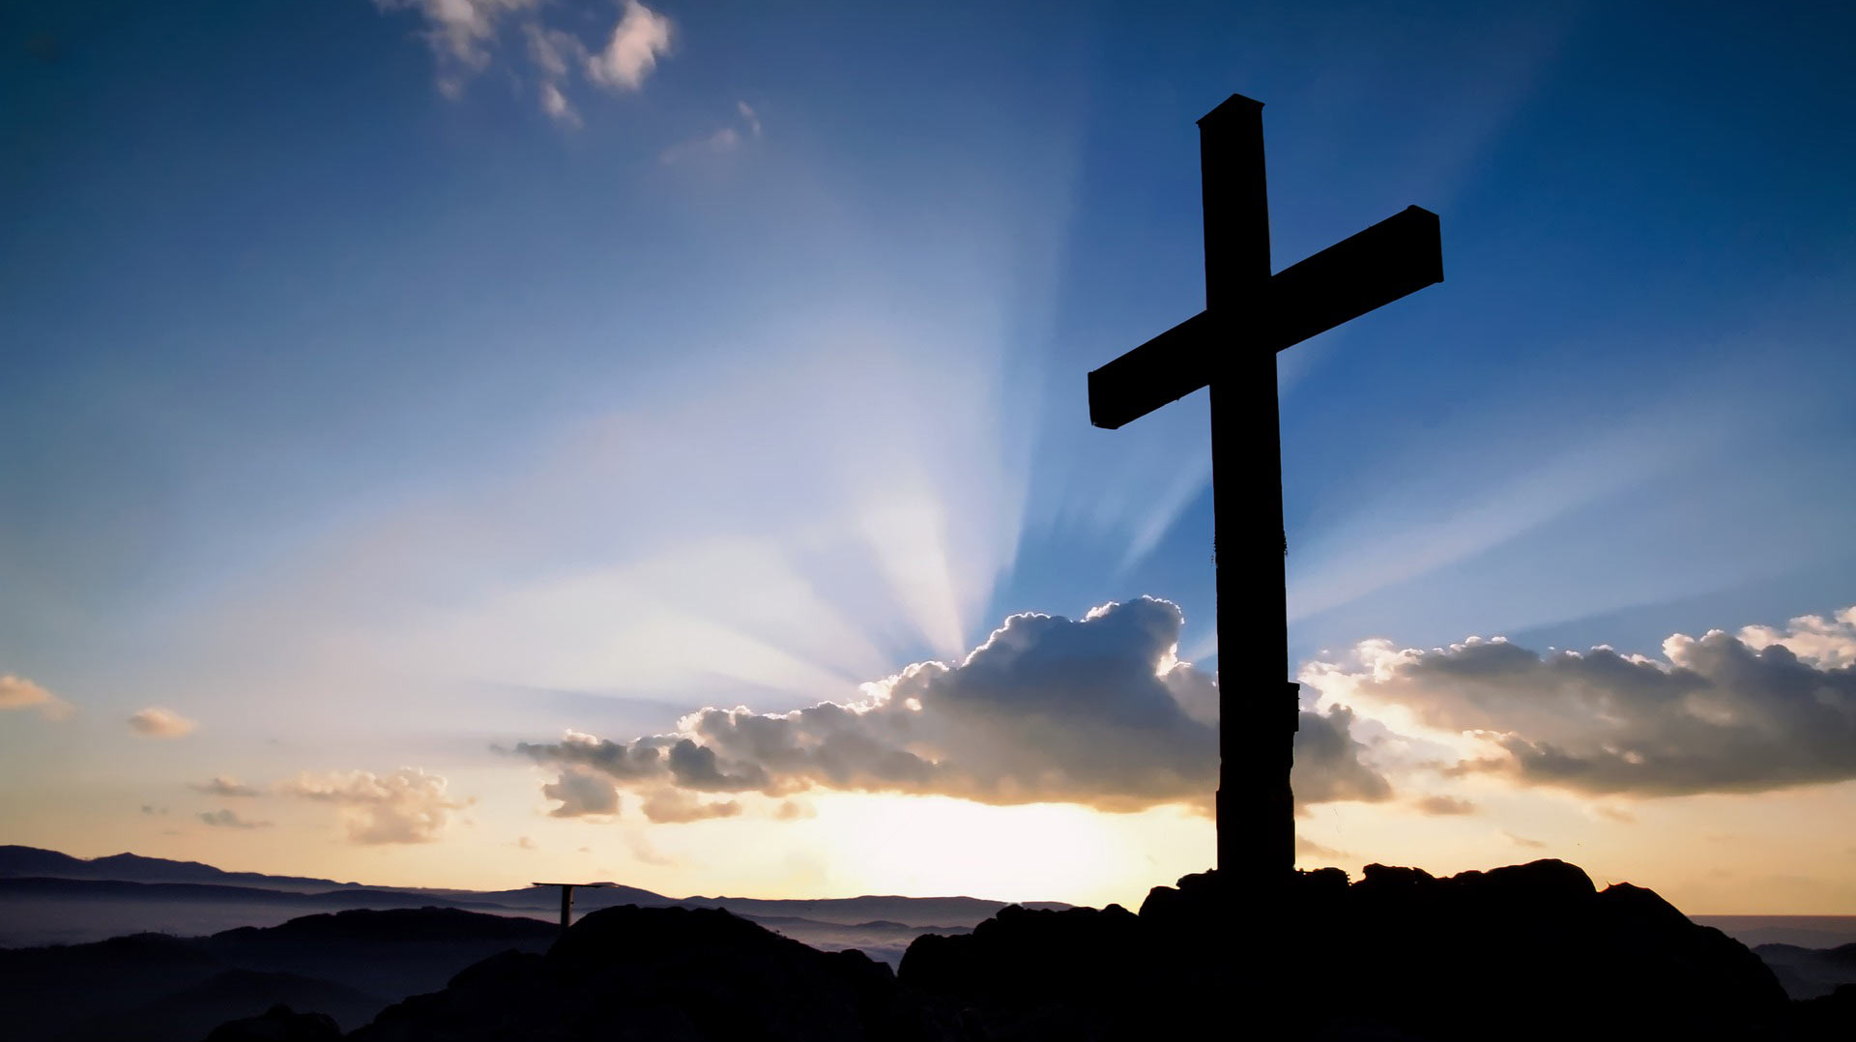

Slide 19
John 4:25-26
The woman said, “I know that Messiah” (called Christ) “is coming. When he comes, he will explain everything to us.”
26 Then Jesus declared, “I, the one speaking to you—I am he.”

Slide 20
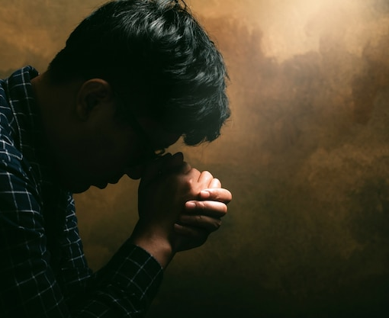
The Living Water can heal you
What is hindering your relationship with God? Pray that God will reveal it to you

Slide 21
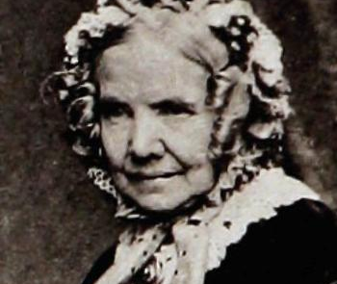
Just As I Am
Just as I am – though toss’d about With many a conflict, many a doubt, Fightings and fears within, without, – O Lamb of God, I come!
Just as I am – poor, wretched, blind; Sight, riches, healing of the mind, Yea, all I need, in Thee to find, – O Lamb of God, I come!

Slide 22
He Must Become Greater: Living Water
John 4:1-42
Notes:
© Copyright PresentationGO.com – The free PowerPoint template library

