Slide 1
1 Timothy 3
The Church of God

Slide 2
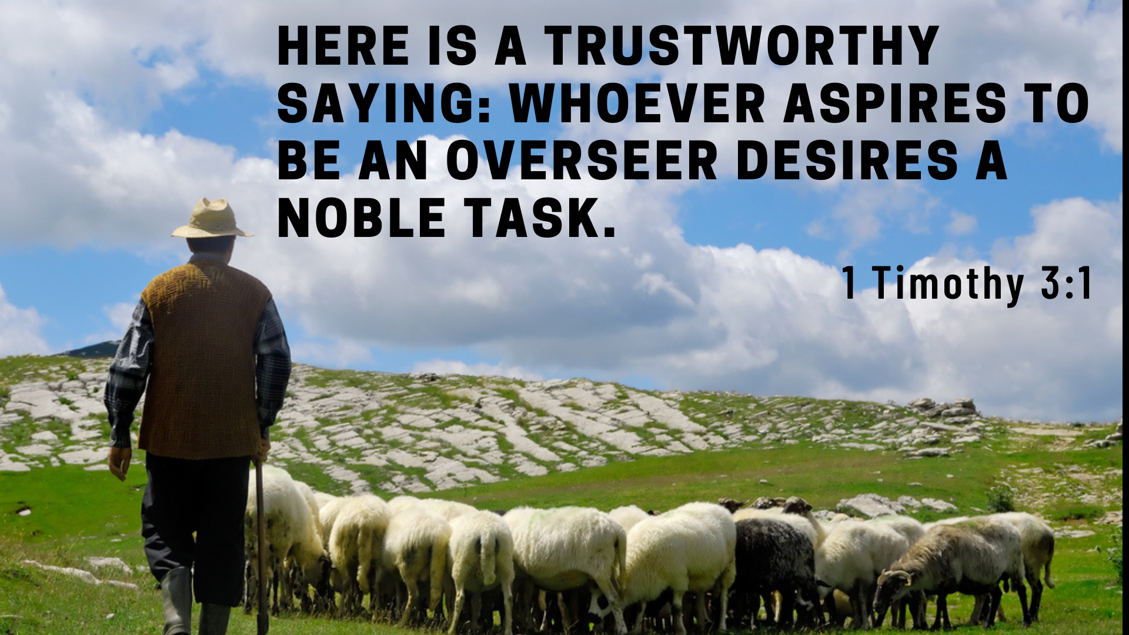

Slide 3
Paul and Barnabas appointed elders for them in each church and, with prayer and fasting, committed them to the Lord, in whom they had put their trust.
- Acts 14:23

Slide 4
1. Noble Task (v.1)

Slide 6
So Christ himself gave the apostles, the prophets, the evangelists, the pastors and teachers, to equip his people for works of service, so that the body of Christ may be built up
- Ephesians 4:11-12

Slide 7
1. Noble Task (v.1)
Do you desire these tasks of serving the church?

Slide 8
2. Noble Character (v.2-12)
Above reproach
One woman man
Temperate and self-controlled
Respectable
Hospitable
Able to teach
Not given to drunkenness
Gentle
Not a lover of money
Respected in the family
Humble, not a recent convert

Slide 9
2. Noble character
Which do you value more? Ability or character?

Slide 10
2. Noble character
Which do you value more? Ability or character?
Pursue Christ-likeness in your life!

Slide 11
3. Noble House (v.14-16)
15 if I am delayed, you will know how people ought to conduct themselves in God’s household, which is the church of the living God, the pillar and foundation of the truth.

Slide 12
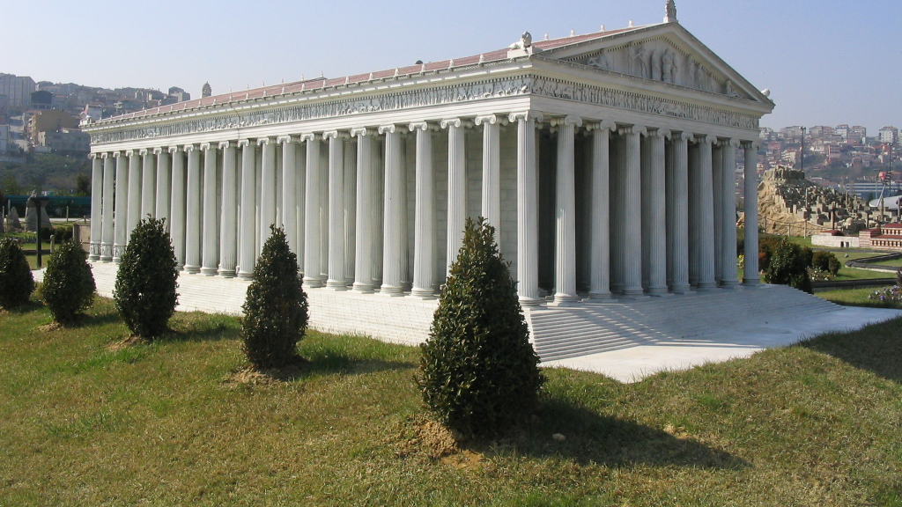
Model of temple of Artemis, at Miniaturk Park, Istanbul

Slide 13
Here then is the double responsibility of the church vis-à-vis the truth. First, as its foundation it is to hold it firm, so that it does not collapse under the weight of false teaching. Secondly, as its pillar it is to hold it high, so that it is not hidden from the world. To hold the truth firm is the defence and confirmation of the gospel; to hold it high is the proclamation of the gospel. The church is called to both these ministries.”
- John Stott

Slide 14
3. Noble House (v.14-16)
16 Beyond all question, the mystery from which true godliness springs is great:
He appeared in the flesh,
was vindicated by the Spirit,[d]
was seen by angels,
was preached among the nations,
was believed on in the world,
was taken up in glory.

