Slide 2
Men in Shatin Church are…
Women in Shatin Church are…
Shatin Church is known for…

Slide 3
1. Priority of the Gospel (v.3-7)

Slide 4
3 This is good, and pleases God our Savior, 4 who wants all people to be saved and to come to a knowledge of the truth. 5 For there is one God and one mediator between God and mankind, the man Christ Jesus, 6 who gave himself as a ransom for all people. This has now been witnessed to at the proper time. 7 And for this purpose I was appointed a herald and an apostle—I am telling the truth, I am not lying—and a true and faithful teacher of the Gentiles.

Slide 5


Slide 6
1. Priority of the Gospel (v.3-7)
Does it further the gospel?

Slide 7
2. Church Praying for the World (v.1-2)
2 I urge, then, first of all, that petitions, prayers, intercession and thanksgiving be made for all people— 2 for kings and all those in authority, that we may live peaceful and quiet lives in all godliness and holiness. 3 This is good, and pleases God our Savior, 4 who wants all people to be saved

Slide 8
2. Church Praying for the World (v.1-2)
2 I urge, then, first of all, that petitions, prayers, intercession and thanksgiving be made for all people— 2 for kings and all those in authority, that we may live peaceful and quiet lives in all godliness and holiness. 3 This is good, and pleases God our Savior, 4 who wants all people to be saved

Slide 9
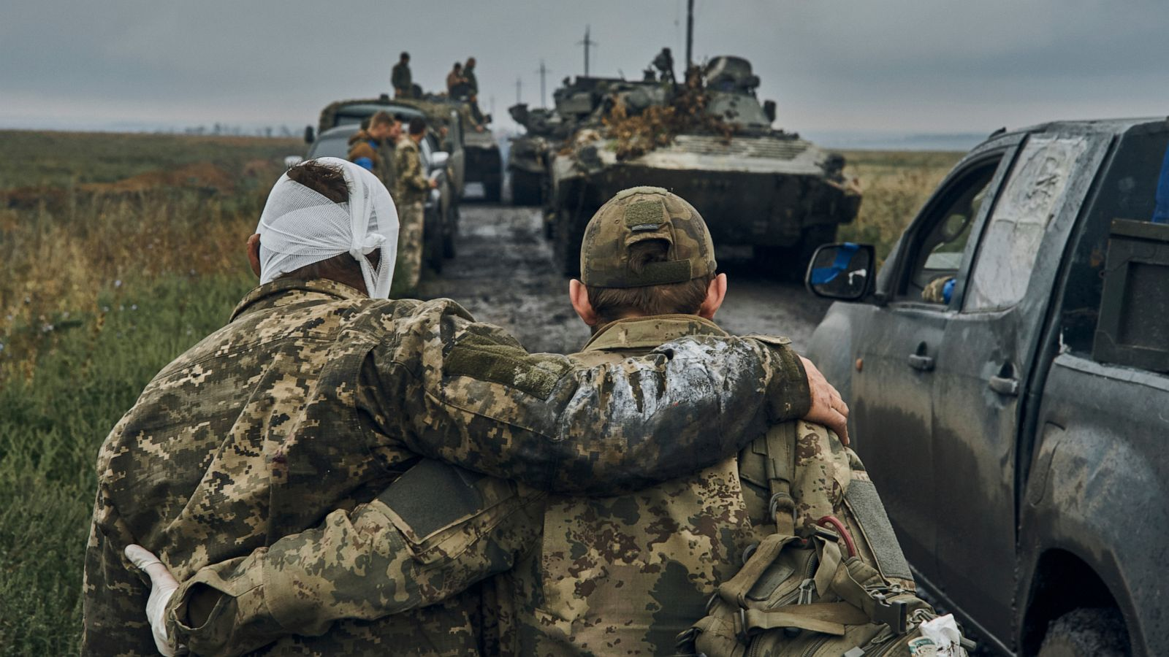

Slide 10
3. Men Known for Praying (v.8)
8 Therefore I want the men everywhere to pray, lifting up holy hands without anger or disputing.

Slide 11
“The potency of prayer has subdued the strength of fire. It has bridled the rage of lions. It has expelled demons. It has broken the chains of death. It has assuaged diseases. It has rescued cities from destruction. It has stopped the sun in its course. It has arrested the progress of the thunderbolt.”
- St. Chrysostom

Slide 12
4. Women Adorned with Good Deeds (v.9-10)
9 I also want the women to dress modestly, with decency and propriety, adorning themselves, not with elaborate hairstyles or gold or pearls or expensive clothes, 10 but with good deeds, appropriate for women who profess to worship God.

Slide 13
5. Order in Worship
11 A woman [wife] should learn in quietness and full submission. 12 I do not permit a woman to teach or to assume authority over a man;[husband] she must be quiet. 13 For Adam was formed first, then Eve. 14 And Adam was not the one deceived; it was the woman who was deceived and became a sinner. 15 But women[c] will be saved through childbearing—if they continue in faith, love and holiness with propriety.

Slide 14
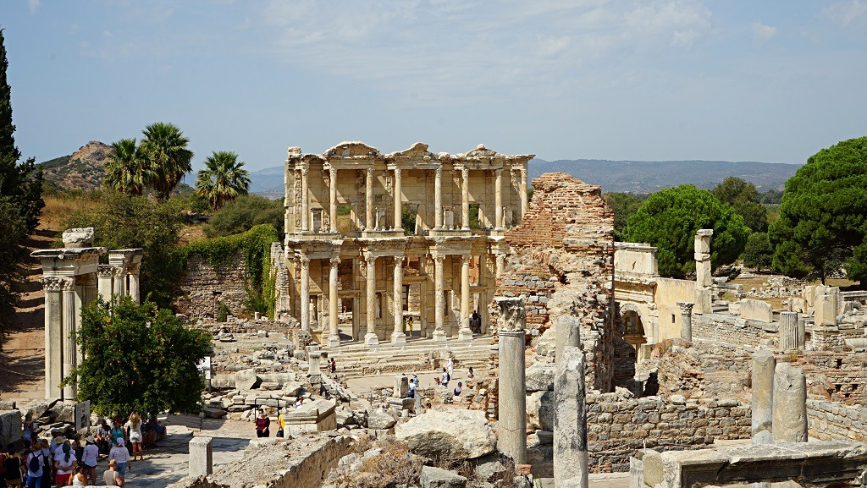

Slide 15
5. Order in Worship
11 A woman [wife] should learn in quietness and full submission. 12 I do not permit a woman to teach or to assume authority over a man;[husband] she must be quiet. 13 For Adam was formed first, then Eve. 14 And Adam was not the one deceived; it was the woman who was deceived and became a sinner. 15 But women[c] will be saved through childbearing—if they continue in faith, love and holiness with propriety.

Slide 16
5. Order in Worship
Women speaking in the Bible
Miriam and Deborah (among others)
“Sons and daughters will prophesy” (Joel 2:28)
Philips daughters (Acts 21:9)
Priscilla (Acts 18:2, 18, 26; Rom 16:3; 1 Cor 16:19; 2 Tim 4:19)
Phoebe (Romans 16:2)
Junia (Romans 16:7)
Women in Corinth (1 Cor 11)

