Slide 2
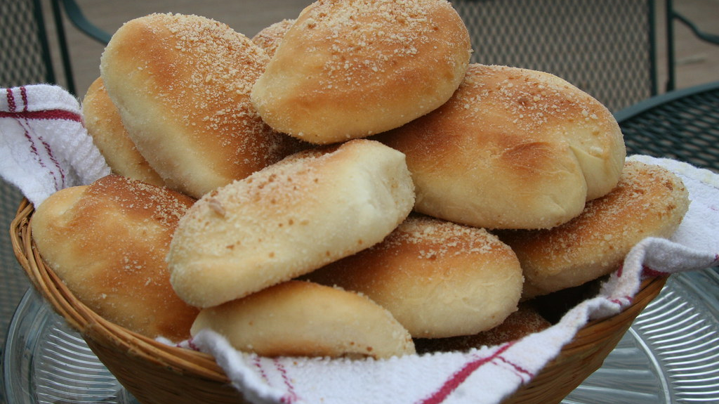
Pandesal

Slide 3
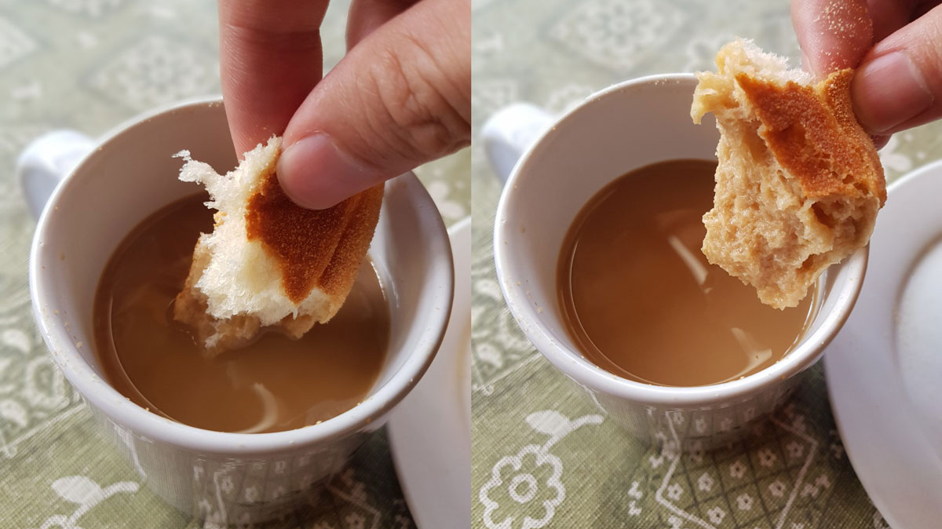

Slide 4
He Must Become Greater: Bread of Life
Bread that Perishes (1-15)
Jesus is the great I AM (16-24)
Jesus is the bread of life (25-29)

Slide 5
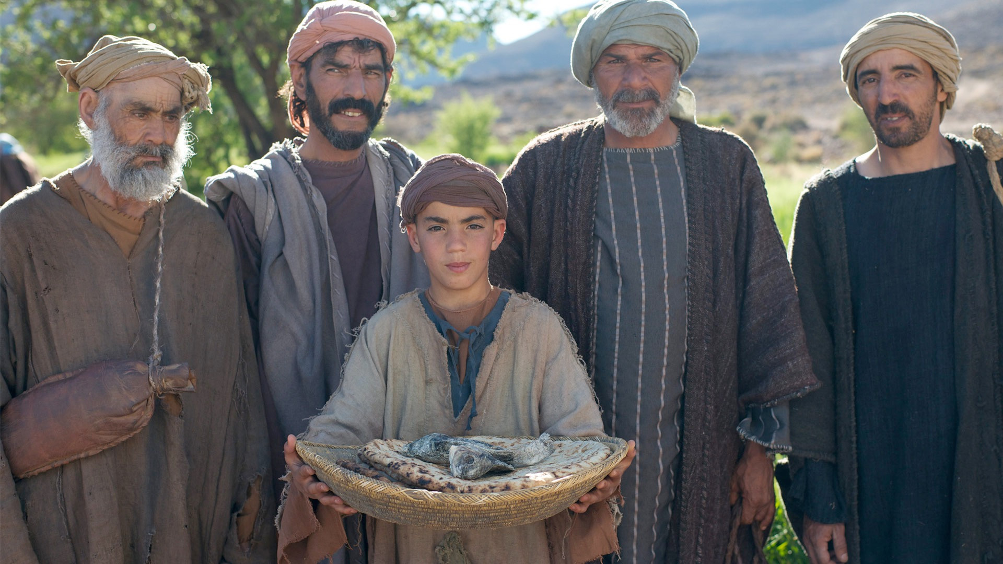

Slide 6
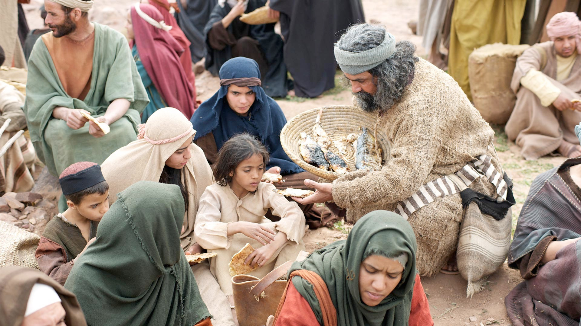

Slide 8
Exodus 16:3 The Israelites said to them, “If only we had died by the Lord’s hand in Egypt! There we sat around pots of meat and ate all the food we wanted, but you have brought us out into this desert to starve this entire assembly to death. Then the Lord said to Moses, “I will rain down bread from heaven for you. The people are to go out each day and gather enough for that day. In this way I will test them and see whether they will follow my instructions.”

Slide 10
- temporary -
- never satisfies -
- it will deceive us -
1) Bread that Perishes (1-15)

Slide 11
2) Jesus is the great I AM (16-24)

Slide 12
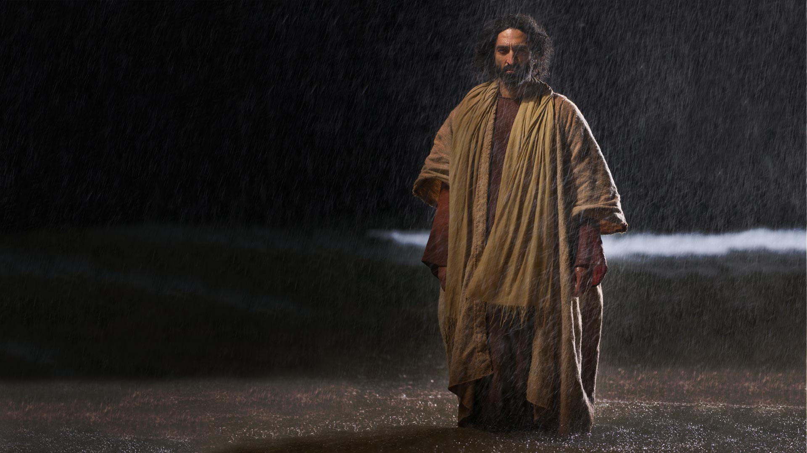

Slide 13
“It is I; don’t be afraid.”

Slide 15
Exodus 14:13 “Do not be afraid. Stand firm and you will see the deliverance the Lord will bring you today…”

Slide 16
- He is God -
- He has power over nature/creation -
2) Jesus is the great I AM (16-24)

Slide 17
3) Jesus is the bread of life (25-59)

Slide 18
“For my Father’s will is that everyone who looks to the Son and believes in him shall have eternal life, and I will raise them up at the last day.”

Slide 20
“It is written: ‘Man shall not live on bread alone, but on every word that comes from the mouth of God. ” Deuteronomy 8:3

Slide 21
- He alone can satisfy our spiritual hunger -
- Come and believe in Him –
- He will give you eternal life -
3) Jesus is the bread of life (25-59)

Slide 23
