Slide 2
Guard the Truth:
Essence of Christian Leadership
Refute False Teaching (v.1-6)
Model Godly Living (v.7-10)
Persevere in Works (v.11-16)

Slide 3
1. Refute False Teaching (v.1-6)
4 The Spirit clearly says that in later times some will abandon the faith and follow deceiving spirits and things taught by demons. 2 Such teachings come through hypocritical liars, whose consciences have been seared as with a hot iron. 3 They forbid people to marry and order them to abstain from certain foods, which God created to be received with thanksgiving by those who believe and who know the truth.

Slide 4
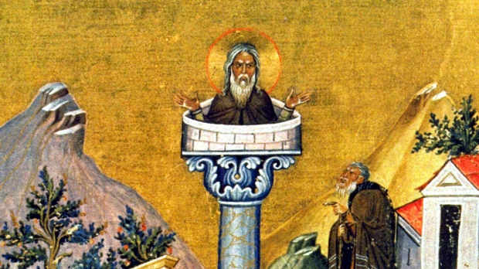
Simeon Stylites, 5th Century

Slide 5
1. Refute False Teaching (v.1-6)
⁴ For everything God created is good, and nothing is to be rejected if it is received with thanksgiving, ⁵ because it is consecrated by the word of God and prayer. 6 If you point these things out to the brothers and sisters, you will be a good minister of Christ Jesus, nourished on the truths of the faith and of the good teaching that you have followed.

Slide 6
1. Refute False Teaching (v.1-6)
⁴ For everything God created is good, and nothing is to be rejected if it is received with thanksgiving, ⁵ because it is consecrated by the word of God and prayer. 6 If you point these things out to the brothers and sisters, you will be a good minister of Christ Jesus, nourished on the truths of the faith and of the good teaching that you have followed.

Slide 7


Slide 8
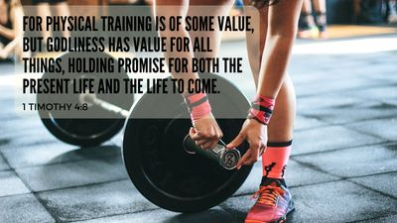

Slide 9
2. Model Godly Living (v.7-9)
⁷ Have nothing to do with godless myths and old wives’ tales; rather, train yourself to be godly. ⁸ For physical training is of some value, but godliness has value for all things, holding promise for both the present life and the life to come. ⁹ This is a trustworthy saying that deserves full acceptance.

Slide 10




Slide 11
2. Model Godly Living (v.7-9)
⁷ Have nothing to do with godless myths and old wives’ tales; rather, train yourself to be godly. ⁸ For physical training is of some value, but godliness has value for all things, holding promise for both the present life and the life to come. ⁹ This is a trustworthy saying that deserves full acceptance.

Slide 12
3. Persevere in the Works (v.10-16)
¹⁰ That is why we labor and strive, because we have put our hope in the living God, who is the Savior of all people, and especially of those who believe.

Slide 13
3. Persevere in the Works (v.10-16)
¹¹ Command and teach these things. ¹² Don’t let anyone look down on you because you are young, but set an example for the believers in speech, in conduct, in love, in faith and in purity. ¹³ Until I come, devote yourself to the public reading of Scripture, to preaching and to teaching. ¹⁴ Do not neglect your gift, which was given you through prophecy when the body of elders laid their hands on you.

Slide 14
3. Persevere in the Works (v.10-16)
² So on the first day of the seventh month Ezra the priest brought the Law before the assembly, which was made up of men and women and all who were able to understand. ³ He read it aloud from daybreak till noon as he faced the square before the Water Gate in the presence of the men, women and others who could understand. And all the people listened attentively to the Book of the Law.
- Nehemiah 8:2-3

Slide 15
3. Persevere in the Works (v.10-16)
“I charge you before the Lord to have this letter read to all the brothers and sisters”
- 1 Thes 5:27 (see also Col 4:6)

Slide 16
3. Persevere in the Works (v.10-16)
“On the day called Sunday…. the memories of the apostles and the writings of the prophets are read, as long as time permits; then, when the reader has finished, the president speaks, instructing and exhorting the people to imitate these good things.”
- Justin the Martyr, 2nd Century AD

Slide 17
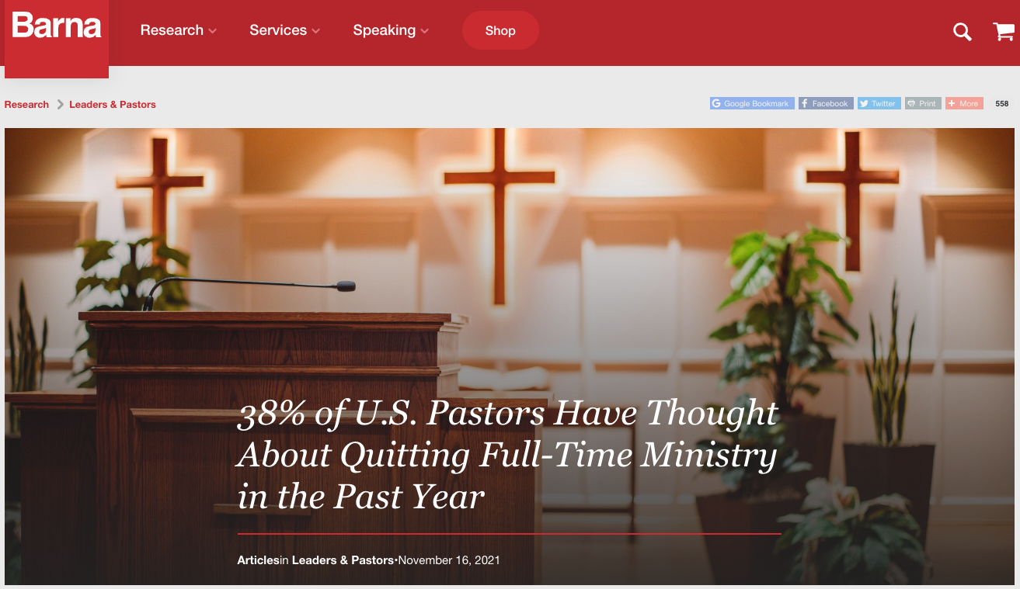

Slide 18
⁷ Have nothing to do with godless myths and old wives’ tales; rather, train yourself to be godly. ⁸ For physical training is of some value, but godliness has value for all things, holding promise for both the present life and the life to come. ⁹ This is a trustworthy saying that deserves full acceptance.

