Slide 1


Slide 2

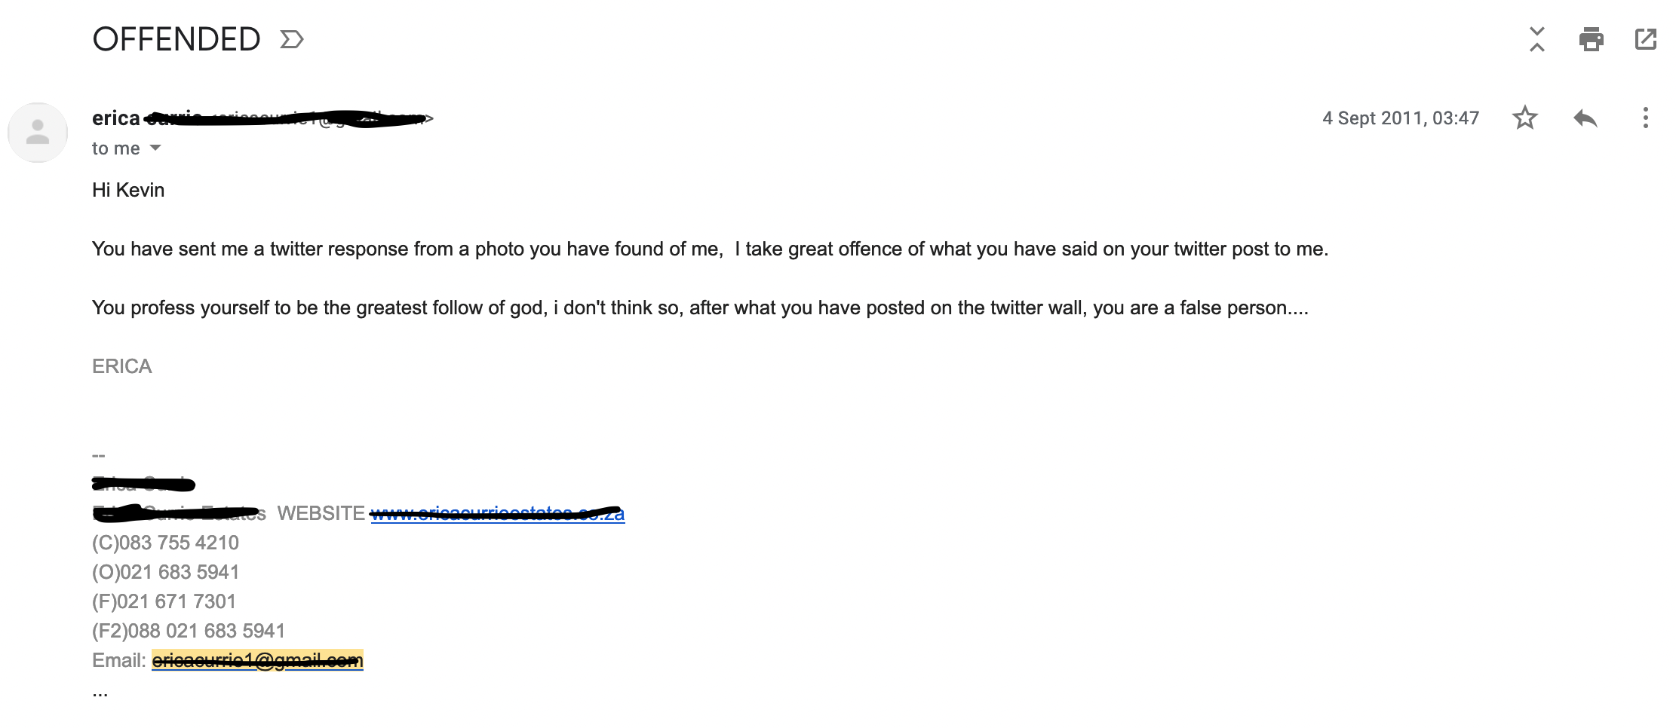

Slide 3
JEREMIAH 29:11
“For I know the plans I have
for you, declares the Lord,
plans for peace and not for evil, to give you a future and a hope.”

Slide 4
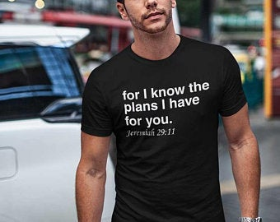

Slide 5
ISAIAH 30:15-16
^{“15} For thus said the Lord GOD, the Holy One of Israel,
“In repentance and rest you shall be saved; in quietness and in trust shall be your strength.”

Slide 6
ISAIAH 30:15-16
But you were unwilling, ¹⁶ and you said,
“No! We will flee upon horses”;
– therefore you shall flee away (as exiles);
“We will ride upon swift steeds”;
– therefore your pursuers shall be swift.”

Slide 7

“It is impossible to exaggerate
the trauma of the events that unfolded with the overthrow of Jerusalem. Everything of value to these people, whether physical, emotional, or spiritual had been ripped away from them.”

Slide 8
PSALM 137
¹ By the waters of Babylon, there we sat down and wept, when we remembered Zion.
² On the willows there, we hung up our lyres.
³ For there our captors, required of us songs,
and our tormentors, mirth (laughter), saying,
“Sing us one of the songs of Zion!”

Slide 9
PSALM 137
⁴ How shall we sing the Lord’s song in a foreign land?
…⁸ O daughter of Babylon, doomed to be destroyed,
blessed shall he be who repays you, with what you have done to us!

Slide 10

Put down your roots.
Seek the welfare of the city.
Pray for the city

Slide 11
1. Put down your roots.
^{“5}Build houses and live in them; plant gardens and eat their produce. ⁶ Take wives and have sons and daughters; take wives for your sons, and give your daughters in marriage, that they may bear sons and daughters; multiply there, and do not decrease.”

Slide 12
Put down your roots.
Seek the welfare of the city.
Pray for the city

Slide 13
2. Seek the welfare of the
city
⁷ But seek the welfare of the city where I have sent you into exile… for in its welfare you will find your welfare.”

Slide 14
“Our hearts were made for you Oh Lord, and will always be restless until we find our rest in you.”

Slide 15
Put down your roots.
Seek the welfare of the city.
Pray for the city

Slide 16
3. Pray for the city.
“…pray to the Lord on its behalf"

