Slide 2
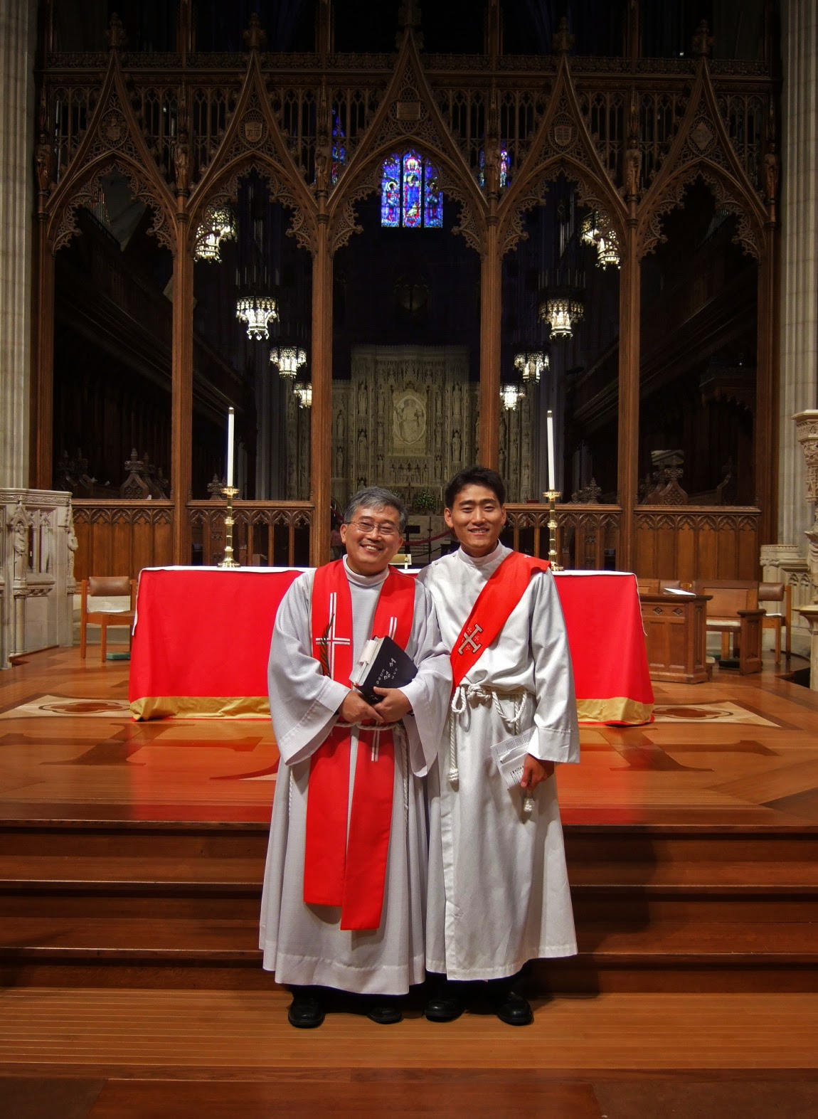

Slide 3
Church in Cities: Trust in the Fog
Expect persecution
Live radically
True God will deliver

Slide 4
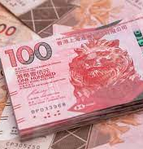
1. Expect persecution
Money

Slide 5
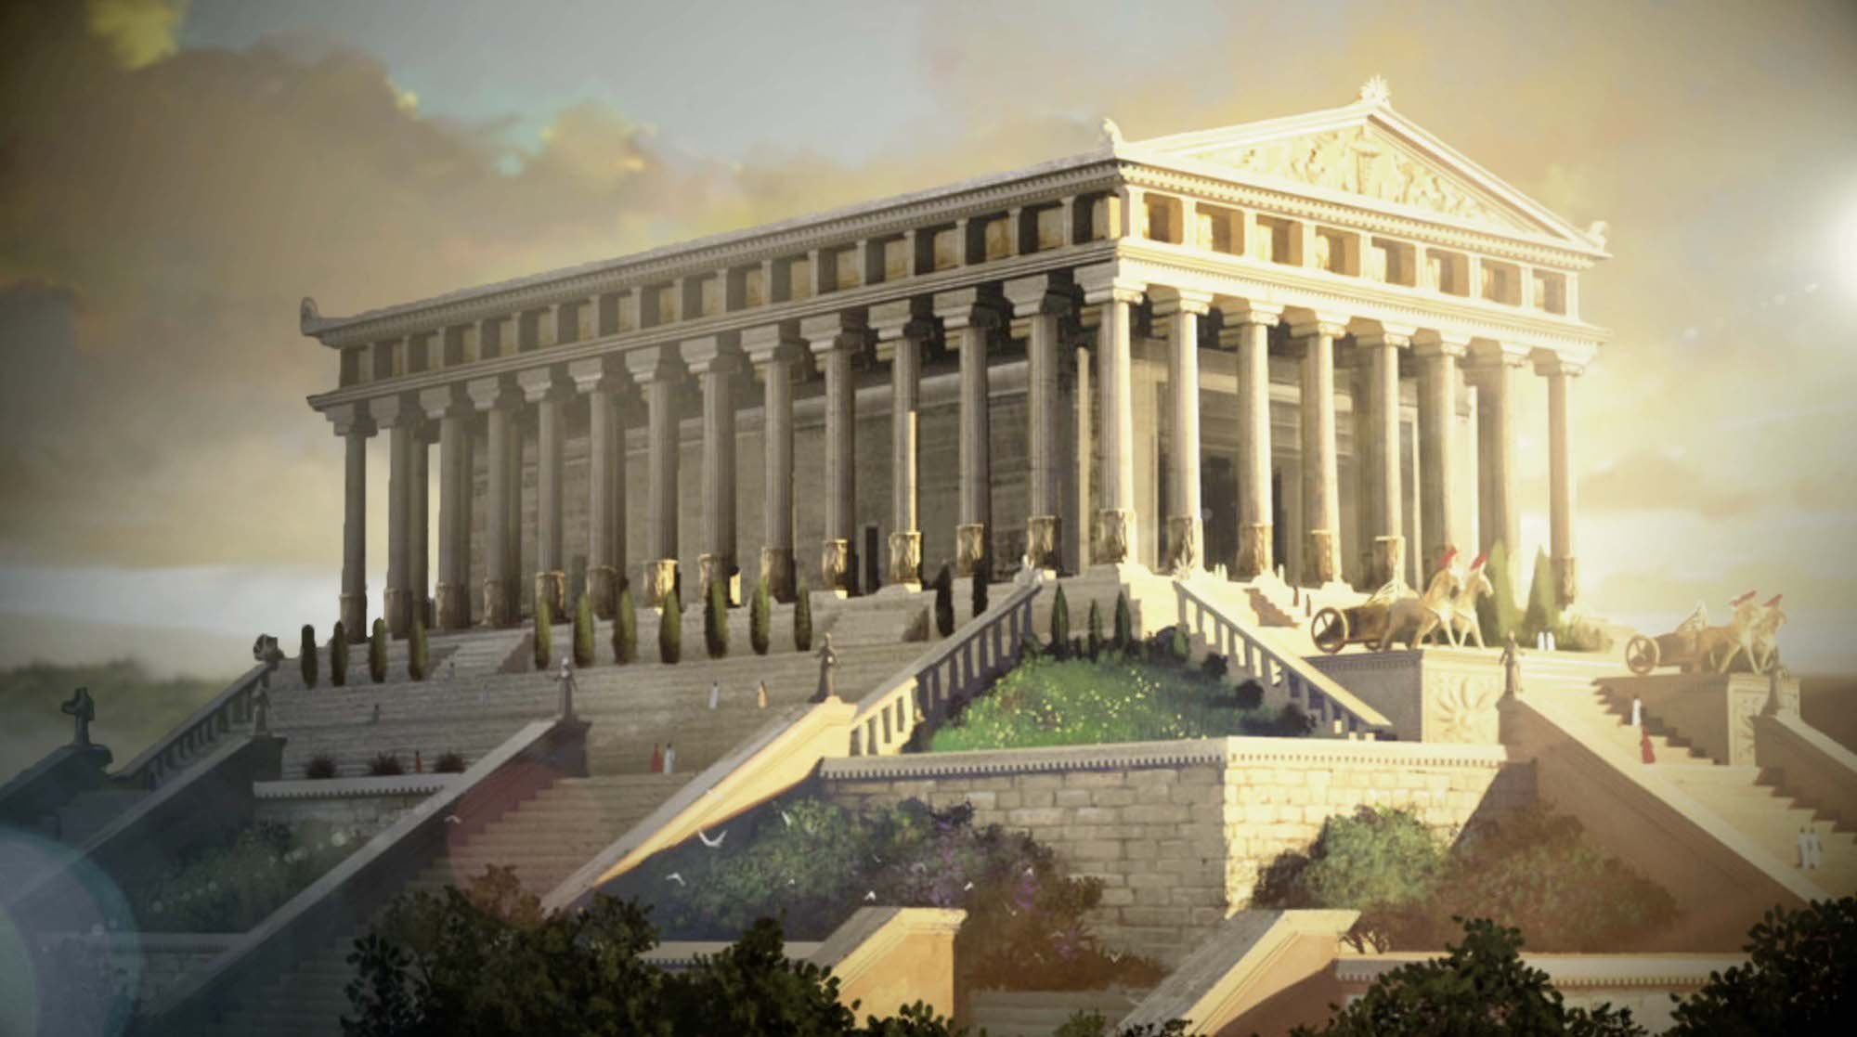

Slide 6

1. Expect persecution
Money
Other religions/ideology

Slide 7
1. Expect persecution
Money
Other religion/ideology
Racism/nationalism

Slide 8
1. Expect persecution
Money
Other religion/ideology
Racism/nationalism
For no reason at all!

Slide 9
‘A servant is not greater than his master.’ If they persecuted me, they will persecute you also.”
John 15:20a

Slide 10
2. Live radically

Slide 11
2. Live radically
Are we living in the world?

Slide 12
2. Live radically
Are we living in the world?
Money

Slide 13
2. Live radically
Are we living in the world?
Money
Christian beliefs
Sinners? Exclusive claims of Jesus? Sexual ethics? Ebracing those who are hurting?

Slide 14
2. Live radically
Are we living in the world?
Money
Christian beliefs
Loving across national/racial/class/ political/ideological divide?

Slide 15
2. Live radically
Are we living in the world?
Money
Christian beliefs
Loving across national/racial/class/ political/ideological divide?
Showing grace

Slide 16
3. True God will deliver
God delivers without speaking!
Trust him even in death

