Slide 1
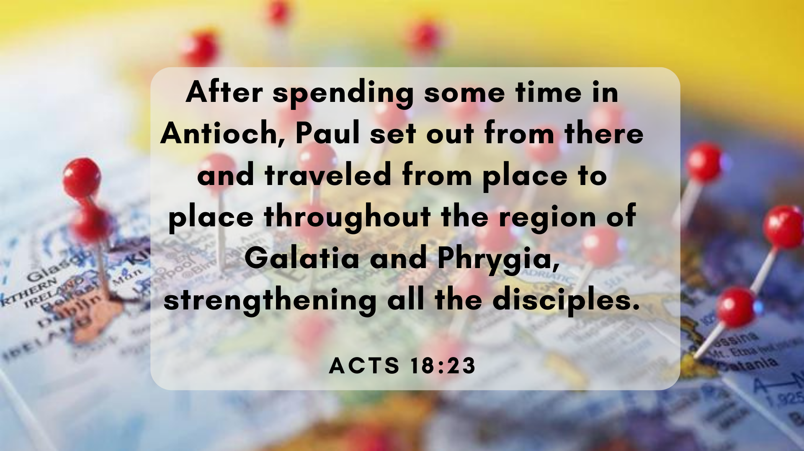

Slide 3
1. Strengthening the Disciples (v18-23)
He himself went into the synagogue and reasoned with the Jews. v19
He went up to Jerusalem and greeted the church. V22
Paul set out from there and travelled from place to place throughout the region of Galatia and Phrygia, strengthening all the disciples. v23

Slide 5
A Nazarite vow involved an abstinence from drinking wine and from cutting one’s hair for a period, at the end of which the hair was first cut and then burned, along with other sacrifices, as a symbol of self-offering to God. Such vows were made either in thankfulness for past blessings or as part of a petition for future blessings.

Slide 6
Numbers 6:22
“This is the law of the Nazirite who vows offerings to the Lord in accordance with their dedication, in addition to whatever else they can afford. They must fulfil the vows they have made, according to the law of the Nazirite."

Slide 7
Acts 21
verse 17 “When we arrived at Jerusalem, the brothers and sisters received us warmly....”
verse 23 and they said to Paul “There are four men with us who have made a vow….”
verse 26 “The next day Paul took the men and purified himself along with them. Then he went to the temple to give notice of the date when the days of purification would end and the offering would be made for each of them.”

Slide 9
1 Corinthians 9:19-22
Though I am free and belong to no one, I have made myself a slave to everyone, to win as many as possible. To the Jews I became like a Jew, to win the Jews. To those under the law I became like one under the law (though I myself am not under the law), so as to win those under the law. To those not having the law I became like one not having the law (though I am not free from God’s law but am under Christ’s law), so as to win those not having the law. To the weak I became weak, to win the weak. I have become all things to all people so that by all possible means I might save some. I do all this for the sake of the gospel, that I may share in its blessings.

Slide 10
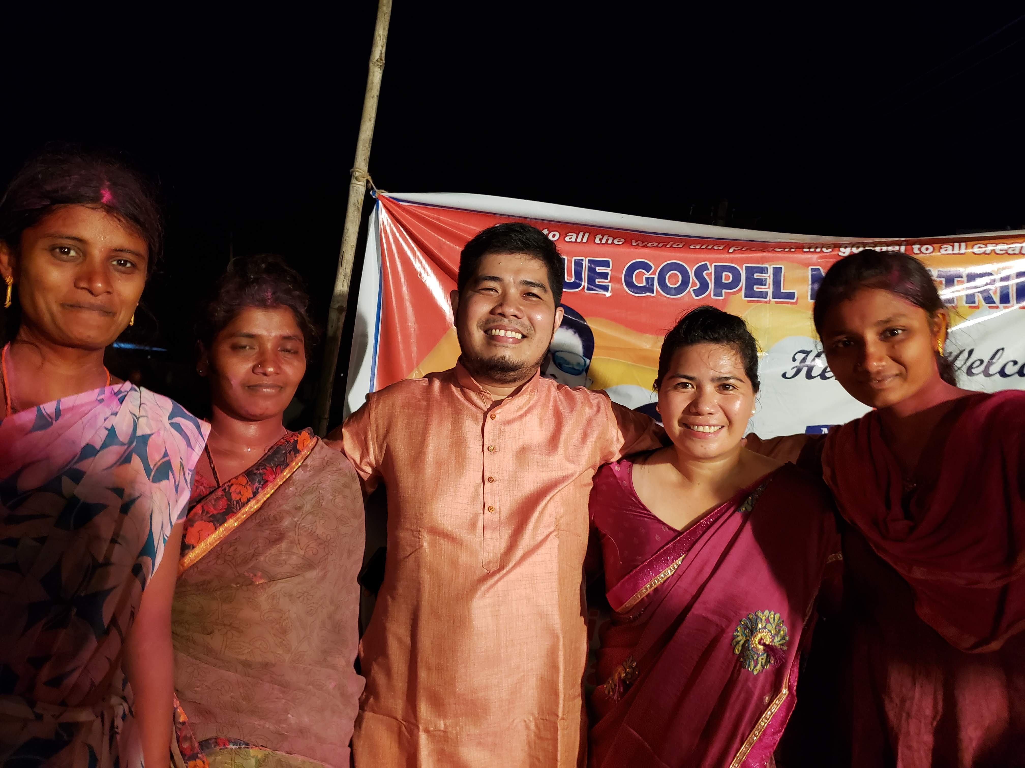
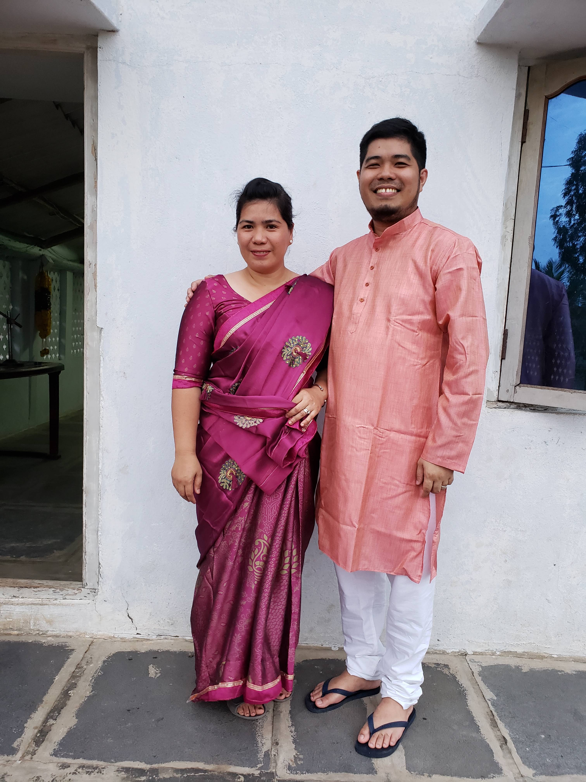

Slide 12
2. Building Others in the Faith (24-28)
”…they invited him to their home and explained to him the way of God more adequately. v26b

Slide 13
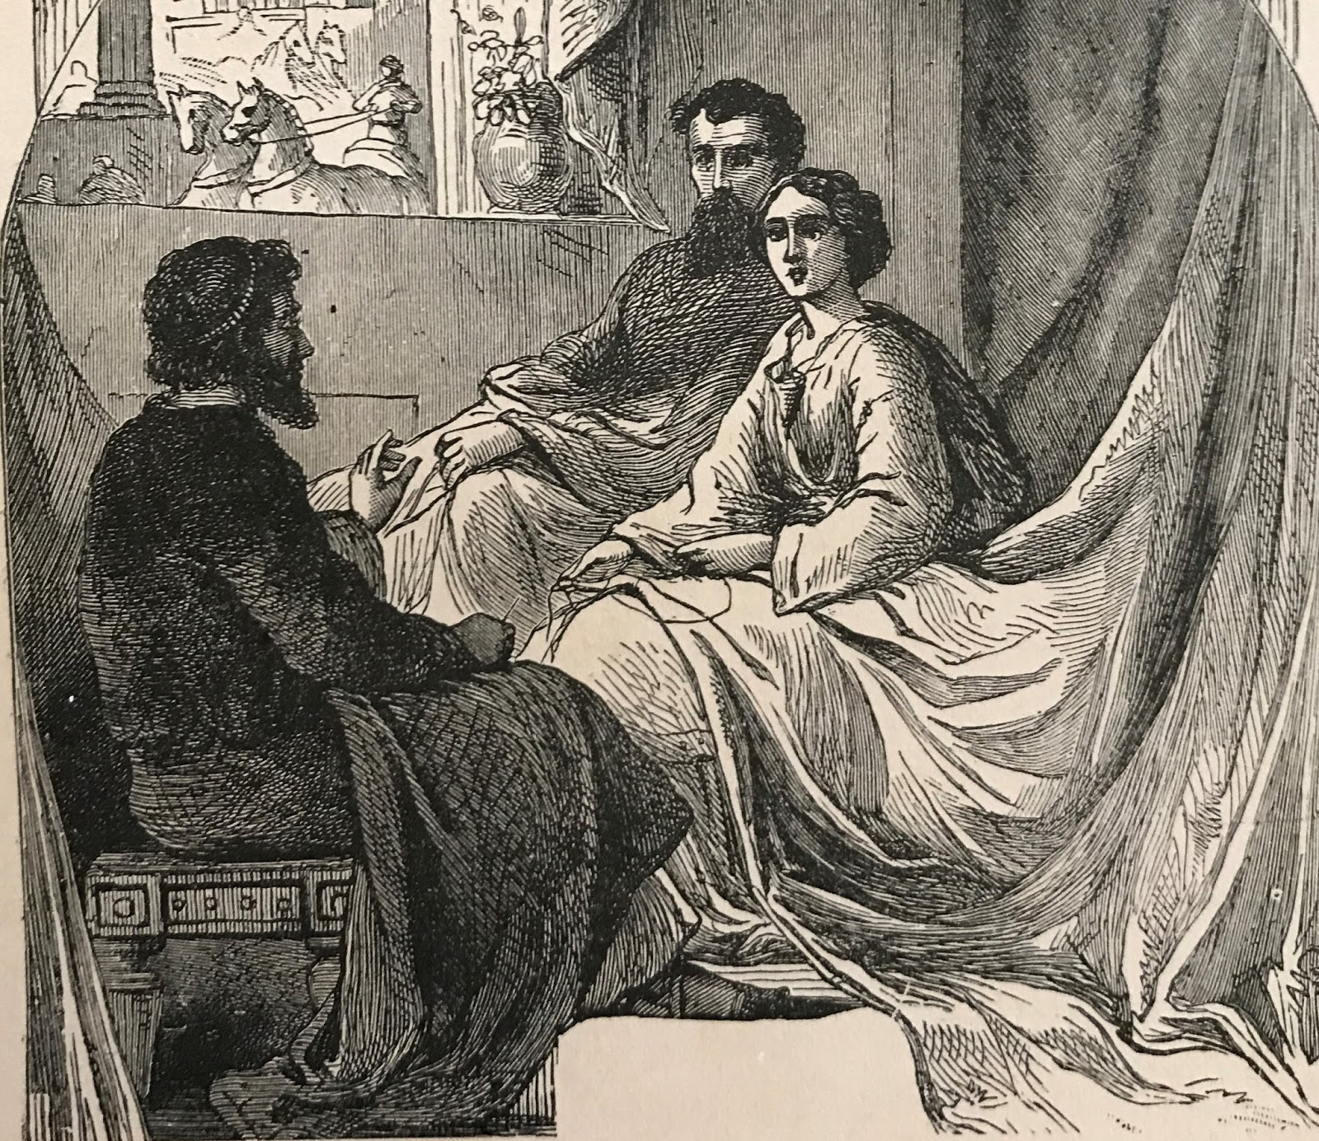

Slide 15
Romans 1:16
“For I am not ashamed of the gospel,
because it is the power of God that brings salvation to everyone who believes: first to the Jew, then to the Gentile.”

