Slide 1
“But you, man of God, flee from all this, and pursue righteousness, godliness, faith, love, endurance and gentleness.”
- 1 Timothy 6:11

Slide 2
Guard the Faith: Man of God
Flee from Love of Money (v.3-12)
Pursue Contentment in God (v.13-16)
Hope in God (v.17-21)

Slide 3
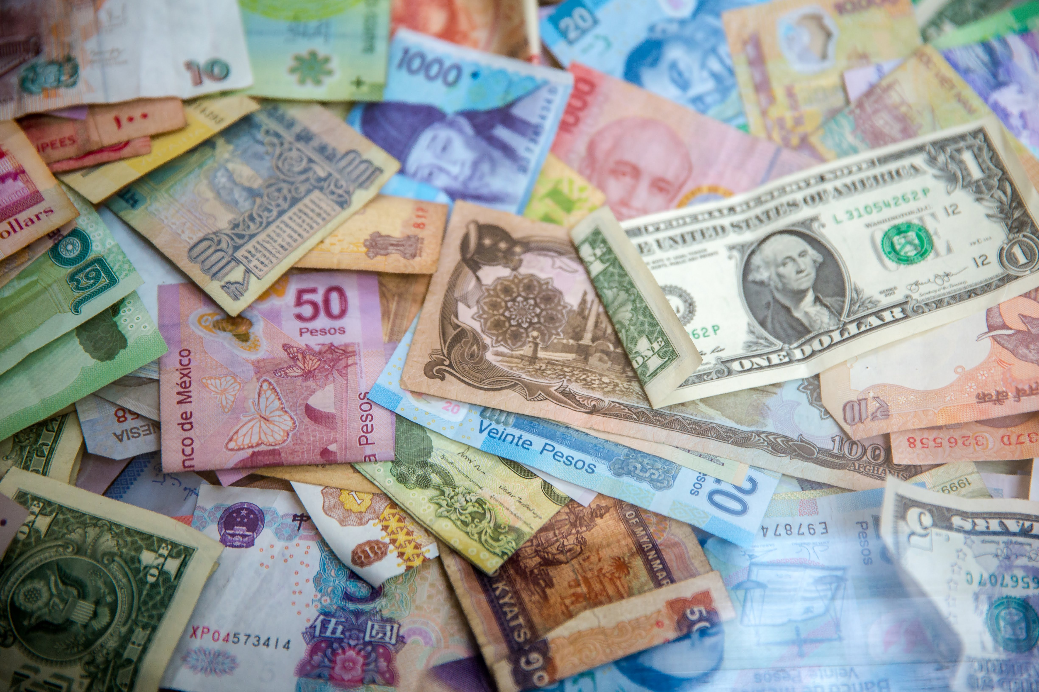

Slide 4
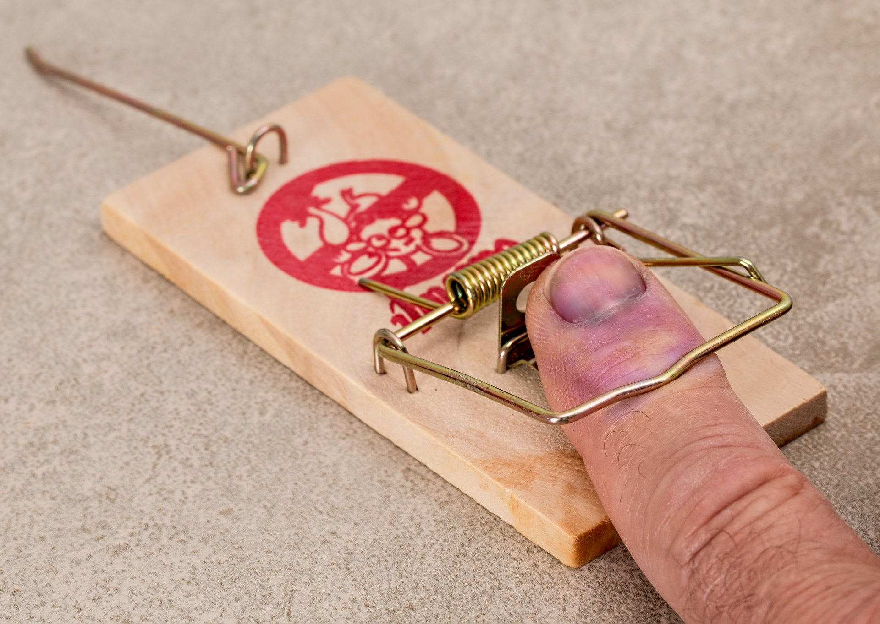

Slide 5


Slide 6
2. Pursue Contentment in God
¹¹ But you, man of God, flee from all this, and pursue righteousness, godliness, faith, love, endurance and gentleness. ¹² Fight the good fight of the faith. Take hold of the eternal life to which you were called when you made your good confession in the presence of many witnesses.

Slide 7
2. Pursue Contentment in God
“But godliness with contentment is great gain” (v.6).

Slide 8


Slide 9
2. Pursue Contentment in God
He who did not spare his own Son, but gave him up for us all—how will he not also, along with him, graciously give us all things?
-Romans 8:32

Slide 10
2. Pursue Contentment in God
¹² I know what it is to be in need, and I know what it is to have plenty. I have learned the secret of being content in any and every situation, whether well fed or hungry, whether living in plenty or in want. ¹³ I can do all this through him who gives me strength.
- Phil 4:12-13

Slide 11
2. Pursue Contentment in God
I charge you ¹⁴ to keep this command without spot or blame until the appearing of our Lord Jesus Christ, ¹⁵ which God will bring about in his own time—God, the blessed and only Ruler, the King of kings and Lord of lords, ¹⁶ who alone is immortal and who lives in unapproachable light, whom no one has seen or can see. To him be honor and might forever. Amen.
- 1 Tim 6:13b-16

Slide 12
3. Hope in God (v.17-21)
¹⁷ Command those who are rich in this present world not to be arrogant nor to put their hope in wealth, which is so uncertain, but to put their hope in God, who richly provides us with everything for our enjoyment. ¹⁸ Command them to do good, to be rich in good deeds, and to be generous and willing to share. ¹⁹ In this way they will lay up treasure for themselves as a firm foundation for the coming age, so that they may take hold of the life that is truly life.

Slide 13
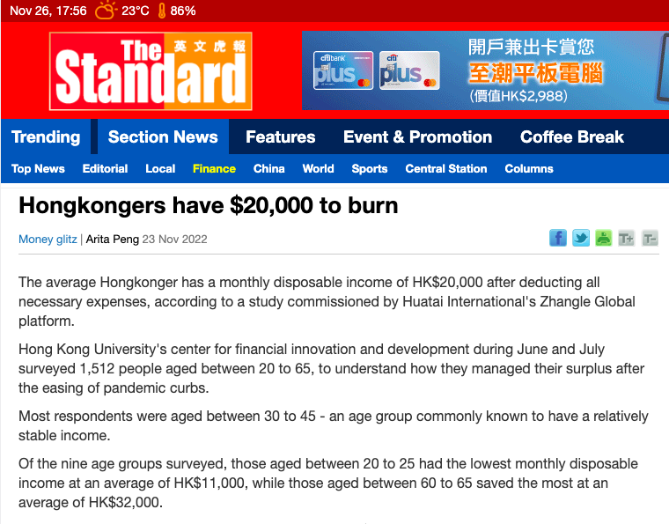

Slide 14
