Slide 2


Slide 3
9 An angel of the Lord appeared to them, and the glory of the Lord shone around them, and they were terrified.

Slide 4
I bring you good news that will cause great joy for all the people. 11 Today in the town of David a Savior has been born to you; he is the Messiah, the Lord.

Slide 5
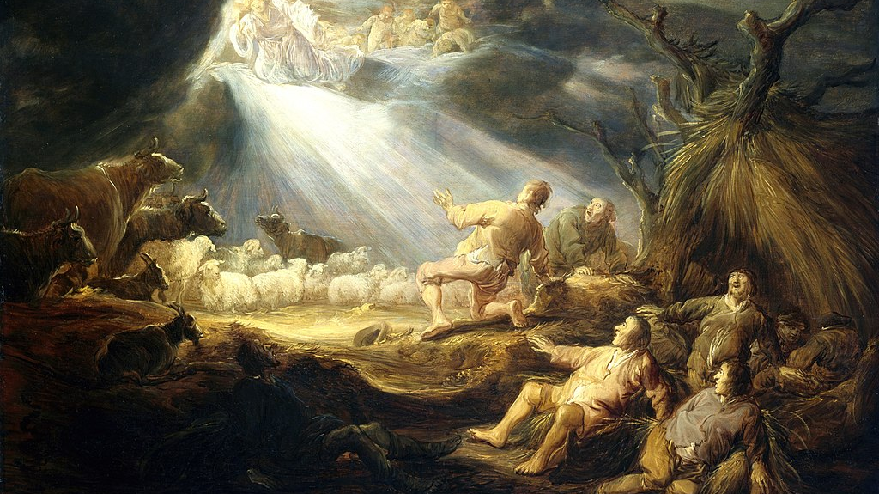
Benjamin Gerritsz, The Annunciation to the Shepherds

Slide 6
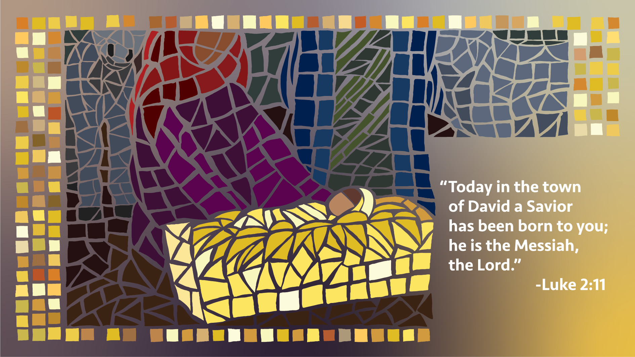

Slide 7
8 And there were shepherds living out in the fields nearby, keeping watch over their flocks at night

Slide 9
17 When they had seen him, they spread the word concerning what they had been told about this child.

Slide 10
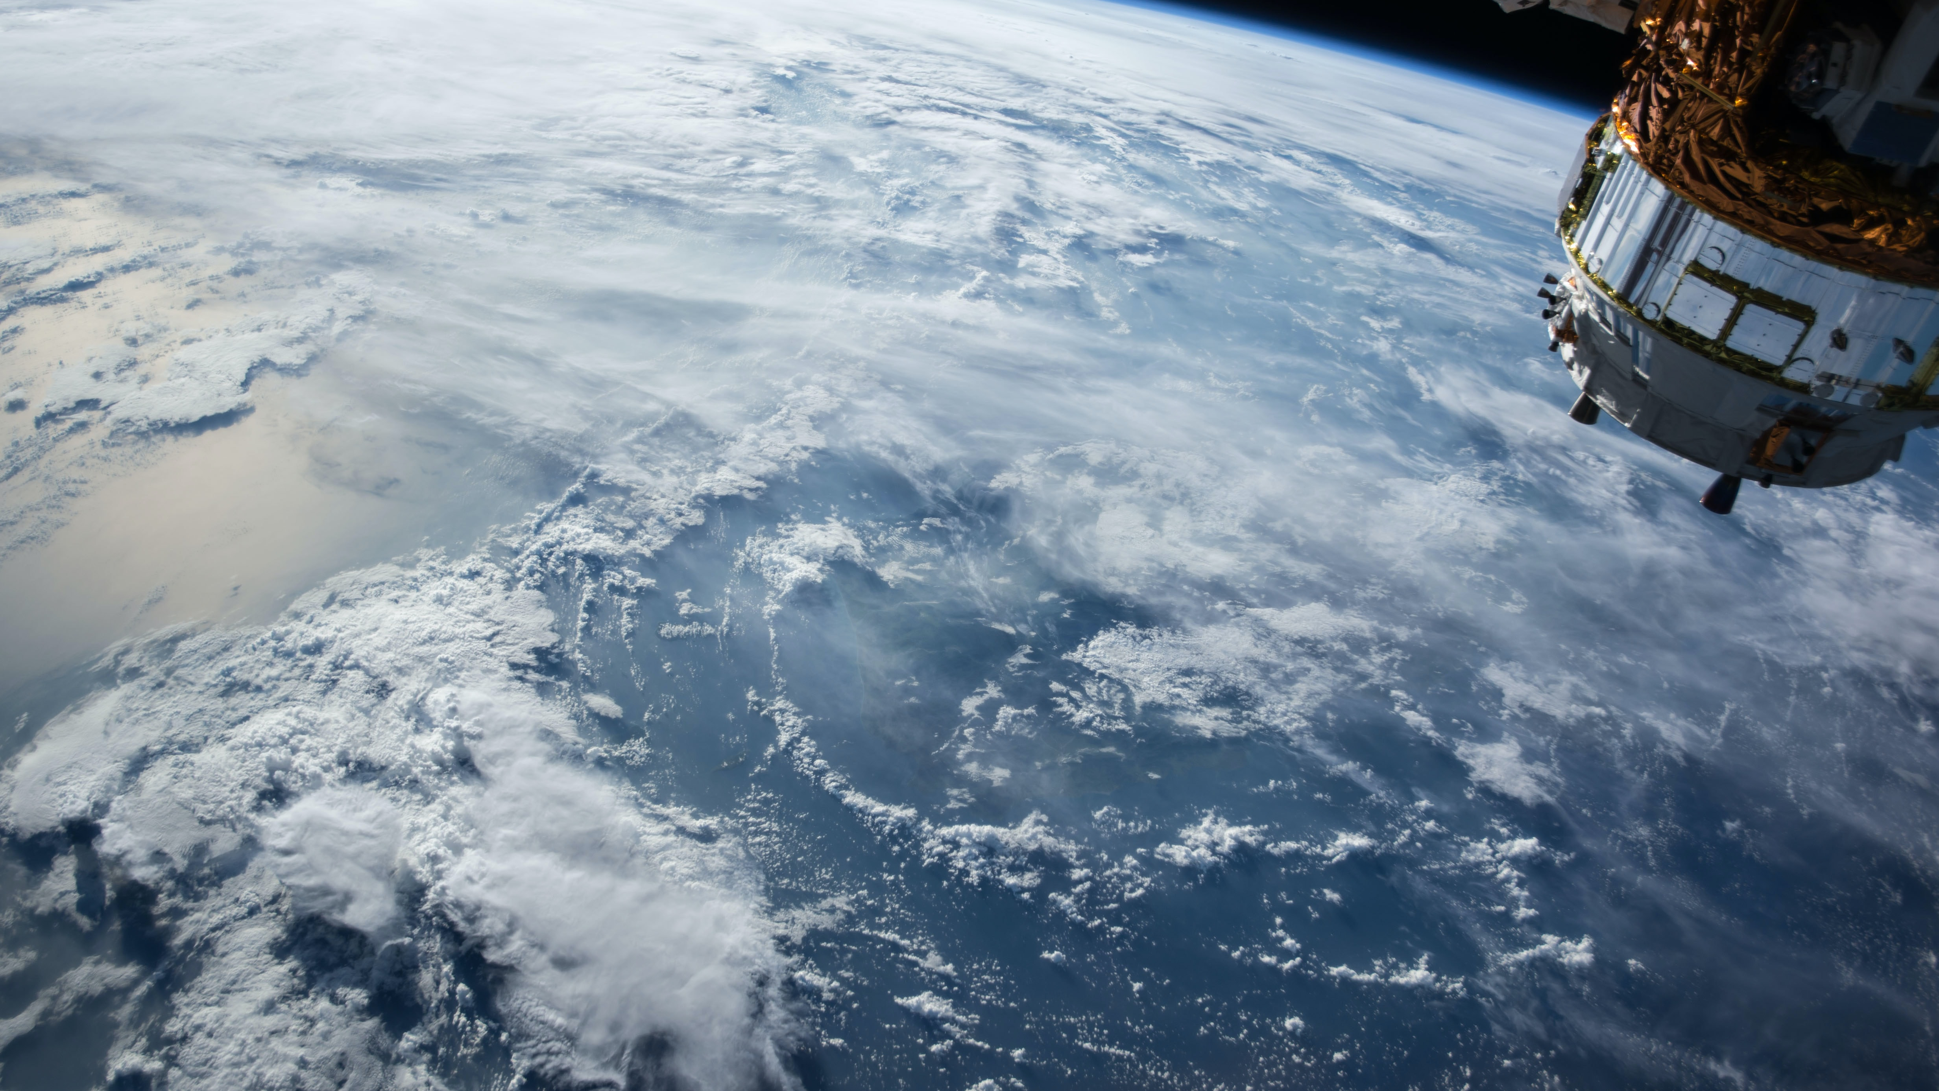

Slide 11
