Slide 2
”But you will receive power when the Holy Spirit comes on you; and you will be my witnesses in Jerusalem, and in all Judea and Samaria, and to the ends of the earth.”
Acts 1:8

Slide 3
1. Have You Met Jesus? (19:1-7)

Slide 4
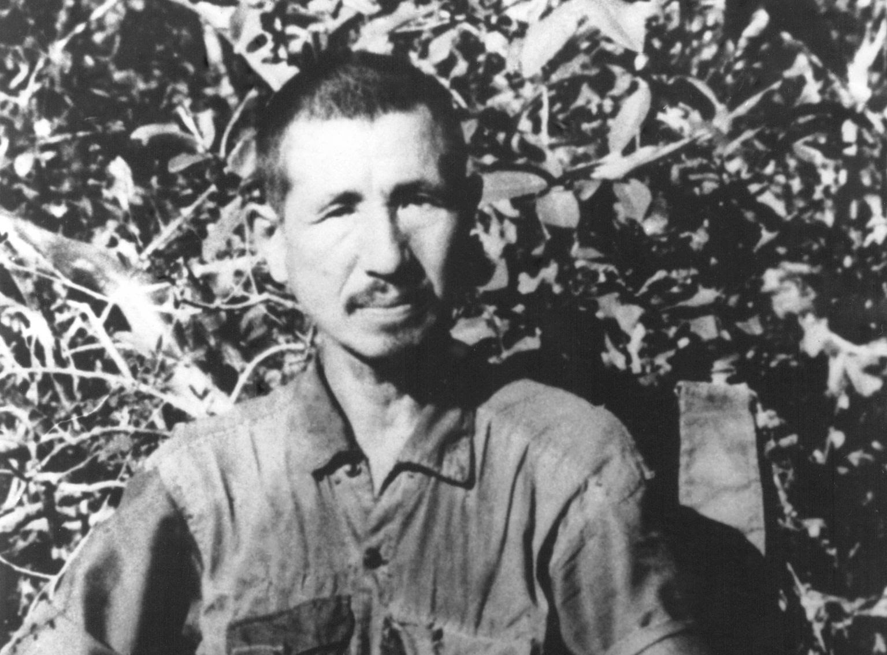

Slide 5
Peter replied, “Repent and be baptized, every one of you, in the name of Jesus Christ for the forgiveness of your sins. And you will receive the gift of the Holy Spirit.
Acts 2:38

Slide 6
13 And you also were included in Christ when you heard the message of truth, the gospel of your salvation. When you believed, you were marked in him with a seal, the promised Holy Spirit,
Ephesians 1:13

Slide 7
The norm of Christian conversion
Repentance
Faith in Jesus
Water baptism
Gift of the Spirit

Slide 8
2. The Word Goes Out (v.8-10, 20)
This went on for two years, so that all the Jews and Greeks who lived in the province of Asia heard the word of the Lord (v.10)
In this way the word of the Lord spread widely and grew in power (v.20).

Slide 9
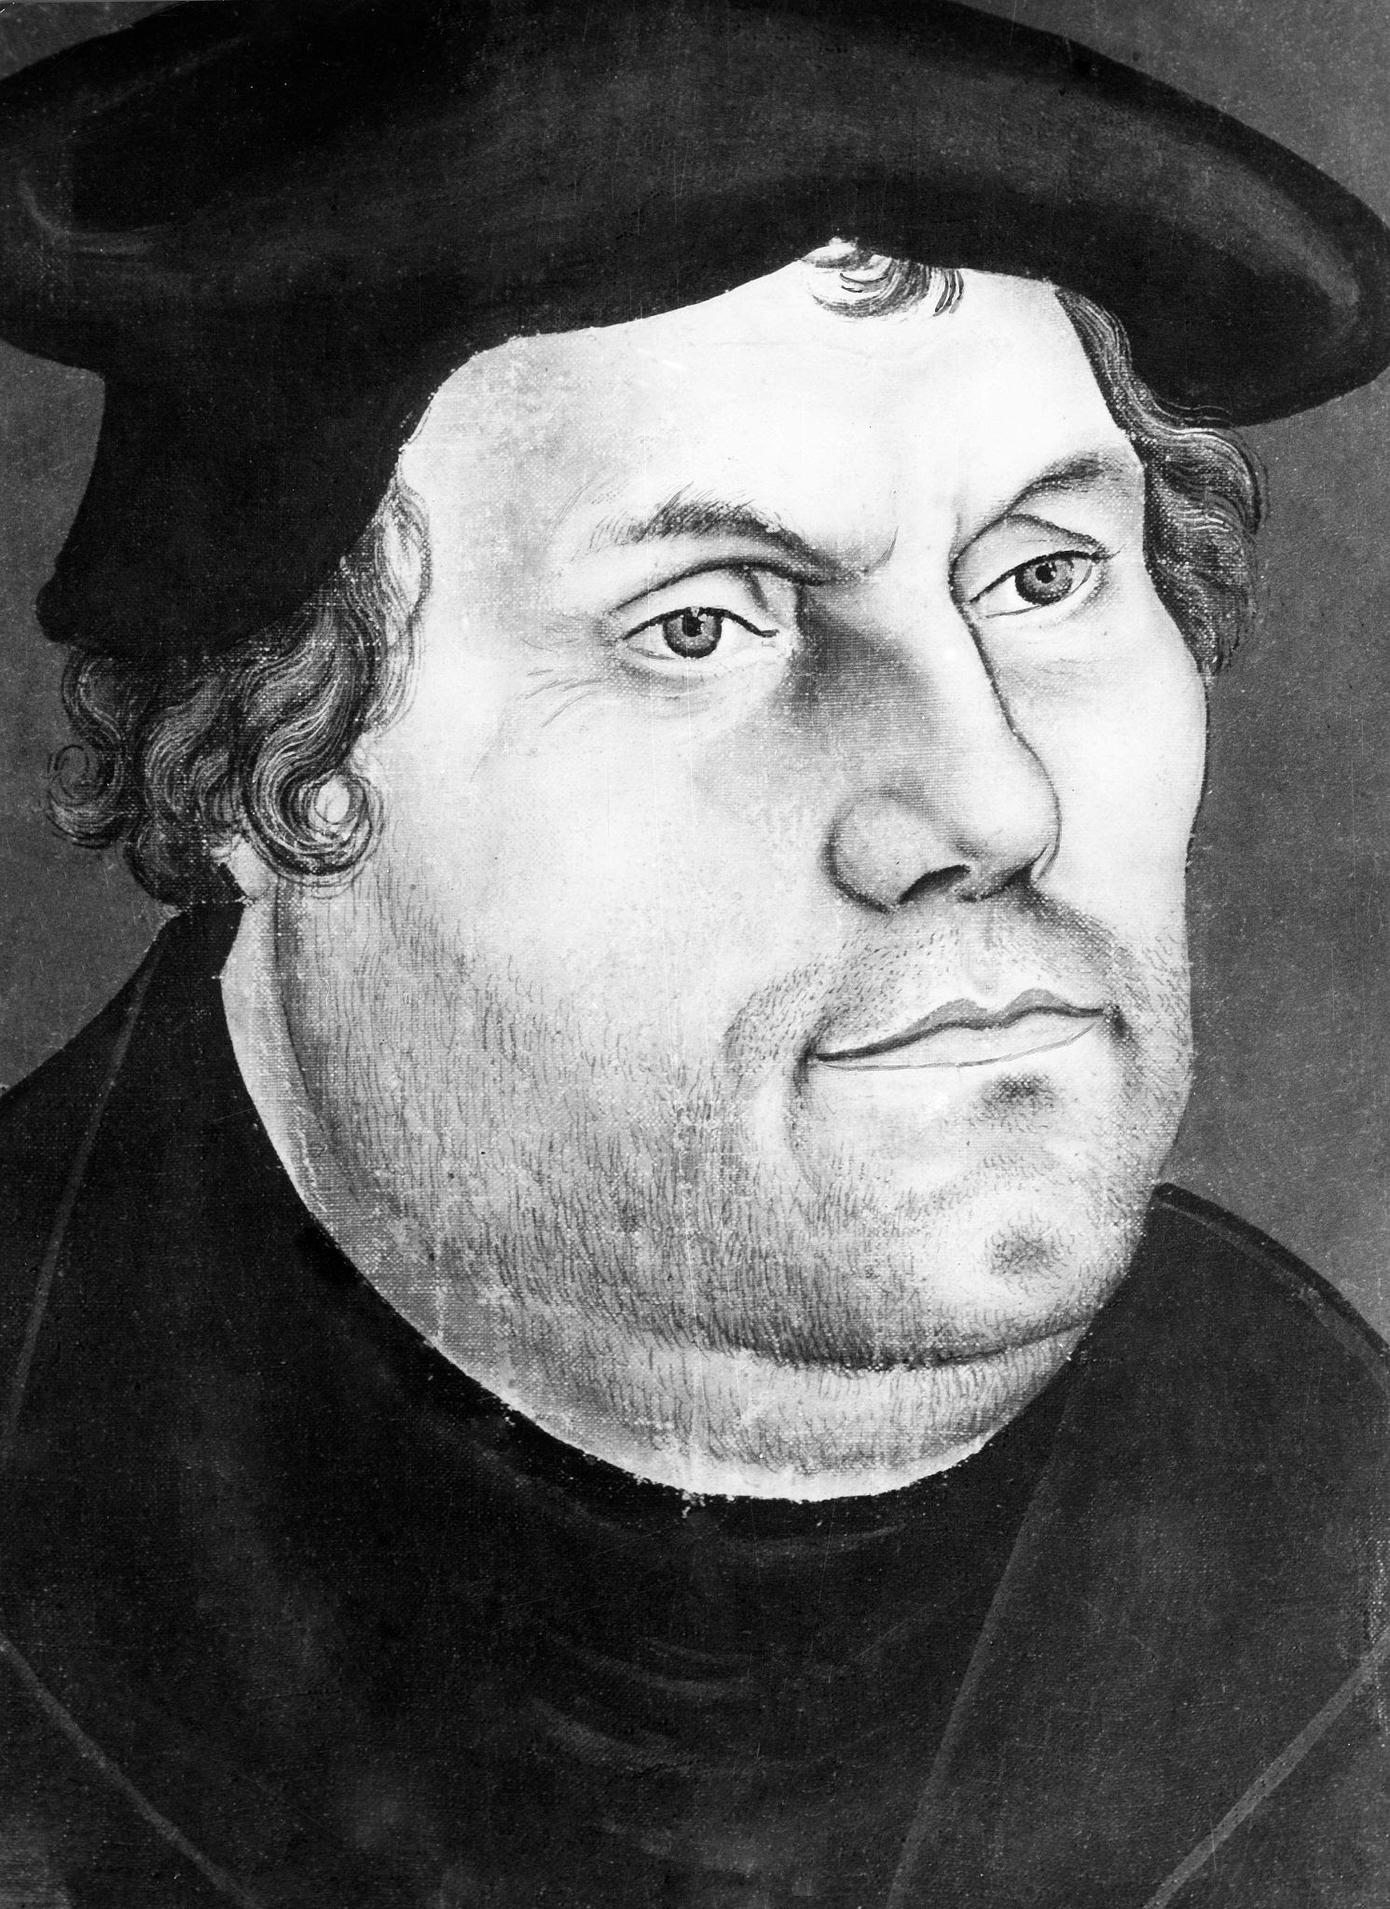
“Take myself as an example. I opposed indulgences and all the papists, but never with force. I simply taught, preached, and wrote God’s Word; otherwise I did nothing. And while I slept, or drank Wittenberg beer with my friends Philipp and Amsdorf, the Word so greatly weakened the papacy that no prince or emperor ever inflicted such losses upon it. I did nothing; the Word did everything.”

Slide 10
24 Meanwhile a Jew named Apollos, a native of Alexandria, came to Ephesus. He was a learned man, with a thorough knowledge of the Scriptures. 25 He had been instructed in the way of the Lord, and he spoke with great fervor and taught about Jesus accurately, though he knew only the baptism of John. 26 He began to speak boldly in the synagogue. When Priscilla and Aquila heard him, they invited him to their home and explained to him the way of God more adequately.
Acts 18:24-26

Slide 11
3. Darkness Recedes (19:11-20)
10 This went on for two years, so that all the Jews and Greeks who lived in the province of Asia heard the word of the Lord.
11 God did extraordinary miracles through Paul, 12 so that even handkerchiefs and aprons that had touched him were taken to the sick, and their illnesses were cured and the evil spirits left them.

Slide 12
 | Peter (1-12) | Paul (13-28)
Filled with the Spirit | 4:8 | 9:17, 13:9
Preached the word of God with boldness | 4:13,31 | 9:27,29
Bore witness before Jewish audiences to Jesus crucified… | 2:22 | 13:16
Preaches to the gentiles | 10:34ff | 13:46ff
Receive vision which gave vital direction to the church’s mission | 10:9ff | 16:9
Imprisoned for their testimony and miraculous escape | 3:2ff | 14:8ff
Miraculous healing | Peter’s shadow (5:15) | Paul’s handkerchief and aprons (19:12)
Raise the dead | Tabitah in Joppa (9:36ff) | Eutychus in Troas (20:7)
Call down God’s judgment on a sorcerer/false teacher | Simon Magus in Samaria (8:20ff) | Elymas in Paphos (13:6ff)
Refuse the worship of their fellow human beings | Cornelius (10:25-26) | Lystrans (14:11ff)

Slide 13
3. Darkness Recedes (19:11-20)
extraordinary miracles (v.11)
Shouldn’t be surprised when people are healed
Demons driven away
  - For we do not wrestle against flesh and blood, but against the rulers, against the authorities, against the cosmic powers over this present darkness, against the spiritual forces of evil in the heavenly places.” (Ephesians 6:12)

Slide 14
3. Darkness Recedes (19:11-20)
extraordinary miracles (v.11)
Shouldn’t be surprised when people are healed
Demons driven away
  For we do not wrestle against flesh and blood, but against the rulers, against the authorities, against the cosmic powers over this present darkness, against the spiritual forces of evil in the heavenly places.” (Ephesians 6:12)
But it’s not magic!

Slide 15
3. Darkness Recedes (19:11-20)
Changed lives (v.18-19)

