Slide 1


Slide 2
Declaring God’s Grace
Be ready to love your enemies
Be ready to tell your testimony
Be ready to exercise your rights

Slide 3
35 When Paul reached the steps, the violence of the mob was so great he had to be carried by the soldiers. 36 The crowd that followed kept shouting, “Get rid of him!”
Acts 21:35-36

Slide 4
1. Be ready to love your enemies
V.1, “brothers and fathers….”

Slide 5
1. Be ready to love your enemies
V.1, “brothers and fathers….”
Story of Jesus = story of Paul
  Journey to Jerusalem despite warnings of hardship
  Accusation of defilement/destruction of the temple
  Apprehended by the Jews, handed over to the Romans
  Beating within an inch of life
  Trials by the Sanhedrin and the Romans
  Murderous shouts

Slide 6
1. Be ready to love your enemies
V.1, “brothers and fathers….”
Story of Jesus = story of Paul
Story of Jesus = your story?

Slide 7
2. Be ready to speak your testimony
¹ “Brothers and fathers, listen now to my defense.”
² When they heard him speak to them in Aramaic, they became very quiet.
Then Paul said: ³ “I am a Jew, born in Tarsus of Cilicia, but brought up in this city. I studied under Gamaliel and was thoroughly trained in the law of our ancestors. I was just as zealous for God as any of you are today. ⁴ I persecuted the followers of this Way to their death, arresting both men and women and throwing them into prison, ⁵ as the high priest and all the Council can themselves testify. I even obtained letters from them to their associates in Damascus, and went there to bring these people as prisoners to Jerusalem to be punished.

Slide 9
2. Be ready to speak your testimony
Speaking of the difference Jesus is making in our life today
Not a formula, but personalized
Speaking of the grace of Jesus

Slide 10
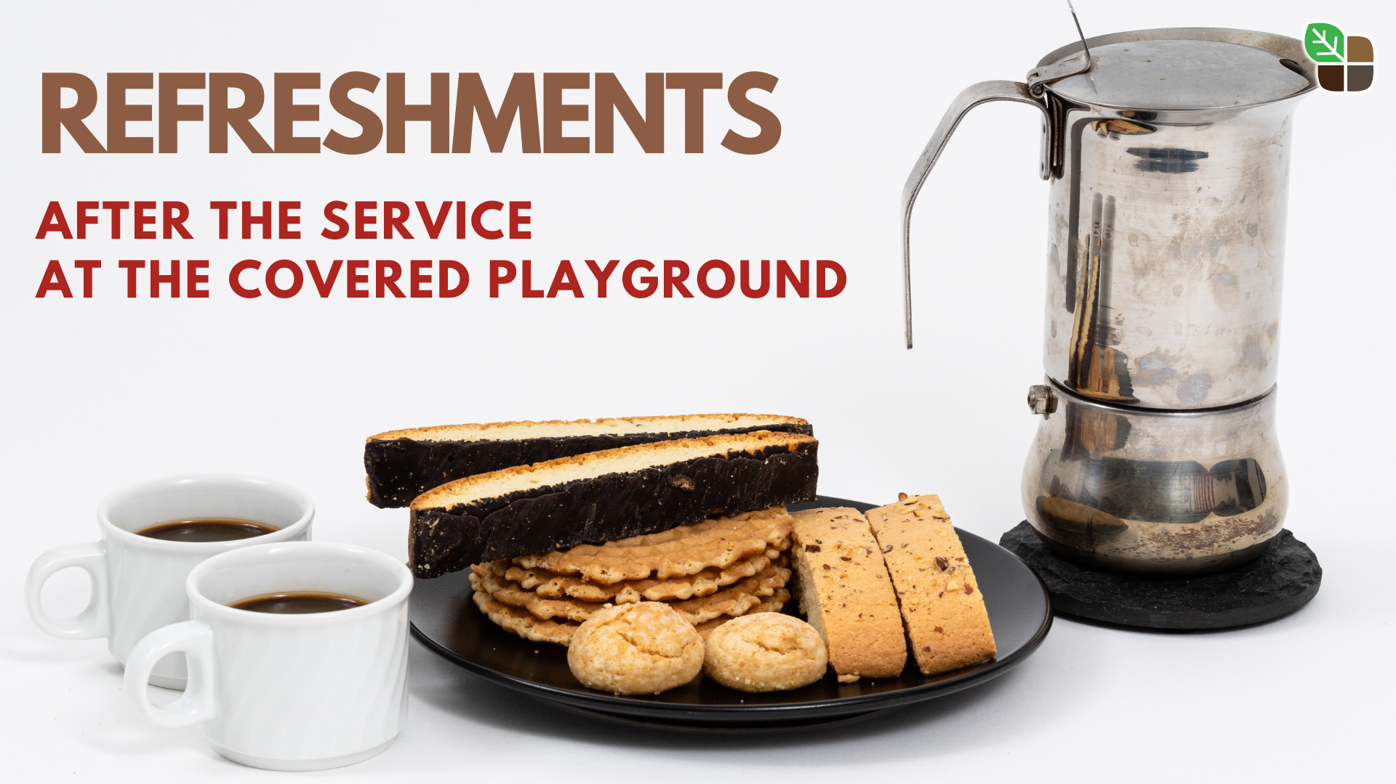

Slide 11
3. Be ready to exercise your rights

Slide 12
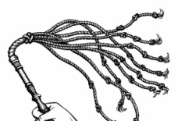
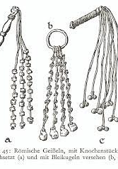
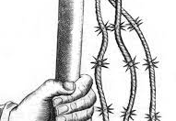
Paul said to the centurion standing there, “Is it legal for you to flog a Roman citizen who hasn’t even been found guilty?” (v.25)

Slide 13
3. Be ready to exercise your rights
Being gracious does not mean being a doormat
But when are we to be gracious and when are we to insist on our rights?

Slide 14
