Slide 2
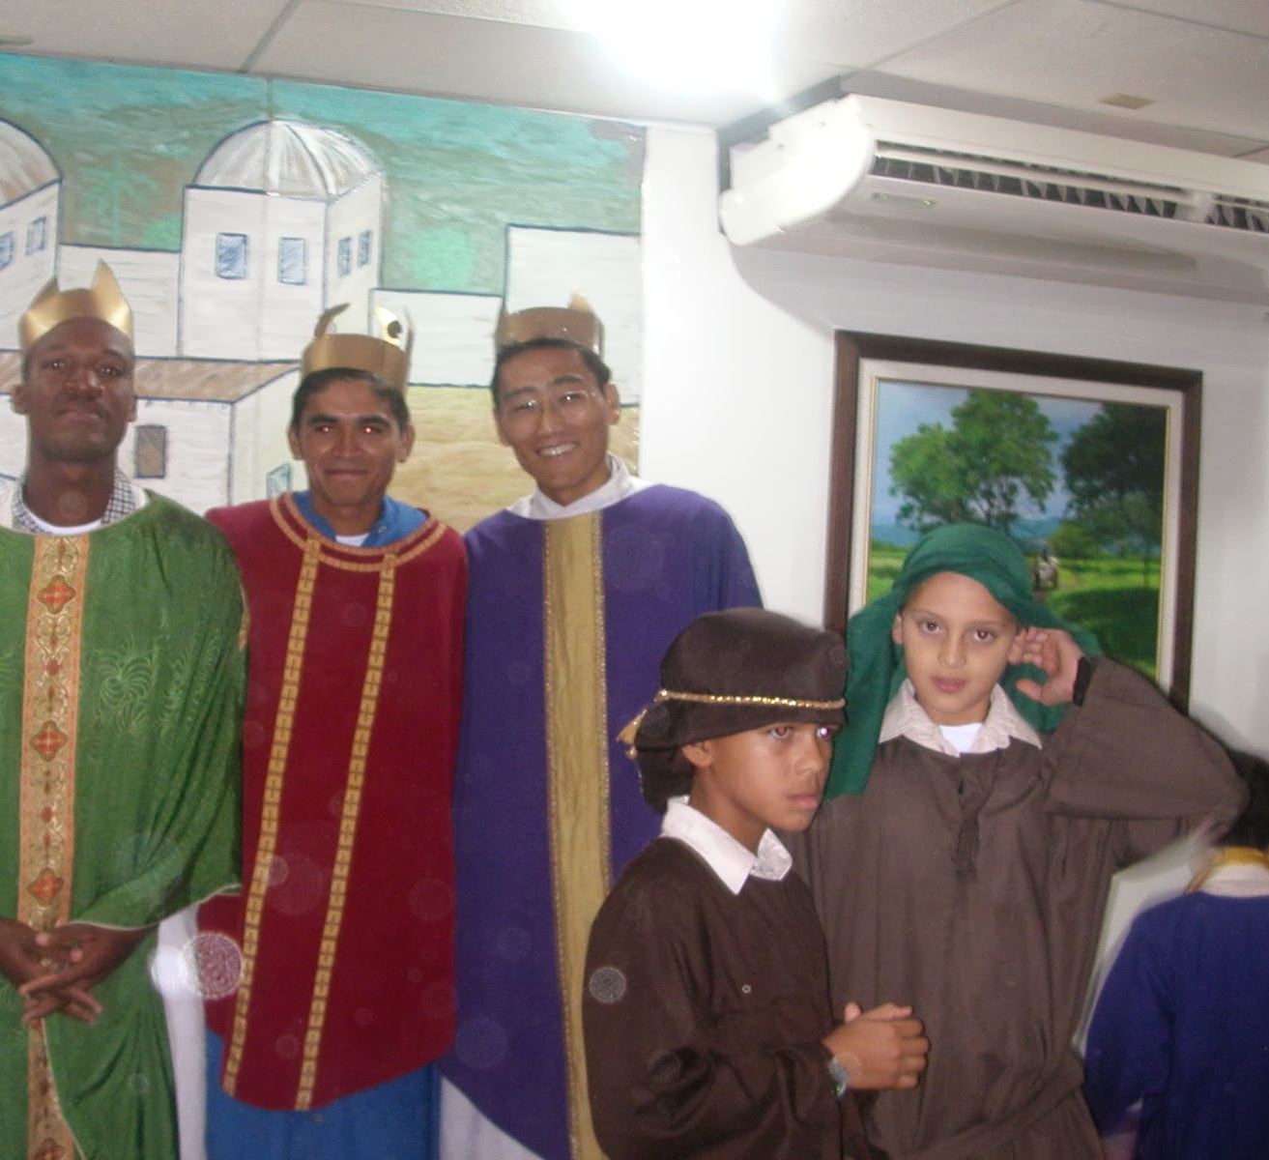
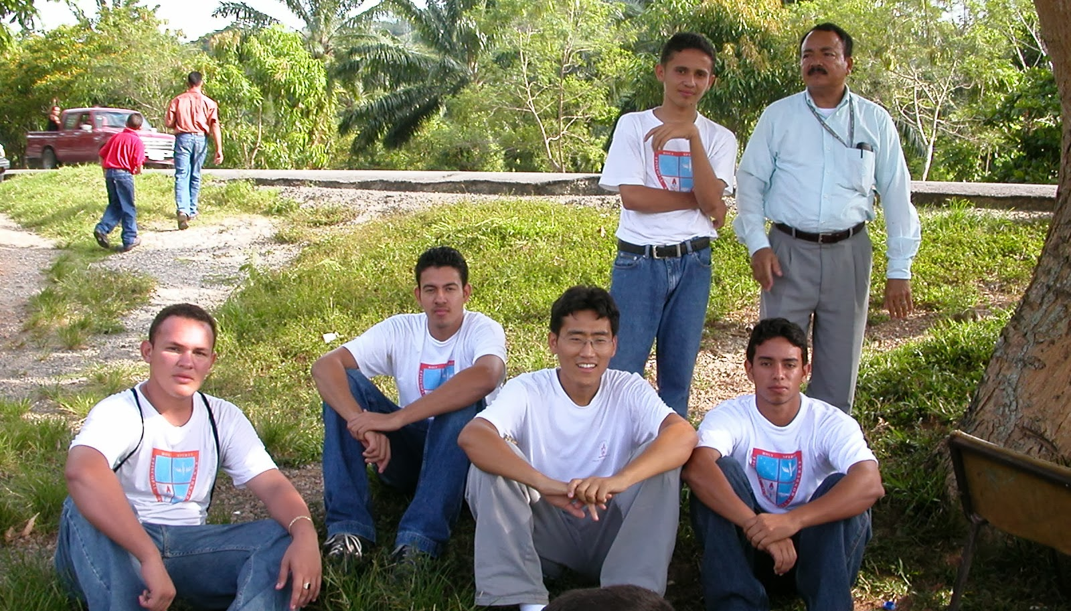
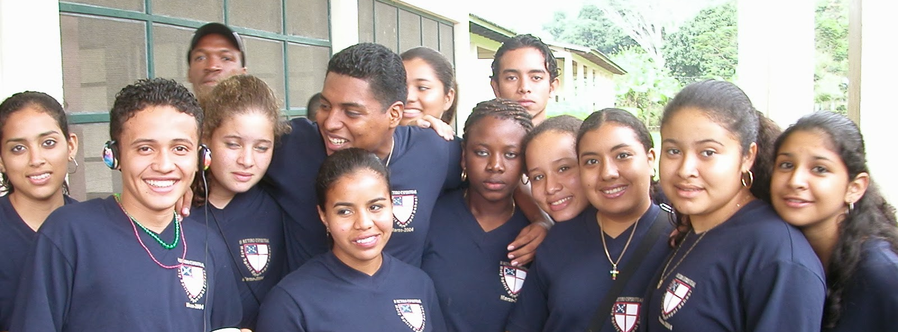

Slide 3
Devoted Leadership
Shows the value of the gospel
Teaches the whole will of God
Keeps watch over the flock

Slide 4
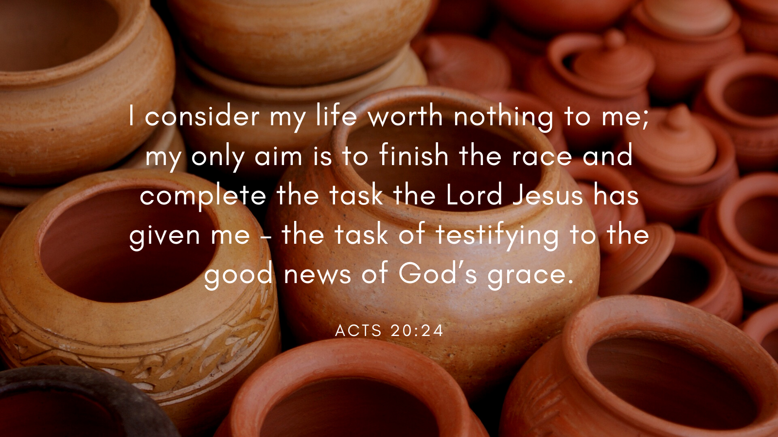

Slide 5
You know how I lived the whole time I was with you. I served the Lord with great humility and with tears and in the midst of severe testing by the plots of my Jewish opponents.
Acts 20:18

Slide 6
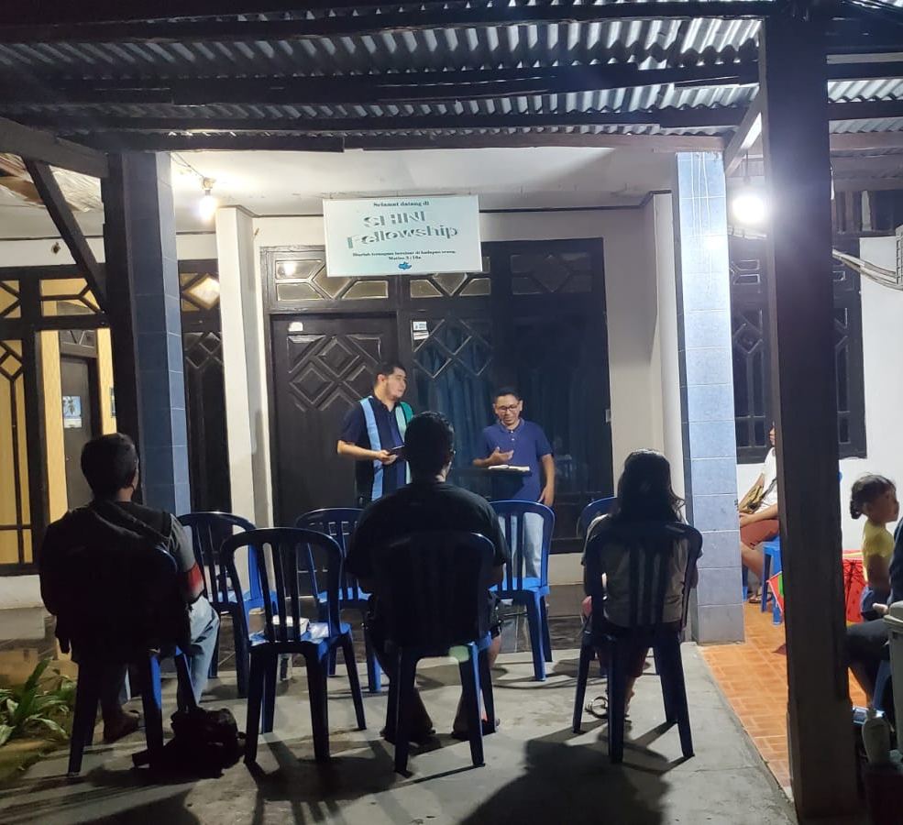
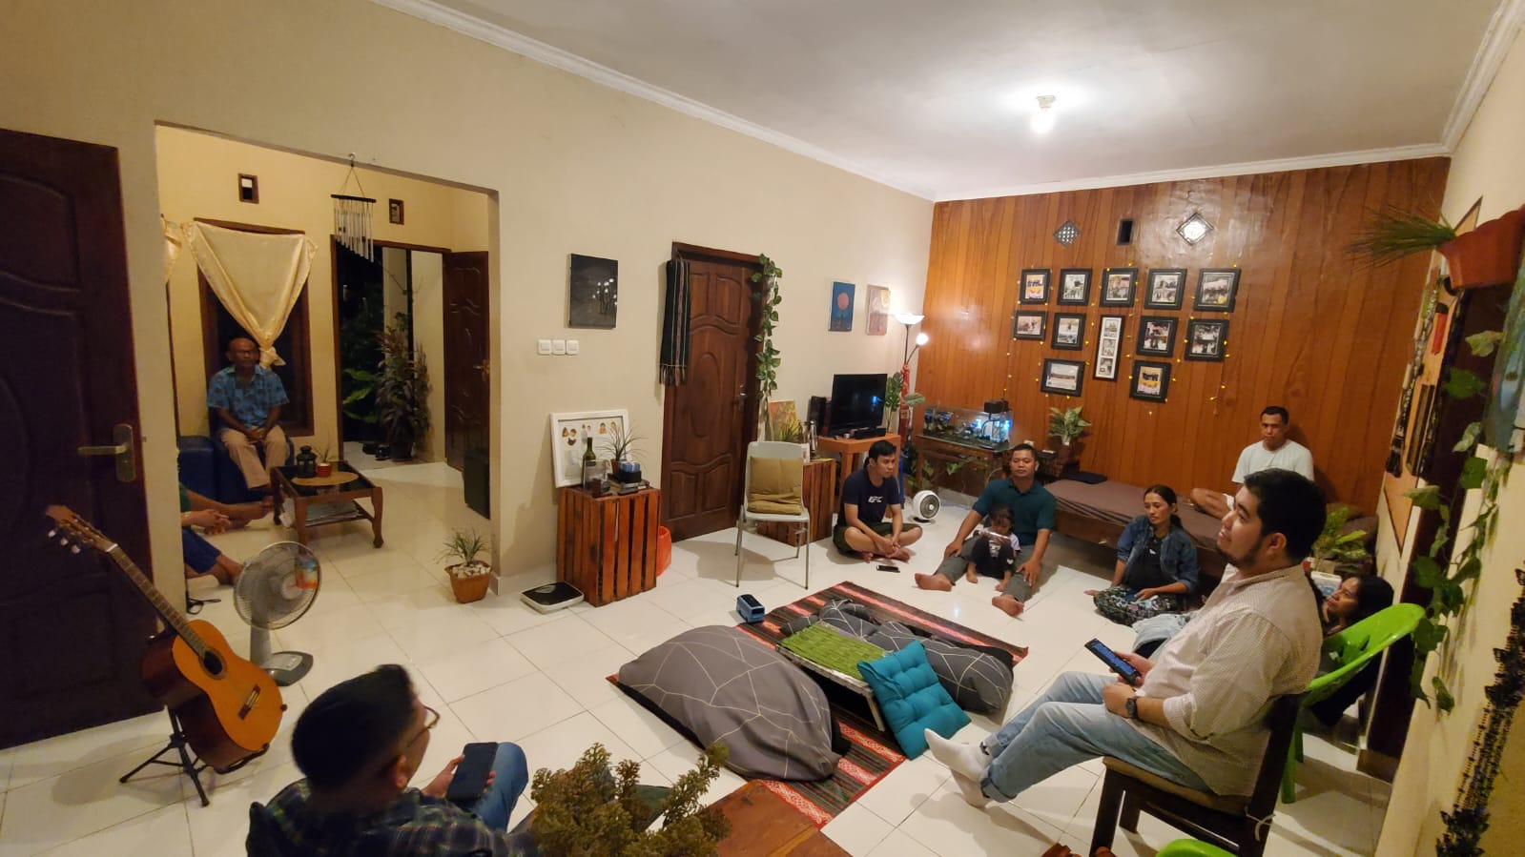
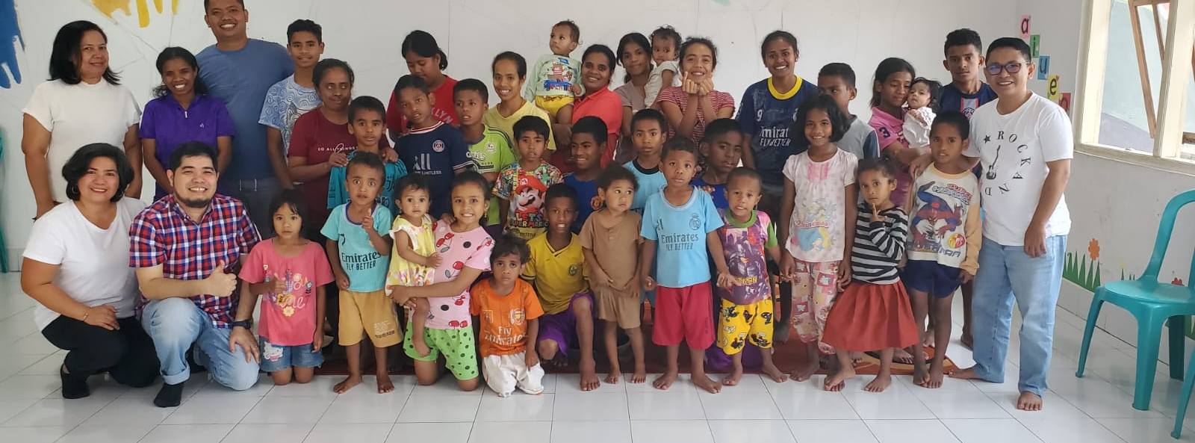

Slide 8
Devoted Leadership
Shows the value of the gospel
Teaches the whole will of God

Slide 9
7 On the first day of the week we came together to break bread. Paul spoke to the people and, because he intended to leave the next day, kept on talking until midnight. 8 There were many lamps in the upstairs room where we were meeting. 9 Seated in a window was a young man named Eutychus, who was sinking into a deep sleep as Paul talked on and on. When he was sound asleep, he fell to the ground from the third story and was picked up dead. 10 Paul went down, threw himself on the young man and put his arms around him. “Don’t be alarmed,” he said. “He’s alive!” 11 Then he went upstairs again and broke bread and ate. After talking until daylight, he left.

Slide 10
Now I commit to you to God and to the word of his grace, which can build you up and give you an inheritance among all those who are sanctified
Acts 20:32

Slide 11
Devoted Leadership
Shows the value of the gospel
Teaches the whole will of God
Keeps watch over the flock

Slide 12
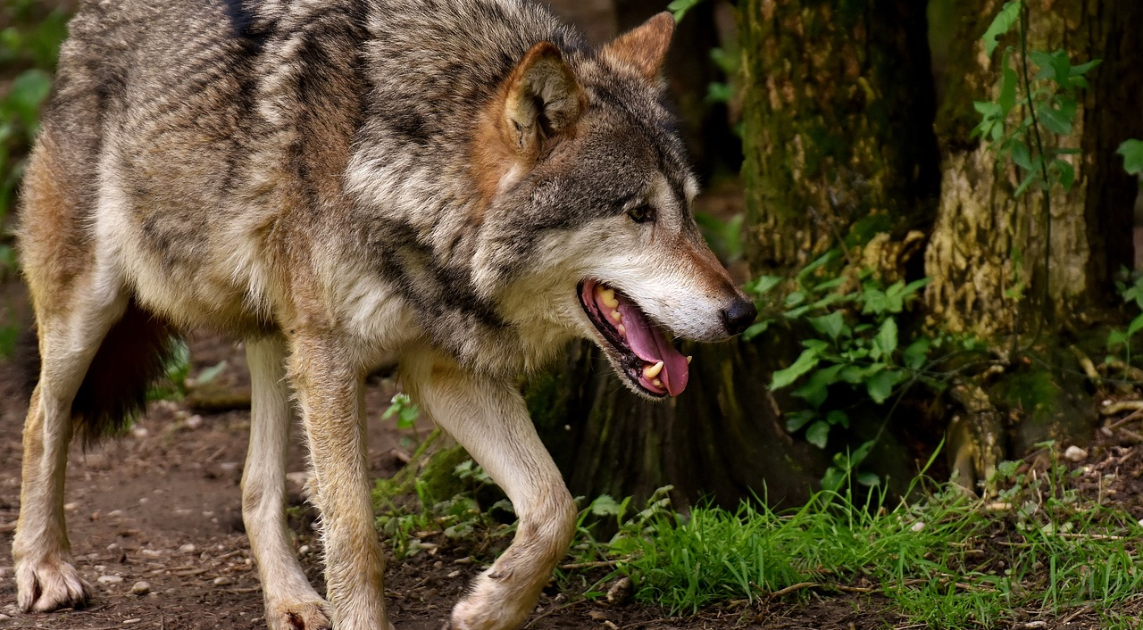

Slide 13
