Slide 1
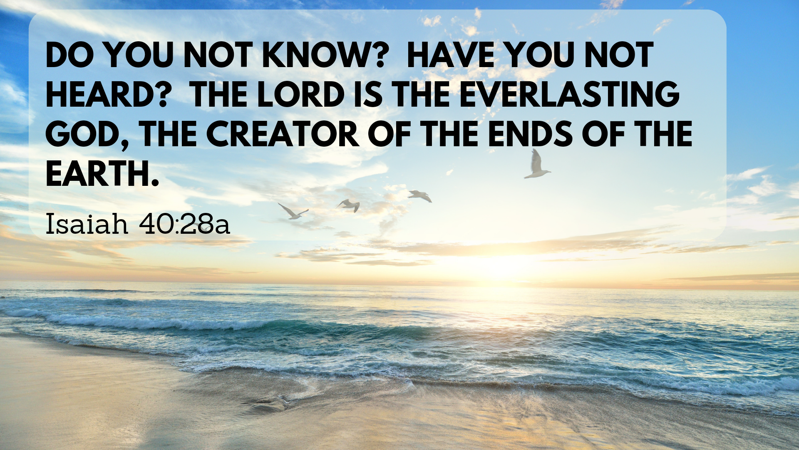

Slide 2
“…yet for us there is but one God, the Father, from whom all things came and for whom we live; and there is but one Lord, Jesus Christ, through whom all things came and through whom we live.”
- 1 Cor 8:6

Slide 3
The Son is the image of the invisible God, the firstborn over all creation. For in him all things were created: things in heaven and on earth, visible and invisible, whether thrones or powers or rulers or authorities; all things have been created through him and for him. He is before all things, and in him all things hold together.
- Colossians 1:15-17

Slide 4
The Spirit you received does not make you slaves, so that you live in fear again; rather, the Spirit you received brought about your adoption to sonship. And by him we cry, “Abba, Father.” The Spirit himself testifies with our spirit that we are God’s children.
- Romans 8:15-16

Slide 5
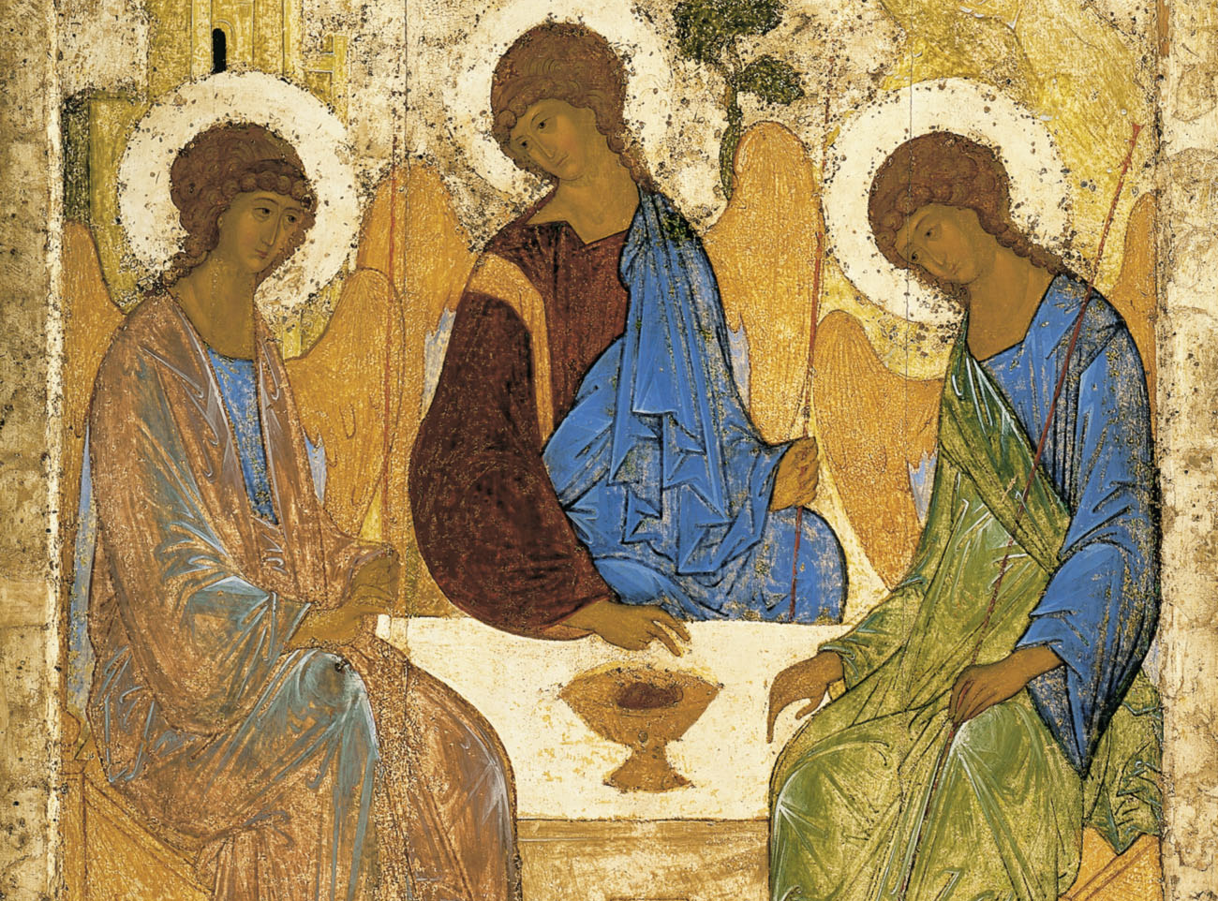

Slide 6
Nadia, “I Couldn’t Call God Father”
“But there was a great challenge awaiting me. I had to accept God as my Father. In my mind, “Father” was not a word of honor toward the God I had come to know. “Mother” would have felt like a much better word. But God wanted to reveal himself to me. And he did so with complete patience and gentleness.
As I studied the Bible, I saw the grace and love of the Father. As I prayed, I felt the attention of the Father. As I worshiped, I felt the embrace of the Father.

Slide 7
He healed my past, my present, and my future. He has transformed me. He even enabled me to truly forgive my earthly father.
I used to hate the word “Father,” but today I worship God the Father with great love and passion. I worship Jesus Christ as Lord, the One who has saved my soul. And I love to walk in the Spirit, who is always with me.”

Slide 9
Heidelberg Catechism, answer to Q27
The almighty and ever present power of God by which God upholds, as with his hand, heaven and earth and all creatures, and so rules them that leaf and blade, rain and drought, fruitful and lean years, food and drink, health and sickness, prosperity and poverty— all things, in fact, come to us not by chance but by his fatherly hand.

Slide 10
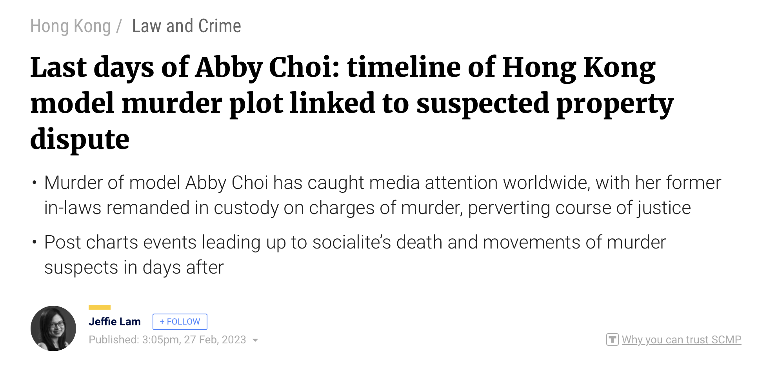

Slide 12
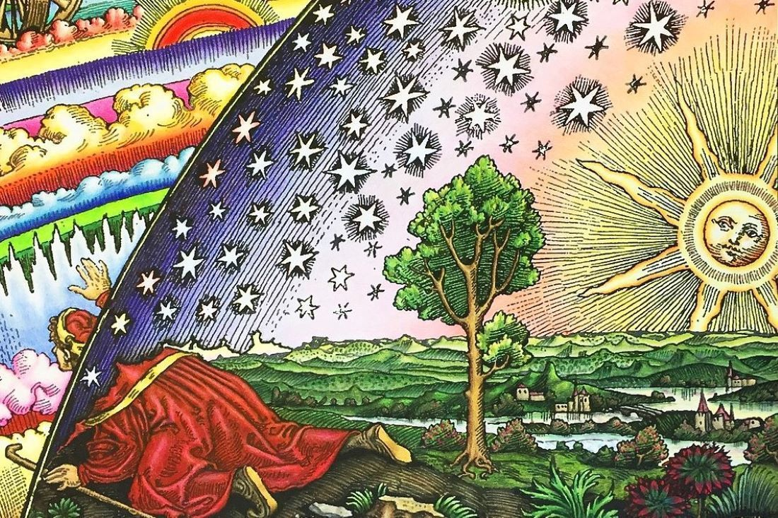

Slide 13
