Slide 1
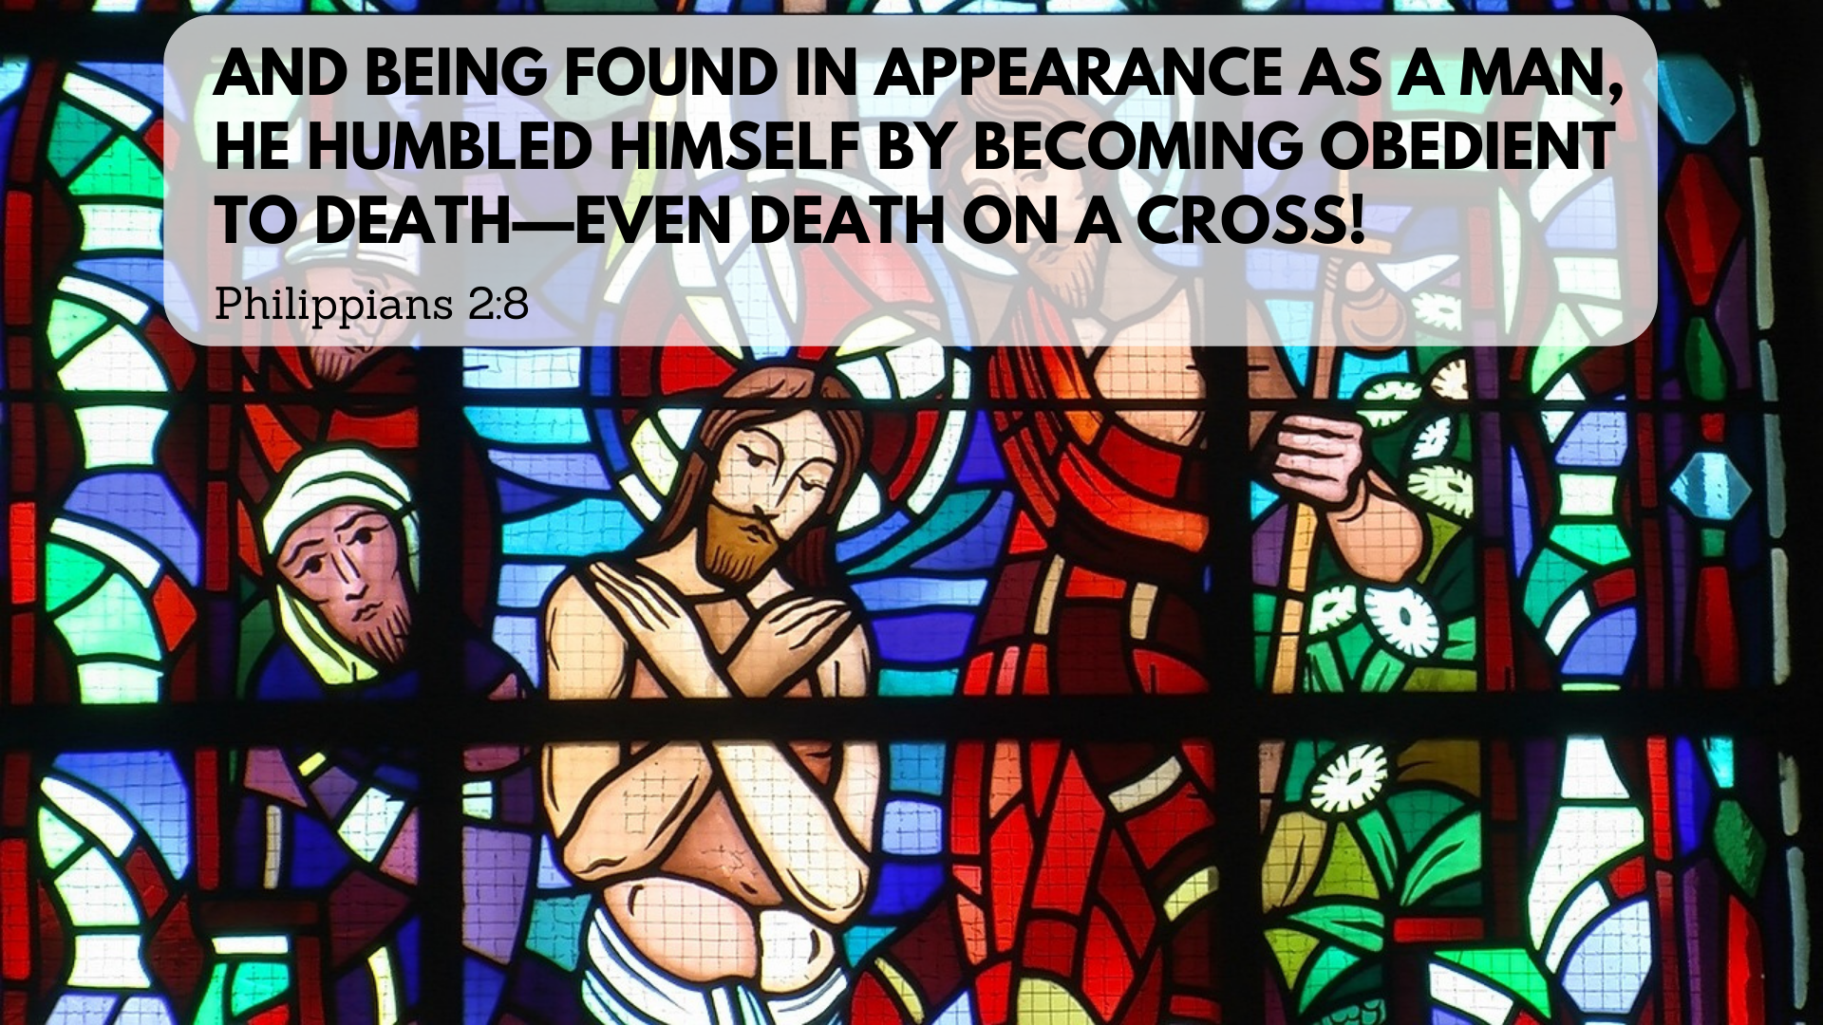

Slide 2
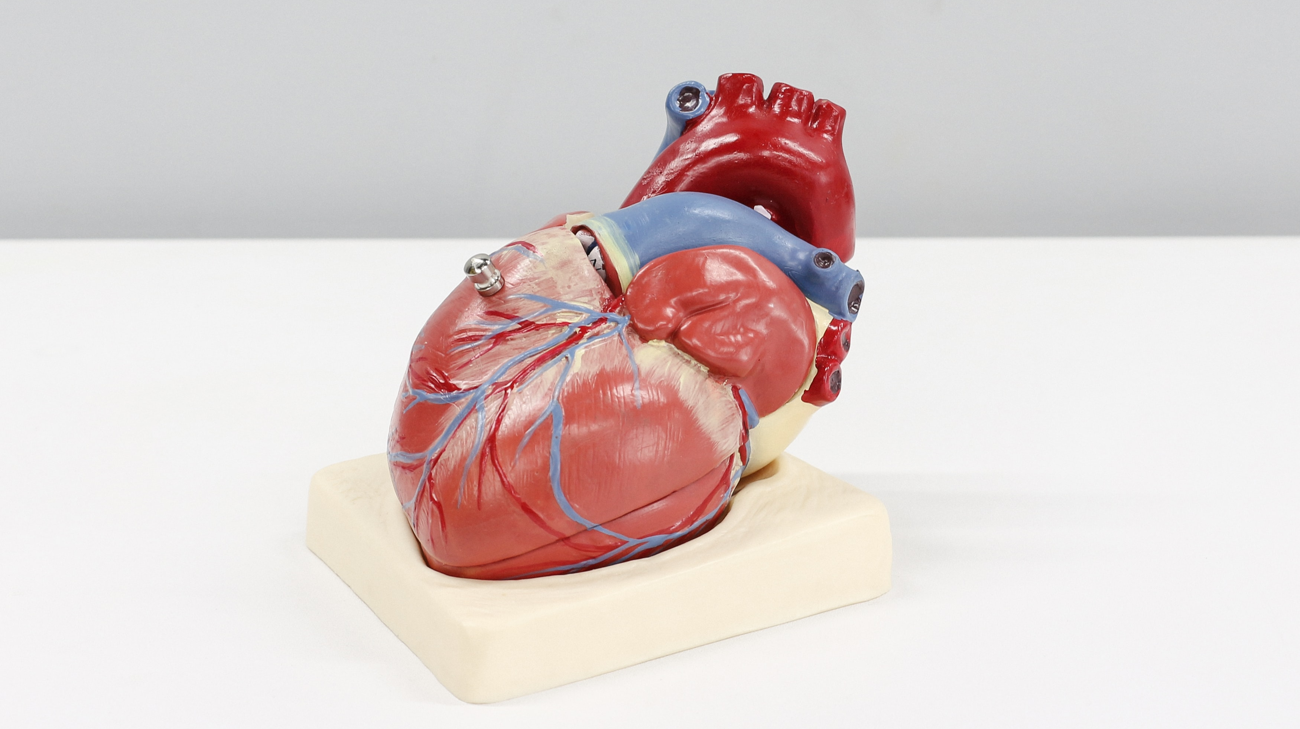

Slide 3
“If you declare with your mouth, ‘Jesus is Lord,’ and believe in your heart that God raised him from the dead, you will be saved.”
- Romans 10:9, cf. 1 Cor 12:3

Slide 4
YHWH: Lord (Adonai)

Slide 5
I believe in Jesus Christ, his only Son,
our Lord, who was conceived by the Holy Spirit and born of the virgin Mary. He suffered under Pontius Pilate, was crucified, died, and was buried; he descended to the dead. The third day he rose again from the dead.

Slide 6
I believe in Jesus Christ, his only Son,
our Lord, who was conceived by the Holy Spirit and born of the virgin Mary. He suffered under Pontius Pilate, was crucified, died, and was buried; he descended to the dead. The third day he rose again from the dead.

Slide 7
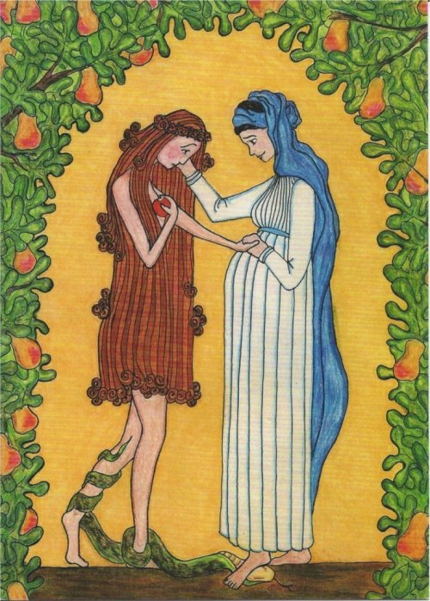
And I will put enmity between you and the woman, and between your offspring and hers; he will crush your head, and you will strike his heel.”
- Genesis 3:15

Slide 8
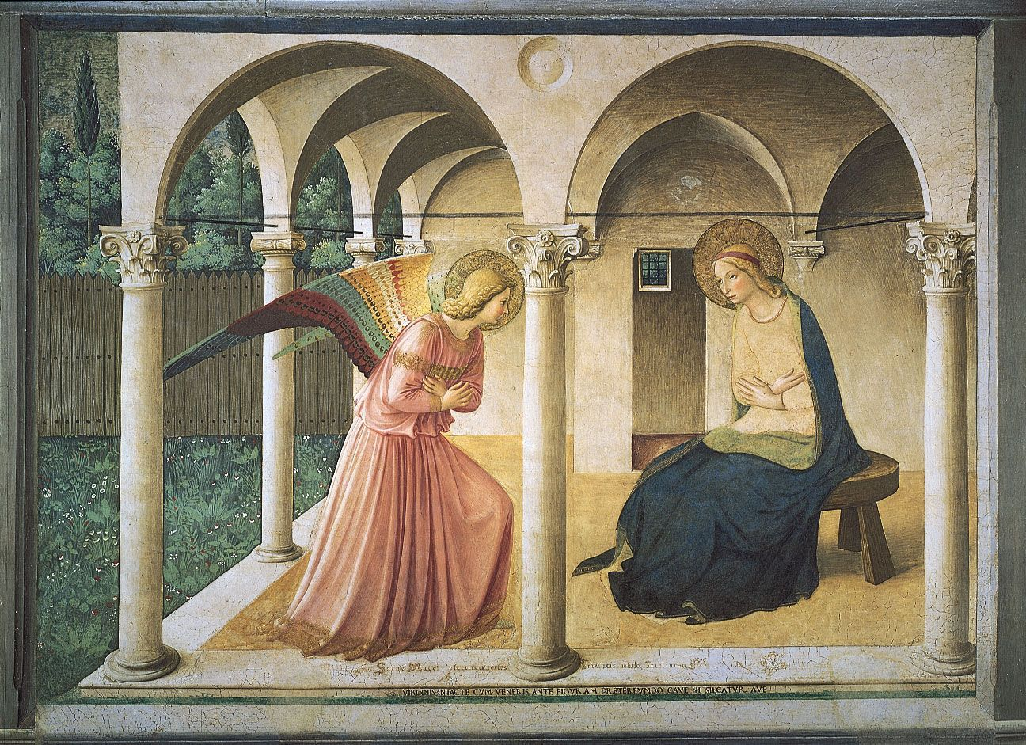

Slide 9
I believe in Jesus Christ, his only Son,
our Lord, who was conceived by the Holy Spirit and born of the virgin Mary. He suffered under Pontius Pilate, was crucified, died, and was buried; he descended to the dead.. The third day he rose again from the dead.

Slide 10
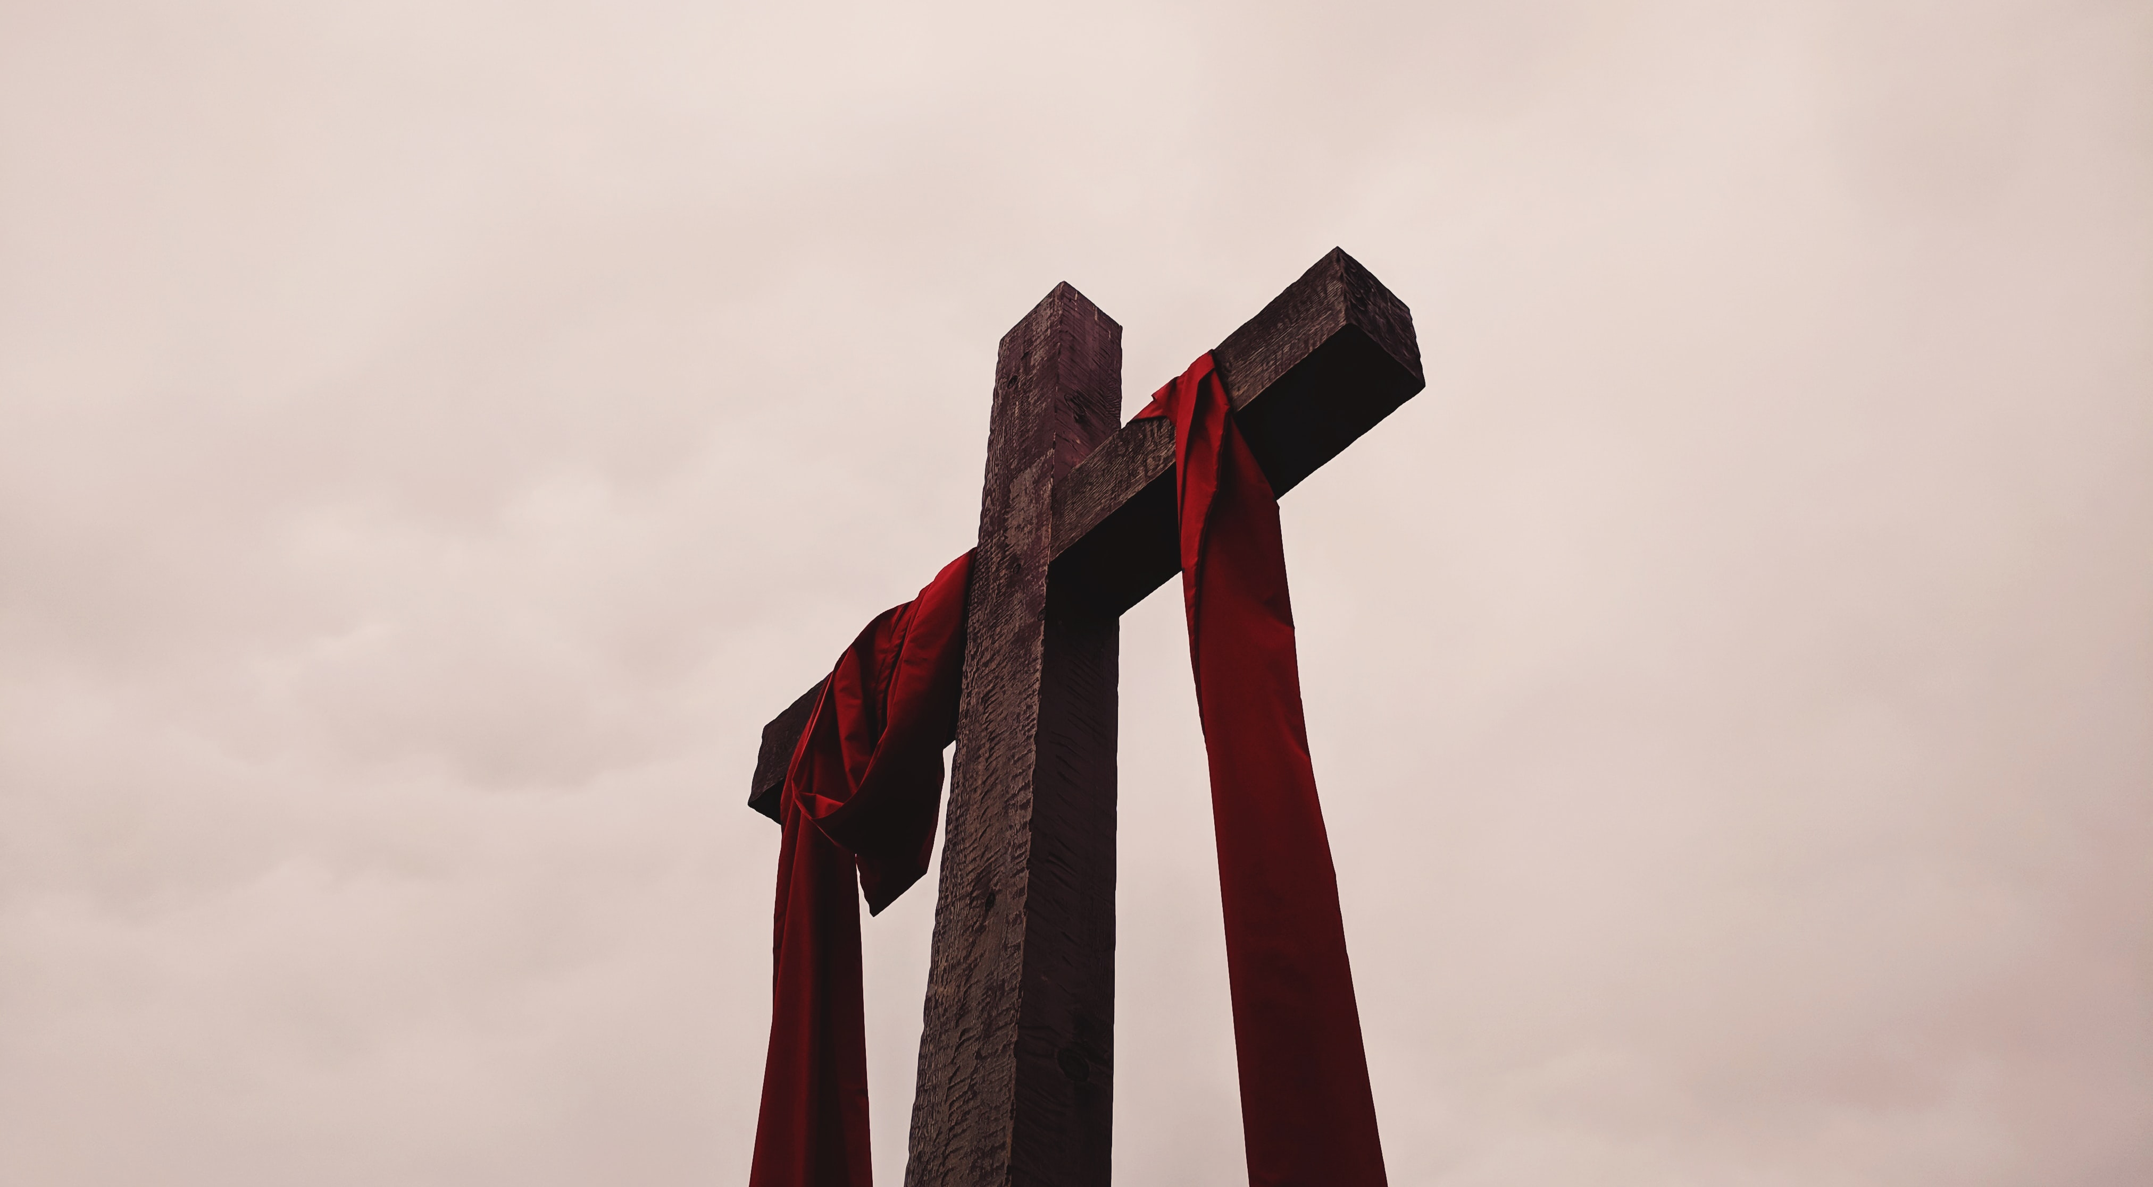

Slide 11
He ascended into heaven,
he is seated at the right hand of the Father,
And he will come to judge the living and the dead.

Slide 12
