Slide 1
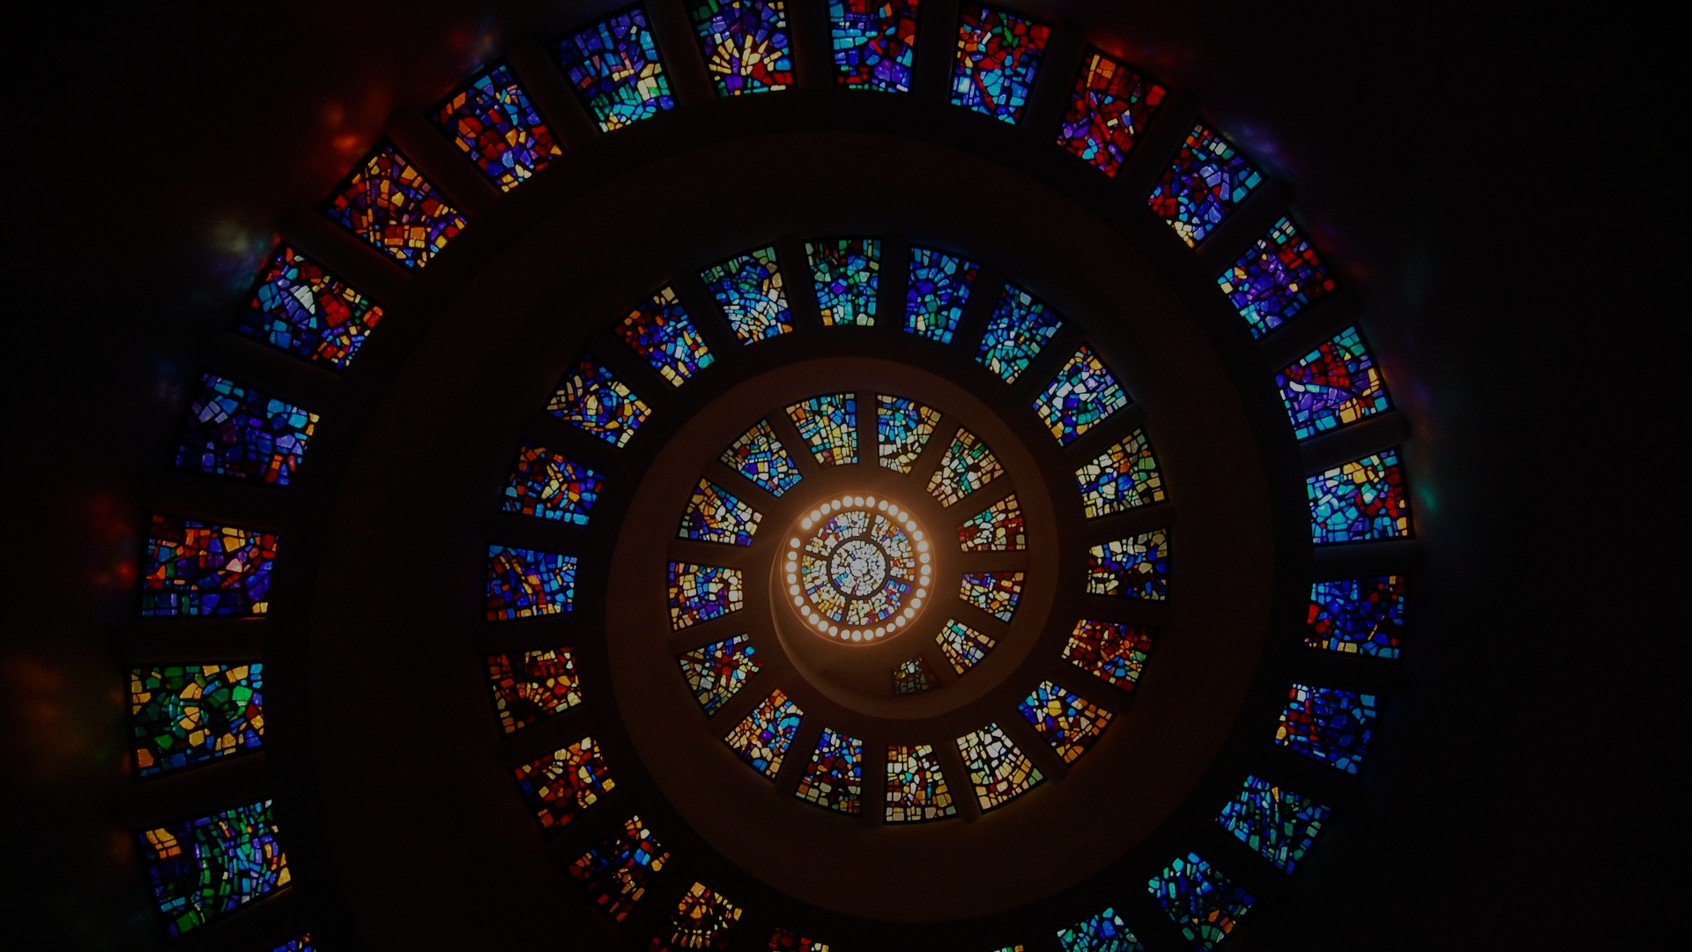
Apostles Creed
Hallelujah! Christ is risen!
He’s risen indeed, Hallelujah!

Slide 2
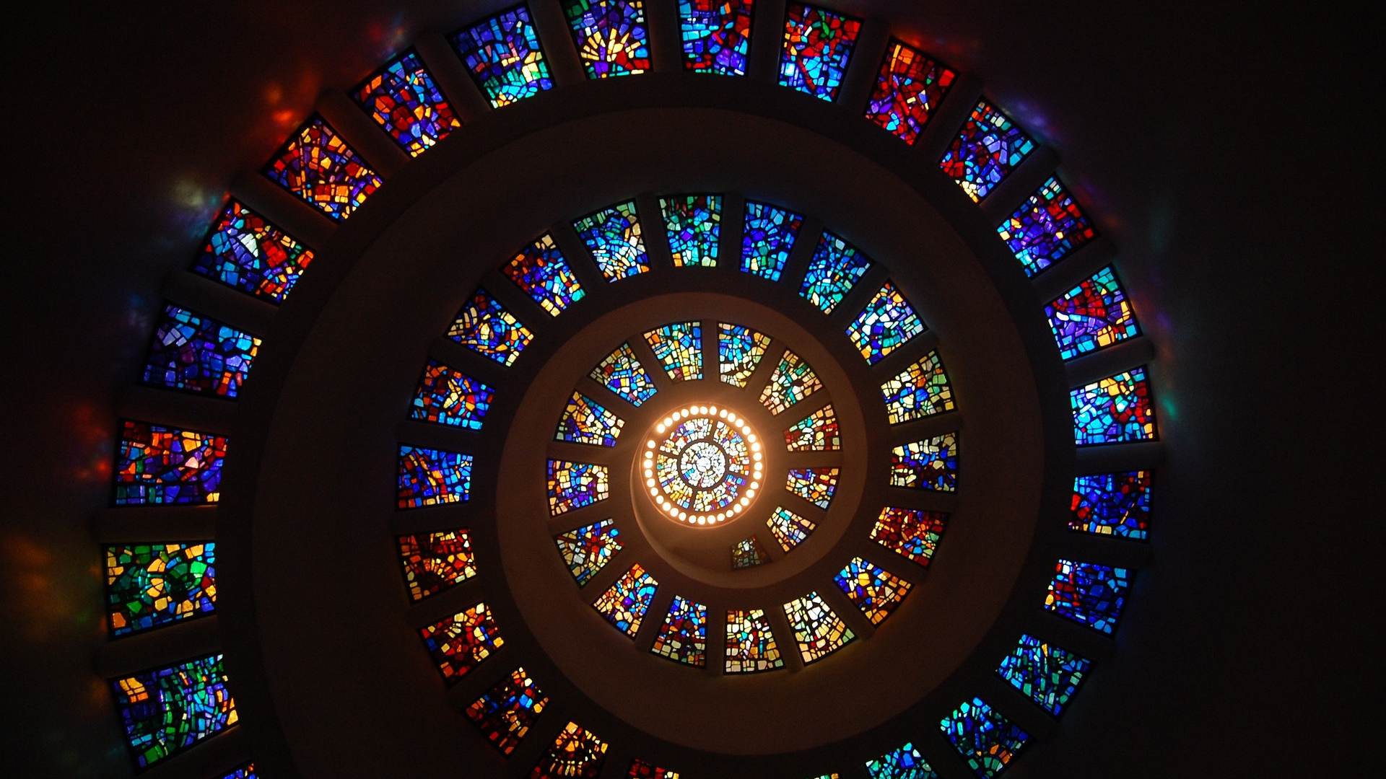
Apostles Creed
Apostles’ Creed

Slide 3
Apostles Creed
The forgiveness of sins
The resurrection of the body
And the life everlasting!

Slide 4

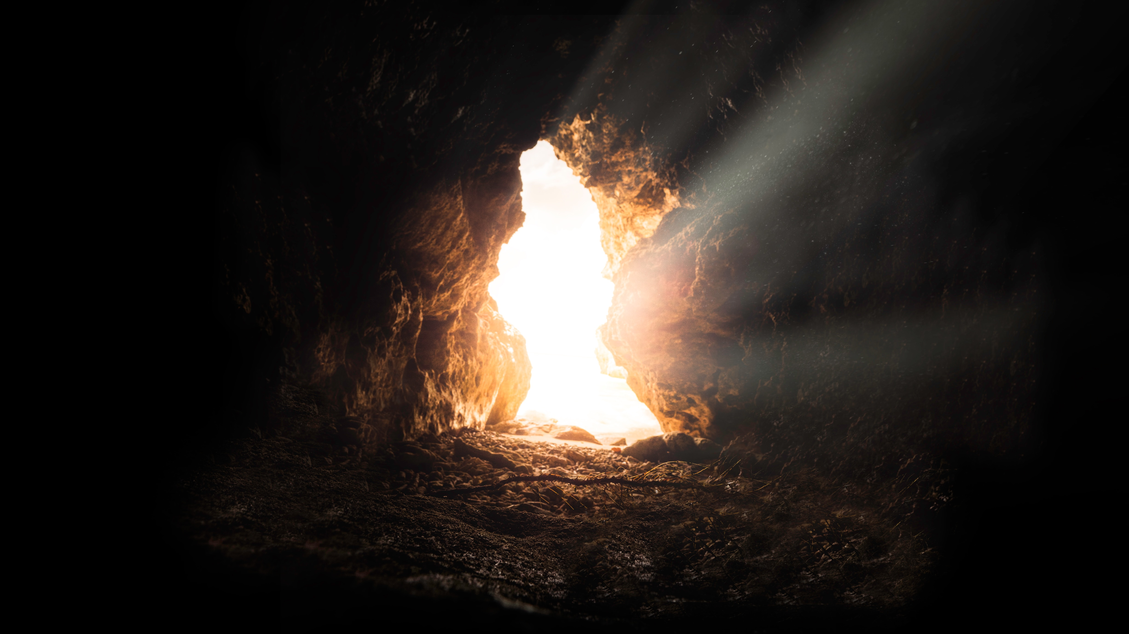

Slide 5
Seed 1??

Slide 6
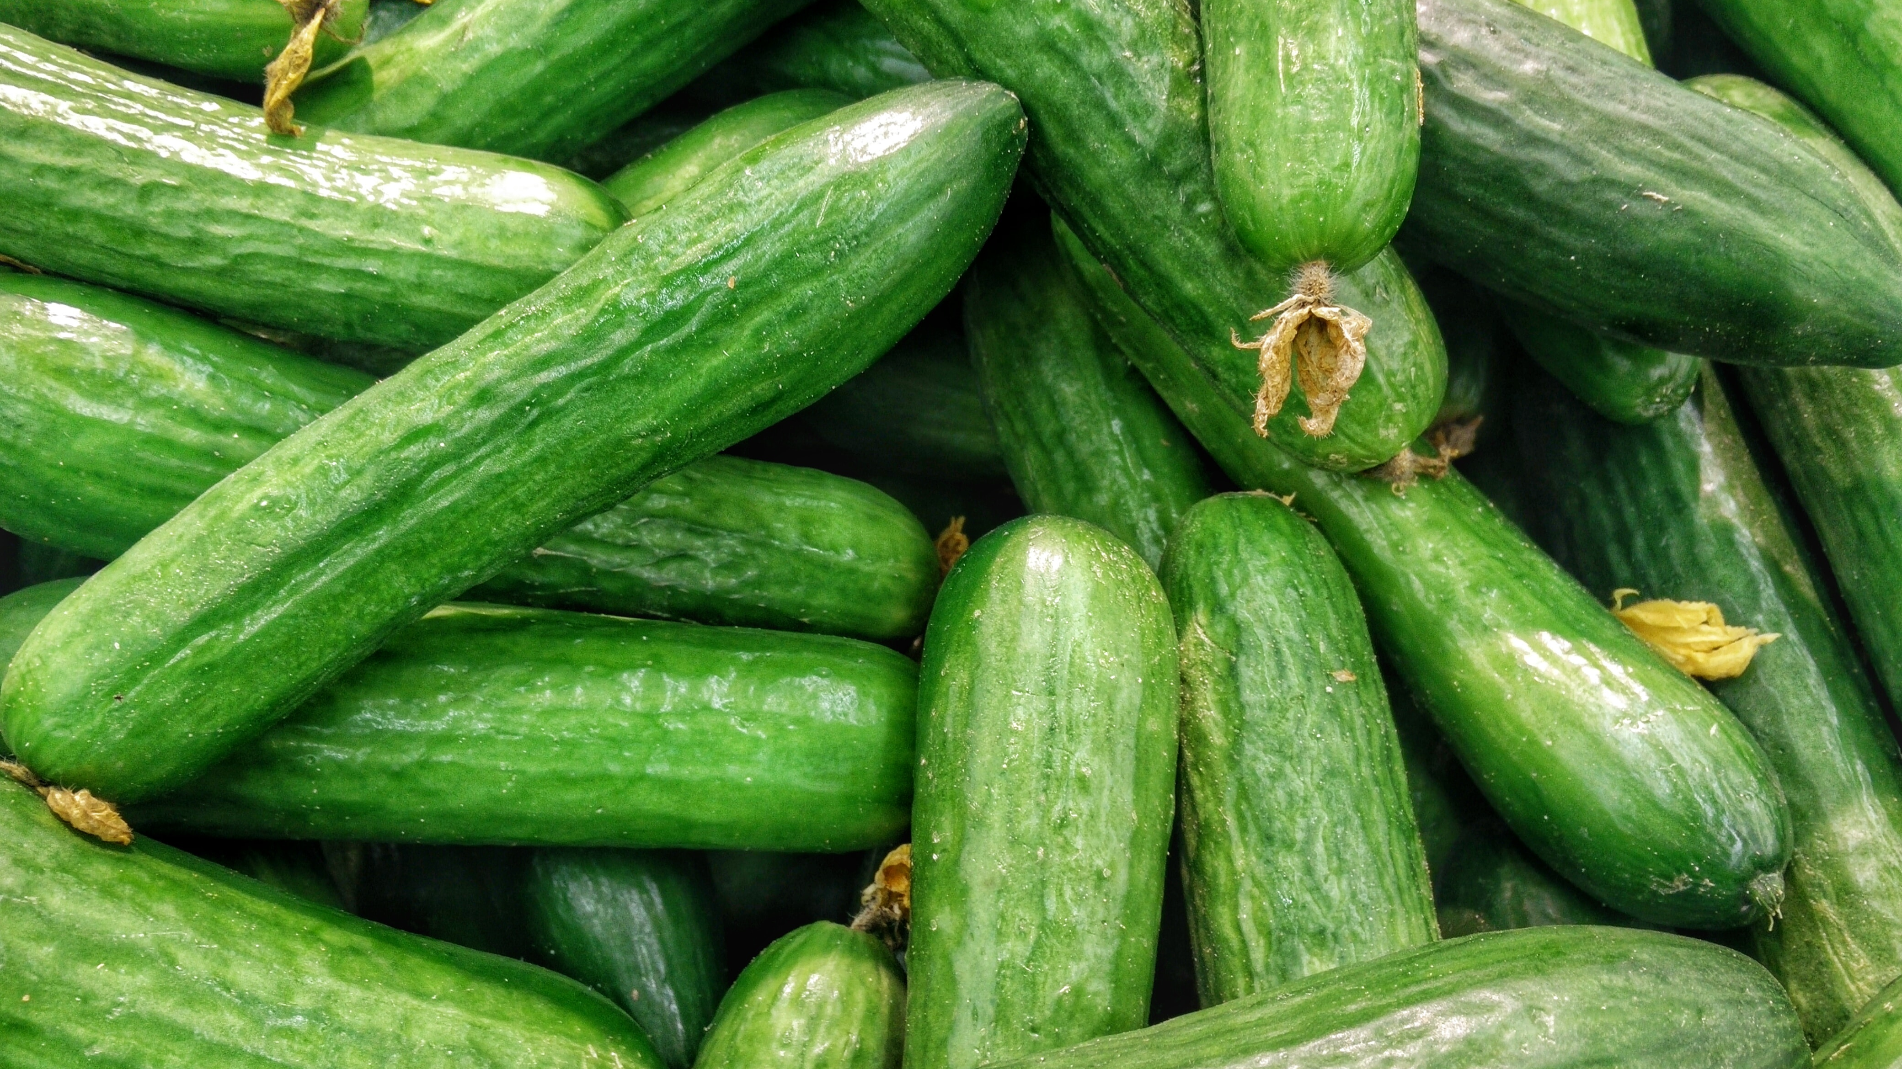

Slide 7
Seed 2?

Slide 8
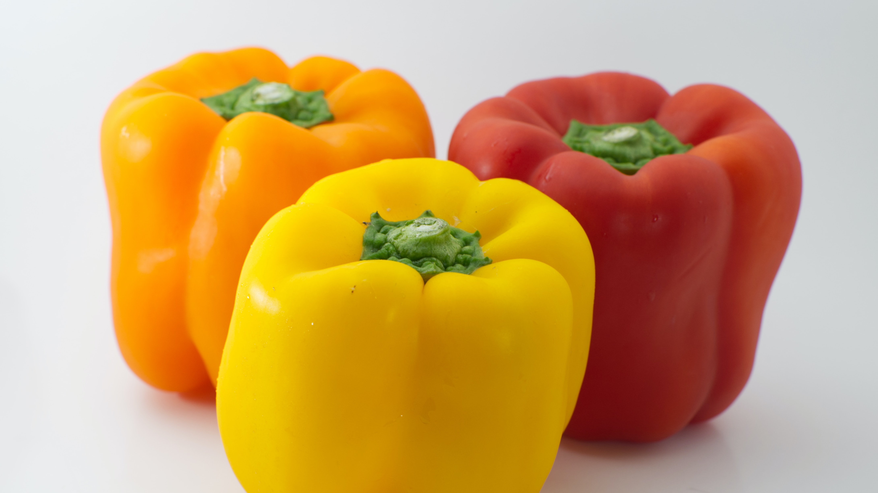

Slide 9
“So will it be with the resurrection of the dead. The body that is sown is perishable, it is raised imperishable; it is sown in dishonor, it is raised in glory; it is sown in weakness, it is raised in power; it is sown a natural body, it is raised a spiritual body.”
1 Cor 15:42-44

Slide 10
“So will it be with the resurrection of the dead. The body that is sown is perishable, it is raised imperishable; it is sown in dishonor, it is raised in glory; it is sown in weakness, it is raised in power; it is sown a natural body, it is raised a spiritual body.”
1 Cor 15:42-44

Slide 12
Listen, I tell you a mystery: We will not all sleep, but we will all be changed— in a flash, in the twinkling of an eye, at the last trumpet. For the trumpet will sound, the dead will be raised imperishable, and we will be changed.
1 Cor 15:51-52

Slide 13
video

Slide 14
Therefore, my dear brothers and sisters, stand firm. Let nothing move you. Always give yourselves fully to the work of the Lord, because you know that your labor in the Lord is not in vain.
1 Cor 15:51-52

Slide 15
Apostles Creed
Hallelujah! Christ is risen!
He’s risen indeed, Hallelujah!

