Slide 1
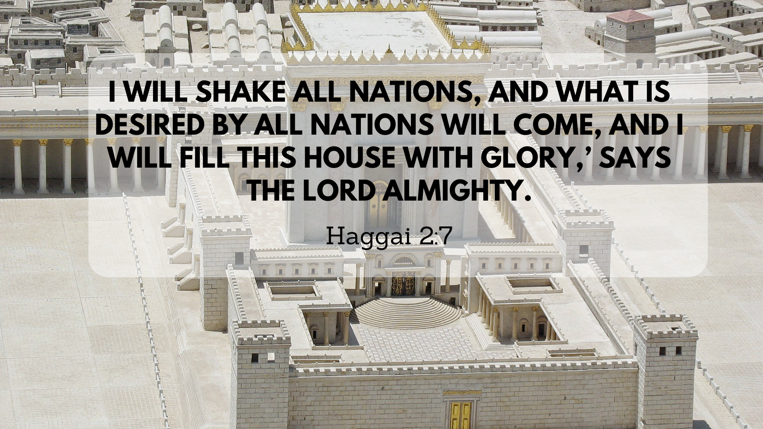

Slide 2
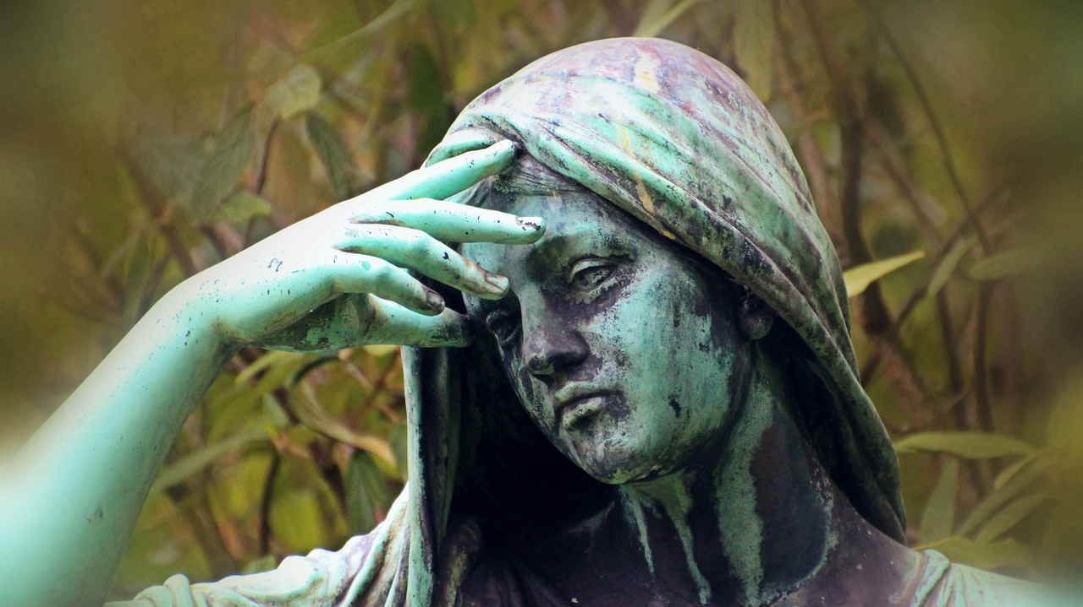

Slide 3
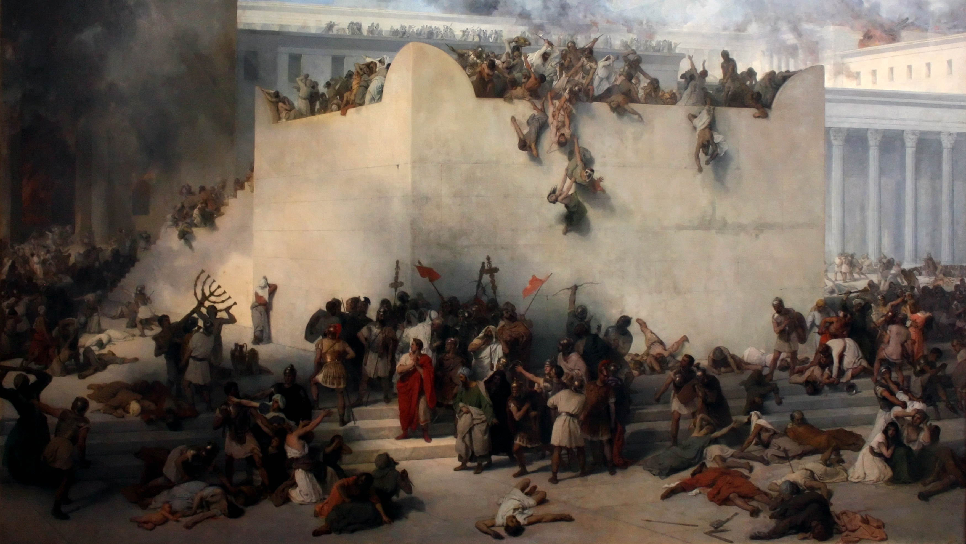
Destruction of the Temple in Jerusalem by Francesco Hayez. Oil on canvas, 1867

Slide 4
3 Besides, in my devotion to the temple of my God I now give my personal treasures of gold and silver for the temple of my God, over and above everything I have provided for this holy temple: 4 three thousand talents of gold (gold of Ophir) and seven thousand talents of refined silver, for the overlaying of the walls of the buildings, 5 for the gold work and the silver work, and for all the work to be done by the craftsmen. Now, who is willing to consecrate themselves to the Lord today?”
^{1 Chronicles 29:3-5}

Slide 5
‘Who of you is left who saw this house in its former glory? How does it look to you now? Does it not seem to you like nothing?
^{Haggai 2:3}

Slide 6
4 But now be strong, Zerubbabel,’ declares the Lord. ‘Be strong, Joshua son of Jozadak, the high priest. Be strong, all you people of the land,’ declares the Lord, ‘and work. For I am with you,’ declares the Lord Almighty. 5 ‘This is what I covenanted with you when you came out of Egypt. And my Spirit remains among you. Do not fear.’
^{Haggai 2:4-5}

Slide 7
2. Confidence in God’s Presence (v.4-5)
Build the Church – God promises to be in the work

Slide 8
2. Confidence in God’s Presence (v.4-5)
Build the Church – God promises to be in the work
Be strong and keep going – God is with you

Slide 9
“This is what the Lord Almighty says: ‘In a little while I will once more shake the heavens and the earth, the sea and the dry land. 7 I will shake all nations, and what is desired by all nations will come, and I will fill this house with glory,’ says the Lord Almighty. 8 ‘The silver is mine and the gold is mine,’ declares the Lord Almighty. 9 ‘The glory of this present house will be greater than the glory of the former house,’ says the Lord Almighty. ‘And in this place I will grant peace,’ declares the Lord Almighty.”
^{Haggai 2:6-9}

Slide 10
8 Moreover, I hereby decree what you are to do for these elders of the Jews in the construction of this house of God:
Their expenses are to be fully paid out of the royal treasury, from the revenues of Trans-Euphrates, so that the work will not stop. 9 Whatever is needed—young bulls, rams, male lambs for burnt offerings to the God of heaven, and wheat, salt, wine and olive oil, as requested by the priests in Jerusalem—must be given them daily without fail, 10 so that they may offer sacrifices pleasing to the God of heaven and pray for the well-being of the king and his sons.
^{Ezra 6:8-10}

Slide 11
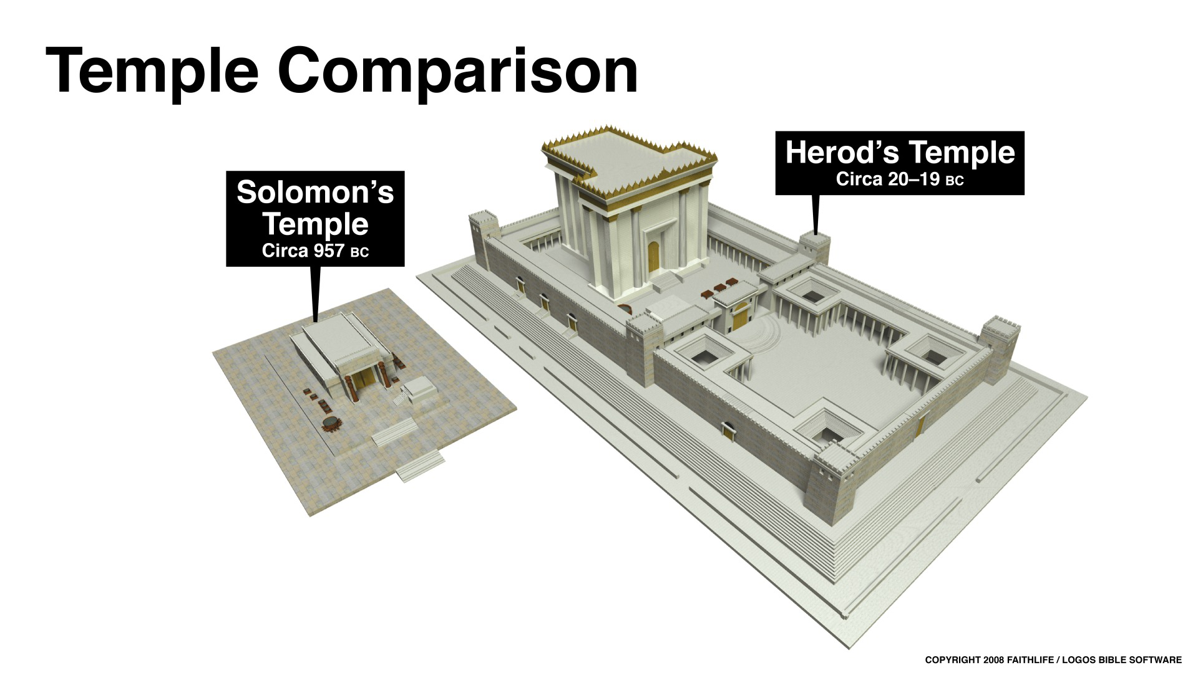

Slide 12
“This is what the Lord Almighty says: ‘In a little while I will once more shake the heavens and the earth, the sea and the dry land. 7 I will shake all nations, and what is desired by all nations will come, and I will fill this house with glory,’ says the Lord Almighty. 8 ‘The silver is mine and the gold is mine,’ declares the Lord Almighty. 9 ‘The glory of this present house will be greater than the glory of the former house,’ says the Lord Almighty. ‘And in this place I will grant peace,’ declares the Lord Almighty.”
^{Haggai 2:6-9}

Slide 13
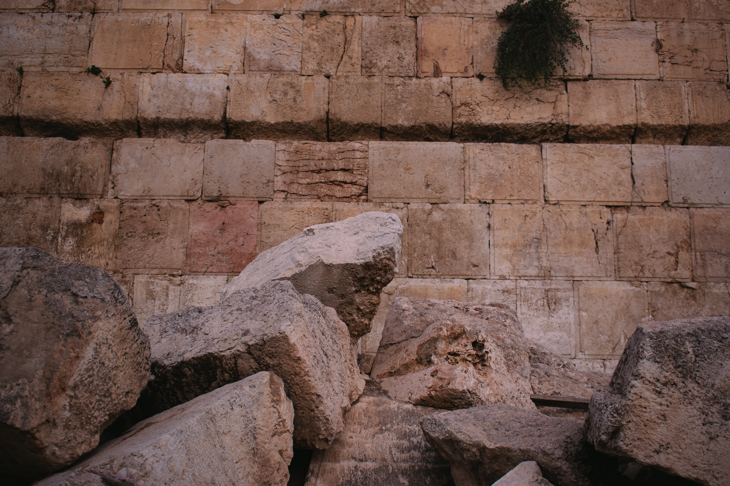
“And we all, who with unveiled faces contemplate the Lord’s glory, are being transformed into his image with ever increasing glory, which comes from the Lord, who is the Spirit”
2 Cor 3:18

Slide 14


Slide 15
God’s Building Project: Keep Going
Discouragement in Ministry (v.1-3)
Confidence in God’s Presence (v4-5)
God’s Glorious House (v.6-9)

