Slide 1


Slide 2
God’s Building Project: Every Blessing
Days of Curses (v.10-14)
Days of Blessings (v.15-19)
Days of the Messiah (v.20-23)

Slide 3
11 “This is what the Lord Almighty says: ‘Ask the priests what the law says: 12 If someone carries consecrated meat in the fold of their garment, and that fold touches some bread or stew, some wine, olive oil or other food, does it become consecrated?’”
The priests answered, “No.”
13 Then Haggai said, “If a person defiled by contact with a dead body touches one of these things, does it become defiled?”
“Yes,” the priests replied, “it becomes defiled.”

Slide 4
14 Then Haggai said, “‘So it is with this people and this nation in my sight,’ declares the Lord. ‘Whatever they do and whatever they offer there is defiled.

Slide 5
⁵ “This is what the Sovereign Lord says: This is Jerusalem, which I have set in the center of the nations, with countries all around her. ⁶ Yet in her wickedness she has rebelled against my laws and decrees more than the nations and countries around her. She has rejected my laws and has not followed my decrees.
Ezekiel 5:5-6

Slide 6
⁹ And he said to me, “Go in and see the wicked and detestable things they are doing here.” ¹⁰ So I went in and looked, and I saw portrayed all over the walls all kinds of crawling things and unclean animals and all the idols of Israel.
Ezekiel 8:9-10

Slide 7
As for you, you were dead in your transgressions and sins,² in which you used to live when you followed the ways of this world and of the ruler of the kingdom of the air, the spirit who is now at work in those who are disobedient. ³ All of us also lived among them at one time, gratifying the cravings of our flesh^{[a]}and following its desires and thoughts. Like the rest, we were by nature deserving of wrath.
Ephesians 2:1-3

Slide 8
“‘From this day on I will bless you.’”
Haggai 2:9b

Slide 9
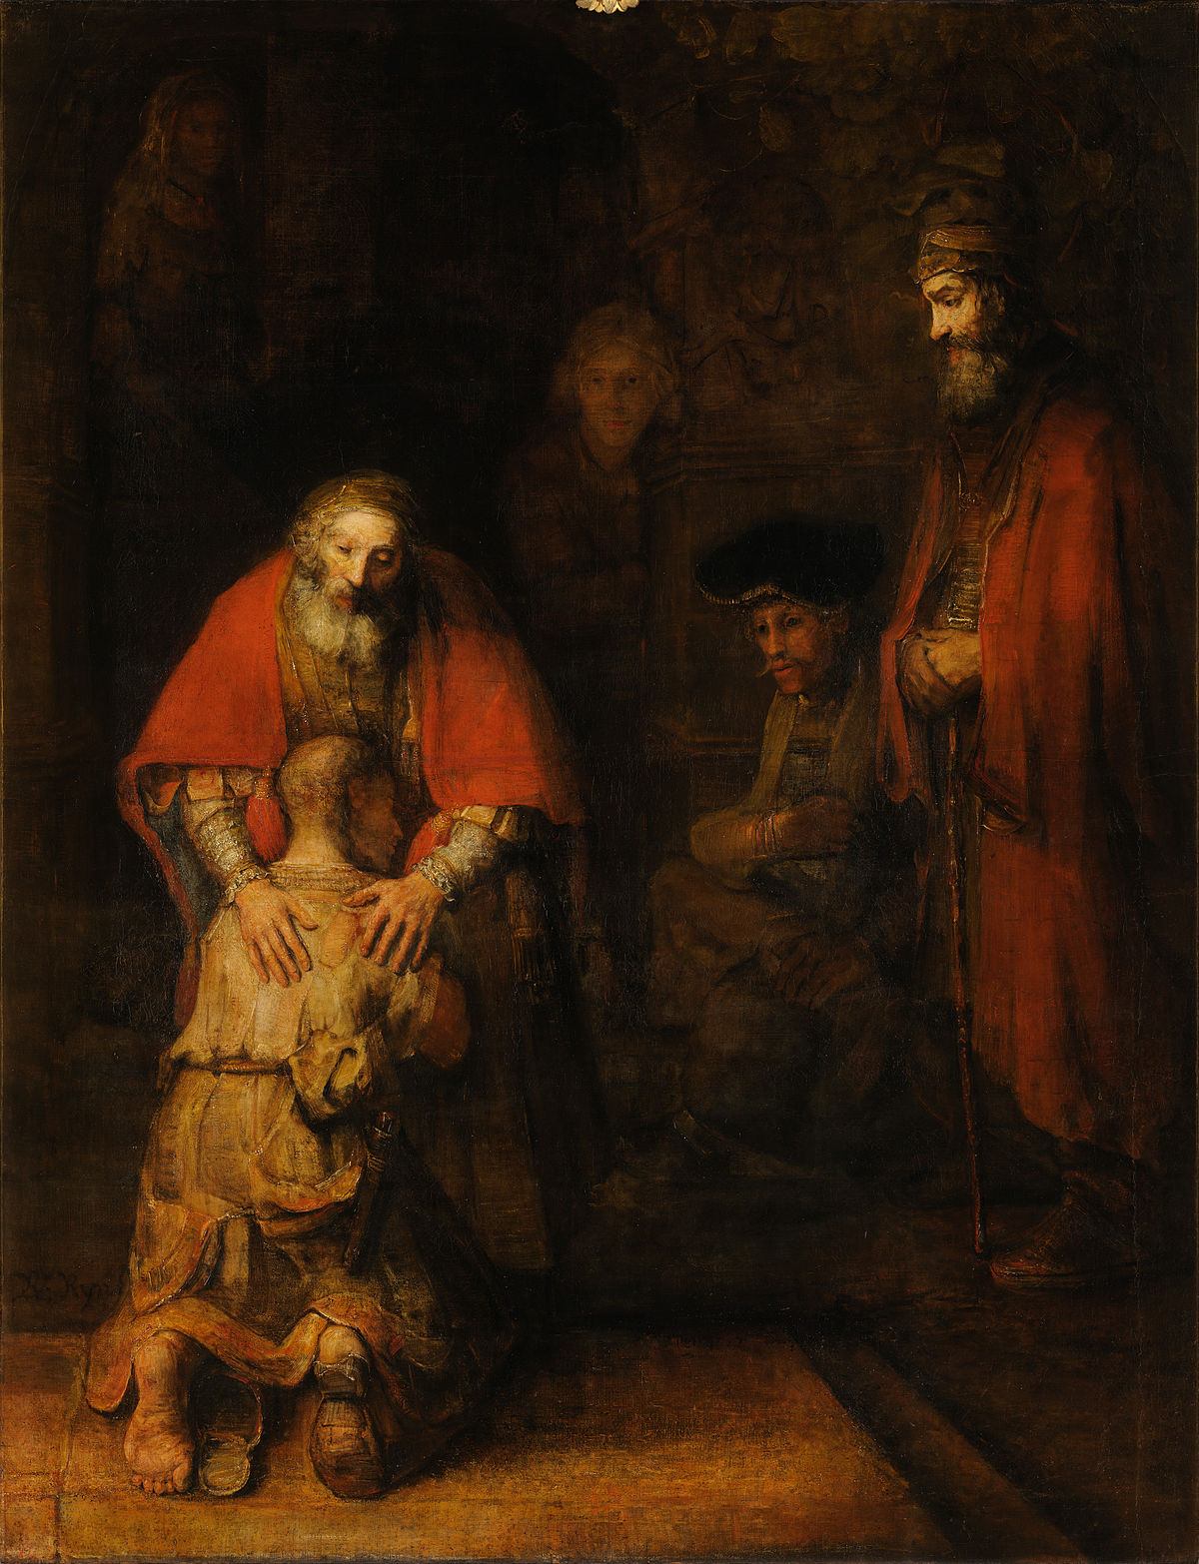
Return of the Prodigal Son, Rembrandt, 1661-9

Slide 10
Praise be to the God and Father of our Lord Jesus Christ, who has blessed us in the heavenly realms with every spiritual blessing in Christ.
Ephesians 1:3

Slide 11
21 “Tell Zerubbabel governor of Judah that I am going to shake the heavens and the earth. 22 I will overturn royal thrones and shatter the power of the foreign kingdoms. I will overthrow chariots and their drivers; horses and their riders will fall, each by the sword of his brother.
23 “‘On that day,’ declares the Lord Almighty, ‘I will take you, my servant Zerubbabel son of Shealtiel,’ declares the Lord, ‘and I will make you like my signet ring, for I have chosen you,’ declares the Lord Almighty.”
Haggai 2:21-13

Slide 12
12 After the exile to Babylon:
Jeconiah was the father of Shealtiel,
Shealtiel the father of Zerubbabel…
16 and Jacob the father of Joseph, the husband of Mary,
and Mary was the mother of Jesus who is called the Messiah.
Matthew 1:12-16

Slide 13
21 “Tell Zerubbabel governor of Judah that I am going to shake the heavens and the earth. 22 I will overturn royal thrones and shatter the power of the foreign kingdoms. I will overthrow chariots and their drivers; horses and their riders will fall, each by the sword of his brother.
23 “‘On that day,’ declares the Lord Almighty, ‘I will take you, my servant Zerubbabel son of Shealtiel,’ declares the Lord, ‘and I will make you like my signet ring, for I have chosen you,’ declares the Lord Almighty.”
Haggai 2:21-13

Slide 14


