Slide 1
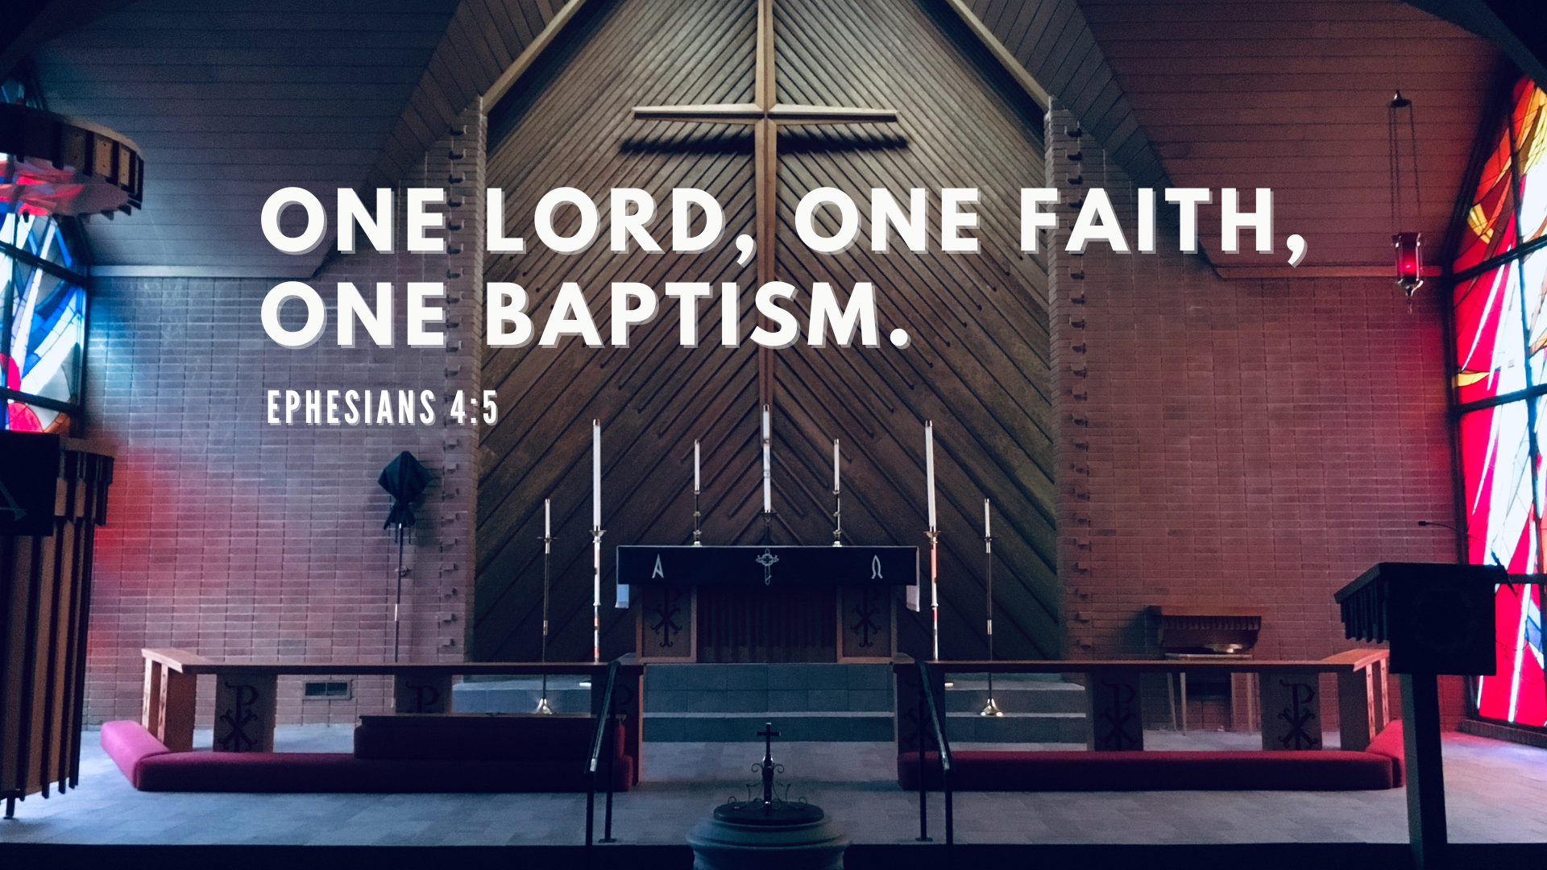

Slide 2
and on this rock I will build my church, and the gates of Hades will not overcome it.
- Matthew 16:18b

Slide 3
...Christ loved the church and gave himself up for her
- Ephesians 5:25b

Slide 4
…Christ is the head of the church, his body, of which he is the Savior.
- Ephesians 5:25b

Slide 5
1. Holy: Call to Be Set Apart
“All of us also lived among them at one time, gratifying the cravings of our flesh and following its desires and thoughts. Like the rest, we were by nature deserving of wrath. But because of his great love for us, God, who is rich in mercy, made us alive with Christ even when we were dead in transgressions—it is by grace you have been saved” (Eph 2:3-5).

Slide 6
1. Holy: Call to Be Set Apart
As a prisoner for the Lord, then, I urge you to live a life worthy of the calling you have received. ² Be completely humble and gentle; be patient, bearing with one another in love. ³ Make every effort to keep the unity of the Spirit through the bond of peace” (Eph 4:1-3).

Slide 7
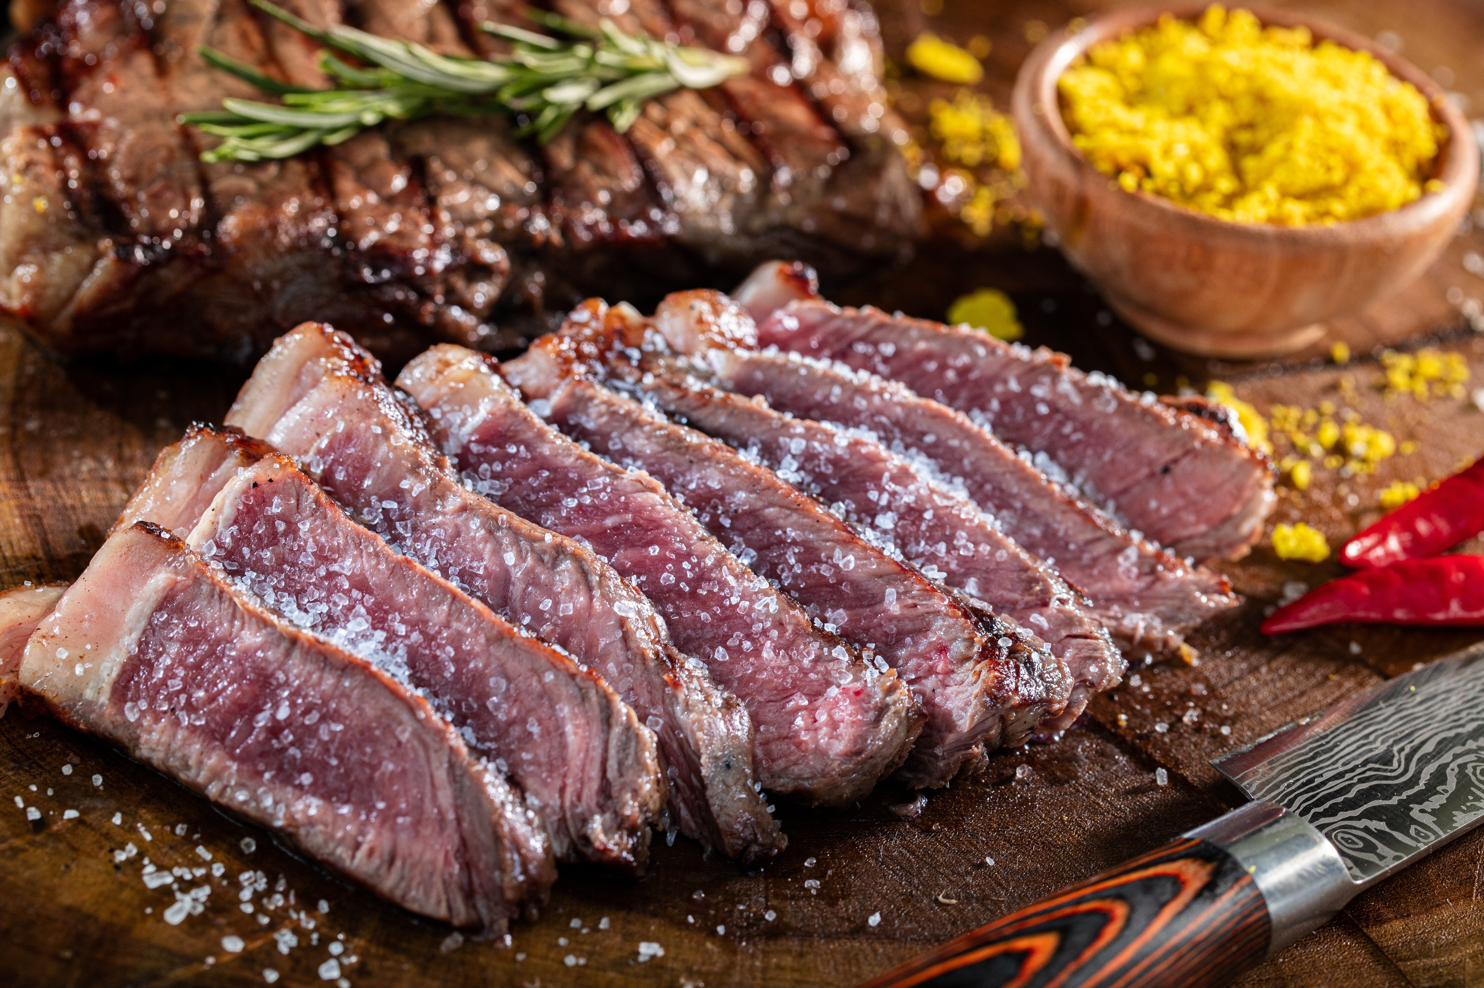

Slide 8
But you are a chosen people, a royal priesthood, a holy nation, God’s special possession, that you may declare the praises of him who called you out of darkness into his wonderful light.
- 1 Peter 2:9

Slide 9
2. Catholic: Call to Be One

Slide 10


Slide 11
2. Catholic: Call to Be One
3 Make every effort to keep the unity of the Spirit through the bond of peace. 4 There is one body and one Spirit, just as you were called to one hope when you were called; 5 one Lord, one faith, one baptism; 6 one God and Father of all, who is over all and through all and in all (Eph 4:3-6).

Slide 12
2. Catholic: Call to Be One
As a prisoner for the Lord, then, I urge you to live a life worthy of the calling you have received. ² Be completely humble and gentle; be patient, bearing with one another in love. ³ Make every effort to keep the unity of the Spirit through the bond of peace” (Eph 4:1-3).

Slide 13


Slide 14


Slide 15
3. Apostolic: Same Foundation
Consequently, you are no longer foreigners and strangers, but fellow citizens with God’s people and also members of his household, built on the foundation of the apostles and prophets, with Christ Jesus himself as the chief cornerstone (Eph 2:19-20)

Slide 16
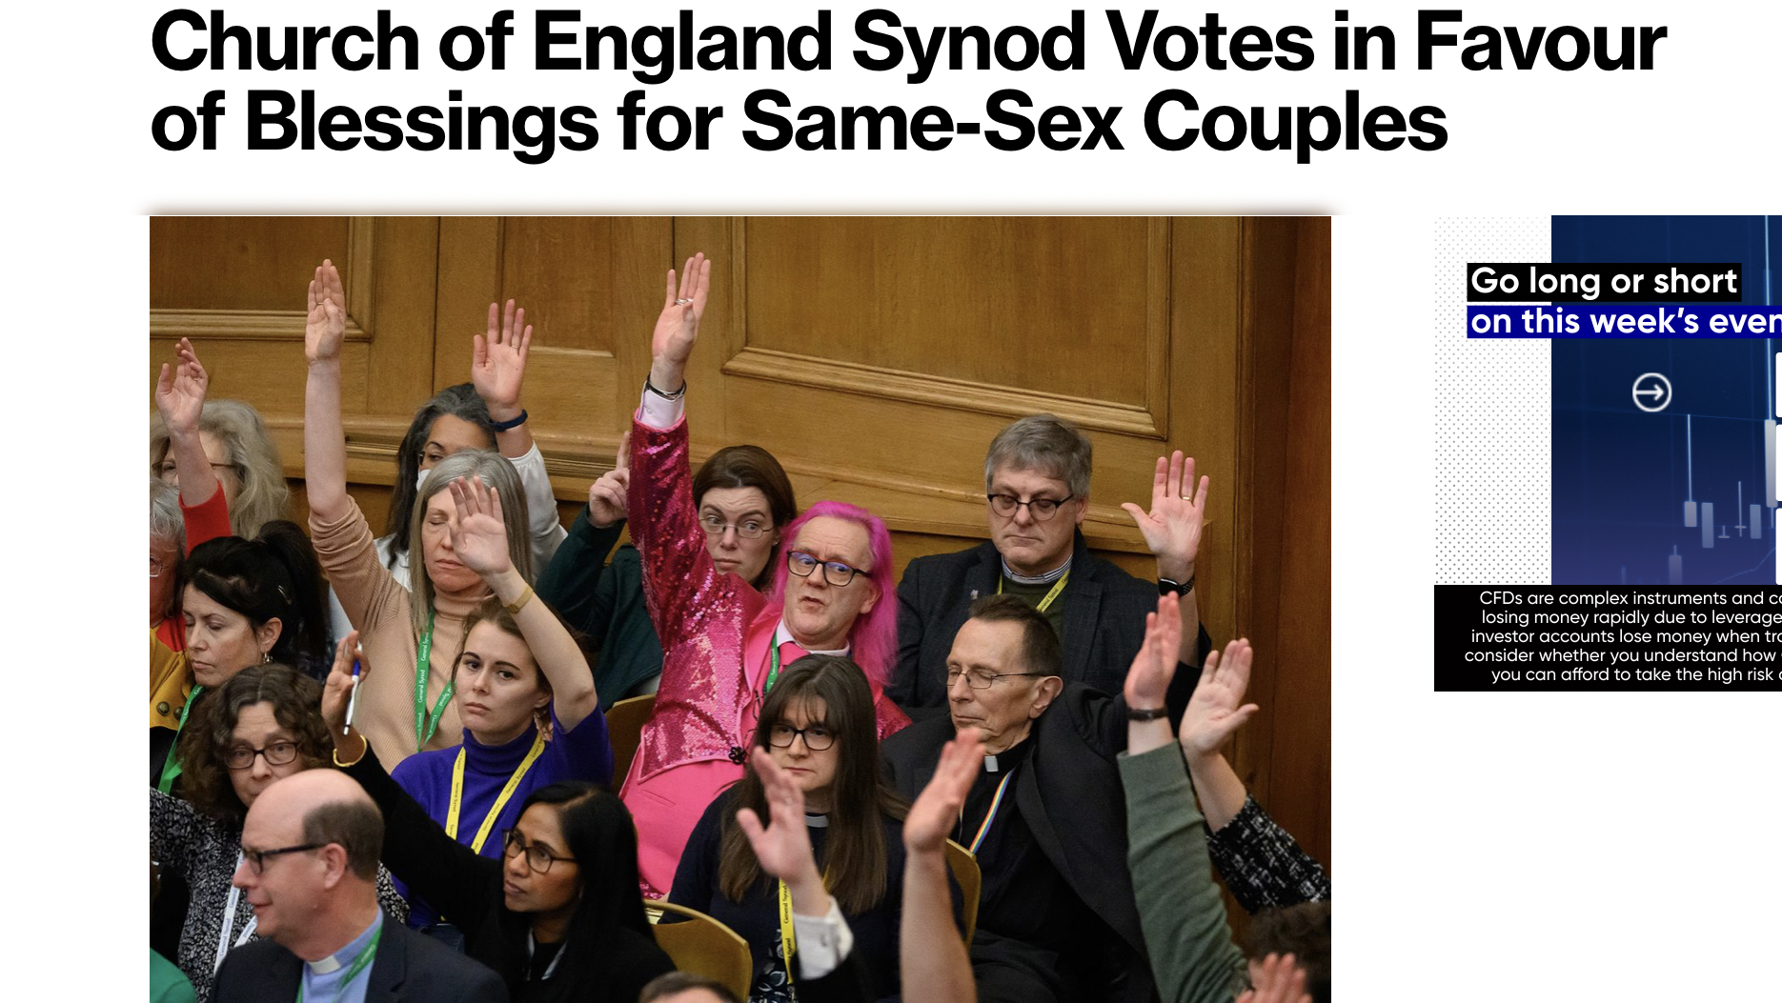

Slide 17
Sanctify them by the truth;
your word is truth.
- John 17:17

Slide 18
But His intent was that now,
through the church,
the manifold wisdom of God should be made known to the rulers and authorities in the heavenly realms,
- Eph 3:10

