Slide 1
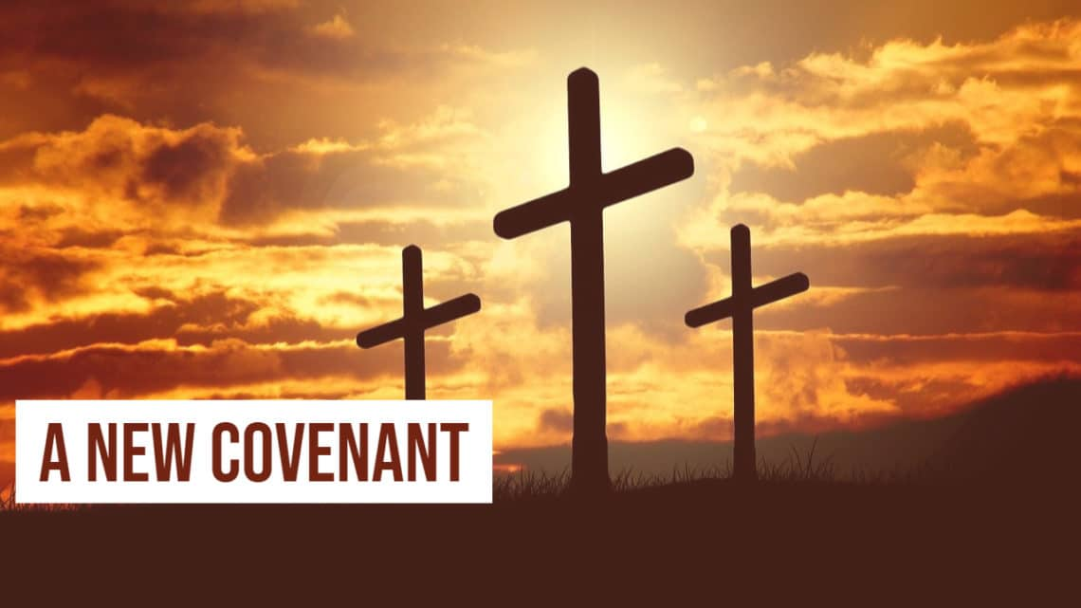

Slide 2
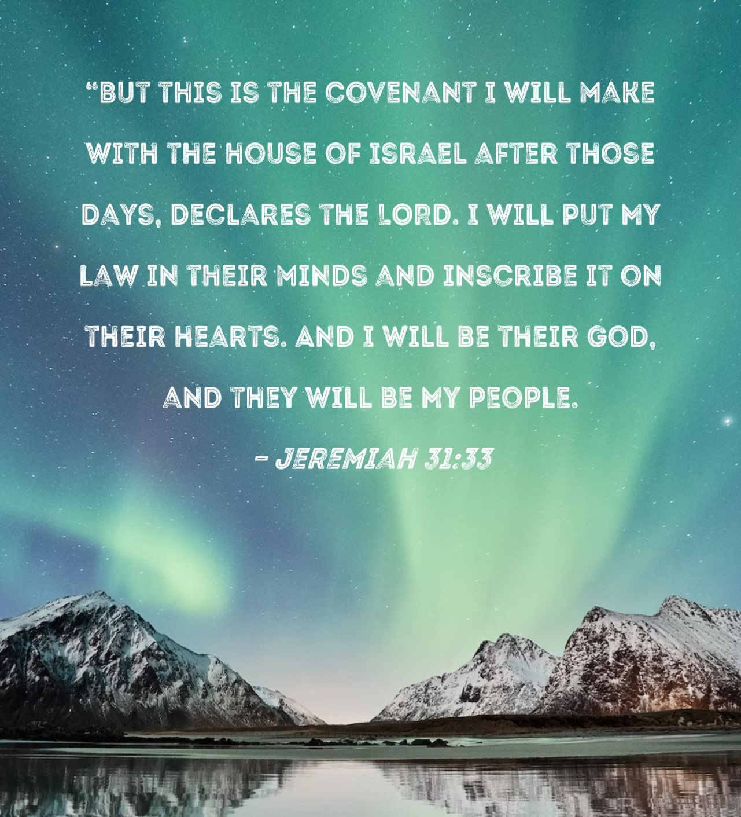
Why we need a new covenant
Foretold in Jeremiah 31:31-33

Slide 3

Sin - sin beneath the sin
Grace - Jesus’ sacrifice
Promise - God is the promisor

Slide 4

Fellowship of the Cross
^{Hebrews 23} Let us hold unswervingly to the hope we profess, for he who promised is faithful. ²⁴ And let us consider how we may spur one another on toward love and good deeds, ²⁵ not giving up meeting together, as some are in the habit of doing, but encouraging one another—and all the more as you see the Day approaching.
How do we DO Church?
Links
Ministries
One-on-One

