Slide 1
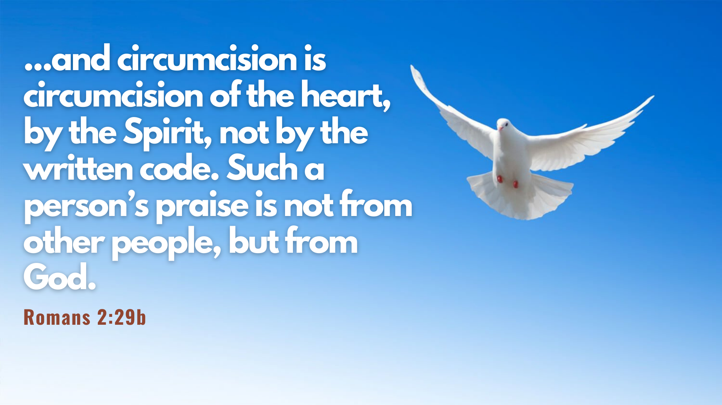

Slide 2
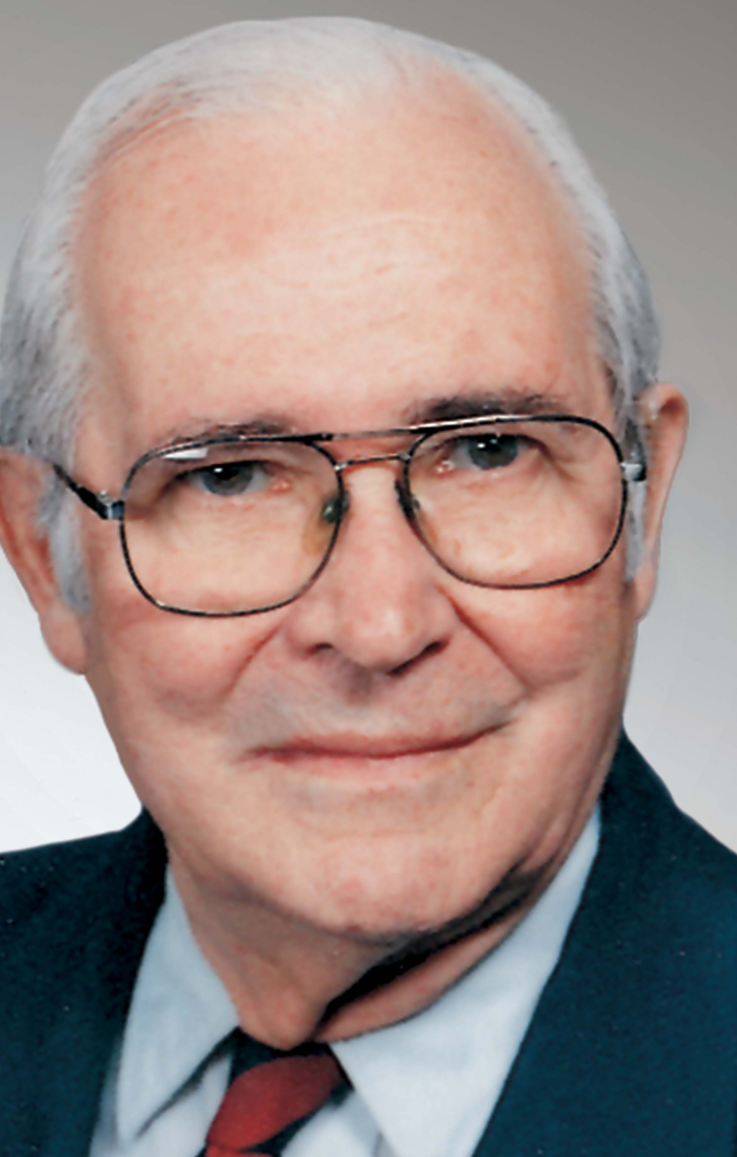


Slide 3

Reliance on Grace Not the Law

Slide 4
17 Now you, if you call yourself a Jew; if you rely on the law and boast in God; 18 if you know his will and approve of what is superior because you are instructed by the law; 19 if you are convinced that you are a guide for the blind, a light for those who are in the dark, 20 an instructor of the foolish, a teacher of little children, because you have in the law the embodiment of knowledge and truth—

Slide 5
Privileges of Being a Jew
“They are Jews”
“They rely on the law”
“They boast in God”
“They know his will”
“They approve of what is superior because they are instructed by the law”
They has a special relationship with God
They thought their reliance on the law would exempt them from judgment
They had pride and joy in the God who had given to Israel so many good things
They assumed that in all things they knew what God wanted
They were able to distinguish the things that really matter

Slide 6
Privileges of Being a Jew
“you are a guide to the blind”
“a light for those who are in the dark”
“an instructor of the foolish”
“a teacher of little children”

Slide 7

you, then, who teach others, do you not teach yourself?

Slide 8
You who preach against stealing, do you steal? 22 You who say that people should not commit adultery, do you commit adultery? You who abhor idols, do you rob temples? 23 You who boast in the law, do you dishonor God by breaking the law?

Slide 9
24 As it is written: “God’s name is blasphemed among the Gentiles because of you.”

Slide 10

Are you relying on grace or the law?

Slide 11
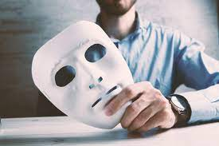
are you living hypocritically

Slide 12
Inward Focus Not Outward Focus

Slide 13
25 Circumcision has value if you observe the law, but if you break the law, you have become as though you had not been circumcised. 26 So then, if those who are not circumcised keep the law’s requirements, will they not be regarded as though they were circumcised? 27 The one who is not circumcised physically and yet obeys the law will condemn you who, even though you have the written code and circumcision, are a lawbreaker.

Slide 14
28 A person is not a Jew who is one only outwardly, nor is circumcision merely outward and physical. 29 No, a person is a Jew who is one inwardly; and circumcision is circumcision of the heart, by the Spirit, not by the written code. Such a person’s praise is not from other people, but from God.

Slide 15
No, a person is a Jew who is one inwardly; and circumcision is circumcision of the heart, by the Spirit, not by the written code.

Slide 16
6 The Lord your God will circumcise your hearts and the hearts of your descendants, so that you may love him with all your heart and with all your soul, and live.
Deuteronomy 30:6

Slide 17
Such a person’s praise is not from other people, but from God.

Slide 18
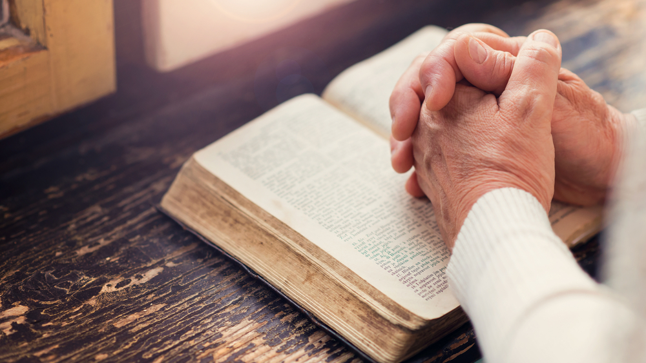
Focus inwardly not externally

Slide 19

Realign our focus on god and not ourselves
This Photo by Unknown Author is licensed under CC BY-NC-ND

Slide 20
Continue in our Relationship with God

Slide 21
What advantage, then, is there in being a Jew, or what value is there in circumcision? 2 Much in every way! First of all, the Jews have been entrusted with the very words of God.

Slide 22
3 What if some were unfaithful? Will their unfaithfulness nullify God’s faithfulness? 4 Not at all! Let God be true, and every human being a liar. As it is written:
“So that you may be proved right when you speak
and prevail when you judge.”

Slide 23
5 But if our unrighteousness brings out God’s righteousness more clearly, what shall we say? That God is unjust in bringing his wrath on us? (I am using a human argument.) 6 Certainly not! If that were so, how could God judge the world? 7 Someone might argue, “If my falsehood enhances God’s truthfulness and so increases his glory, why am I still condemned as a sinner?” 8 Why not say—as some slanderously claim that we say—“Let us do evil that good may result”? Their condemnation is just!

Slide 24
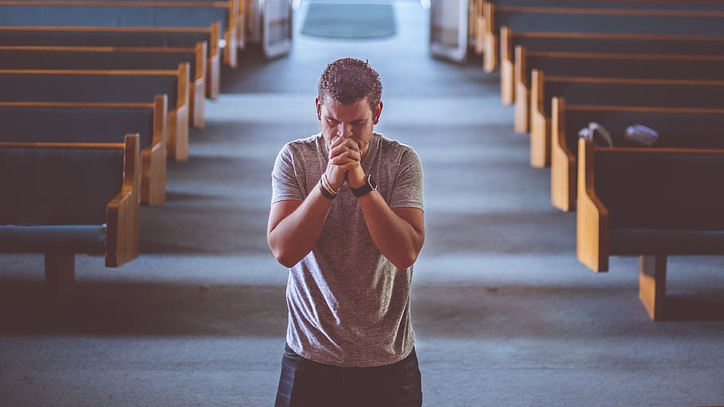
Continue in our walk with god

