Slide 1
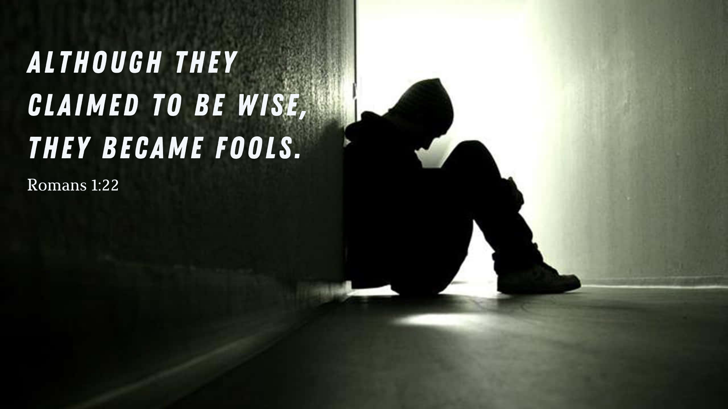

Slide 2


Slide 3
Good News for All: Wicked Fools
Glory revealed and suppressed (v.18-21)
Glory exchanged for idolatry (v.21-23)
Glory given over to sin (v.24-32)

Slide 4
¹⁸ The wrath of God is being revealed from heaven against all the godlessness and wickedness of people, who suppress the truth by their wickedness, ¹⁹ since what may be known about God is plain to them, because God has made it plain to them. ²⁰ For since the creation of the world God’s invisible qualities—his eternal power and divine nature—have been clearly seen, being understood from what has been made, so that people are without excuse.

Slide 5
Glory revealed and suppressed (v.18-21)
Genesis 1-3 language:
Creation of the world (v.20)
Glory, image or likeness (v.23)
Reference to human being’s knowledge of God (v.19, 21)
Their resolve to be ‘wise’ (v.22)
Exchanging God’s truth for Satan’s lies (v.25)
Rebellion deserves death
This is the story of the world!

Slide 6
Glory revealed and suppressed (v.18-21)
How did the universe come into being?
How does organic life come from inorganic matter?
Human consciousness?
Moral sense?

Slide 7
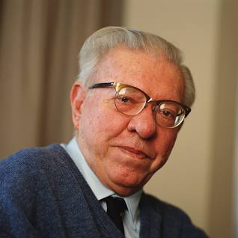
Sir Fred Hoyle
Calculated the chance of life happening on its own to be 1/10^40,000
Believes that a comet might have brought life to earth
Believed that the universe has existed forever

Slide 8
Glory revealed and suppressed (v.18-21)

Slide 9
Glory Exchanged for Idolatry (v.21-23)
²¹ For although they knew God, they neither glorified him as God nor gave thanks to him, but their thinking became futile and their foolish hearts were darkened. ²² Although they claimed to be wise, they became fools ²³ and exchanged the glory of the immortal God for images made to look like a mortal human being and birds and animals and reptiles.

Slide 10
Glory Exchanged for Idolatry (v.21-23)
^{Covert idols of the heart…}
^{Jesus and…}

Slide 11
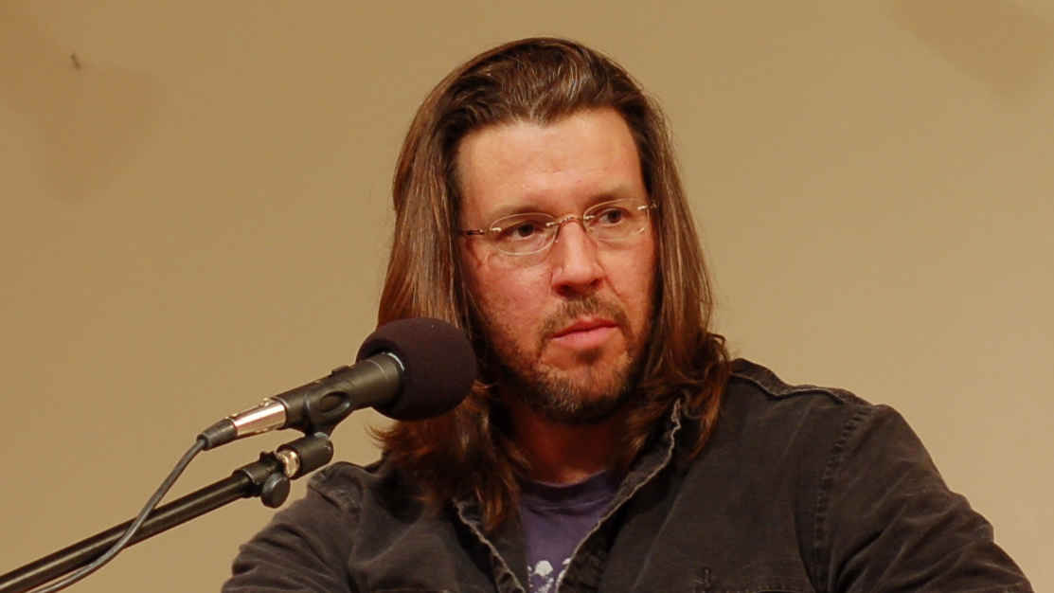

Slide 12
Glory Given over to Sin (v.24-34)
God gave them over to…
sinful desires of their hearts.. (v.24)
shameful lusts... (v.26)
depraved minds... (v.28)

Slide 13
Glory Given over to Sin (v.24-34)
²⁹ They have become filled with every kind of wickedness, evil, greed and depravity. They are full of envy, murder, strife, deceit and malice. They are gossips, ³⁰ slanderers, God-haters, insolent, arrogant and boastful; they invent ways of doing evil; they disobey their parents; ³¹ they have no understanding, no fidelity, no love, no mercy.

Slide 14

…they not only continue to do these very things but also approve of those who practice them.

Slide 15
Good News for All: Wicked Fools
Glory revealed and suppressed (v.18-21)
Glory exchanged for idolatry (v.21-23)
Glory given over to sin (v.24-32)

